Slide 1
External Memory

Slide 2
Types of External Memory
Magnetic Disk
  RAID
  Removable
Optical
  CD-ROM
  CD-Recordable (CD-R)
  CD-R/W
  DVD
Magnetic Tape

Slide 3
Magnetic Disk
Disk substrate coated with magnetizable material (iron oxide…rust)
Substrate used to be aluminium
Now glass
  Improved surface uniformity
    Increases reliability
  Reduction in surface defects
    Reduced read/write errors
  Lower flight heights (See later)
  Better stiffness
  Better shock/damage resistance

Slide 4
Read and Write Mechanisms
Recording and retrieval via conductive coil called a head
May be single read/write head or separate ones
During read/write, head is stationary, platter rotates
Write
  Current through coil produces magnetic field
  Pulses sent to head
  Magnetic pattern recorded on surface below
Read (traditional)
  Magnetic field moving relative to coil produces current
  Coil is the same for read and write
Read (contemporary)
  Separate read head, close to write head
  Partially shielded magneto resistive (MR) sensor
  Electrical resistance depends on direction of magnetic field
  High frequency operation
    Higher storage density and speed

Slide 5
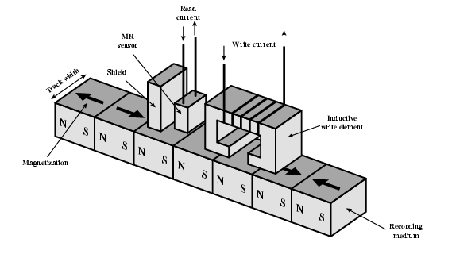
Inductive Write MR Read

Slide 6
Data Organization and Formatting
Concentric rings or tracks
  Gaps between tracks
  Reduce gap to increase capacity
  Same number of bits per track (variable packing density)
  Constant angular velocity
Tracks divided into sectors
Minimum block size is one sector
May have more than one sector per block

Slide 7
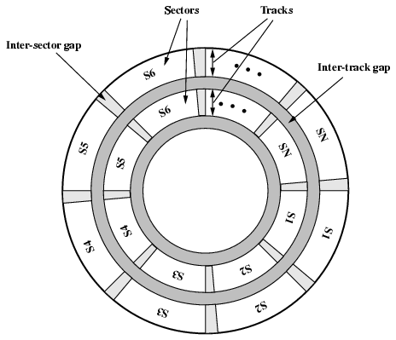
Disk Data Layout

Slide 8
Disk Velocity
Bit near centre of rotating disk passes fixed point slower than bit on outside of disk
Increase spacing between bits in different tracks
Rotate disk at constant angular velocity (CAV)
  Gives pie shaped sectors and concentric tracks
  Individual tracks and sectors addressable
  Move head to given track and wait for given sector
  Waste of space on outer tracks
    Lower data density
Can use zones to increase capacity
  Each zone has fixed bits per track
  More complex circuitry

Slide 9
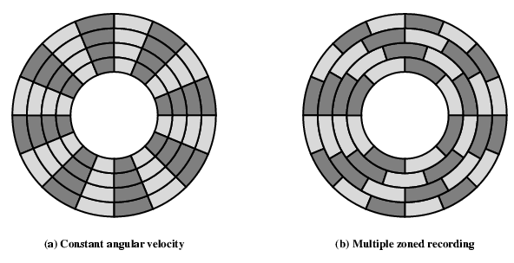
Disk Layout Methods Diagram

Slide 10
Finding Sectors
Must be able to identify start of track and sector
Format disk
  Additional information not available to user
  Marks tracks and sectors

Slide 11
ST506 format (old!)
Gap1
Id
Gap2
Data
Gap3
Gap1
Id
Gap2
Data
Gap3
Sync
Byte
Track
Sync
Byte
Head
Sector
CRC
Data
CRC
Foreground reading
  Find others

Slide 12
Characteristics
Fixed (rare) or movable head
Removable or fixed
Single or double (usually) sided
Single or multiple platter
Head mechanism
  Contact (Floppy)
  Fixed gap
  Flying (Winchester)

Slide 13
Fixed/Movable Head Disk
Fixed head
  One read write head per track
  Heads mounted on fixed ridged arm
Movable head
  One read write head per side
  Mounted on a movable arm

Slide 14
Removable or Not
Removable disk
  Can be removed from drive and replaced with another disk
  Provides unlimited storage capacity
  Easy data transfer between systems
Nonremovable disk
  Permanently mounted in the drive

Slide 15
Multiple Platter
One head per side
Heads are joined and aligned
Aligned tracks on each platter form cylinders
Data is striped by cylinder
  reduces head movement
  Increases speed (transfer rate)

Slide 16
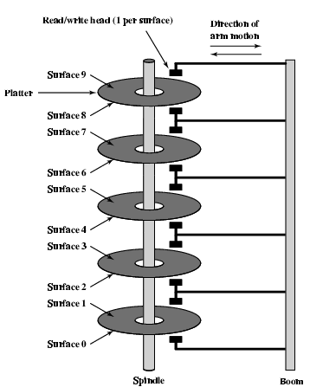
Multiple Platters

Slide 17
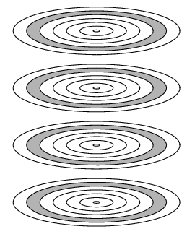
Cylinders

Slide 18
Floppy Disk
8”, 5.25”, 3.5”
Small capacity
  Up to 1.44Mbyte (2.88M never popular)
Slow
Universal
Cheap
Obsolete?

Slide 19
Winchester Hard Disk (1)
Developed by IBM in Winchester (USA)
Sealed unit
One or more platters (disks)
Heads fly on boundary layer of air as disk spins
Very small head to disk gap
Getting more robust

Slide 20
Winchester Hard Disk (2)
Universal
Cheap
Fastest external storage
Getting larger all the time
  Multiple Gigabyte now usual

Slide 21
Removable Hard Disk
ZIP
  Cheap
  Very common
  Only 100M
JAZ
  Not cheap
  1G
L-120 (a: drive)
  Also reads 3.5” floppy
  Becoming more popular?
All obsoleted by CD-R and CD-R/W?

Slide 22
Speed
Seek time
  Moving head to correct track
(Rotational) latency
  Waiting for data to rotate under head
Access time = Seek + Latency
Transfer rate
See timing comparison on p.173
  Sequential organization = .064 seconds to read 1.28 MB
  Random organization = 4.008 seconds to 1.28 MB
  Why periodic defragmentation is important!

Slide 23
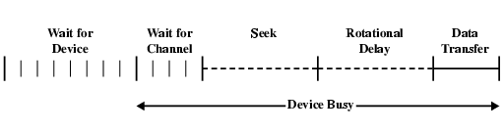
Timing of Disk I/O Transfer

Slide 24
RAID
Redundant Array of Independent Disks
Redundant Array of Inexpensive Disks
6 levels in common use
Not a hierarchy—but different design architectures with 3 common characteristics:
  Set of physical disks viewed as single logical drive by O/S
  Data distributed across physical drives of an array
  Can use redundant capacity to store parity information, which guarantees data recoverability in case of a disk failure (except RAID 0)

Slide 25
RAID 0
No redundancy
Data striped across all disks
Round Robin striping
Increase speed
  Multiple data requests probably not on same disk
  Disks seek in parallel
  A set of data is likely to be striped across multiple disks
disk striping: The procedure of combining a set of same-size disk partitions that reside on separate disks (from 2 to 32 disks) into a single volume, forming a virtual "stripe" across the disks that the operating system recognizes as a single drive. Disk striping enables multiple I/O operations in the same volume to proceed concurrently, thus offering enhanced performance. Microsoft Press« Computer and Internet Dictionary, 4th Edition, ©2000 Microsoft Corporation. All rights reserved.

Slide 26
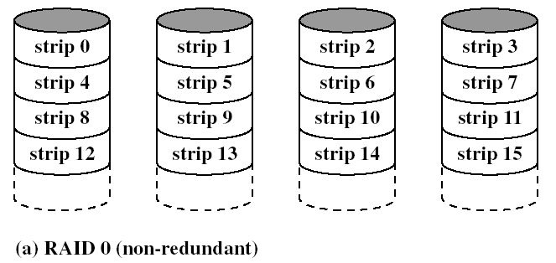
RAID 0 Striping

Slide 27
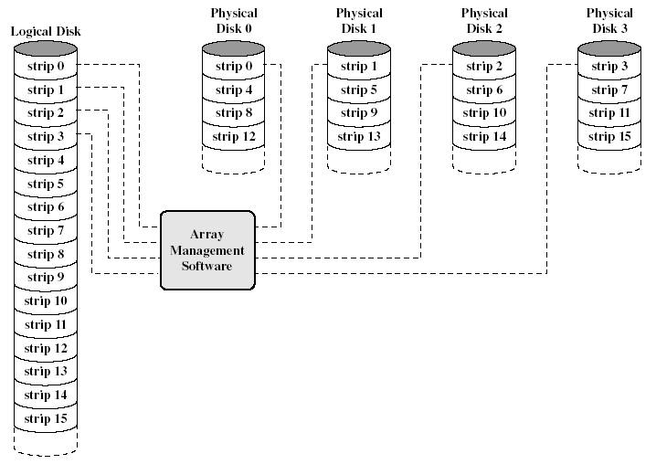
RAID 0 Logical Disk

Slide 28
RAID 1
Mirrored Disks
Data is striped across disks
2 copies of each stripe on separate disks
Read from either to speed up reads
Write to both at the same time in parallel
Recovery is simple
  Swap faulty disk & re-mirror
  No down time
Expensive—two complete sets of drives

Slide 29
RAID 2
Disks are synchronized
Very small stripes
  Often single byte/word
Error correction calculated across corresponding bits on disks
Multiple parity disks store Hamming code error correction in corresponding positions
Lots of redundancy
  Expensive
  Not commercially available

Slide 30
RAID 3
Similar to RAID 2
Only one redundant parity disk, no matter how large the array
Simple parity bit for each set of corresponding bits
Data on failed drive can be reconstructed from surviving data and parity info
Very high transfer rates

Slide 31
RAID 4
Each disk operates independently
Good for high I/O request rate
Large stripes
Bit by bit parity calculated across stripes on each disk
Parity stored on parity disk
Not commercially available

Slide 32
RAID 5
Like RAID 4
Parity striped across all disks
Round robin allocation for parity stripe
Avoids RAID 4 bottleneck at parity disk
Commonly used in network servers
N.B. DOES NOT MEAN 5 DISKS!!!!!

Slide 33
RAID 6
Two parity calculations
Stored in separate blocks on different disks
User requirement of N disks needs N+2
High data availability
  Three disks need to fail for data loss
  Significant write penalty

Slide 34
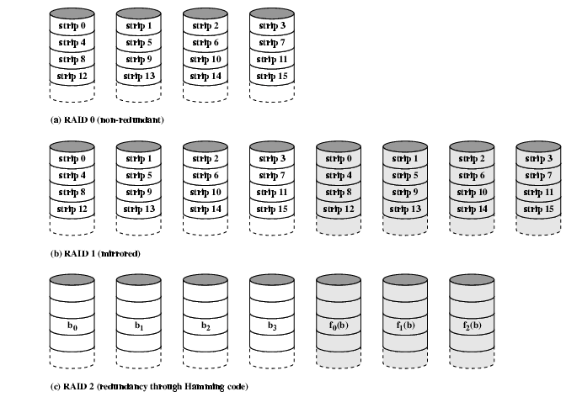
RAID 0, 1, 2

Slide 35
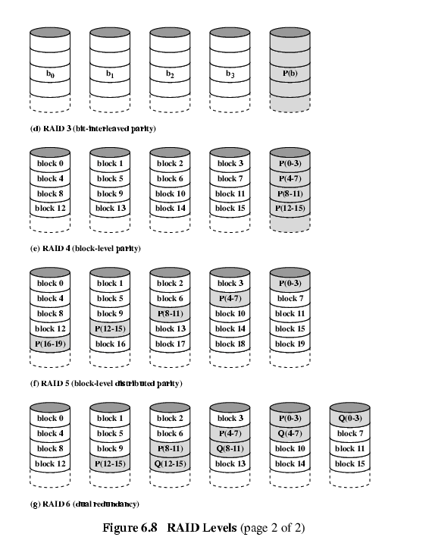
RAID 3 & 4

Slide 36
RAID 5 & 6

Slide 37
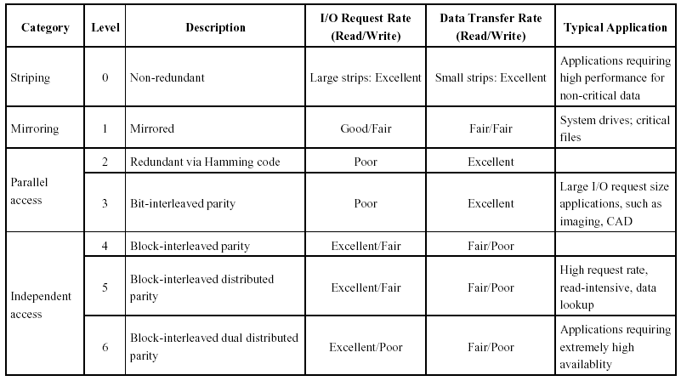
RAID Levels

Slide 38
Optical Storage CD-ROM
Originally for audio
650Mbytes giving over 70 minutes audio
Polycarbonate coated with highly reflective coat, usually aluminium
Data stored as pits
Read by reflecting laser
Constant packing density
Constant linear velocity

Slide 39
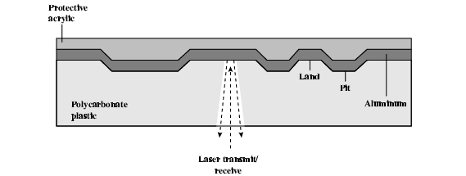
CD Operation

Slide 40
CD-ROM Drive Speeds
Audio is single speed
  Constant linier velocity
  1.2 ms⁻¹
  Track (spiral) is 5.27km long
  Gives 4391 seconds = 73.2 minutes
Other speeds are quoted as multiples
e.g. 24x
Quoted figure is maximum drive can achieve

Slide 41
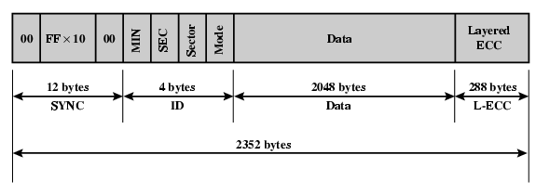
CD-ROM Format
Mode 0=blank data field
Mode 1=2048 byte data+error correction
Mode 2=2336 byte data

Slide 42
Random Access on
CD-ROM
Difficult
Move head to rough position
Set correct speed
Read address
Adjust to required location
(Yawn!)

Slide 43
CD-ROM for & against
Large capacity (?)
Easy to mass produce
Removable
Robust
Expensive for small runs
Slow
Read only

Slide 44
Other Optical Storage
CD-Recordable (CD-R)
  WORM
  Now affordable
  Compatible with CD-ROM drives
CD-RW
  Erasable
  Getting cheaper
  Mostly CD-ROM drive compatible
  Phase change
    Material has two different reflectivities in different phase states

Slide 45
DVD - what’s in a name?
Digital Video Disk
  Used to indicate a player for movies
    Only plays video disks
Digital Versatile Disk
  Used to indicate a computer drive
    Will read computer disks and play video disks
Dogs Veritable Dinner
Officially - nothing!!!

Slide 46
DVD - technology
Multi-layer
Very high capacity (4.7G per layer)
Full length movie on single disk
  Using MPEG compression
Finally standardized (honest!)
Movies carry regional coding
Players only play correct region films
Can be “fixed”

Slide 47
DVD – Writable
Loads of trouble with standards
First generation DVD drives may not read first generation DVD-W disks
First generation DVD drives may not read CD-RW disks
Wait for it to settle down before buying!

Slide 48
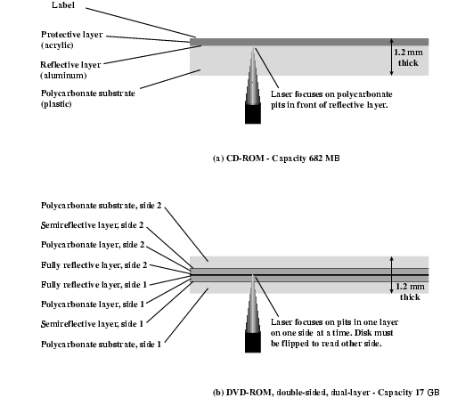
CD and DVD

Slide 49
Magnetic Tape
Serial access
Slow
Very cheap
Backup and archive

Slide 50
Digital Audio Tape (DAT)
Uses rotating head (like video)
High capacity on small tape
  4Gbyte uncompressed
  8Gbyte compressed
Backup of PC/network servers

