Slide 1
UNIT 1
Introduction to computer systems
Overview of Organization and Architecture

Slide 2
COMPUTER ARCHITECTURE AND ORGANIZATION
Computer architecture refers to those attributes that have a direct impact on the logical execution of a program.
Examples of architectural attributes include the
instruction set,
the number of bits used to represent various data types (e.g., numbers, characters),
I/O mechanisms, and
techniques for addressing memory.

Slide 3
Contd…
Computer organization refers to the operational units and their interconnections that realize the architectural specifications.
Organizational attributes include those
hardware details transparent to the programmer, such as control signals;
interfaces between the computer and peripherals; and
the memory technology used.

Slide 4
COMPUTER SYSTEM
A computer is a complex system; contemporary computers contain millions of elementary electronic components.
A hierarchical system is a set of interrelated subsystems, each of the latter, in turn, hierarchical in structure until we reach some lowest level of elementary subsystem.

Slide 5
EVOLUTION OF INTEL x86 PROCESSORS
Name Date Transistors MHz
8086 1978 29K 5-10
First 16-bit Intel processor. Basis for IBM PC & DOS
1MB address space
386 1985 275K 16-33
First 32 bit Intel processor , referred to as IA32
Added “flat addressing”, capable of running Unix
Pentium 4E 2004 125M 2800-3800
First 64-bit Intel x86 processor, referred to as x86-64
Core 2 2006 291M 1060-3333
First multi-core Intel processor
Core i7 2008 731M 1600-4400
Four cores (our shark machines)

Slide 6
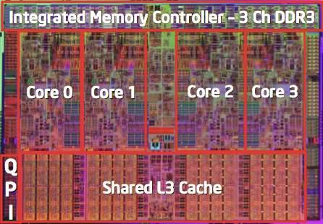
CONTD…
Machine Evolution
386 1985 0.3M
Pentium 1993 3.1M
Pentium/MMX 1997 4.5M
PentiumPro 1995 6.5M
Pentium III 1999 8.2M
Pentium 4 2000 42M
Core 2 Duo 2006 291M
Core i7 2008 731M
Added Features
Instructions to support multimedia operations
Instructions to enable more efficient conditional operations
Transition from 32 bits to 64 bits
More cores

Slide 7
X86 Clones: Advanced micro devices (AMD)
Historically
AMD has followed just behind Intel
A little bit slower, a lot cheaper
Then
Recruited top circuit designers from Digital Equipment Corp. and other downward trending companies
Built Opteron: tough competitor to Pentium 4
Developed x86-64, their own extension to 64 bits
Recent Years
Intel got its act together
Leads the world in semiconductor technology
AMD has fallen behind
Relies on external semiconductor manufacturer

Slide 8
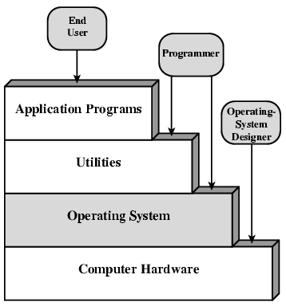
Layers and views of Computer System

Slide 9
Computer System can be defined …
Simply put, a computer is a sophisticated electronic calculating machine that:
Accepts input information,
Processes the information according to a list of internally stored instructions and
Produces the resulting output information.
Functions performed by a computer are:
Accepting information to be processed as input.
Storing a list of instructions to process the information.
Processing the information according to the list of instructions.
Providing the results of the processing as output.

Slide 10
Evolution of Computer Systems
FIRST GENERATION (1945–1955)
• Program and data reside in the same memory (stored program concepts –John von Neumann)
• ALP was made used to write programs
• Vacuum tubes were used to implement the functions (ALU & CU design)
• Magnetic core and magnetic tape storage devices are used
• Using electronic vacuum tubes as the switching components

Slide 11
Contd…
SECOND GENERATION (1955 – 1965)
• Transistor were used to design ALU & CU
• HLL is used (FORTRAN)
• To convert HLL to MLL compiler were used
• Separate I/O processor were developed to operate in parallel with CPU thus improving the performance
• Invention of the transistor which was faster smaller and required considerably less power to Operate

Slide 12
Contd…
THIRD GENERATION (1965 ‐ 1975)
• IC technology improved
• Improved IC technology helped in designing low cost high speed processor and memory
modules
• Multiprogramming pipelining concepts were incorporated
• DOS allowed efficient and coordinate operation of computer system with multiple users
• Cache and virtual memory concepts were developed
• More than one circuit on a single silicon chip became available

Slide 13
Contd…
FOURTH GENERATION (1975 ‐ 1985)
• CPU –Termed as microprocessor
• INTEL MOTOROLA TEXAS,NATIONAL semiconductors started developing
microprocessor
• Workstations, microprocessor (PC) & Notebook computers were developed
• Interconnection of different computer for better communication LAN,MAN,WAN
• Computational speed increased by 1000 times
• Specialized processors like Digital Signal Processor were also developed
BEYOND THE FOURTH GENERATION (1985 – TILL DATE)
E‐Commerce E‐banking, home office
• ARM, AMD, INTEL, MOTOROLA
• High speed processor‐ GHz speed
• Because of submicron IC technology lot of added features in small size

Slide 14
Structure and Function of a Computer System
Structure: The way in which the components are interrelated.
Function: The operation of each individual component as part of the structure.

Slide 15
Functions
The basic functions that a computer can perform. In general terms, there are only four:
• Data processing
• Data storage
• Data movement
• Control

Slide 16
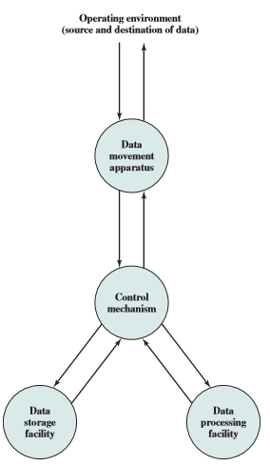
FUNCTIONAL VIEW OF THE COMPUTER SYSTEM

Slide 17
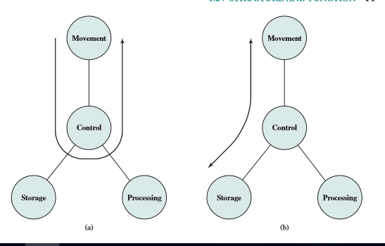
Possible computer operations

Slide 18
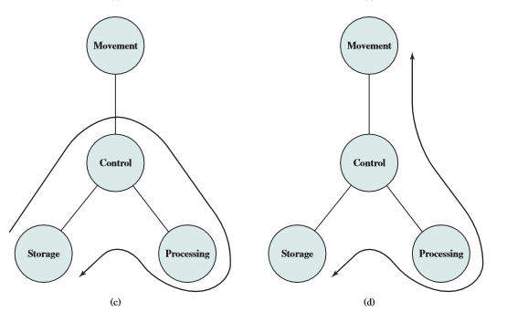
Contd…

Slide 19
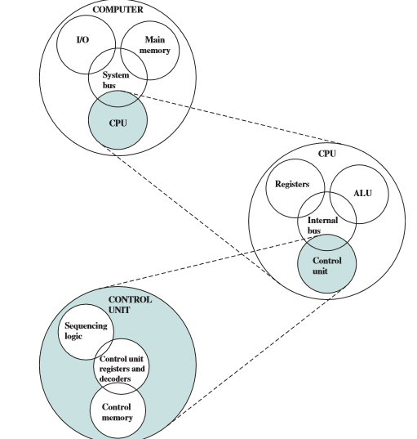
The Computer System – Top-level Structure

Slide 20
References
W. Stallings, Computer Organization and Architecture, Design for Performance, 10th Edition, Prentice-Hall.

