Slide 1
UNIT 1
Organization of the von Neumann machine
Harvard architecture

Slide 2
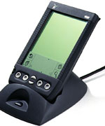
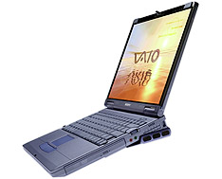
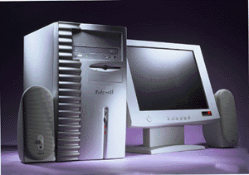
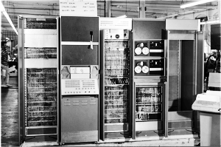
Designing Computers
All computers more or less based on the same basic design, the Von Neumann Architecture! – stored program concept

Slide 3
The Von Neumann Architecture
Model for designing and building computers, based on the following three characteristics:
The computer consists of four main sub-systems:
Memory
ALU (Arithmetic/Logic Unit)
Control Unit
Input/Output System (I/O)
Program is stored in memory during execution.
Program instructions are executed sequentially.

Slide 4
The Von Neumann Architecture
Bus
Memory
Processor (CPU)
Input-Output
Control Unit
ALU
Communicate with
"outside world", e.g.
Screen
Keyboard
Storage devices
...
Store data and program
Execute program
Do arithmetic/logic operations requested by program

Slide 5
Memory Subsystem
Memory, also called RAM (Random Access Memory),
Consists of many memory cells (storage units) of a fixed size. Each cell has an address associated with it: 0, 1, …
All accesses to memory are to a specified address. A cell is the minimum unit of access (fetch/store a complete cell).
The time it takes to fetch/store a cell is the same for all cells.
When the computer is running, both
Program
Data (variables)
are stored in the memory.

Slide 6
RAM
Need to distinguish between
the address of a memory cell and the content of a memory cell
Memory width (W):
How many bits is each memory cell, typically one byte (=8 bits)
Address width (N):
How many bits used to represent each address, determines the maximum memory size = address space
If address width is N-bits, then address space is 2^{N} (0,1,...,2^{N}-1)
N
0000000000000001
1 bit
0
1
2
...
2^{N}
2^{N}-1
W

Slide 7
Memory Size / Speed
Typical memory in a personal computer (PC):
64MB - 256MB
Memory sizes:
Kilobyte (KB) = 2¹⁰ = 1,024 bytes ~ 1 thousand
Megabyte(MB) = 2²⁰ = 1,048,576 bytes ~ 1 million
Gigabyte (GB) = 2³⁰ = 1,073,741,824 bytes ~ 1 billion
Memory Access Time (read from/ write to memory)
50-75 nanoseconds (1 nsec. = 0.000000001 sec.)
RAM is
volatile (can only store when power is on)
relatively expensive

Slide 9
Operations on Memory
Fetch (address):
Fetch a copy of the content of memory cell with the specified address.
Non-destructive, copies value in memory cell.
Store (address, value):
Store the specified value into the memory cell specified by address.
Destructive, overwrites the previous value of the memory cell.
The memory system is interfaced via:
Memory Address Register (MAR)
Memory Data Register (MDR)
Fetch/Store signal

Slide 10
Structure of the Memory Subsystem
Fetch(address)
Load address into MAR.
Decode the address in MAR.
Copy the content of memory cell with specified address into MDR.
Store(address, value)
Load the address into MAR.
Load the value into MDR.
Decode the address in MAR
Copy the content of MDR into memory cell with the specified address.
MAR
MDR
F/S
Memory
decoder
circuit
Fetch/Store
controller
...

Slide 11
Input/Output Subsystem
Handles devices that allow the computer system to:
Communicate and interact with the outside world
Screen, keyboard, printer, ...
Store information (mass-storage)
Hard-drives, floppies, CD, tapes, …
Mass-Storage Device Access Methods:
Direct Access Storage Devices (DASDs)
Hard-drives, floppy-disks, CD-ROMs, ...
Sequential Access Storage Devices (SASDs)
Tapes (for example, used as backup devices)

Slide 12
I/O Controllers
Speed of I/O devices is slow compared to RAM
RAM ~ 50 nsec.
Hard-Drive ~ 10msec. = (10,000,000 nsec)
Solution:
I/O Controller, a special purpose processor:
Has a small memory buffer, and a control logic to control I/O device (e.g. move disk arm).
Sends an interrupt signal to CPU when done read/write.
Data transferred between RAM and memory buffer.
Processor free to do something else while I/O controller reads/writes data from/to device into I/O buffer.

Slide 13
Structure of the I/O Subsystem
Interrupt signal (to processor)
Data from/to memory
I/O controller
I/O Buffer
Control/Logic
I/O device

Slide 14
The ALU Subsystem
The ALU (Arithmetic/Logic Unit) performs
mathematical operations (+, -, x, /, …)
logic operations (=, <, >, and, or, not, ...)
In today's computers integrated into the CPU
Consists of:
Circuits to do the arithmetic/logic operations.
Registers (fast storage units) to store intermediate computational results.
Bus that connects the two.

Slide 15
Structure of the ALU
Registers:
Very fast local memory cells, that store operands of operations and intermediate results.
CCR (condition code register), a special purpose register that stores the result of <, = , > operations
ALU circuitry:
Contains an array of circuits to do mathematical/logic operations.
Bus:
Data path interconnecting the registers to the ALU circuitry.
R0
R1
R2
Rn
ALU circuitry
GT
EQ
LT

Slide 16
The Control Unit
Program is stored in memory
as machine language instructions, in binary
The task of the control unit is to execute programs by repeatedly:
Fetch from memory the next instruction to be executed.
Decode it, that is, determine what is to be done.
Execute it by issuing the appropriate signals to the ALU, memory, and I/O subsystems.
Continues until the HALT instruction

Slide 17
Structure of the Control Unit
PC (Program Counter):
stores the address of next instruction to fetch
IR (Instruction Register):
stores the instruction fetched from memory
Instruction Decoder:
Decodes instruction and activates necessary circuitry
PC
IR
+1
Instruction
Decoder

Slide 18
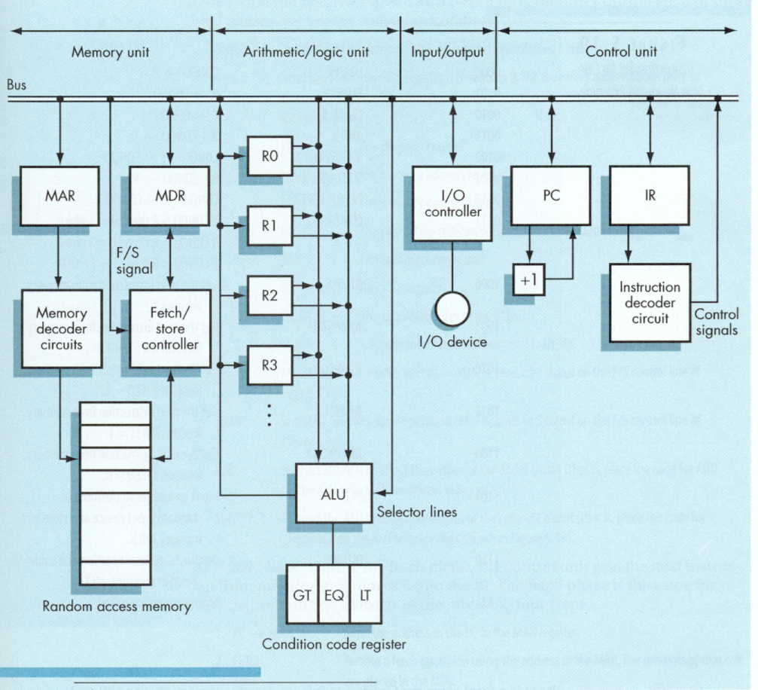
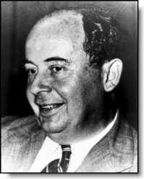
von Neumann
Architecture

Slide 19
Harvard Architecture

