Slide 1
Instructions Formats

Slide 2
IAS MACHINE
MEMORY: 4096 WORDS
WORD LENGTH: 40 BITS
STORED PROGRAM CONCEPT
DATA: SIGN BIT AND 39 BIT VAULE
TWO 20 BIT ISTRUCTIONS
EACH INSTRUCTION: 8 BIT OPCODE, 12 BIT ADDRESS (POINTS TO THE OPERAND IN THE MEMORY)

Slide 3
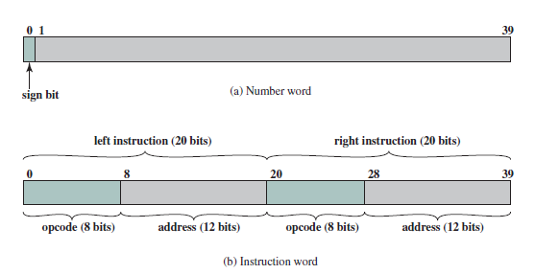
IAS MEMORY FOMATS

Slide 4
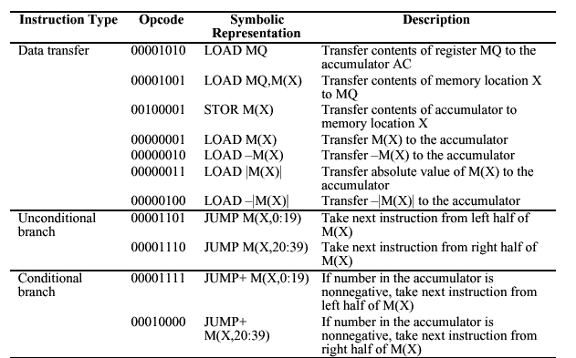
IAS Instruction set

Slide 5
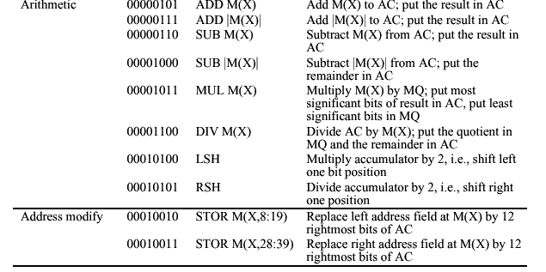
IAS Instruction set (continued)

Slide 6
Problem
Write an appropriate assembly language code for the following operation and interpret to Von Neumann IAS architecture
X=Y*Z
// Where X->40 bit data and Y->40 bit data
Result would be more than 40 bit.

Slide 7
EXAMPLE ALP (IAS)
Assume that data variables ‘Y’ & ‘Z’ available at memory locations 801 & 802 resly. And X will be stored 803 onwards.
LOAD MQ, M(801) MQ←M[801]
MUL M(802) Ac←MQ * M[802]
STOR M(803) M[803]←AC
LOAD MQ AC←MQ
STOR M(804) M[804]←AC

Slide 8
Fetch / Execute Cycle

Slide 9
IAS Computer
AC
MQ
Input/output
Equipments
MAR←PC
MBR←M[MAR]
Arithmetic & Logic Circuits
IBR←MBR<20..39>
IBR←MBR<20..39>
IR←MBR<0..7>
IR←MBR<0..7>
MAR←MBR<8..19>
MAR←MBR<8..19>
MBR
MBR←M[MAR]
MBR←AC
AC←MBR
M[MAR}←MBR
IR←IBR<0..7>
IR←IBR<0..7>
MAR←IBR<8..19>
IBR
PC
Main Memory
MBR←M[MAR]
AC←AC + MBR
PC←PC+1
MAR←PC
IR
MBR←M[MAR]
MAR
Control
Circuits

Slide 10
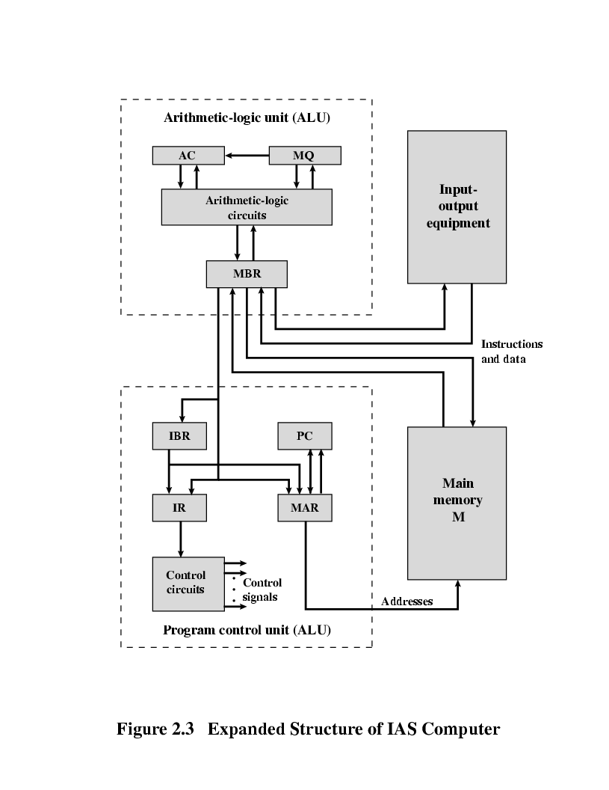
AC = 7
AC = 3
MEMORY
1. LOAD M(X) 500, ADD M(X) 501
2. STOR M(X) 500, (Other Ins)
.....
3
4
AC
MQ
500
MBR = 4
LOAD M(X)
MBR
MBR = 3
500
ADD M(X) 501
(Other Ins)
STOR M(X)
PC
1
2
MAR
1
500
501
2
500
MBR
LOAD M(X) 500, ADD M(X) 501
3
4
STOR M(X) 500, (Other Ins)
IR
LOAD M(X)
ADD M(X)
STOR M(X)
IBR
ADD M(X) 501
(Other Ins)
AC
3
501
PC = 2
7
IBR
PC = 1
Add M(X)
Mar ← PC
MAR ←PC
3
LOAD M(X) 500, ADD M(X) 501
4
MAR = 2
STOR M(X) 500, (Other Ins)
IR
MAR = 501
MAR = 1
MAR = 500
MAR =500
add = 501
add = 1
add = 500
add = 2

Slide 11
AC = 7
AC = 3
MEMORY
1. LOAD M(X) 500, ADD M(X) 501
2. STOR M(X) 500, (Other Ins)
.....
3
4
AC
MQ
500
MBR = 4
LOAD M(X)
MBR
MBR = 3
500
ADD M(X) 501
(Other Ins)
STOR M(X)
PC
1
2
MAR
1
500
501
2
500
MBR
LOAD M(X) 500, ADD M(X) 501
3
4
STOR M(X) 500, (Other Ins)
IR
LOAD M(X)
ADD M(X)
STOR M(X)
IBR
ADD M(X) 501
(Other Ins)
AC
3
501
PC = 2
7
IBR
PC = 1
Add M(X)
Mar ← PC
MAR ←PC
3
LOAD M(X) 500, ADD M(X) 501
4
MAR = 2
STOR M(X) 500, (Other Ins)
IR
MAR = 501
MAR = 1
MAR = 500
MAR =500
add = 501
add = 1
add = 500
add = 2

Slide 12
Example Problems
Write an Assembly language programming for the following expressions using IAS computer Instruction set and interpret to the flow of IAS computer
1. A=(B-C)*D
2. A=B*(C+D)
Make necessary assumptions.

Slide 13
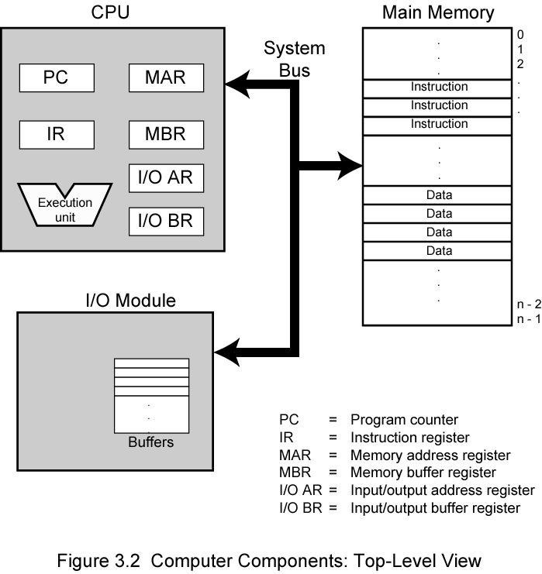
Computer Components: Top Level View

Slide 14
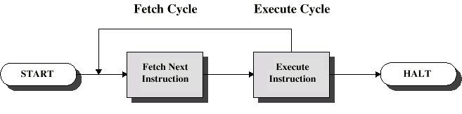
Instruction Cycle
The IAS operates repetitively performing an instruction cycle.
Each instruction cycle consists of Two subcycles.
Two steps:
Fetch
Execute

Slide 15
Fetch Cycle
Program Counter (PC) holds address of next instruction to fetch
Processor fetches instruction from memory location pointed to by PC
Increment PC
Unless told otherwise
Instruction loaded into Instruction Register (IR)
Processor interprets instruction and performs required actions

Slide 16
Execute Cycle
Processor-memory
data transfer between CPU and main memory
Processor- I/O
Data transfer between CPU and I/O module
Data processing
Some arithmetic or logical operation on data
Control
Alteration of sequence of operations
e.g. jump
Combination of above

Slide 18
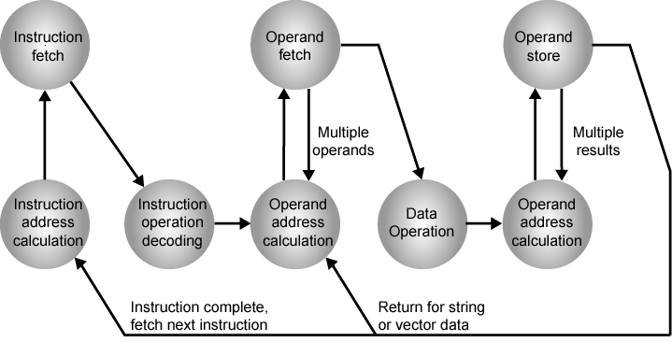
Instruction Cycle State Diagram

Slide 19
Instruction state cycle diagram (cont..)
Instruction address calculation (iac):
Determine the address of the next instruction to be executed. Adding a fixed number to a next number.
Instruction fetch: (if)
Read the instruction from its memory location into the processor.
Instruction operation decoding (iod)
Analyze instruction to determine type of operation to be performed and operand(s) to be used.
Operand Address Calculation: (oac)
If the operation involves the reference to an operand in memory or available via I/O, then determine the address of the operand.
Operand Fetch (of):
Fetch the operand from memory or read it from I/O.
Data Operation (do):
Perform the operation indicated in the instruction.
Operand store (os)
Write the result into memory or out to I/O.

Slide 20
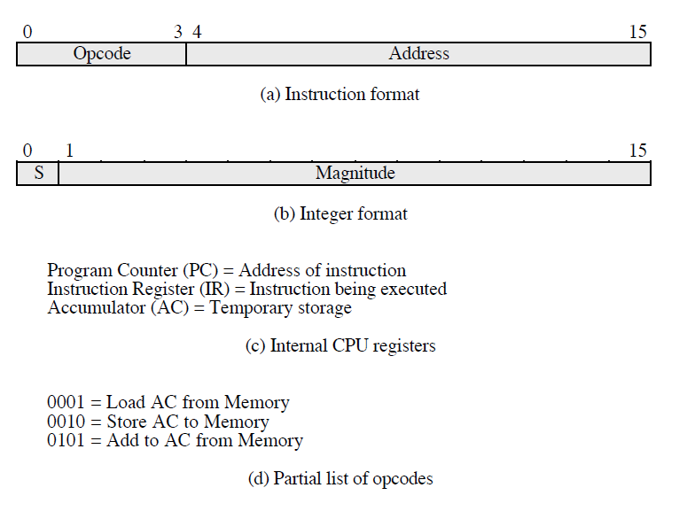
Characteristics of Hypothetical Machine

Slide 21
Characteristics of Hypothetical Machine (cont..)
The processor contains a single data register called an accumulator (AC). Both instructions and data are 16 bits long. Thus it is convenient to organize memory using 16 bit words.
The instruction format provides 4 bits for the opcode, so that there can be as many as 2⁴ =16 different opcodes, and upto 2¹²= 4096(4K) words of memory can be directly addressed.

Slide 22
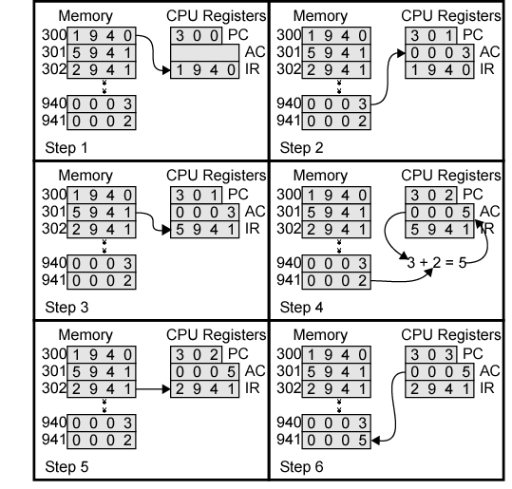
Example of Program Execution

Slide 23
Instruction
Definition:
Instruction is a statement by which the operation of CPU is determined.
These instructions referred as “Machine instructions or computer Instructions”
The collection of different instructions that the CPU can execute is referred to as the CPU’s instruction set.

Slide 24
What must an instruction set specify…?

Slide 25
Which Operation to perform
Where to find the operand or operands
Where to put the result, if there is result
Where to find the next instruction

Slide 26
Instruction Representations
Each instruction is represented by sequence of bits
The instruction is divided into two fields
Opcode field
Operand field
This operand field further divided into one to four fields.
This layout of the instruction is known as the “Instruction Format”
Simple instruction format
Opcode
Operand
Address1
Operand
Address2
Result
Address1
Next
Instruction

Slide 27
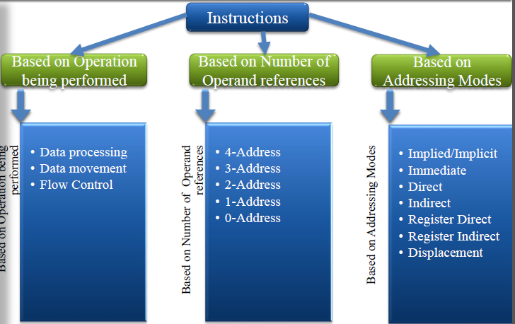
CLASSIFICATION OF INSTRUCTIONS

Slide 28
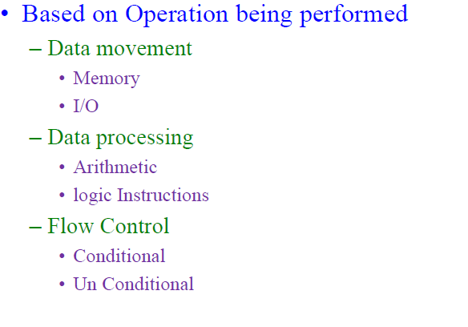

Slide 29
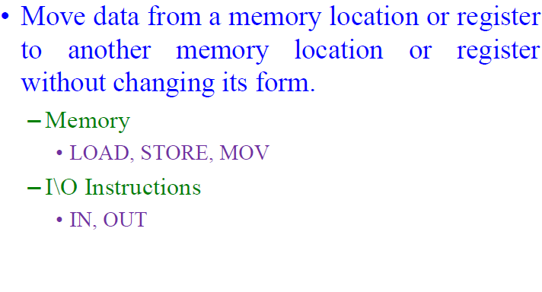

Slide 30
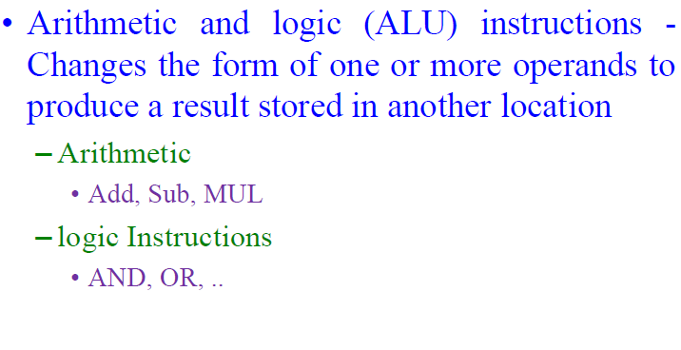

Slide 31
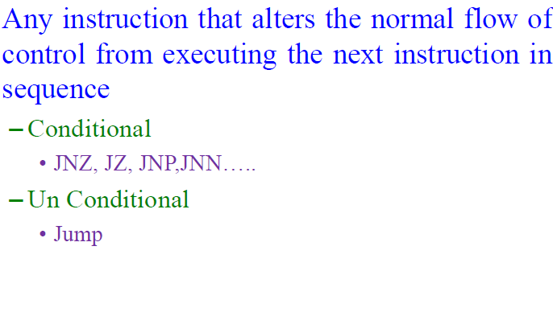

Slide 32
