Slide 1
CONTENTS
Introduction
RAM,ROM,PROM,EPROM
Auxiliary Storage Devices-Magnetic Tape, Hard Disk, Floppy Disk
Optical Disks: CD-R Drive,CD-RW disks,DVD,Blue ray Discs.

Slide 2
2. RAM,ROM,PROM,EPROM
Memory Devices
  Memory: Is one or more sets of chips that store data/program instructions, either temporarily or permanently .
  It is critical processing component in any computer
  PCs use several different types

Slide 3
RAM,ROM,PROM,EPROM
Memory Devices
  Two most important are
    RAM(Random Access Memory)
    ROM(Read-only Memory)
  They work in different ways and perform distinct functions
  CPU Registers
  Cache Memory

Slide 4
RAM
RAM is packaged as a chip.
Basic storage unit is a cell (one bit per cell).
Multiple RAM chips form a memory.
Random Access Memory
Volatile
Used for temporary storage
Typical ranges 256 MB - 4 GB
Random Access means direct access to any part of memory

Slide 5
Nonvolatile Memories(ROM)
DRAM and SRAM are volatile memories
  Lose information if powered off.
Nonvolatile memories retain value even if powered off.
  Generic name is read-only memory (ROM).
  Misleading because some ROMs can be read and modified.

Slide 6
Nonvolatile Memories(ROM)
Types of ROMs
  Programmable ROM (PROM)
  Eraseable programmable ROM (EPROM)
  Electrically eraseable PROM (EEPROM)
  Flash memory (used in portable digital devices)
Firmware (Program instruction used frequently)
  Program stored in a ROM
    Boot time code, BIOS (basic input/output system)
    graphics cards, disk controllers.

Slide 7
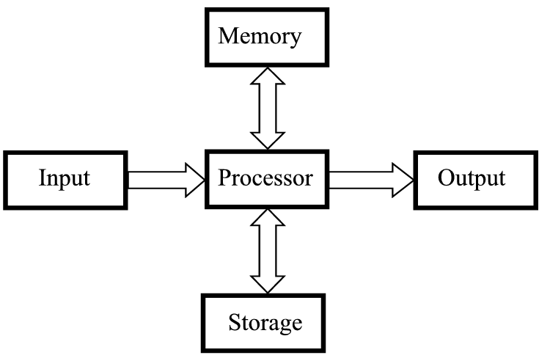
Memory

Slide 8
3. Storage Vs. Memory
Memory (e.g., RAM)
Keep the information for a shorter period of time (usually volatile)
Faster
More expensive

Slide 9
3. Storage Vs. Memory
Storage (e.g., Hard disk)
The information is retained longer (non-volatile)
Slower
Cheaper

Slide 10
CONTENTS
Introduction
RAM,ROM,PROM,EPROM
Auxiliary Storage Devices-Magnetic Tape, Hard Disk, Floppy Disk
Optical Disks: CD-R Drive,CD-RW disks,DVD,Blue ray Discs.

Slide 11
Categories Of Storage
Magnetic
  Floppy disks
  Zip disks
  Hard drives
Optical
  CD-ROM
  DVD
Solid state storage devices
  USB Key (a very common form of solid state storage)

