Slide 1
Floating Point Arithmetic Operations

Slide 2
BINARY REPRESENTATION OF FLOATING POINT NUMBERS
Converting decimal fractions into binary representation.
Consider a decimal fraction of the form: 0.d1d2...dn
We want to convert this to a binary fraction of the form:
0.b1b2...bn (using binary digits instead of decimal digits)

Slide 3
Algorithm for conversion
Let X be a decimal fraction: 0.d₁d₂..d_{n}
i = 1
Repeat until X = 0 or i = required no. of binary fractional digits {
Y = X * 2
X = fractional part of Y
B_{i} = integer part of Y
i = i + 1
}

Slide 4
EXAMPLE 1
Convert 0.75 to binary
X = 0.75 (initial value)
X* 2 = 1.50. Set b1 = 1, X = 0.5
X* 2 = 1.0. Set b2 = 1, X = 0.0
The binary representation for 0.75 is thus
0.b1b2 = 0.11b

Slide 5
Let's consider what that means...
In the binary representation
0.b1b2...bm
b1 represents 2⁻¹ (i.e., 1/2)
b2 represents 2⁻² (i.e., 1/4)
...
bm represents 2^{-m} (1/(2^{m}))
So, 0.11 binary represents
2⁻¹ + 2⁻² = 1/2 + 1/4 = 3/4 = 0.75

Slide 6
EXAMPLE 2
Convert the decimal value 4.9 into binary
Part 1: convert the integer part into binary: 4 = 100b

Slide 7
Part 2.
Convert the fractional part into binary using multiplication by 2:
X = .9*2 = 1.8. Set b₁ = 1, X = 0.8
X*2 = 1.6. Set b₂ = 1, X = 0.6
X*2 = 1.2. Set b₃ = 1, X = 0.2
X*2 = 0.4. Set b₄ = 0, X = 0.4
X*2 = 0.8. Set b₅ = 0, X = 0.8,
which repeats from the second line above.

Slide 8
Since X is now repeating the value 0.8,
we know the representation will repeat.
The binary representation of 4.9 is thus:
100.1110011001100...

Slide 9
COMPUTER REPRESENTATION OF FLOATING POINT NUMBERS
In the CPU, a 32-bit floating point number is represented using IEEE standard format as follows:
S | EXPONENT | MANTISSA
where S is one bit, the EXPONENT is 8 bits, and the MANTISSA is 23 bits.

Slide 10
The mantissa represents the leading significant bits in the number.
The exponent is used to adjust the position of the binary point (as opposed to a "decimal" point)

Slide 11
The mantissa is said to be normalized when it is expressed as a value between 1 and 2. I.e., the mantissa would be in the form 1.xxxx.

Slide 12
The leading integer of the binary representation is not stored. Since it is always a 1, it can be easily restored.

Slide 13
The "S" bit is used as a sign bit and indicates whether the value represented is positive or negative
(0 for positive, 1 for negative).

Slide 14
IEEE 754 Standard for Floating Point
Single precision format
Double precision format
S sign | E: Biased Exponent 8 bits | Z Significand 23 bits
Bit index 31 30 23 22 0
S sign | E: Biased Exponent 11 bits | Z Significand 20 bits
Bit index 31 30 20 19 0
Significand continued 32 bits

Slide 15
Example 1. Represent the decimal value 2.5 in 32-bit floating point format.
2.5 = 10.1b
In normalized form, this is: 1.01 * 2¹
The mantissa: M = 01000000000000000000000
(23 bits without the leading 1)
The exponent: E = 1 + 127 = 128 = 10000000b
The sign: S = 0 (the value stored is positive)
So, 2.5 = 01000000001000000000000000000000

Slide 16
Example 2: Represent the number -0.00010011b in floating point form.
0.00010011b = 1.0011 * 2⁻⁴
Mantissa: M = 00110000000000000000000 (23 bits with the integral 1 not represented)
Exponent: E = -4 + 127 = 01111011b
S = 1 (as the number is negative)
Result: 1 01111011 00110000000000000000000

Slide 17
Floating Point Addition
(See Figs 4.44, 4.45 - pp. 284, 285 )
Pseudo Code:
Compare the exponents of the two numbers and align:
  Shift the smaller number (mantissa) to the right (holding binary point fixed) until its exponent matches the larger exponent – actually we are effectively shifting the binary point left.
  Note: the integral part participates in the shift - the hardware must supply or account for the binary integral part of ‘1’.
  Over/under flow cannot occur on this initial re-alignment of the binary point because the smaller exponent will adjust until it matches the larger exponent which is assumed ok.
Add the significands - really the aligned mantissas since the integral parts participate . - see not below.
Loop:
  Normalize the sum by shifting right or left and inc/dec the exponent – may end up being
  un-normalized if addition or rounding (below) caused a integral part of > 1 bit.
  Overflow or underflow in exponent?
  If yes exception raised
  If no, then round significand to proper number of bits
Repeat normalization (goto loop) if no longer normalized

Slide 18
Floating Point Addition (cont)
Note on the “addition” step:
  The addition of the mantissas is a “signed magnitude” operation, we must do an unsigned addition/subtraction of the numbers:
  The mantissa/significand does not have a sign bit as in 2 complement form.
  Between the overall sign of the numbers, and the overall (net) operation (add or subtract) we do unsigned addition if there is no “net” subtract, or an unsigned 2’s complement subtraction if there is a “net” subtract. For a net subtract, we determine the sign of the answer by observing the carryout:
  For subtraction, conceptually:
  Hardware checks carry out in the 2’s complement sum
  If there is a carry out, answer is positive
  If no carry out, answer is negative and in 2's comp form
  Example:
  5 + (-7) = 5 - (+7) = 5 - (2's comp of 7) ... no c.o. => answer neg
  7 + (-5) = 7 - (+5) = 7 - (2's comp of 5) ... is c.o. => answer pos

Slide 19
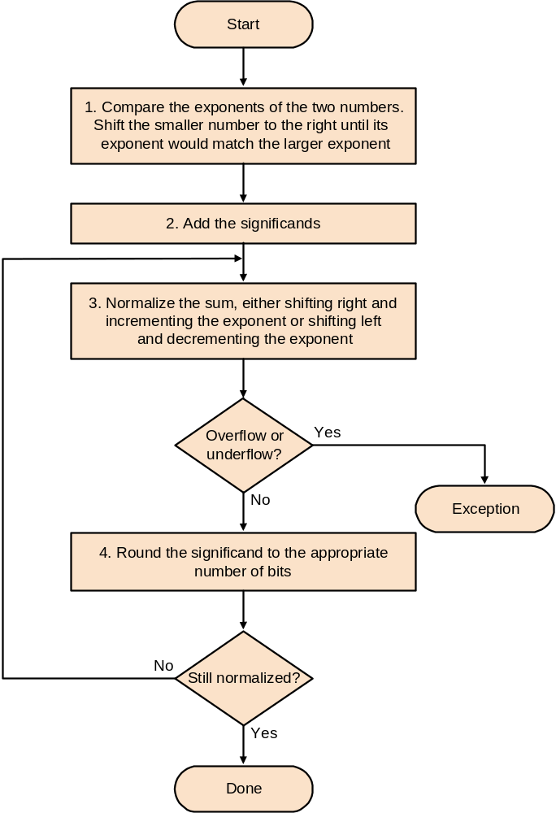

Slide 20
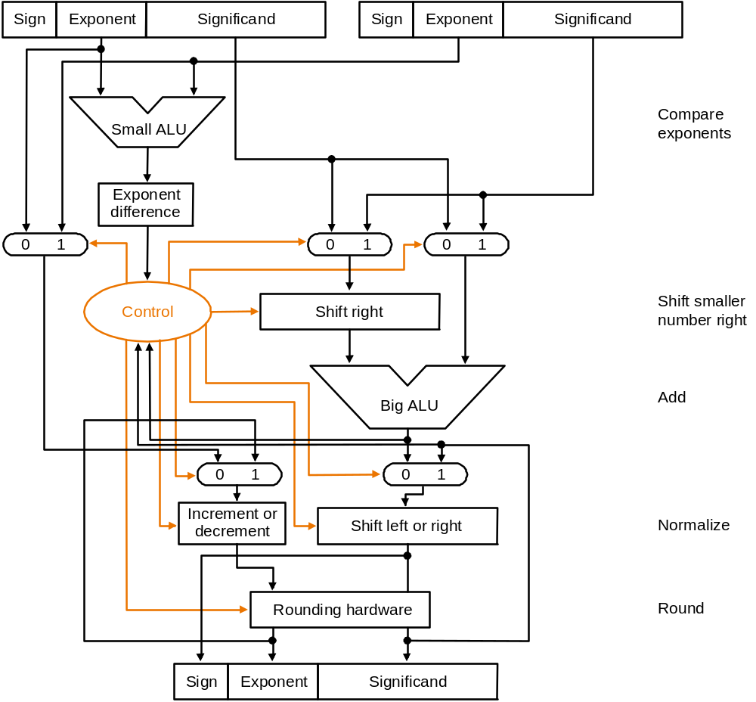
Floating Point Addition –Data Flow
←for re-normalization
Rounding up (add 1)
Could cause > 1 bit to left of
Significand.
Note: over flow is when a positive exponent is too large for exponent field
Underflow is when negative exponent is too large for exponent field.

Slide 21
Example of Floating Point Addition
Add 0.5 and –0.4375 (both base 10) to give 0.0625
Floating point representations, assuming 4 bits of precision:
0.5)_{ten} = 0.1)_{two} x 2⁰ = 1.000)_{two} x 2⁻¹ adding bias gives: 1.000 x 2¹²⁶
–0.4375 )_{ten} = -0.0111 )_{two} x2⁰ = -1.110 )_{two} x 2⁻² adding bias gives: -1.110 x 2¹²⁵
Shift the smaller number to get the same exponent as the larger to make exponents
match: -1.110 x 2¹²⁵ = -0.111x2¹²⁶
Adding significands: 1.0 x2¹²⁶ + (-0.111x2¹²⁶ ) = 1.0 x2¹²⁶ + (-0.111x2¹²⁶ )
= 1.0 x2¹²⁶ + 1.001x2¹²⁶ ) , used 2’s complement of 2nd number
= 0.001 x 2¹²⁶ … since there was a net carryout, the sum is positive.
Normalize: = 1.000 x 2¹²³ … no overflow since biased exponent is between 0
and 255.
Round the sum: no need to, it fits in 4 bits.
Final answer with bias removed is: 1.000 x 2⁽¹²³⁻¹²⁷⁾ = 1.000 x 2⁻⁴ = 0.0625)_{ten}

Slide 22
Floating Point Multiplication see fig 4.46, p. 289
As with addition, the process of multiplication and the process of rounding can produce a non-normalized number ... Which in turn can result in over/under flow on re-normalization.

Slide 23
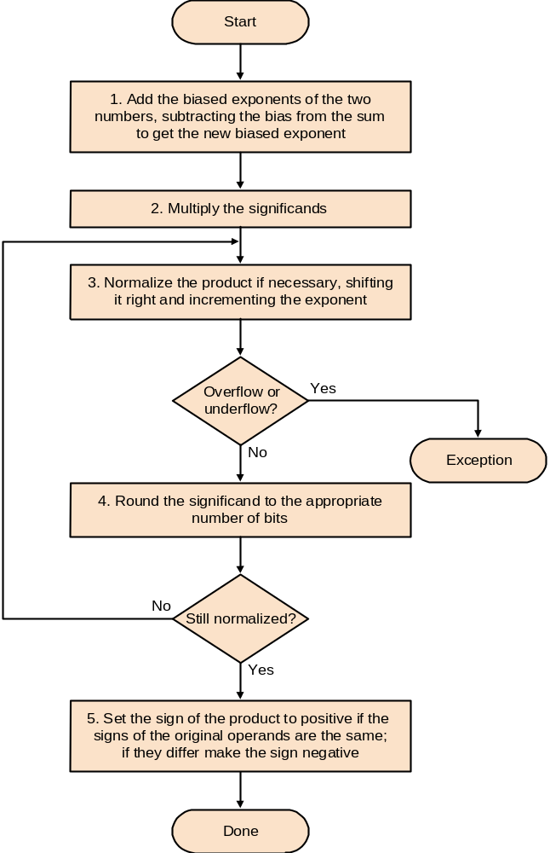
Floating Point Multiplication (cont)

Slide 24
Example of Floating Point Multiplication
Multiply 0.5 and –0.4375 (both base 10) to give -0.21875 = 0.00111)_{two}
From before: (1.000 x 2⁽⁻¹⁺¹²⁷⁾) x (-1.110 x 2⁽⁻²⁺¹²⁷⁾) using biased exponent.
Adding exponents (and dropping the extra bias): 126+125-127 = 124
Multiply mantissas using a previously described multiply algorithm:
1.110 x 1.000 = 1.110000
Yielding: 1.110000 x 2¹²⁴ = 1.110 x 2¹²⁴ keeping to 4 bits
Product is already normalized and no overflow since 1 ≤ 124 ≤ 254
Rounding makes no change
Signs of operands differ, hence answer is negative: -1.110 x 2⁻³
Converting to decimal: -1.110 x 2⁻³ = -0.001110 = -0.21875)_{ten}

