Slide 1
SURVIVABILITY PREDICTION OF CANCER PATIENTS USING MACHINE LEARNING ALGORITHMS ON MONGODB
By, Group F
Supervisor: Dr. Sunirmal Khatua
MSc. Semester 4
Session : 2020-2022
University Of Calcutta
Date: 16/06/2022

Slide 2

i) Name: Hannah Brijit
Roll Number: C91/CSC/201006
Registration Number: D01-1211-0010-20
ii) Name: Ripan Adak
Roll Number: C91/CSC/201017
Registration Number: 562-1111-0112-17
iii) Name: Rupal Mondal
Roll Number: C91/CSC/201018
Registration Number: 221-1212-0284-17
16/06/2022
Members of Group (F)

Slide 3
Overview
16/06/2022
Kaplan-Meier Estimator
Cox Proportional Hazard Model
AdaBoost Regression
XGBoost Regression
XGBoost Regression with Parameters Optimization

Slide 4

16/06/2022
Dataset 1: Chemotherapy for Stage B/C colon cancer
id: ID of the patient
study: 1 for all patients
rx: Treatment - Obs(ervation) - 1, Lev(amisole) - 2, Lev(amisole)+5-FU -3
sex: Patient’s gender(1=male, 0=female)
age: Age of the patient in years
obstruct: Obstruction of colon by tumour
perfor: Perforation of colon
adhere: Adherence of tumour to nearby organs
nodes: Number of lymph nodes with detectable cancer
time: Days until event or censoring
status: 0=death, 1=censored
differ: Differentiation of tumour (1=well, 2=moderate, 3=poor)
extent: Extent of local spread(1=submucosa,2=muscle,3=serosa,4=contiguous structures)
surg: Time from surgery to registration (0=short, 1=long)
node4: More than 4 positive lymph nodes.(1=yes, 0=no)
The dataset 1 enlists, 888 entries, after the removal of null values.

Slide 5
16/06/2022
Dataset 2: Collected from Krembil Research Institute.
age: Age of the patient in years, [40, 95].
anaemia: A condition in which there is a deficiency of red cells or of hemoglobin in the blood {0:No, 1:Yes}.
creatinine_phosphokinase: Level of the CPK enzyme in patient's blood in micrograms per liter (mcg/L), [23, 7861]
diabetes: If the patient has diabetes, {0:No, 1:Yes}
ejection_fraction: A measurement of the percentage of blood leaving the heart each time it squeezes, [14, 80]
high_blood_pressure: If a patient has high blood pressure, {0:No, 1:Yes}
platelets: Level of platelets in patient's blood in platelets/mL, [25100, 850000]
serum_creatinine: Level of creatinine in a patient's blood in mg/dL, [0.5, 9.4]
serum_sodium: Level of sodium in patient's blood in mEq/L, [113, 148].
sex: Gender of the patient, {0:Female, 1:Male}
smoking: If the patient smokes, {0:No, 1:Yes}
time: Follow-up period in days, [4, 285].
DEATH_EVENT: If the patient is dead (due to heart attack), target feature, {0:No, 1:Yes}
The dataset 2 consists of 299 entries without any null or missing values.

Slide 6
Kaplan-Meier Estimator
16/06/2022
Non-parametric procedure.
Univariate analysis.
Takes categorical variables as input feature.

Slide 7
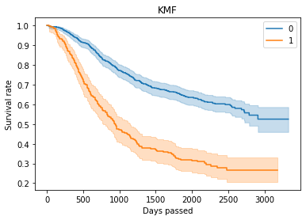
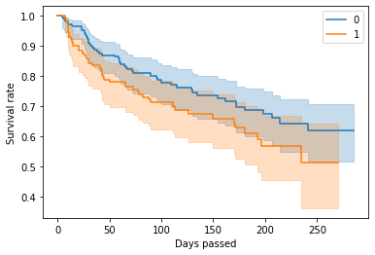
16/06/2022
Kaplan-Meier Survival Curves
Kaplan Meier Survival curve plotted for the feature node4, on Dataset 1.
Kaplan Meier Survival curve plotted for the feature anaemia, on Dataset 2.

Slide 8
Cox Proportional Hazard Model
16/06/2022
Semi-parametric procedure.
Multivariate analysis.
Functions both for categorical variables and quantitative predictor variables.

Slide 9
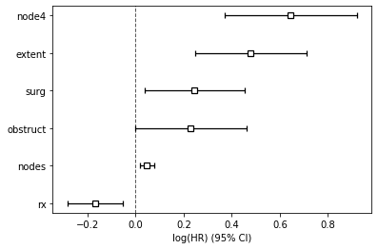
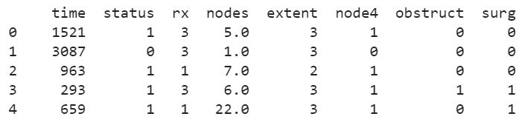
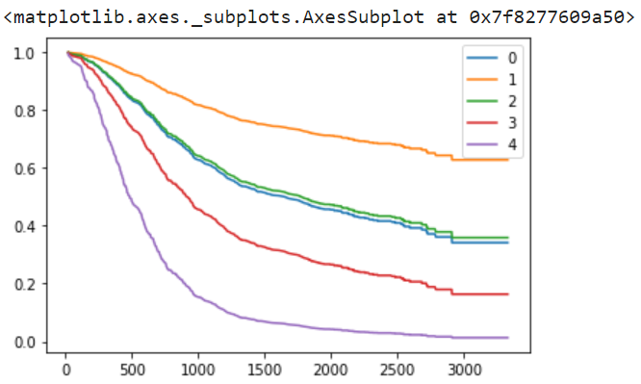
16/06/2022
Cox Proportional Hazard Regression
Feature Importance graph and the survival curve plotted using Cox regression method with reduced features for patients indexed 0-4, on Dataset 1.
Survival Duration is on X axis (in days) Survival Probability is on the Y axis.

Slide 10
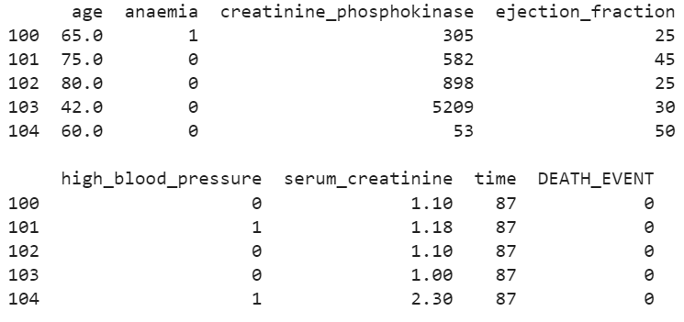
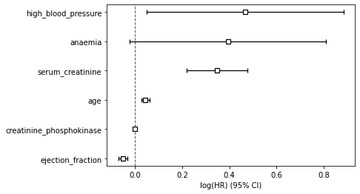
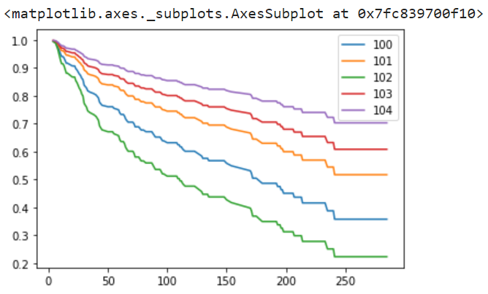
16/06/2022
Cox Proportional Hazard Regression(Contd.)
Feature Importance graph and the survival curve plotted using Cox regression method with reduced features for patients indexed 100-104, on Dataset 2.
Survival Duration is on X axis (in days) Survival Probability is on the Y axis.

Slide 11
Adaptive Boosting
16/06/2022
A popular tree based ensemble method.
Many weak learners additively form a strong learner.
We apply them in survival prediction, as a regression problem.
Used Adaboost with different weak learners such as decision tree, random forest, K-nearest neighbor (KNN) to see whether we can optimize the already existing algorithm, giving better accuracy.

Slide 12
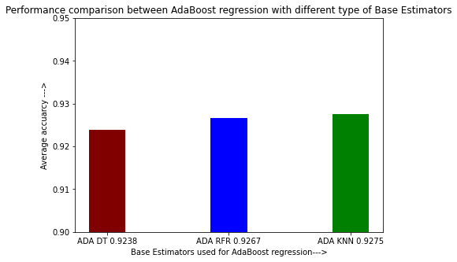
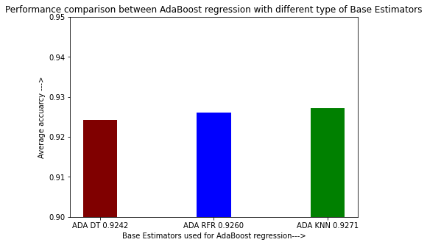
AdaBoost with different types of base estimators: performance comparison
16/06/2022
KNN performs 0.37% better than ADA DT and 0.08%
Better than ADA RFR.
Base Estimator | Accuracy
ADA DT | 0.9238
ADA RFR | 0.9267
ADA KNN | 0.9275
KNN performs 0.29%better than ADA DT and 0.11%
Better than ADA RFR.
For Run 1
Base Estimator | Accuracy
ADA DT | 0.9242
ADA RFR | 0.9260
ADA KNN | 0.9271
ADA DT -> DecisionTreeRegressor, ADA RFR -> RandomForestRegressor, and ADA KNN ->KNeighborsRegressor.
For Run 2

Slide 13
Extreme Gradient Boosting(XGBoost)
16/06/2022
A decision-tree-based ensemble Machine Learning algorithm that uses a gradient boosting framework.
Advantages :
Very high speed compared to other algorithms, such as AdaBoost.
Consists of a number of hyper-parameters that can be tuned.
Tried to increase the accuracy of the model by tuning those parameters.

Slide 14
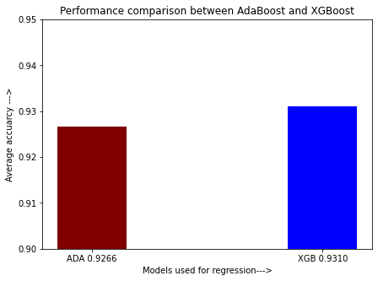
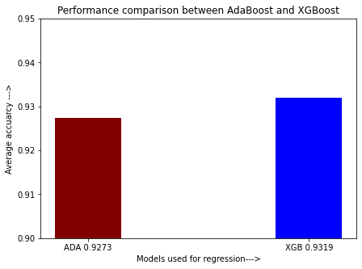
pt
16/06/2022
XGBoost vs AdaBoost
(with default parameters)
0.44% increase in accuracy for XGBoost
Performance comparison of AdaBoost Regression and XGBoost Regression (Run 1)
Model | Accuracy
AdaBoost | 0.9266
XGBoost | 0.9310
Performance comparison of AdaBoost Regression and XGBoost Regression (Run 2)
0.46% increase in accuracy for XGBoost
Model | Accuracy
AdaBoost | 0.9273
XGBoost | 0.9319

Slide 15
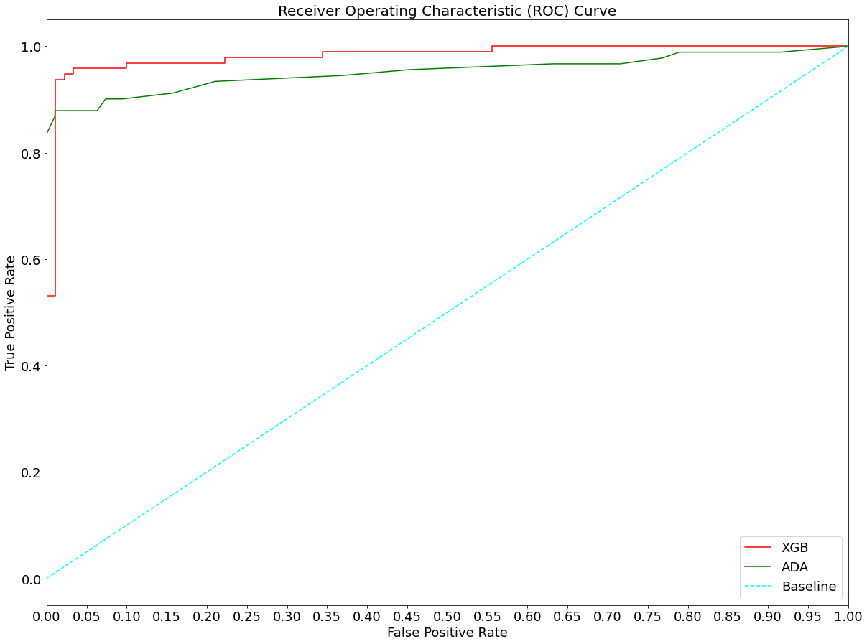
ROC Curve for XGBoost vs AdaBoost
16/06/2022
ROC Curve clearly shows that XGBoost Regression performs better than Adaboost.
ROC curve of XGBoost Regression and AdaBoost Regression

Slide 16
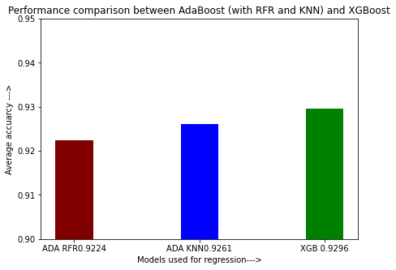
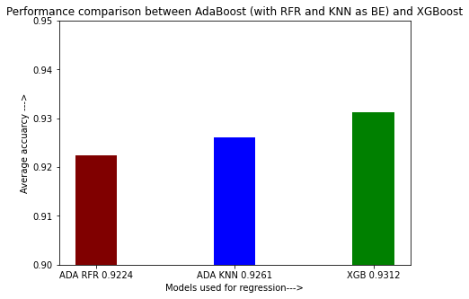
16/06/2022
ADA RFR vs ADA KNN vs XGBoost:
Performance comparison
XGBoost performed 0.72% better than ADA RFR and 0.35% better than ADA KNN
Model | Accuracy
ADA RFR | 0.9224
ADA KNN | 0.9261
XGBoost | 0.9296
Run 1
XGBoost performed 0.88% better than ADA RFR and 0.51% better than ADA KNN
Model | Accuracy
ADA RFR | 0.9224
ADA KNN | 0.9261
XGBoost | 0. 9312
ADA RFR -> RandomForestRegressor, and ADA KNN->KNeighborsRegressor and XGB ->XGBoost Regression.
Run 2

Slide 17
16/06/2022
Parameter tuning of XGBoost to achieve better accuracy
Find optimal values of the parameters using the GridSearchCV
(GridSearchCV object resides in the model_selection module of sklearn library)
Step 1: Store a set of possible optimal values in a list namely param_test.
Step 2: Create an GridSearchCV object passing the parameters as: estimator = XGBRegressor(max_depth=3, n_estimators=200, learning_rate=0.05), param_grid = param_test, scoring='roc_auc', n_jobs=4, cv=5).
Step 3: Fit GridSearchCV object with X_train and Y_train data.
Step 4: The best parameter value and best score are found from best_params_ and best_score_ attributes of the GridSearchCV object.

Slide 18
16/06/2022
Optimal values for parameters for XGBoost
i) max_depth = 3
ii) learning_rate = 0.02
iii) n_estimators = 200
iv) min_child_weight = 5
v) gamma = 0.4
vi) colsample_bytree = 0.6
vii) subsample = 0.8
viii) reg_alpha = 1.1
Other parameters were kept as default.

Slide 19
Comparing Accuracies Between
XGBoost (with default parameters) And XGBoost (with tuned parameters)
[XGB vs XGB-mod]
16/06/2022

Slide 20
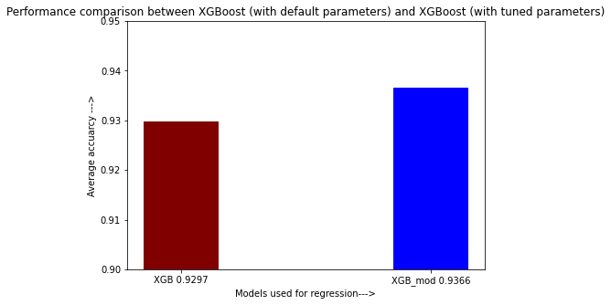

XGB vs XGB-mod
16/06/2022
Comparison between XGB and XGB-mod (Run 1)
0.69% increment of
accuracy
Model | Accuracy
XGB | 0.9297
XGB-mod | 0.9366
Comparison between XGB and XGB-mod (Run 2)
Model | Accuracy
XGB | 0.9303
XGB-mod | 0.9380
0.77% increment of
accuracy
XGB parameters → (max_depth=3, learning_rate=0.1, n_estimators=100, gamma=0, min_child_weight=1, subsample=1, colsample_bytree=1, reg_alpha=0)
XGB-mod parameters → (max_depth=3, learning_rate=0.02, n_estimators=200, gamma=0.4, min_child_weight=5, subsample=0.8, colsample_bytree=0.6, reg_alpha=1.1)

Slide 21
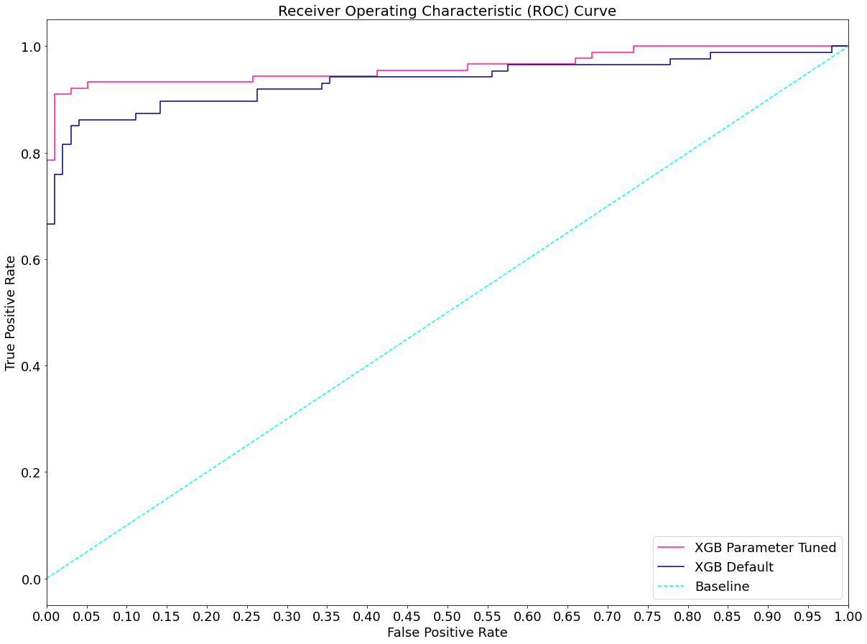
ROC Curve for XGB vs XGB-mod
16/06/2022
The ROC curve also clearly says that XGB-mod performs better than XGB
ROC curve of XGB and XGB-mod

Slide 22
MongoDB
16/06/2022
NoSQL based Non-Relational Database Management System
JSON‐like documents with dynamic schemas instead of tables and rows
Simplify large data handling

Slide 23
Why did we use MongoDB?
16/06/2022
To store the dataset permanently
Faster query processing compared to relational DBMS.
Integration into web applications becomes easier
MongoDB supports storing data of any size
Easy updation and deletion

Slide 24
Conclusion
16/06/2022
Among AdaBoost regressions with different base estimators, AdaBoost with KNN as base estimator performs the best for our dataset with 92.93% accuracy
Among AdaBoost and XGBoost regressions, XGBoost performs better for our dataset with 93.19% accuracy
Among XGBoost with default parameters and XGBoost with tuned parameters (XGB-mod), XGB-mod performs better for our dataset with 93.80% accuracy
93.80% is the highest accuracy we have got on XGB-mod from our project within the stipulated time

Slide 25
Future Scope
16/06/2022
Accuracy might be increased using other ML algorithms
We would like to try to increase the accuracy of prediction of survivability of patients building prediction model using deep neural network (Deep Learning)

Slide 26
References
16/06/2022
Schapire, R.E., 2013. Explaining adaboost. In Empirical inference (pp. 37-52). Springer, Berlin, Heidelberg.
Song, Y.Y. and Ying, L.U., 2015. Decision tree methods: applications for classification and prediction. Shanghai archives of psychiatry, 27(2), p.130.
Oliver, J.J. and Hand, D., 1994, April. Averaging over decision stumps. In European conference on machine learning (pp. 231-241). Springer, Berlin, Heidelberg.
Drucker, H., 1997, July. Improving regressors using boosting techniques. In ICML (Vol. 97, pp. 107-115).
Chen, T., He, T., Benesty, M., Khotilovich, V., Tang, Y., Cho, H. and Chen, K., 2015. Xgboost: extreme gradient boosting. R package version 0.4-2, 1(4), pp.1-4.
Bentéjac, C., Csörgő, A. and Martínez-Muñoz, G., 2021. A comparative analysis of gradient boosting algorithms. Artificial Intelligence Review, 54(3), pp.1937-1967.
Šimundić, A.M., 2009. Measures of diagnostic accuracy: basic definitions. ejifcc, 19(4), p.203.
Hoo, Z.H., Candlish, J. and Teare, D., 2017. What is an ROC curve?. Emergency Medicine Journal, 34(6), pp.357-359.
Moertel, C.G., Fleming, T.R., Macdonald, J.S., Haller, D.G., Laurie, J.A., Tangen, C.M., Ungerleider, J.S., Emerson, W.A., Tormey, D.C., Glick, J.H. and Veeder, M.H., 1995. Fluorouracil plus levamisole as effective adjuvant therapy after resection of stage III colon carcinoma: a final report. Annals of internal medicine, 122(5), pp.321-326.

Slide 27
Thank you!
16/06/2022

