Slide 1

ENVIRONMENTAL SCIENCE, WASTE AND DISASTER MANAGEMENT
Ms. Akriti
Assistant Professor
Chandigarh University
Gharuan, Mohali, Punjab
DISASTER PREPAREDNESS, RESPONSE, RECOVERY
DISCOVER . LEARN . EMPOWER

Slide 2

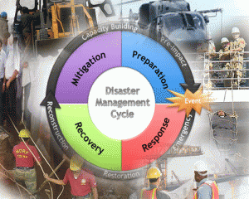
DISASTER PREPAREDNESS, RESPONSE, RECOVERY
Course Outcome
CO Number | Title | Level
CO1 | Understudies will be able to identify different dimensions of environmental studies; problems related to the environmental degradation & will be able to take remedial steps. | Remember
CO2 | Disciples will learn about different type of disaster that occur in nature consequently learning to develop the preparedness and remedial techniques | Understand
CO3 | Upon learning the problems related to environmental waste students will be able to segregate the waste in different categories and will learn its effective management techniques | Understand

Slide 3
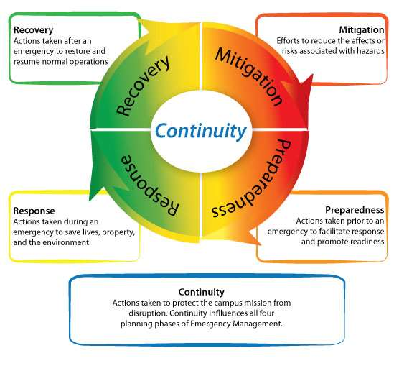
DISASTER MANAGEMENT
Disaster management is about dealing with a disaster , avoiding risks and also looking for and implementing strategies that could prevent or at least minimize the chance of them happening again or minimizing their impact.
Source: http://www.masslocalinstitute.info/EPinMA/EPinMA_print.html

Slide 4
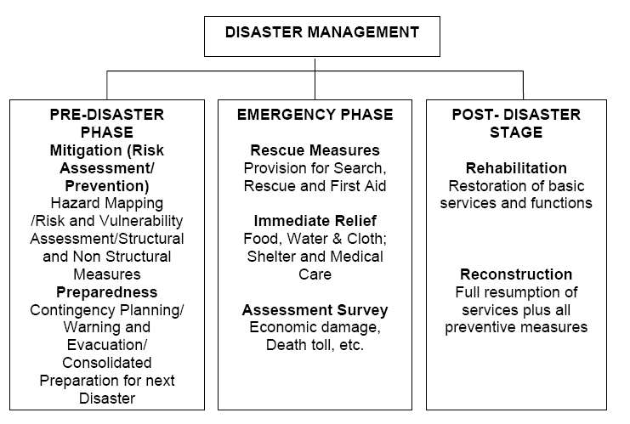
DISASTER MANAGMENT
Google images

Slide 5
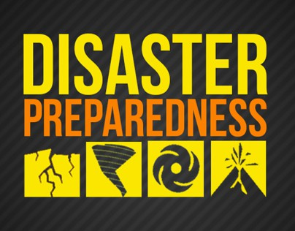
DISASTER PREPAREDNESS
Disaster preparedness refers to measures taken to prepare for and reduce the effects of disasters. That is, to predict and—where possible—prevent them, mitigate their impact on vulnerable populations, and respond to and effectively cope with their consequences.
Google images
http://www.masslocalinstitute.info/EPinMA/EPinMA_print.html

Slide 6
DISASTER PREPAREDNESS OBJECTIVE
Keeping ready Rapid Response Teams, Search and Rescue personnel along with Emergency Medical Teams
Making available relief activities including emergency shelters, medical, food, first aid services, and security arrangements
Strengthening warning systems and meteorological studies
Setting up secure and safe shelters to house the rescued
Putting in place emergency evacuation procedures
http://www.masslocalinstitute.info/EPinMA/EPinMA_print.html

Slide 7
DISASTER PREPAREDNESS
Preparing to handle an emergency
Includes strategies and preparations made to save lives and/or to help response and rescue operations.
Evacuation plans and storing food and water are both examples of preparedness.
Preparedness happens much before an emergency occurs.
Co-ordination of various sectors to:
Evaluate risk
Adopt standards/guidelines and regulations.
Organize communication and response mechanism.
Ensure all resources are ready and can be easily mobilized.
Public education programmes.
Disseminate information through media.
Disaster simulation exercises.
http://www.masslocalinstitute.info/EPinMA/EPinMA_print.html

Slide 8
DISASTER PREPAREDNESS
Preparedness should be in the form of money, manpower and materials :
Learning from past experiences and evaluating.
Identifying location of disaster prone areas
Organization of communication, information and warning system
Ensuring efficient functioning of co-ordination and response mechanisms
Planning, training & educational activities for things that cant be mitigated.
The goal of emergency preparedness programs is to achieve a satisfactory level of readiness to respond to any emergency situation through programs that strengthen the technical and managerial capacity of governments, organizations, and communities.
http://www.masslocalinstitute.info/EPinMA/EPinMA_print.html

Slide 9
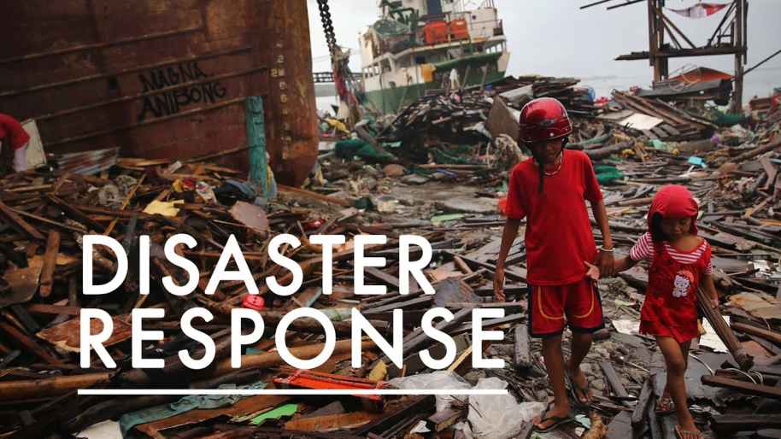
RESPONSE
Immediate reaction to disaster as the disaster is anticipated, or soon after it begins in order to assess the needs, reduce the suffering, limit the spread and consequences of the disaster, open up the way to rehabilitation.
By-
Mass evacuation
Search and rescue
Emergency medical services
Securing food and water
Google images
http://www.masslocalinstitute.info/EPinMA/EPinMA_print.html

Slide 10
RESPONSE
Responding safely to an emergency
Includes actions taken to save lives and prevent further property damage in an emergency situation. Response is putting your preparedness plans into action.
Seeking shelter from a tornado or turning off gas valves in an earthquake are both response activities.
Response activities take place during an emergency.
The aim of emergency response is to provide immediate assistance to maintain life, improve health and support the morale of the affected population.
Such assistance may range from providing specific but limited aid, such as assisting refugees with transport, temporary shelter, and food, to establishing semi-permanent settlement in camps and other locations.
It also may involve initial repairs to damaged infrastructure.
The focus in the response phase is on meeting the basic needs of the people until more permanent and sustainable solutions can be found.
http://www.masslocalinstitute.info/EPinMA/EPinMA_print.html

Slide 11
RECOVERY
Recovering from an emergency
Includes actions taken to return to a normal or an even safer situation following an emergency.
Recovery includes getting financial assistance to help pay for the repairs.
Recovery activities take place after an emergency.
As the emergency is brought under control, the affected population is capable of undertaking a growing number of activities aimed at restoring their lives and the infrastructure that supports them.
Recovery activities continue until all systems return to normal or better.
Recovery measures, both short and long term, include returning vital life-support systems to minimum operating standards; temporary housing; public information; health and safety education; reconstruction; counseling programs; and economic impact studies.
Information resources and services include data collection related to rebuilding, and documentation of lessons learned.
http://www.masslocalinstitute.info/EPinMA/EPinMA_print.html

Slide 12

PREDICTION AND EARLY WARNING
Prediction: Predict an “event”.
-specify place, time, and size, in advance
-specify impacts, in advance
Early Warning System (EWS) can be defined as a set of capacities needed to generate and disseminate timely and meaningful warning information of the possible extreme events or disasters (e.g. floods, drought, fire etc.) that threatens people’s lives.
Google images
http://www.masslocalinstitute.info/EPinMA/EPinMA_print.html

Slide 13
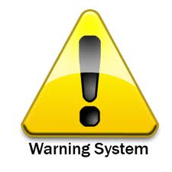
ELEMENTS OF PREDICTION AND EARLY WARNING
Knowledge of the risks: Risks arise from both the hazards and the vulnerabilities that are present. What are the patterns and trends in these factors?
Monitoring, analysis and forecasting of the hazards: Constant monitoring of possible disaster precursors is necessary to generate accurate warnings on time.
Communication or dissemination of alerts and warnings: Clear understandable warnings must reach those at risk.
Local capabilities to respond to the warnings received: Building up a prepared community requires the participation of formal and informal education sectors.
Google images
http://www.masslocalinstitute.info/EPinMA/EPinMA_print.html

Slide 14
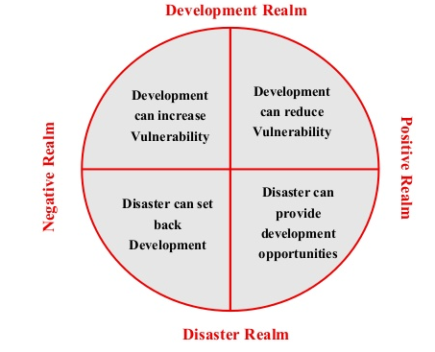
INTER-RELATIONSHIP BETWEEN DISASTERS AND DEVELOPMENT
Google Images

Slide 15
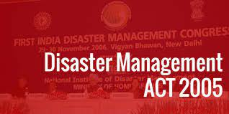
DISASTER MANAGEMENT ACT-2005
The Disaster Management Act of 2005 (DMA 2005) is an act passed by the government of India for the ‘efficient management of disasters and other matters connected to it.
Containing 11 chapters and 79 sections, the act received the assent of the President of India on 23 December 2005.
Google images

Slide 16

DISASTER MANAGEMENT ACT-2005
What has been the progress made by DMA 2005?
The Disaster Management Act is based on the principle belief that mitigation of disaster-related losses is efficient that expenditure on relief and rehabilitation. The drawing up planes for strategic partnerships and course of actions to counter disasters of various degrees the act has made significant inroads in the following
Detailed directions to guide disaster management efforts
Capacity development in all spheres
Consolidation of past initiatives and best practices
Co-operation with agencies at national and international levels.
Google images

Slide 17
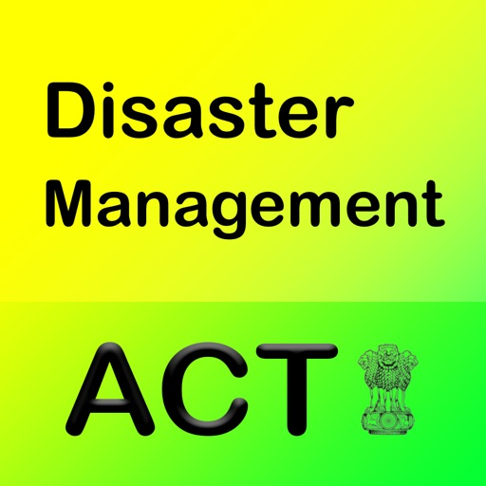
DISASTER MANAGEMENT ACT-2005
Objective
To manage disasters, including preparation of mitigation strategies, capacity-building, and more.
Definition of a “disaster” in Section 2 (d) of the DM Act states that a disaster means a “catastrophe, mishap, calamity or grave occurrence in any area, arising from natural or man made causes.
Google images

Slide 18
DISASTER MANAGEMENT ACT-2005
Institutional Structure: It puts into place a systematic structure of institutions at the national, state and district levels.
National Level Important Entities:
The National Disaster Management Authority (NDMA):
It is tasked with laying down disaster management policies and ensuring timely and effective response mechanisms.
The National Executive Committee (NEC):
It is constituted under Section 8 of the DM Act to assist the National Disaster Management Authority in the performance of its functions.
The NEC is responsible for the preparation of the National Disaster Management Plan for the whole country and to ensure that it is “reviewed and updated annually.
The National Institute of Disaster Management (NIDM):
It is an institute for training and capacity development programs for managing natural calamities.

Slide 19
DISASTER MANAGEMENT ACT-2005
Institutional Structure
National Disaster Response Force (NDRF):
It refers to trained professional units that are called upon for specialized response to disasters
State and District level:
The Act also provides for state and district level authorities responsible for, among other things, drawing plans for implementation of national plans and preparing local plans.
State Disaster Management Authority
District Disaster Management Authority.
http://www.masslocalinstitute.info/EPinMA/EPinMA_print.html

Slide 20
ASSESSMENT PATTERN
FAQ’s
Discuss various features of disaster preparedness.
State various features of response phase in disaster management.
Mention various elements of early warning system
Disaster preparedness planning plays an important role in disaster management. Justify the statement.
How disaster and development can be interlinked?
Discuss in detail about the Disaster Management Act-2005.

Slide 21
APPLICATIONS
To acquaint with the technical and scientific skills necessary for the wide range of disaster management areas ,both natural and anthropogenic, as earthquake, cyclone, nuclear and many others.
To appreciate the mitigation measures for the various natural and man made disasters

