Slide 1


UNIVERSITY INSTITUTE OF ENGINEERING
COMPUTER SCIENCE & ENGINEERING
Introduction to Information Security and cryptography
(Subject Code:20CST-354/ITT-354)
Prepared By : Er.Puneet kaur(E6913)
INTRODUCTION
DISCOVER . LEARN . EMPOWER

Slide 2

SSL and TLS
www. cuchd.in Campus : Gharaun, Mohali

Slide 3
Web Security Essential
Web now widely used by business, government,
individuals for multiple application
• But Internet & Web are vulnerable
• Have a variety of threats
• integrity
• confidentiality
• denial of service
• authentication
• Need added security mechanisms

Slide 4
Security Architecture
Security Architecture
• ITU-T Recommendation X.805 Security architecture for
systems providing end‑to‑end communications had been
developed by ITU-T SG 17 (ITU-T Lead Study Group on
Telecommunication Security) and was published in
October 2003.
• The group has developed a set of the well-recognized
Recommendations on security. Among them are X.800
Series of Recommendations on security and X.509 v3 -
Public-key and Attribute Certificate Frameworks.

Slide 5
ITU-T X.800 Threat Model
X 1 - Destruction (an attack on availability):
– Destruction of information and/or network
resources
2 - Corruption (an attack on integrity):
– Unauthorized tampering with an asset
3 - Removal (an attack on availability):
– Theft, removal or loss of information and/or
other resources
4 - Disclosure (an attack on confidentiality):
– Unauthorized access to an asset
5 - Interruption (an attack on availability):
– Interruption of services.

Slide 6
SSL (Secure Socket Layer)
• transport layer security service originally developed by Netscape version 3 designed with public input subsequently became Internet standard known as TLS (Transport Layer Security)
• uses TCP to provide a reliable end-to-end service
• SSL has two layers of protocols

Slide 7
Uses Public Key Scheme
Uses Public Key Scheme
• Each client-server pair uses
• 2 public keys
• one for client (browser)
• created when browser is installed on client machine
• one for server (http server)
• created when server is installed on server hardware
• 2 private keys
• one for client browser
• one for server (http server)

Slide 8
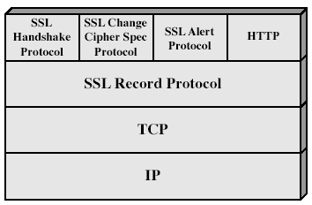
SSL Architecture

Slide 9
SSL Architecture
• SSL session
• an association between client & server
• created by the Handshake Protocol
• define a set of cryptographic parameters
• may be shared by multiple SSL connections (by using
same session symmetric key)
• SSL connection
• a transient, peer-to-peer, communications link
• associated with 1 SSL session

Slide 10
SSL Record Protocol
• confidentiality
• using symmetric encryption with a shared secret key
defined by Handshake Protocol
• IDEA, RC2-40, DES-40, DES, 3DES, Fortezza, RC4-40,
RC4-128
• message is compressed before encryption
• message integrity
• using a MAC (Message Authentication Code) created
using a shared secret key and a short message

Slide 11
SSL Alert Protocol
• conveys SSL-related alerts to peer entity
• severity
• warning or fatal
• specific alert
• unexpected message, bad record mac, decompression failure,
handshake failure, illegal parameter
• close notify, no certificate, bad certificate, unsupported
certificate, certificate revoked, certificate expired, certificate
unknown
• compressed & encrypted like all SSL data

Slide 12
SSL Handshake Protocol
• allows server & client to:
• authenticate each other
• to negotiate encryption & MAC algorithms
• to negotiate cryptographic keys to be used
• comprises a series of messages in phases
• Establish Security Capabilities
• Server Authentication and Key Exchange
• Client Authentication and Key Exchange
• Finish

Slide 13
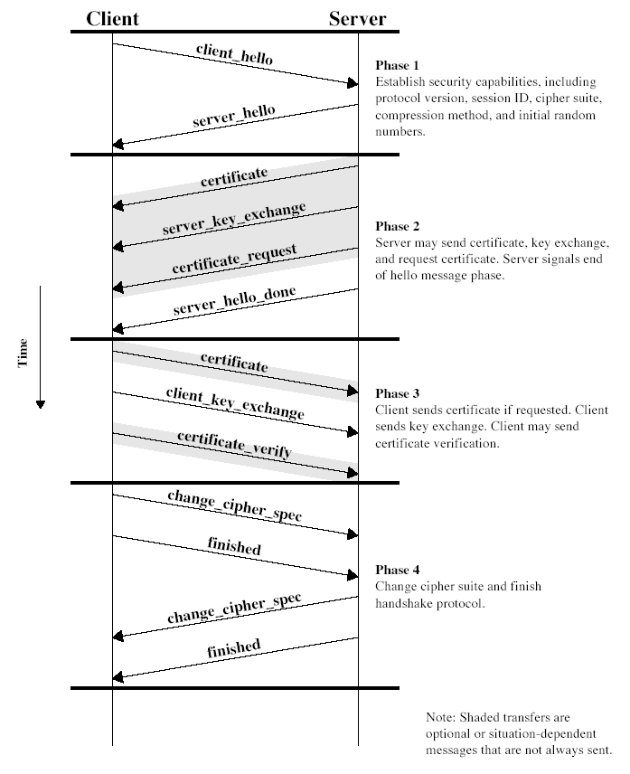
SSL Handshake Protocol
[1]

Slide 14
Changes from SSL 3.0 to TLS
• Fortezza removed
• Additional Alerts added
•Modification to hash calculations
• Protocol version 3.1 in ClientHello,
ServerHello

Slide 15
TLS (Transport Layer Security)
• IETF standard RFC 2246 similar to SSLv3 with minor differences in record format version number uses HMAC for MAC a pseudo-random function expands secrets has additional alert codes some changes in supported ciphers
changes in certificate negotiations
changes in use of padding
[1]

Slide 16
TLS: Integrity
TLS: Integrity
• Compute fixed-length Message Authentication
Code (MAC)
• Includes hash of message
• Includes a shared secret
• Include sequence number
• Transmit MAC with message
• Receiver creates new MAC
• should match transmitted MAC
• TLS allows MD5, SHA-1

Slide 17
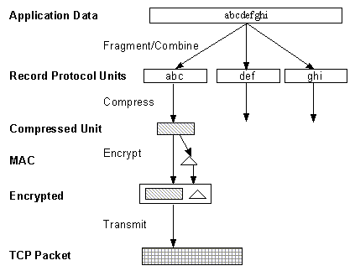
TLS: Record Protocol

Slide 18
TLS: Handshake
• Negotiate Cipher-Suite Algorithms
• Symmetric cipher to use
• Key exchange method
• Message digest function
• Establish and share master secret
• Optionally authenticate server and/or client
[4]

Slide 19
TLS: Key Exchange
• Server sends certificate containing public key
(RSA) or Diffie-Hellman parameters
• Client sends encrypted “pre-master” secret to
server using Client Key Exchange message
• Master secret calculated
• Use random values passed in Client and Server
Hello messages

Slide 20
Public Key Certificates
• X.509 Certificate associates public key with
identity
• Certification Authority (CA) creates certificate
• Adheres to policies and verifies identity
• Signs certificate
• User of Certificate must ensure it is valid.

Slide 21
Application of SSL/TLS
· On top of the Transport Layer protocols
Primarily with TCP
Datagram Transport Layer Security(DTLS) for UDP
· Encapsulating the application protocols
HTTP (HTTPS)
for securing WWW traffic
FTP (FTPS), SMTP, NNTP, etc.

Slide 22
References
http://www.brainkart.com/article/Classical-Encryption-Techniques_8339/
https://www.tutorialspoint.com/cryptography/index.htm
https://www.geeksforgeeks.org/cryptography-introduction/
https://www.techopedia.com/definition/1770/cryptography#:~:text=Cryptography%20involves%20creating%20written%20or,information%20to%20be%20kept%20secret.&text=Information%20security%20uses%20cryptography%20on,transit%20and%20while%20being%20stored.
https://www2.slideshare.net/lineking/classical-encryption-techniques-in-network-security?qid=e388c29f-793d-4f2b-bcaf-9d22e9ca07b5&v=&b=&from_search=1

Slide 23
E- Books Recommended
https://www.pdfdrive.com/cyber-security-books.html
https://bookauthority.org/books/new-cyber-security-ebooks
https://bookauthority.org/books/best-cyber-security-ebooks
https://www.freetechbooks.com/information-security-f52.html

