Slide 1


UNIVERSITY INSTITUTE OF ENGINEERING
COMPUTER SCIENCE & ENGINEERING
Introduction to Information Security and cryptography
(Subject Code:20CST-354/ITT-354)
Prepared By : Er.Puneet kaur(E6913)
INTRODUCTION
DISCOVER . LEARN . EMPOWER

Slide 2

IPv4 and IPv6
www. cuchd.in Campus : Gharaun, Mohali

Slide 3
What is IP?
An Internet Protocol address is also known as IP address.
It is a numerical label which assigned to each device connected to a computer network which uses the IP for communication.
IP address act as an identifier for a specific machine on a particular network.
The IP address is also called IP number and internet address.
IP address specifies the technical format of the addressing and packets scheme.
Most networks combine IP with a TCP (Transmission Control Protocol). It also allows developing a virtual connection between a destination and a source.

Slide 4
What is IPv4?
IPv4 was the first version of IP. It was deployed for production in the ARPANET in 1983. Today it is most widely used IP version. It is used to identify devices on a network using an addressing system.
The IPv4 uses a 32-bit address scheme allowing to store 2^32 addresses which is more than 4 billion addresses. Till date, it is considered the primary Internet Protocol and carries 94% of Internet traffic.

Slide 5
What is IPv6?
It is the most recent version of the Internet Protocol. Internet Engineer Taskforce initiated it in early 1994. The design and development of that suite is now called IPv6.
This new IP address version is being deployed to fulfill the need for more Internet addresses. It was aimed to resolve issues which are associated with IPv4. With 128-bit address space, it allows 340 undecillion unique address space. IPv6 also called IPng (Internet Protocol next generation).

Slide 6
KEY DIFFERENCE
IPv4 is 32-Bit IP address whereas IPv6 is a 128-Bit IP address.
IPv4 is a numeric addressing method whereas IPv6 is an alphanumeric addressing method.
IPv4 binary bits are separated by a dot(.) whereas IPv6 binary bits are separated by a colon(:).
IPv4 offers 12 header fields whereas IPv6 offers 8 header fields.
IPv4 supports broadcast whereas IPv6 doesn’t support broadcast.
IPv4 has checksum fields while IPv6 doesn’t have checksum fields
IPv4 supports VLSM (Virtual Length Subnet Mask) whereas IPv6 doesn’t support VLSM.
IPv4 uses ARP (Address Resolution Protocol) to map to MAC address whereas IPv6 uses NDP (Neighbour Discovery Protocol) to map to MAC address.

Slide 7
FEATURES OF IPV4
Connectionless Protocol
Allow creating a simple virtual communication layer over diversified devices
It requires less memory, and ease of remembering addresses
Already supported protocol by millions of devices
Offers video libraries and conferences

Slide 8
Features of IPv6
Hierarchical addressing and routing infrastructure
Stateful and Stateless configuration
Support for quality of service (QoS)
An ideal protocol for neighboring node interaction

Slide 9
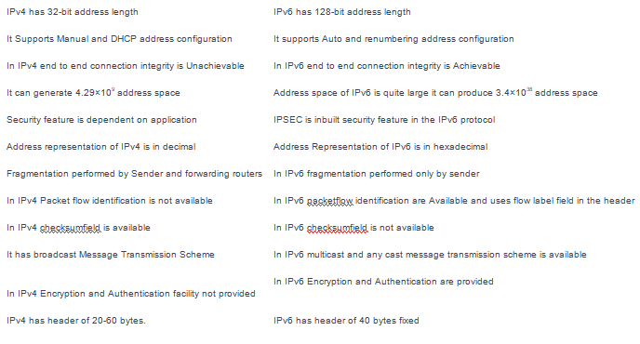
Difference between IPV4 and IPV6

Slide 10
References
http://www.brainkart.com/article/Classical-Encryption-Techniques_8339/
https://www.tutorialspoint.com/cryptography/index.htm
https://www.geeksforgeeks.org/cryptography-introduction/
https://www.techopedia.com/definition/1770/cryptography#:~:text=Cryptography%20involves%20creating%20written%20or,information%20to%20be%20kept%20secret.&text=Information%20security%20uses%20cryptography%20on,transit%20and%20while%20being%20stored.
https://www2.slideshare.net/lineking/classical-encryption-techniques-in-network-security?qid=e388c29f-793d-4f2b-bcaf-9d22e9ca07b5&v=&b=&from_search=1

Slide 11
E- Books Recommended
https://www.pdfdrive.com/cyber-security-books.html
https://bookauthority.org/books/new-cyber-security-ebooks
https://bookauthority.org/books/best-cyber-security-ebooks
https://www.freetechbooks.com/information-security-f52.html

