Slide 1

UNIVERSITY INSTITUTE OF ENGINEERING
COMPUTER SCIENCE ENGINEERING
Bachelor of Engineering (Computer Science & Engineering)
Subject Name: STATISTICAL METHODS USING R
Subject Code: 20SMT-460
Regression analysis
Mapped with CO
Prepared By:
Ms. Hardeep Kaur
DISCOVER . LEARN . EMPOWER

Slide 2
Lines of Regression
If the variables in a bivariate distribution are related, we will find that the points in the scatter diagram will cluster round some curve called the "curve of regression".
If the curve is a straight line, it is called the line of regression and there is said to be linear regression' between the variables, otherwise regression is said to be curvilinear.

Slide 3
Lines of Regression
The line of regression is the line which gives the best estimate to the value of one variable for any specific value of the other variable. Thus the line of regression is the line of "best fit" and is obtained by the principles of least squares.
Let us suppose that in the bivariate distribution (Xi, Yi); i = 1, 2, ..., n; Y is dependent variable and X is independent variable. Let the line of regression of Y on X be Y = a + bX.

Slide 4
There are always two lines of regression one of Y on X and the other of X on Y. The line of regression of Y on X is used to estimate or predict the value of Y for any given value of X i.e., when Y is dependent variable and X is an independent variable. Hence to estimate or predict X for any given value of Y, we use the regression equation of X on Y. Here X is a dependent variable and Y is an independent variable.

Slide 5
The two regression equations are not reversible or interchangeable because of the simple reason that the basis and assumptions for deriving these equations are quite different.

Slide 6
In statistics, lines of regression, also known as regression lines, are mathematical models that represent the relationship between two variables. These lines are used in regression analysis to provide insights into the nature and strength of the association between a dependent variable and one or more independent variables. Let's delve into the key components and concepts related to lines of regression:

Slide 7
Types of Regression Lines:
Regression Line of Y on X (Y given X):
Equation: Y=a+bX
Interpretation: This line predicts the values of the dependent variable (Y) based on the values of the independent variable (X).
Components:
a is the y-intercept, representing the predicted value of Y when X is zero.
b is the slope, indicating the change in the mean of Y for a one-unit change in X.

Slide 8
Regression Line of X on Y (X given Y):
Equation: X=c+dY
Interpretation: This line predicts the values of the independent variable (X) based on the values of the dependent variable (Y).
Components:
c is the x-intercept, representing the predicted value of X when Y is zero.
d is the slope, indicating the change in the mean of X for a one-unit change in Y.

Slide 9
Purpose:
Regression lines help predict values of one variable based on the known values of another, providing insights into trends and relationships.

Slide 10
Correlation Coefficient:
a. Definition:
The correlation coefficient (usually denoted as r) quantifies the strength and direction of a linear relationship between two variables.

Slide 11
b. Range:
r ranges from -1 to 1:
r=1 indicates a perfect positive linear relationship.
r=−1 indicates a perfect negative linear relationship.
r=0 indicates no linear relationship.

Slide 12
c. Purpose:
Correlation coefficients help assess the degree to which changes in one variable correspond to changes in another, indicating the linear association between them.

Slide 13
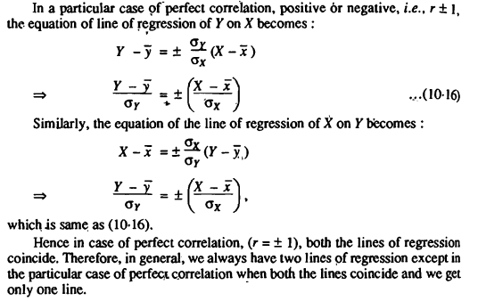

Slide 14
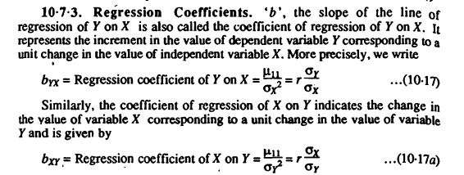
Regression Coefficients

Slide 15
Properties of Regression Coefficients
Correlation coefficient is the geometric mean between the regression coefficients.
If one of the regression coefficients is greater than unity, the other must be less than unity.
Arithmetic mean of the regression coefficients is greater than the correlation coefficient r, provided r > 0.
Regression coefficients are independent of the change of origin but not of scale.

