Slide 1

UNIVERSITY INSTITUTE OF ENGINEERING
COMPUTER SCIENCE ENGINEERING
Bachelor of Engineering (Computer Science & Engineering)
Subject Name: STATISTICAL METHODS USING R
Subject Code: 20SMT-460
Discrete Distribution
Mapped with CO
Prepared By:
Ms. Hardeep Kaur
DISCOVER . LEARN . EMPOWER

Slide 2
Introduction
In the present chapter we will discuss theoretical discrete distributions in which variables are distributed according to some definite probability law which can be expressed mathematically.
The present study will also enable us to fit a mathematical model or a function of the form y = p(x) to the observed data.

Slide 3
Bernoulli Distribution
A random variable X which takes two values 0 and 1 with probabilities q and p respectively.
i.e . P (X = 1) = p,
P(X = 0) = q; q = 1 –p
is called a Bernoulli variate and is said to have a Bernoulli distribution.
Remark: Sometimes the two values are +1, -1 instead of 1 and 0.

Slide 4
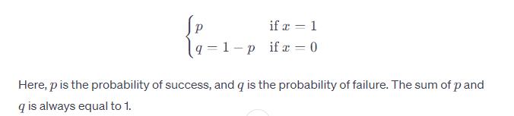
Probability Mass Function (PMF): The probability mass function of a Bernoulli-distributed random variable is defined as follows:

Slide 5
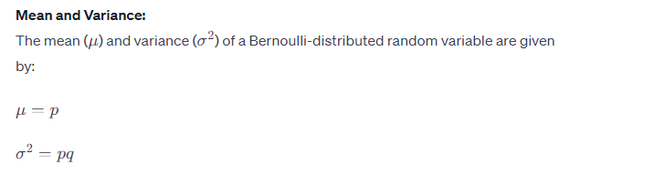

Slide 6
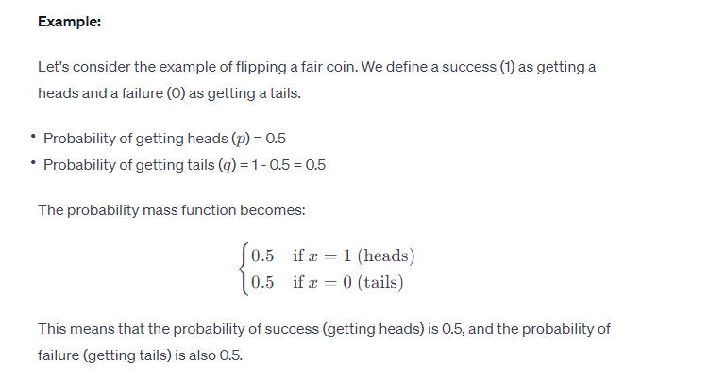

Slide 7
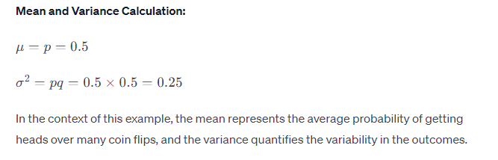

Slide 8
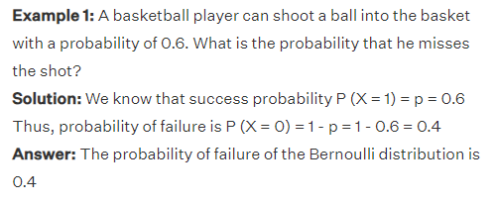

Slide 9
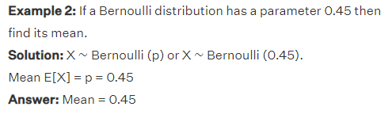

Slide 10
