Slide 1
Redesigning Turkish Airlines Mobile Application
Final report
CAROLINA QUESADA VILCHEZ 40099828 RAMA ALRIFAI 40116096 CHRISTOPHER DI GIACOMO 40133600

Slide 2
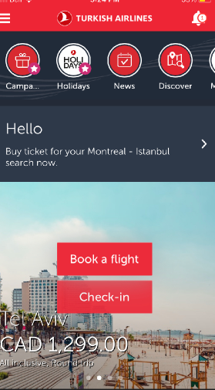
Original
Hidden navigation options
Distracting publicity notification
Buttons to unnecessary information
Crowded top bar and chunky redirection buttons
Chunky redirection buttons with unclear purpose
Potentially discouraging price

Slide 3
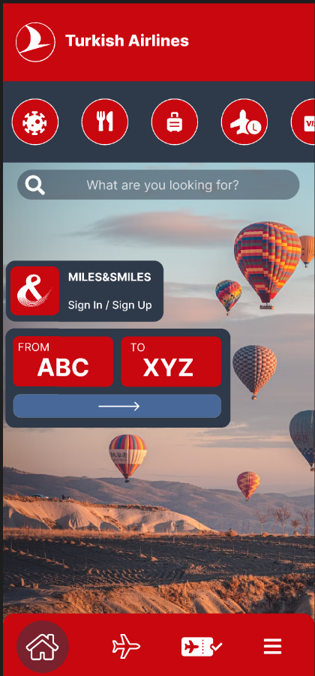
Redesigned
Airy and simple layout
Buttons for frequently updated information
Pertinent redirections
Highlighting Turkish history
Alluring shortcut style destination selectors
Visible navigation

Slide 4
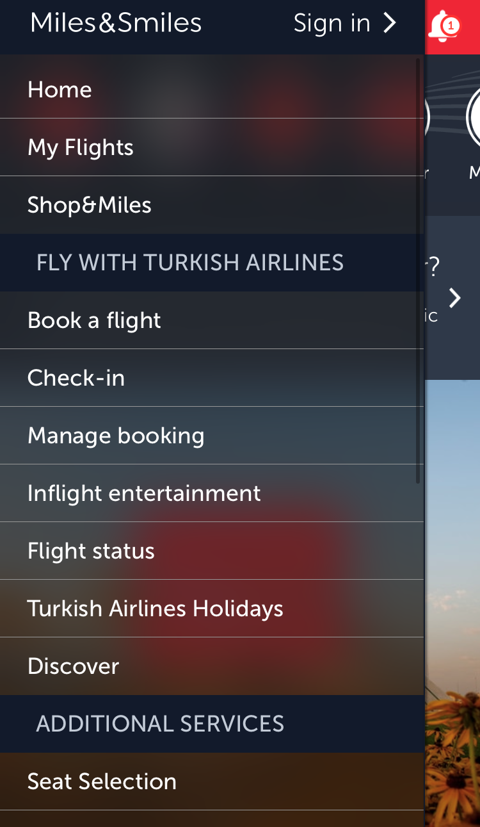
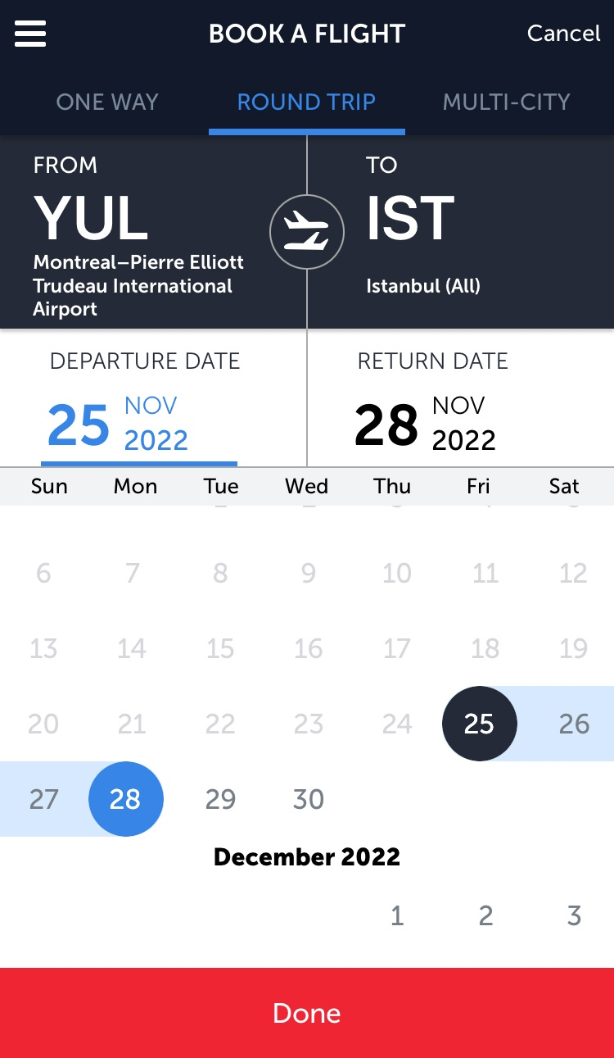
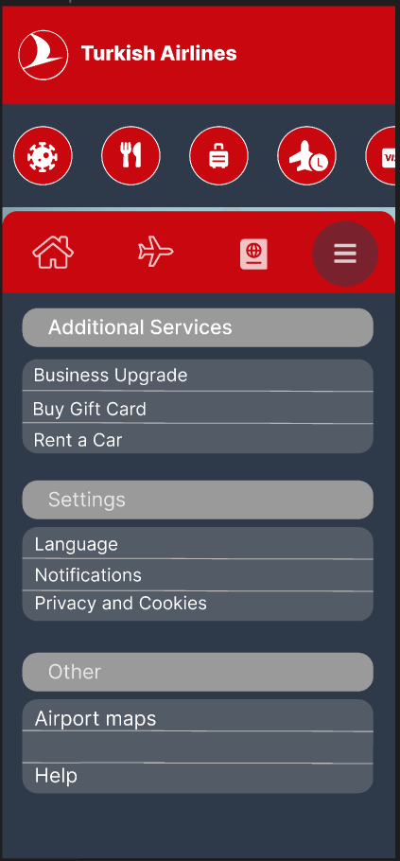
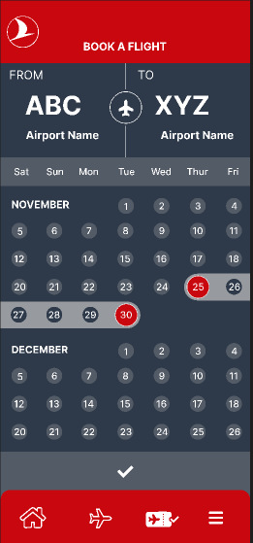
Other pages
Before
After

