Slide 1
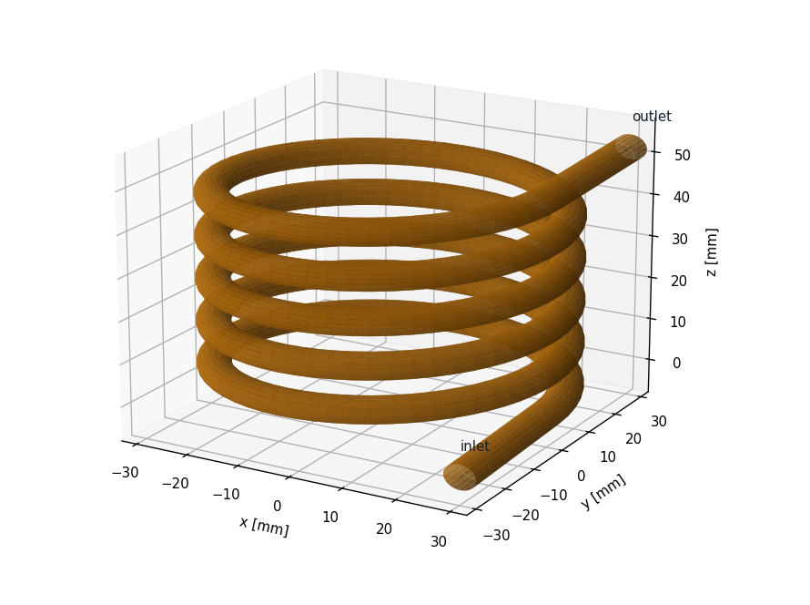
CFD Characterisation of a Helical-Channel Fluid Inerter for Race-Car Suspension
PNEUMATICS AND DYNAMICS · 23ME2002
The J-damper: how much of the ideal inerter's grip benefit survives real fluid behaviour?
PRESENTED BY
Rishi Gerolaga Kumar URK24RA3001
C Y Nicholas URK24RA3012
Karunya Institute of Technology and Sciences
Notes:
Good morning. We are Rishi Gerolaga Kumar (URK24RA3001) and C Y Nicholas (URK24RA3012). Our project for Pneumatics and Dynamics (23ME2002) is a CFD characterisation of a helical-channel fluid inerter, the device McLaren raced in Formula 1 as the 'J-damper'. The question we answer is how much of the ideal inerter's grip benefit survives once real fluid behaviour is included.

Slide 2

What we will cover
1
2
3
4
5
Background
Method
CFD results
Vehicle results
Conclusions
The inerter, the J-damper and why real fluid behaviour matters
Meshing, CFD validation, oscillating-flow CFD and vehicle models
Inertance, parasitic damping, port losses and cavitation
Quarter-car grip and full-car laps of real circuits
Findings, limitations and next steps
Research question: How far does a real fluid inerter depart from the ideal model, and how much of the theoretical grip benefit to a race car survives?
Notes:
The talk has five parts: background, method, CFD results, vehicle results and conclusions. Everything is driven by one research question: how far does a real fluid inerter depart from the ideal model, and how much of the grip benefit survives?

Slide 3
What is an inerter?
F = b · (a₁ − a₂)
Force ∝ relative acceleration of the two ends. b = inertance, in kg (Smith, 2002)
BASELINE INERTER
46 g of oil acts like
Raced by McLaren in Formula 1 (2005–2007) under the codename “J-damper”
A fluid inerter makes inertance hydraulically: a piston forces oil through a long, narrow helical channel
The fast-moving oil column acts as a large effective mass
The ideal model F = b·ẍ ignores friction, swirl and frequency effects in the real oil
91.7 kg
Piston diameter
40 mm
Channel
6 mm × 1.89 m
Coil radius
30 mm
Oil
ISO VG 32
Notes:
An inerter is a two-terminal suspension element whose force is proportional to the relative acceleration between its ends, F = b times (a1 minus a2). b is called the inertance and has units of kilograms. McLaren raced it in F1 from 2005 to 2007 as the J-damper. A fluid inerter pushes oil through a long, narrow helical channel. In our baseline device, only 46 grams of oil behave like 91.7 kilograms, because the oil moves much faster than the piston.

Slide 4
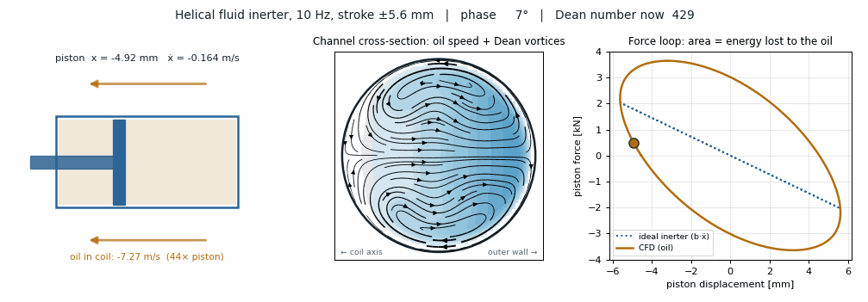



How the fluid inerter works
Piston strokes ±5.6 mm at 10 Hz
Oil in the coil moves about 44× faster than the piston
Area of the force loop = energy lost to the oil (parasitic damping)
Notes:
This is our CFD result animated (it plays in slideshow mode). On the left the piston moves plus/minus 5.6 mm at 10 Hz. In the middle is the channel cross-section: colour is oil speed and the arrows are the Dean vortices. On the right is the force loop: an ideal inerter would be the dotted straight line; the real oil gives an ellipse, and its area is the energy lost every cycle.

Slide 5



Why the ideal model is not enough
Viscous and curvature losses
Unsteady flow
Dean vortices in the curved channel raise the pressure drop above straight-pipe values: parasitic damping
With Womersley number above about 1 the velocity profile changes with frequency, so b and c do too
RESEARCH QUESTION
How far does a real fluid inerter depart from the ideal model, and how much of the theoretical grip benefit to a race car survives once these effects are included?
Entry and exit losses
Cavitation
Sharp ports at the piston chambers and channel junctions waste kinetic energy
Large inertial pressures can drop the chamber pressure below the oil's vapour pressure
Notes:
The ideal formula ignores four real effects. One: viscous and curvature losses; the Dean vortices raise the pressure drop and add parasitic damping. Two: unsteady flow; above a Womersley number of about 1 the velocity profile, and therefore b and c, depend on frequency. Three: entry and exit losses at the ports. Four: cavitation, when the chamber pressure drops below the vapour pressure. So our question is: how far does the real device depart from the ideal, and how much grip benefit survives?

Slide 6





Method: CFD as a virtual test rig
STEP 1
STEP 2
STEP 3
STEP 4
STEP 5
Mesh
Validate
Oscillate
Reduce
Drive
Own structured O-grid hex mesh generator in Python (0.16–0.90 M cells)
Steady full-helix CFD vs the Ito and White correlations, plus a GCI mesh study
Periodic torus sector at 1–20 Hz, 2 and 5 mm stroke (pimpleFoam)
Fit b(ω), c(ω) and a reduced-order force model
Quarter car, then a full car on Monza, Spa and Daytona
Reduced-order model: F = b·ẍ + c₁·ẋ + c₂·ẋ|ẋ|
TOOLS (all free / open source)
OpenFOAM v2406
Python: NumPy, SciPy, Matplotlib
ParaView
MATLAB (equivalent scripts)
Notes:
Our method uses CFD as a virtual test rig, because we have no hardware. Step 1: we wrote our own structured hex mesh generator. Step 2: we validated steady flow in the full helix against published correlations and did a mesh-independence study. Step 3: oscillating flow on a periodic torus sector from 1 to 20 Hz. Step 4: we fitted frequency-dependent inertance and damping and a reduced-order model. Step 5: we put that model into a quarter car and then a full car on real tracks. All tools are free and open source.

Slide 7
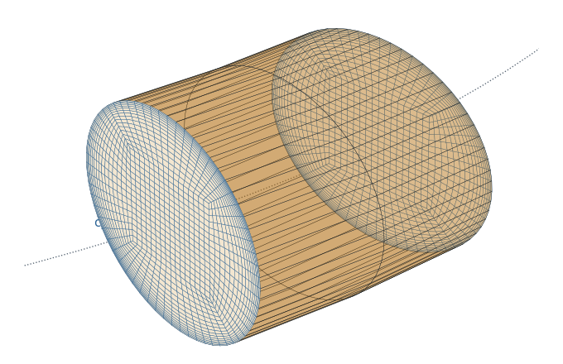
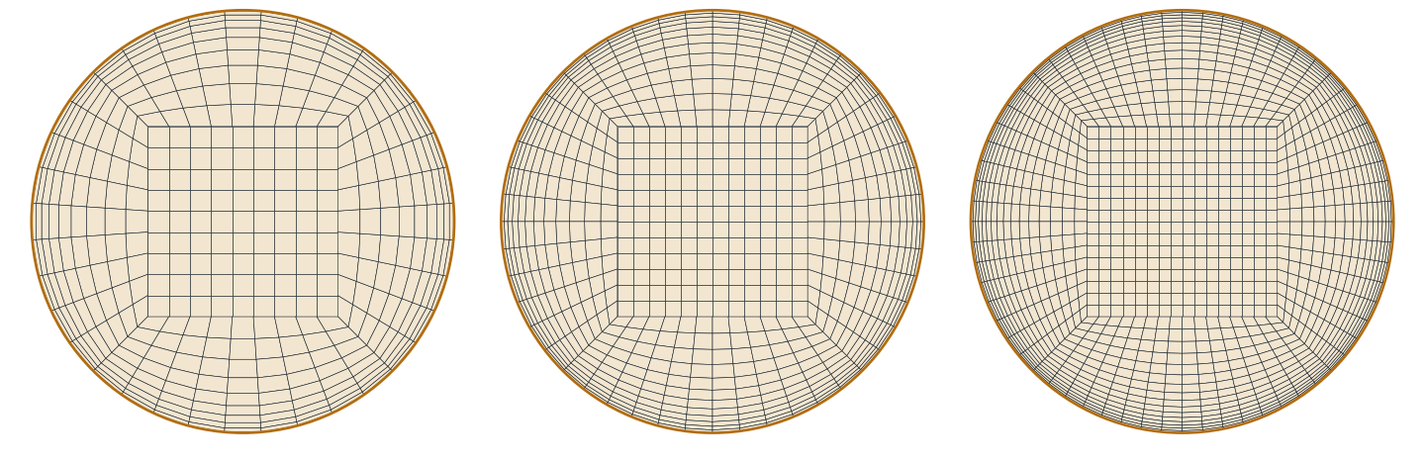
CFD models: full helix and periodic sector
Structured O-grid cross-sections: coarse / medium / fine
Periodic 10° torus sector, 2,560 cells
0.16 / 0.38 / 0.90 M
2,560
≈ 1/100
cells in the full 5-turn helix (d = 6 mm, R = 30 mm, pitch 10 mm)
cells in the periodic sector: cyclic faces make the flow repeat like an endless coil
of the cost: minutes instead of days per oscillating case
Notes:
Two CFD models. The full helix (five turns, 6 mm channel) with three structured meshes from 0.16 to 0.90 million cells, used for steady validation. For the oscillating flow we used a 10-degree torus sector with cyclic faces, only 2,560 cells. Fully developed flow repeats every turn, so this costs about one hundredth of the full helix. We checked that the helix pitch changes friction by less than 0.1 %.

Slide 8
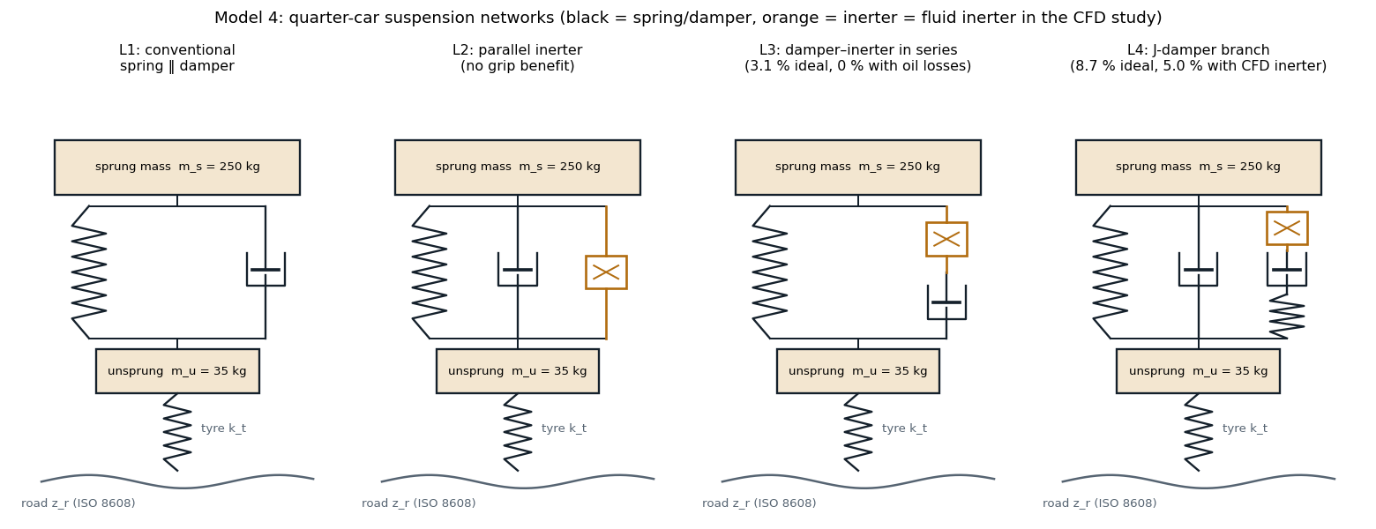



Vehicle model: four suspension layouts
Quarter car: 250 kg sprung, 35 kg unsprung mass
ISO 8608 class A road at 180 km/h
Goal: minimise dynamic tyre load (more grip)
Notes:
For the vehicle we compared four quarter-car layouts: L1 conventional, L2 parallel inerter (which gives no grip benefit), L3 damper and inerter in series, and L4, the J-damper branch, which is the best. Each was optimised to minimise dynamic tyre load on an ISO 8608 class A road at 180 km/h, using an ideal inerter and then each fluid-inerter model.

Slide 9
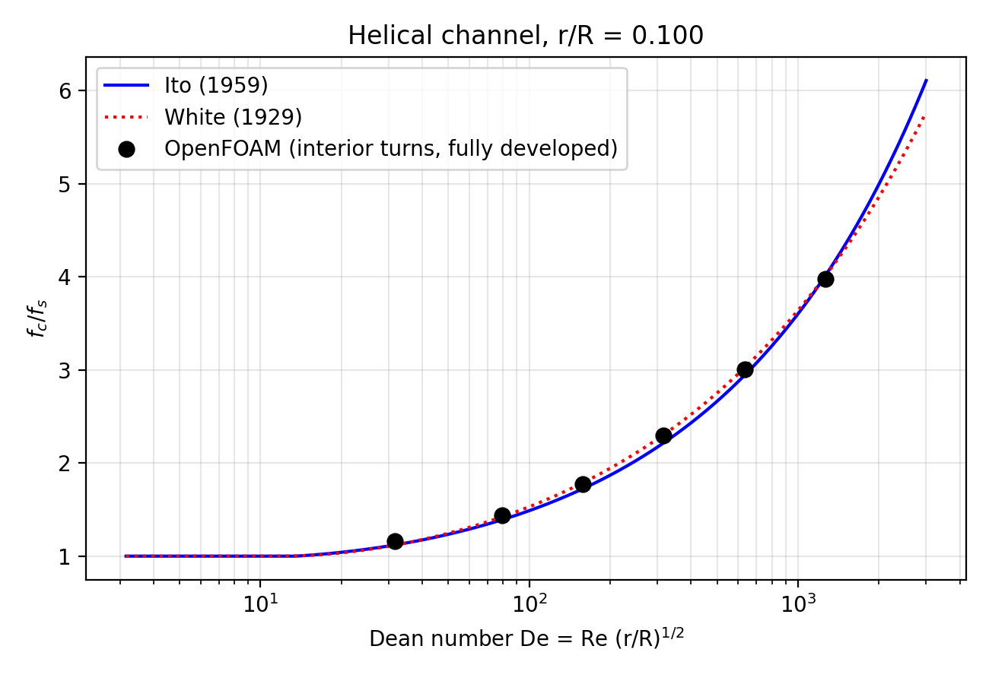
CFD validation: we can trust the numbers
0.3–3.6 %
agreement with the Ito (1959) friction correlation, Re 100–4000 (De 32–1265)
0.1–0.3 %
discretisation uncertainty from a 3-mesh GCI study (up to De ≈ 300)
< 0.1 %
effect of helix pitch: the torus sector reproduces the full helix
Notes:
Validation. The black dots are our OpenFOAM friction factors; the lines are the Ito and White correlations. We agree within 0.3 to 3.6 % from Re 100 to 4000. The grid convergence index study with three meshes gives 0.1 to 0.3 % uncertainty up to Dean number 300. At De about 1265 only the fine mesh converges, so very high Dean numbers need more wall resolution.

Slide 10
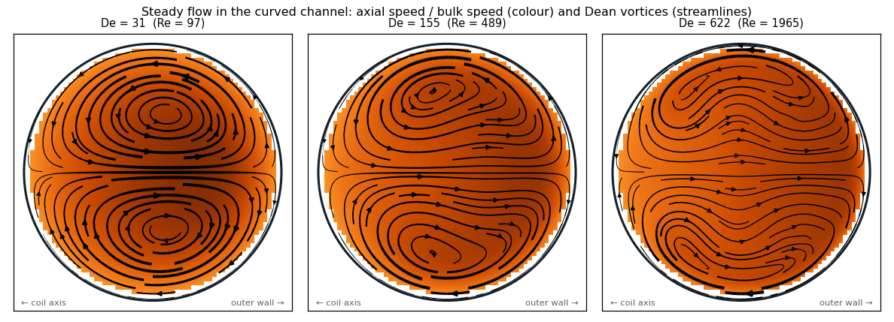


Seeing the flow: Dean vortices
The coil's curvature drives two counter-rotating Dean vortices
The fastest oil is pushed to the outer wall as De rises
Extra friction, but a flatter profile: inertance moves towards ideal
Notes:
Here is the flow inside the channel at three Dean numbers. Colour is axial speed and the streamlines are the secondary flow. Curvature creates two counter-rotating Dean vortices that push the fastest oil to the outer wall. That costs extra friction, but it also flattens the velocity profile, which brings the inertance closer to the ideal formula.

Slide 11
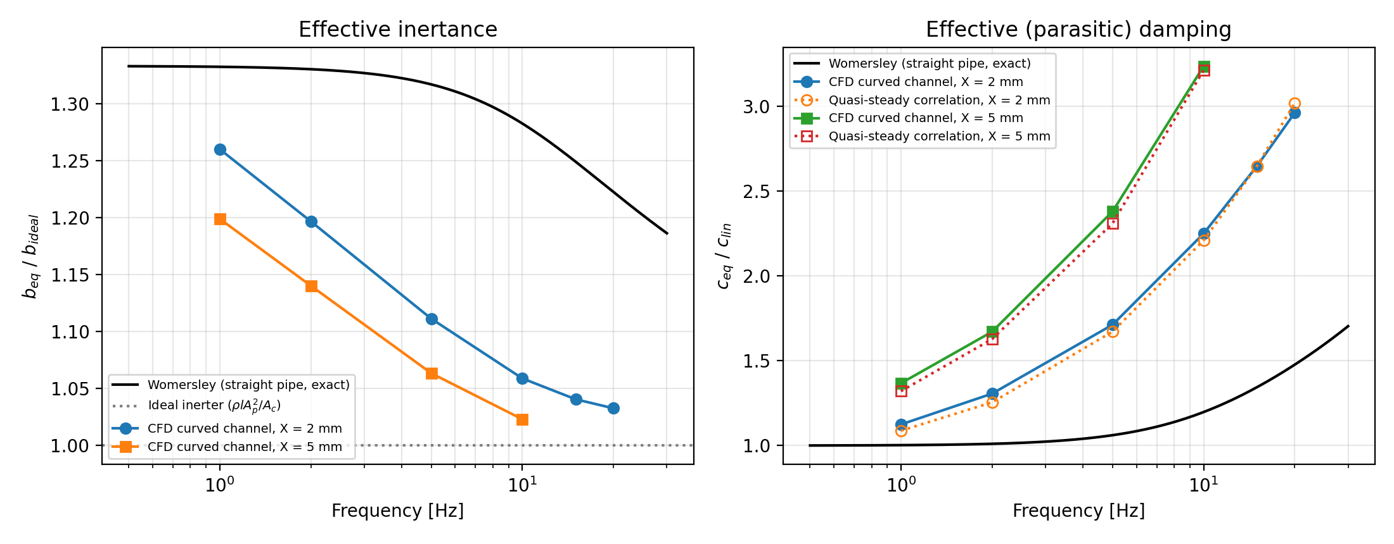
Main CFD result: inertance and parasitic damping
1.02–1.26 × ideal
Effective inertance (straight pipe: 1.22–1.33 ×)
1.1–3.2 × straight pipe
Parasitic damping (quasi-steady correlation: within ≈ 4 %)
Notes:
This is the main CFD result. Left: the effective inertance is 1.02 to 1.26 times the ideal formula. It falls with frequency and Dean number, because the vortices flatten the profile; a straight laminar pipe would give 1.22 to 1.33. Right: the parasitic damping is 1.1 to 3.2 times the straight-pipe value, rising with frequency and stroke. A quasi-steady correlation predicts the damping within about 4 %, but the frequency-dependent inertance is only captured by the CFD.

Slide 12
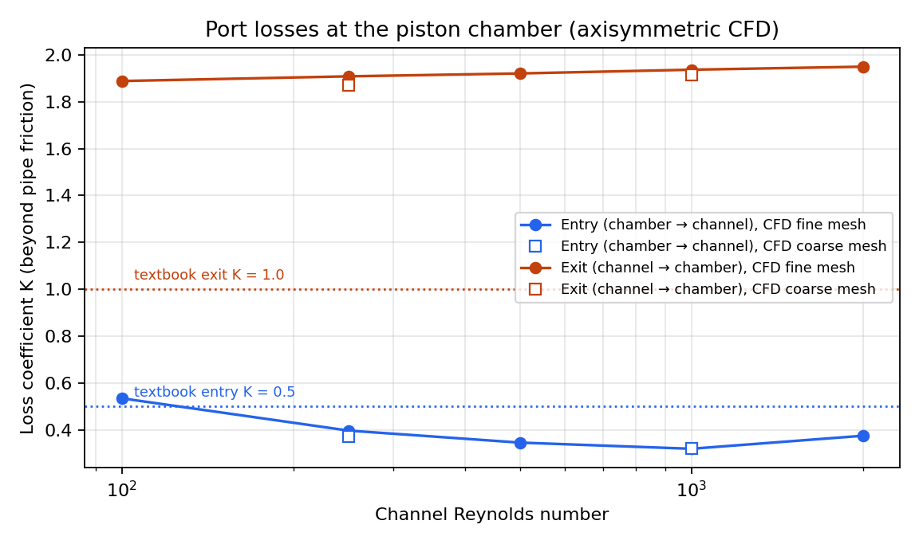

Piston chamber and ports: bigger losses than textbooks
Loss coefficient K | Textbook | 2D port | 3D drilled port
Entry, K_in | 0.5 | 0.32–0.54 | ≈ 2.6
Exit, K_out | 1.0 | 1.89–1.95 | ≈ 3.8
Total (velocity heads) | 1.5 | ≈ 2.3 | ≈ 6.4
Laminar oil leaves the channel with a peaked profile (α ≈ 2): exit loss ≈ 1.9, not 1.0
Each sharp 90° drilled elbow costs about one extra velocity head
Chambers add +7.4 % damping at 10 Hz; quarter-car grip still 5.0 %
Axisymmetric CFD of the chamber and port; two meshes agree within 0–6 %
Design lesson: radius the drilled passages
Notes:
The coil CFD drives only the channel, so we simulated the piston, its chambers and the ports separately. The exit loss is about 1.9, not the textbook 1.0: laminar oil leaves with a peaked profile carrying twice the kinetic energy, and the chamber destroys it all. A 3D model of the drilled port as built, a radial hole with two sharp elbows, gives K_in about 2.6 and K_out about 3.8, a total of 6.4 velocity heads. The oscillating-piston CFD shows the chambers add 7.4 % damping. Quarter-car grip stays at 5.0 %. Lesson: radius the drillings.

Slide 13
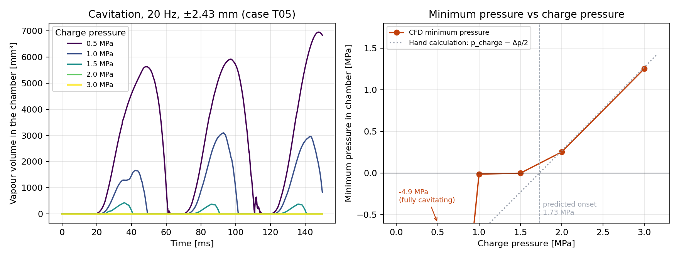
Cavitation: how much pre-charge is needed?
≈ 1.75 MPa
CFD onset; hand calculation Δp/2 gives 1.73 MPa
up to 28 %
of chamber volume is vapour at 0.5–1.5 MPa
≥ 2.0 MPa
pre-charge: no vapour forms at all
Notes:
Cavitation, using two-phase CFD (interPhaseChangeFoam with the Schnerr–Sauer model) at 20 Hz and plus/minus 2.4 mm. At 0.5, 1.0 and 1.5 MPa pre-charge vapour forms, up to 28 % of the chamber volume, in the ring vortex next to the port and at the piston corner. At 2.0 and 3.0 MPa there is none. The CFD onset of about 1.75 MPa matches our hand calculation of 1.73 MPa.

Slide 14
Quarter-car grip: real oil costs about 40 % of the benefit
8.7 % → 5.0 %
Grip benefit: ideal inerter vs the CFD-measured fluid inerter
≈ 40 %
of the ideal grip benefit is removed by real fluid behaviour
Notes:
Quarter-car results with the J-damper layout. An ideal inerter reduces the dynamic tyre load by 8.7 %. With our CFD inerter at 2 mm stroke it is 5.0 %, and 4.5 % at 5 mm. Including the piston chambers and ports it stays at 5.0 %. So real fluid behaviour removes about 40 to 50 % of the ideal benefit.

Slide 15
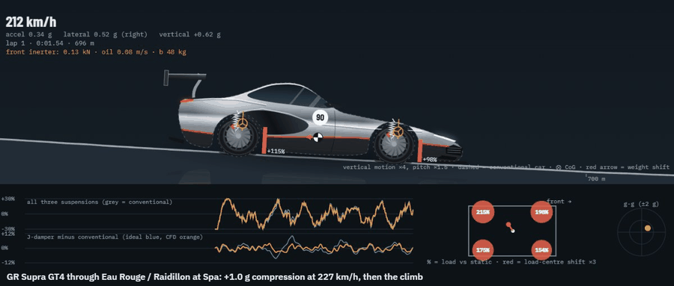

Full car on real circuits
VEHICLES
Toyota GR Supra (road car)
GR Supra GT4 (race car)
Ford F-150 (pickup)
TRACKS
Monza and Spa (TUM racetrack database)
Daytona (banking, built from official dimensions)
Straight rough test road
Weight transfer, pitch, roll, kerbs and bump stops are modelled
GR Supra GT4 through Eau Rouge / Raidillon at Spa: +1.0 g compression at 227 km/h
1:54.6
2:34.9
GT4 at Monza (real pace ≈ 1:57)
GT4 at Spa (real pace ≈ 2:30)
Notes:
Then we built a full-car track simulator: Toyota GR Supra road car and GT4 race car, and a Ford F-150, on Monza, Spa, Daytona and a straight rough test road. It models weight transfer, pitch, roll, kerbs and bump stops. The animation is the GT4 through Eau Rouge at Spa. Simulated GT4 lap times are 1:54.6 at Monza and 2:34.9 at Spa, close to real GT4 pace.

Slide 16
Grip effect on each track
Steadier tyre load vs conventional suspension (%, positive = more grip); J-damper replaces the main damper
Ideal J-damper
CFD J-damper (real fluid inerter)
Soft road car and pickup: the real inerter's fluid damping helps (+4 to +7 % on circuits). Stiff GT4: fluid losses cancel most of the gain (0 to +2 %).
Notes:
Full-lap results with the J-damper replacing the main damper. On the soft Supra road car and the F-150 the CFD J-damper is 4 to 7 % better than conventional on circuits, often better than the ideal inerter, because its built-in fluid damping helps body control. On the stiff GT4 race car the fluid losses cancel most of the benefit: 0 to 2 %, where an ideal inerter would give 5 to 6 %.

Slide 17

The trade-off: bump grip vs body control
Conventional
Ideal J-damper
CFD J-damper
Spring + damper per wheel
Perfect inerter, F = b·ẍ
Real fluid inerter, as measured
BUMPS (> 3 HZ)
BUMPS (> 3 HZ)
BUMPS (> 3 HZ)
Baseline
Better, up to +7 %
Better on soft cars (up to +9 %)
BODY MOTION (< 3 HZ)
BODY MOTION (< 3 HZ)
BODY MOTION (< 3 HZ)
Best controlled
Worse without the main damper (down to −7 %)
Fluid damping keeps control (+1 to +3 %)
BEST FOR
BEST FOR
BEST FOR
Body control, simplicity
Stiff race car (GT4)
Road car and pickup
Design implication: parasitic damping per kg of inertance, c_par / b = 32ν / d² · (f_c / f_s), depends only on channel diameter. Race cars: widen the channel. Road cars: let the fluid damping replace part of the main damper.
Notes:
Why the results differ. The inerter helps with bumps and wheel hop above about 3 Hz. But if you remove the main damper, an ideal inerter gives almost no damping at body frequencies, so the body wallows after braking and cornering. The real inerter's fluid friction damps that motion, which is why it beats the ideal one on soft cars. Kerb strikes and wheel lifts are unaffected by all three. Design implication: parasitic damping per kg of inertance depends only on the channel diameter, so packaging versus fluid losses is the core trade-off.

Slide 18
Conclusions
1
CFD is validated
within 0.3–3.6 % of established correlations; mesh uncertainty 0.1–0.3 %
2
A real fluid inerter is not ideal
inertance 1.02–1.26 × ideal, plus 1.1–3.2 × the parasitic damping of a straight pipe
3
On a single wheel
real-fluid effects cost about 40 % of the ideal grip benefit (8.7 % → 5.0 %)
4
Ports and cavitation
drilled ports lose ≈ 6.4 velocity heads; at least ≈ 1.75 MPa pre-charge avoids cavitation
5
On real cars and tracks
a trade-off between bump grip and body control: +4–7 % for soft cars, 0–2 % for the stiff race car
Notes:
To conclude. One: our CFD is validated against correlations and a mesh study. Two: a real fluid inerter's inertance is close to ideal, but it adds significant parasitic damping. Three: on a single wheel that costs about 40 % of the grip benefit. Four: the drilled ports lose about 6.4 velocity heads and the device needs at least 1.75 MPa pre-charge. Five: on real cars it is a trade-off between bump grip and body control; the real inerter helps soft cars, while for a stiff race car the fluid losses must be minimised.

Slide 19


Limitations and next steps
Limitations
Next steps
Laminar, isothermal oil (viscosity changes with temperature)
Chamber and cavitation CFD are axisymmetric; the 3D port CFD is steady
Track simulator: tyres carry vertical load only; CoG, anti-roll bars and aero are estimates
Spring rates from owner forums; F-150 rear axle modelled as independent
Compare with published fluid-inerter experiments (Swift et al. 2013; Liu et al. 2018)
CFD of radiused port passages
Finer study of the high-Dean regime (De > 1000)
Tyre force model, lap-time study and a build-and-test rig
Notes:
Limitations: laminar isothermal oil; the chamber and cavitation CFD are axisymmetric and the 3D port CFD is steady; the track simulator uses vertical tyre load only, and some vehicle parameters are estimates. Next steps: compare with published fluid-inerter experiments, simulate radiused ports, refine the high-Dean regime, and add a tyre model and a physical test rig.

Slide 20
References
Smith, M.C. (2002). Synthesis of mechanical networks: the inerter. IEEE Trans. Automatic Control, 47(10), 1648–1662.
Smith, M.C. & Wang, F.-C. (2004). Performance benefits in passive vehicle suspensions employing inerters. Vehicle System Dynamics, 42(4), 235–257.
Swift, S.J. et al. (2013). Design and modelling of a fluid inerter. Int. J. Control, 86(11), 2035–2051.
Liu, X., Jiang, J.Z., Titurus, B. & Harrison, A. (2018). Model identification methodology for fluid-based inerters. Mech. Systems and Signal Processing, 106, 479–494.
Dean, W.R. (1927/1928). The stream-line motion of fluid in a curved pipe. Phil. Mag.
White, C.M. (1929). Streamline flow through curved pipes. Proc. R. Soc. Lond. A, 123, 645–663.
Ito, H. (1959). Friction factors for turbulent flow in curved pipes. J. Basic Engineering, 81, 123–134.
Womersley, J.R. (1955). Method for the calculation of velocity, rate of flow and viscous drag in arteries when the pressure gradient is known. J. Physiology, 127, 553–563.
Celik, I.B. et al. (2008). Procedure for estimation and reporting of uncertainty due to discretization in CFD applications. J. Fluids Eng., 130(7), 078001.
Schnerr, G.H. & Sauer, J. (2001). Physical and numerical modeling of unsteady cavitation dynamics. ICMF 2001.
ISO 8608:2016. Mechanical vibration — Road surface profiles — Reporting of measured data.
Notes:
These are the main references for the inerter theory, curved-pipe flow, oscillating pipe flow, the mesh-uncertainty method and the cavitation model.

Slide 21


Thank you
Questions and discussion
Rishi Gerolaga Kumar
URK24RA3001
C Y Nicholas
URK24RA3012
Karunya Institute of Technology and Sciences
Pneumatics and Dynamics (23ME2002)
Notes:
Thank you. We are happy to take questions. Likely ones: why a torus sector (fully developed flow repeats every turn; < 0.1 % difference), how we know the CFD is right (correlations, GCI, Womersley limit), and why the exit loss is 1.9 not 1.0 (laminar profile carries twice the kinetic energy).

