Slide 1

Exploratory Data Analysis
G2M insight for Cab Investment firm
21/01/2023

Slide 2
Agenda
Case Study
Understanding datasets
EDA and Summary
Recommendations

Slide 3
Case Study

Slide 4
Case Study: G2M-insight-for-Cab-Investment-firm
As a private equity firm based in the United States, XYZ is considering investing in the rapidly growing taxi industry, given the presence of numerous key players in the market.
Responsibility: In order to assist XYZ firm in selecting the appropriate company to invest in, I must furnish them with actionable insights.
The analysis has been divided into three parts:
Understanding and Pre-processing Datasets
Exploratory Data Analysis
Recommendations for investment

Slide 5
Understanding and Pre-processing datasets

Slide 6
Understanding and Pre-processing Datasets
General Information:
The data of all four datasets are from 31/01/2016 to 31/12/2018
None of the datasets contain null values
Cab_Data.csv:
Observations: 359392, Features: 7
Changed the format of the Date to make the data more readable e.g from 43465 to 2018-12-30
Added new columns like month, year, profit into the dataset to understand and explore it better
Created two subsets: yellow_cab, pink_cab to put out significant amount of important information

Slide 7
Understanding and Pre-processing Datasets
Dataset: City.csv
Observations 20, Features 3
Added a new column percent_users that shows the percentage of users in each city
Dataset: Customer_ID.csv
Observations 49171, Features 4
Dataset: Transaction_ID.csv
Observations 440098, Features 3

Slide 8
Exploratory Data Analysis
and Summary

Slide 9
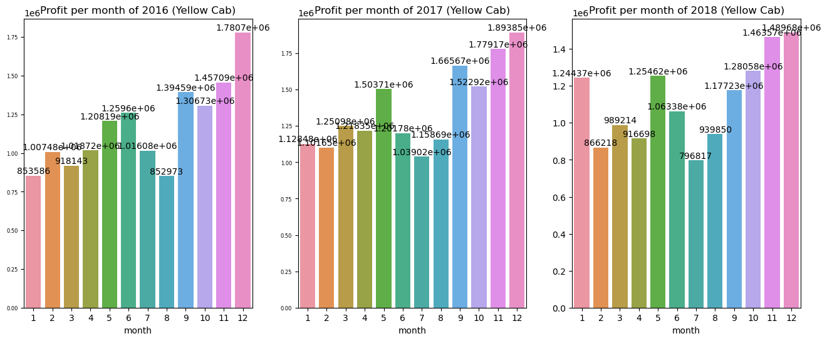
Exploratory Data Analysis
Profit per Month (2016-2018) by Yellow Cab

Slide 10
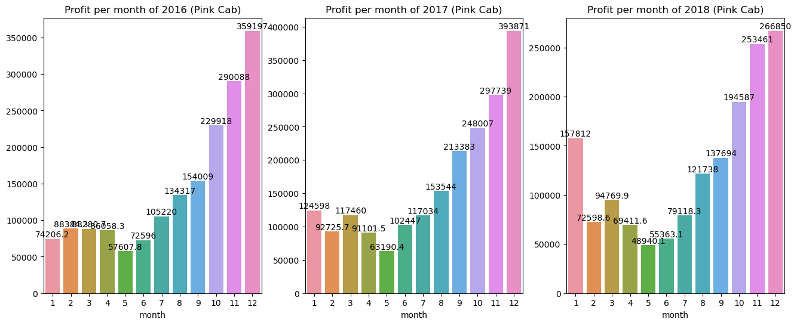
Exploratory Data Analysis
Profit per Month (2016-2018) by Pink Cab

Slide 11
Exploratory Data Analysis
Compare Yellow cab and Pink cab in terms of Profit per Month
Both yellow cab and pink cab made their highest profit in the last quarter of each year from 2016 to 2018
Both cabs made the highest profit in December and November being the second highest in terms of profit in each year.
However, yellow cab made extremely higher profit than the profit of pink cab.
if we consider December 2016 as an example,
The profit of yellow cab is 1.7807e+06 where pink cab made 359197
This means that the Yellow cab made approximately 397% more profit than the Pink cab in December 2016.

Slide 12
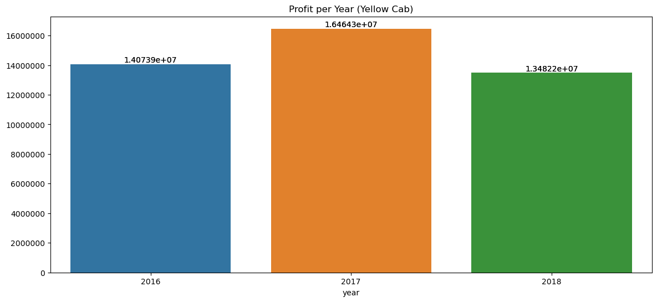
Exploratory Data Analysis
Profit per Year by Yellow Cab

Slide 13
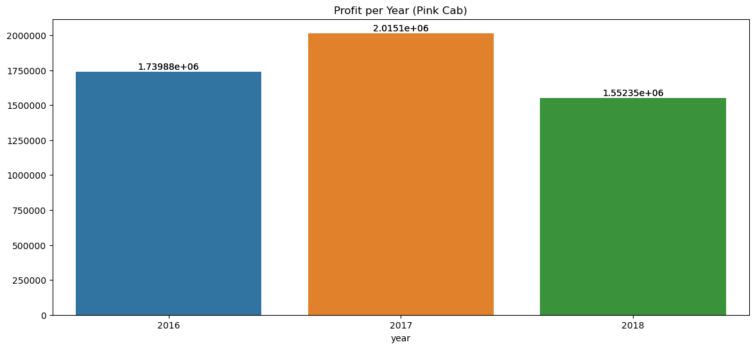
Exploratory Data Analysis
Profit per Year by Pink Cab

Slide 14
Exploratory Data Analysis
Compare Yellow cab and Pink cab in terms of Profit per Year
In terms of profit, 2017 was the highest earning year for both cabs, followed by 2016 as the second highest and 2018 as the third among the three years considered.
However, the graph shows that yellow cab made extremely higher profit than the profit of pink cab.
if we consider 2017 as an example,
Yellow cab made the profit of about 1.64643e+07, and the profit of pink cab is 2.0151e+06
This results in a difference of approximately 14.44887e+06.
Yellow cab made a significantly higher profit than the pink cab in 2017
Similarly, in other years the profit of yellow cab is significantly higher than pink cab

Slide 15
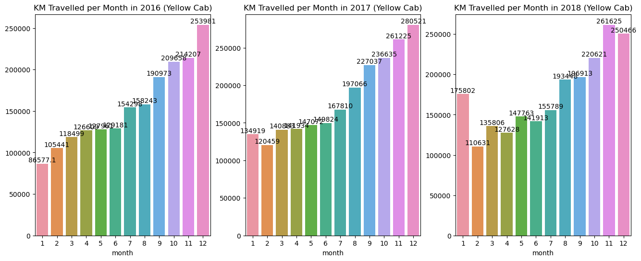
Exploratory Data Analysis
KM Travelled per Month (2016, 201, 2018) by Yellow Cab

Slide 16
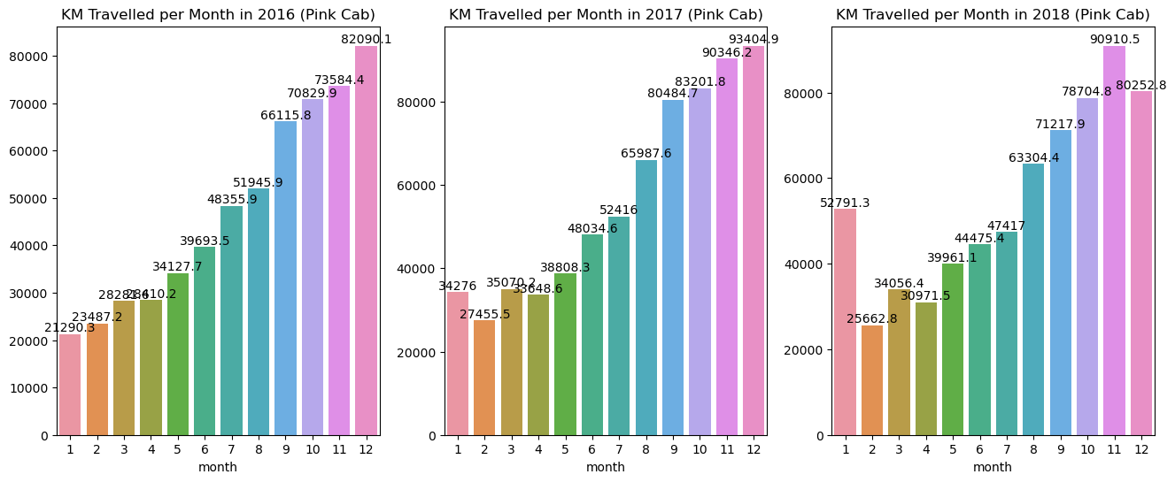
Exploratory Data Analysis
KM Travelled per Month (2016, 201, 2018) by Pink Cab

Slide 17
Exploratory Data Analysis
Compare Yellow cab and Pink cab in terms of KM Travelled per Month
Both cabs travelled the most in the last quarter of each year
In every year except 2018, the highest distance traveled by both cabs occurred during the month of December. In 2018, the highest distance traveled by both cabs occurred in November.
However, the graphs show that yellow cab travelled significantly higher than the pink cab.
if we consider November 2018 as an example,
The yellow cab travelled 261625 km where pink cab covered 90910.5 km
The yellow cab traveled approximately 2.88 times more distance than the pink cab

Slide 18
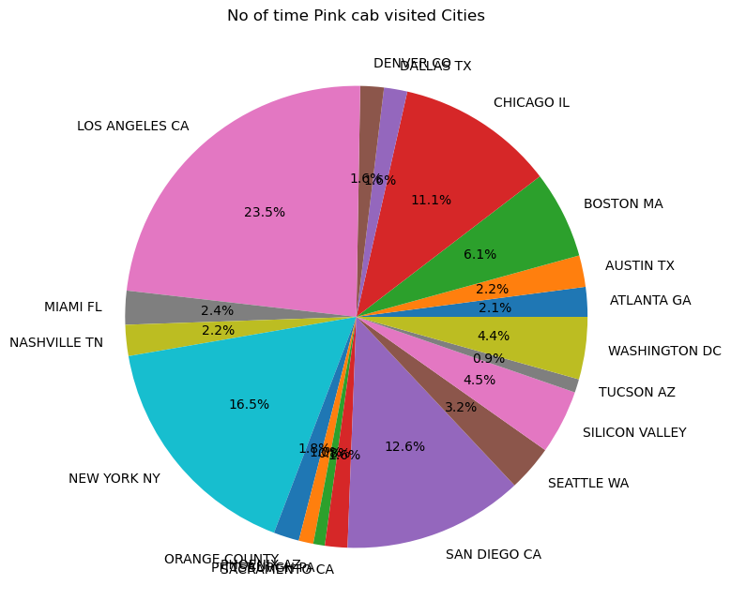
Exploratory Data Analysis
Cities visited by Pink Cab

Slide 19
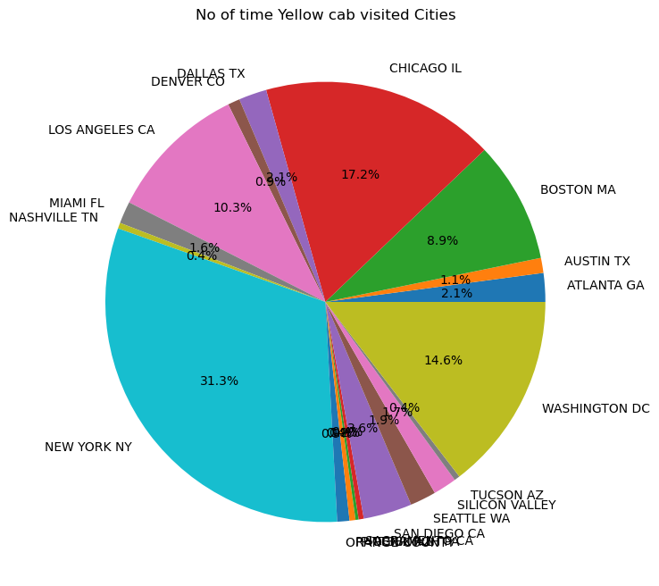
Exploratory Data Analysis
Cities visited by Yellow Cab

Slide 20
Exploratory Data Analysis
Compare Yellow cab and Pink cab in terms of visiting Cities
When analyzing the data of the three years from 2016 to 2018, it can be observed that the most frequently visited city by the Pink Cab is Los Angeles, accounting for approximately 23.5% of total visits. However, when comparing this data to that of the Yellow Cab, it is clear that the number of visits to Los Angeles by the Pink Cab is significantly lower than the number of visits to New York by the Yellow Cab (31.5%).
The second most visited city for the Pink Cab is San Diego, at 12.6%, while for the Yellow Cab it is Chicago (17.2%).
These figures also indicate that the Pink Cab is less popular than the Yellow Cab.

Slide 21
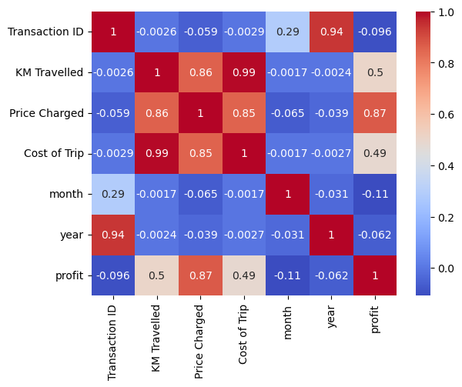
Exploratory Data Analysis
Heatmap to see the correlations between the features of Yellow Cab

Slide 22
Exploratory Data Analysis
Analyze the correlations of Yellow cab
KM Travelled, Price Charged, Cost of Trip, and profit are positively and strongly correlated.
It seems reasonable since the more you will travel, the more you could charge money and make more profit.
We can conclude that the more users, the more KM travelled, the more Price Charged and therefore, the more profit.

Slide 23
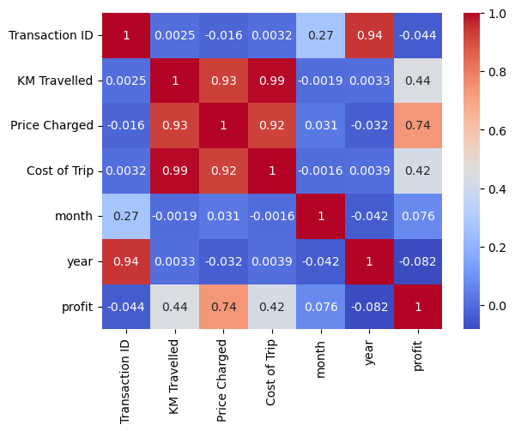
Exploratory Data Analysis
Heatmap to see the correlations between the features of Pink Cab

Slide 24
Exploratory Data Analysis
Analyze the correlations of Pink cab
KM Travelled, Price Charged, Cost of Trip, and profit are positively and strongly correlated.
It seems reasonable since the more you will travel, the more you could charge money and make more profit.

Slide 25
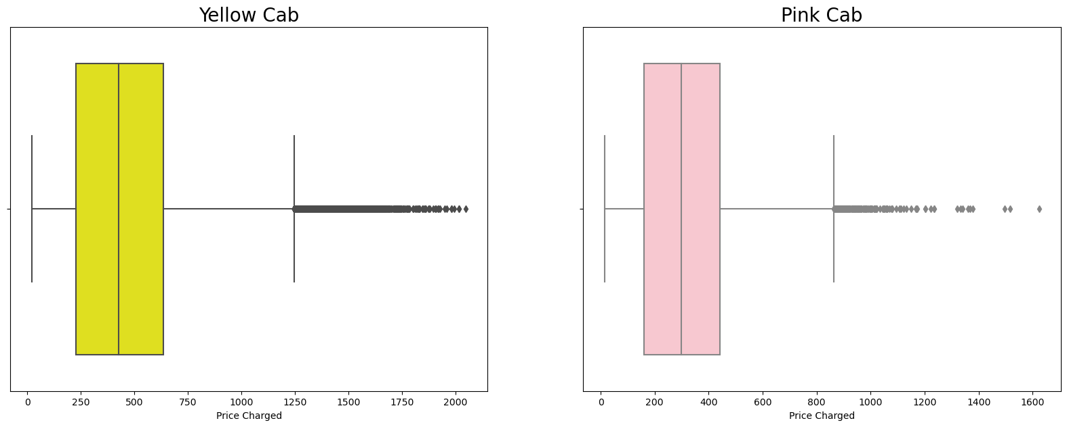
Exploratory Data Analysis
Identifying Outliers using Box-plots with respect to Price Charged

Slide 26
Exploratory Data Analysis
Analyze the outliers of both Yellow and Pink cab
Despite the presence of outliers in both box plots, I chose to retain them as they provide a more comprehensive view of the company that charges higher prices.
The comparison of these box plots illustrates that, on average, the yellow cab charges more than the pink cab.

Slide 27
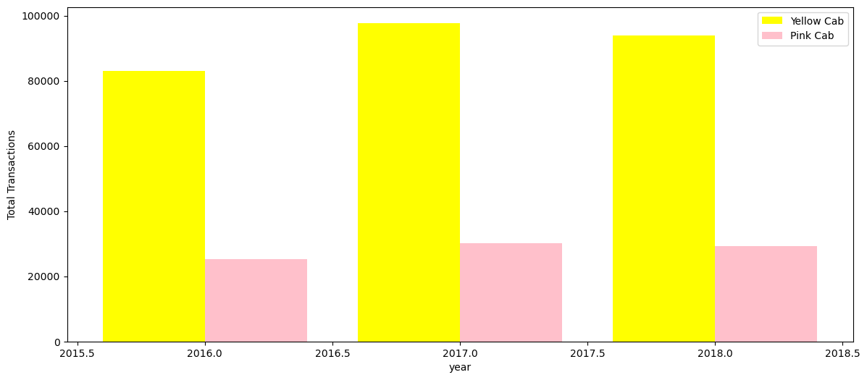
Exploratory Data Analysis
Analyzing Yellow cab and Pink cab with respect to Total Transaction

Slide 28
Exploratory Data Analysis
Observation of the yellow and pink cab in terms of transaction
Based on the data presented in the plot, it can be inferred that the total number of transactions for the yellow cab is approximately three times greater than that of the pink cab for each year.
This evidence suggests that the yellow cab is performing well in the market.

Slide 29
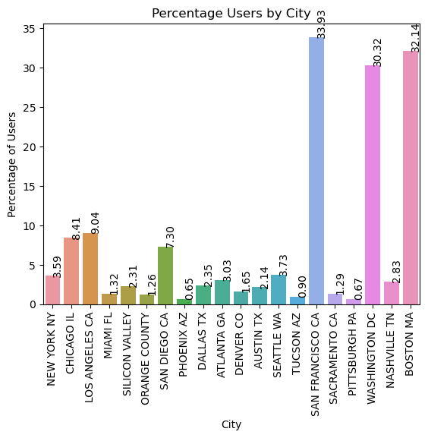
Exploratory Data Analysis
Percentage of users per City

Slide 30
Exploratory Data Analysis
Users per City
From the graph, it can be observed that the cities of San Francisco, Washington, and Boston have the highest percentages of total users, with 33.93%, 32.14%, and 30.32% respectively.
These values represent the relative proportion of users that belong to each city among the total population of users in the sample.

Slide 31
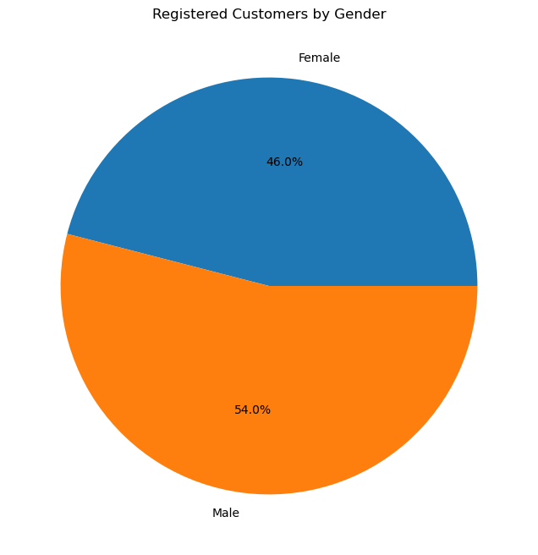
Exploratory Data Analysis
Users by Gender

Slide 32
Exploratory Data Analysis
Users by Gender
Based on the sample data, it can be observed that the proportion of male users among the total population is 54%, while the proportion of female users is 46%.
This indicates that there is a higher representation of male users among the sample population, as compared to female users.
The proportion of male users is greater than female users by 8%.

Slide 33
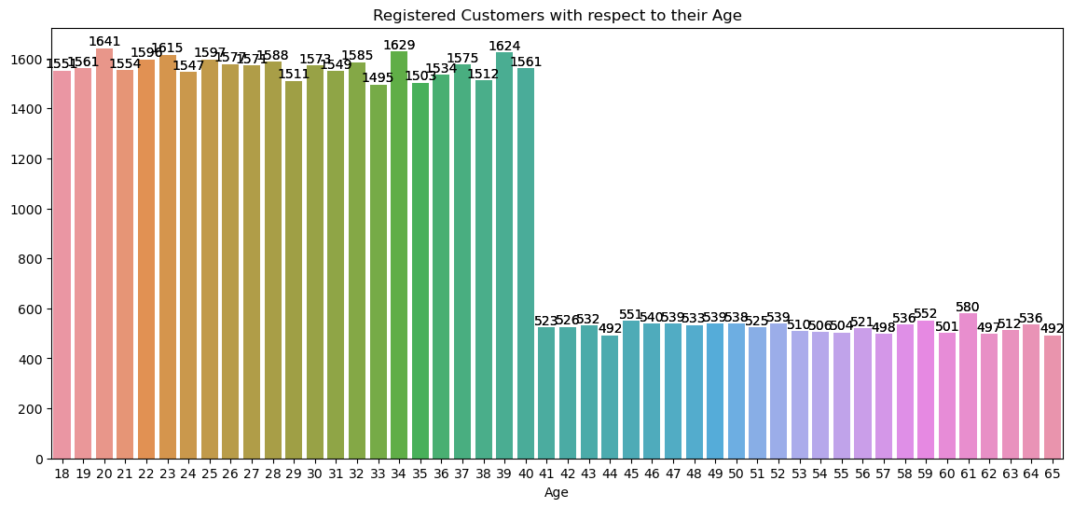
Exploratory Data Analysis
Users by Age

Slide 34
Exploratory Data Analysis
Users by Gender
Based on the sample data, it can be observed that the service of these cab companies has a higher level of popularity among individuals within the age range of 18-40, as compared to those within the age range of 41-65.
The proportion of registered customers within the age range of 18-40 is approximately three times higher than that of the older group.
This suggests that the service is more utilized by younger individuals.

Slide 35
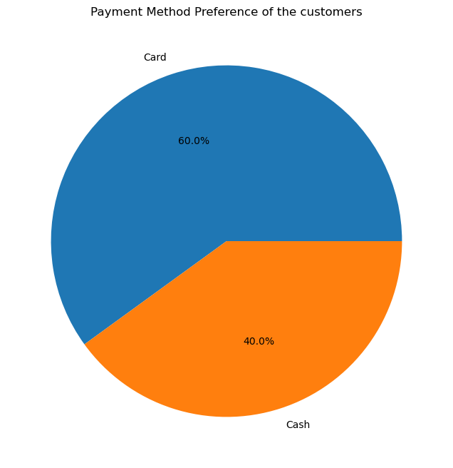
Exploratory Data Analysis
Users by Payment method preferences

Slide 36
Exploratory Data Analysis
Users by Payment method preferences
Based on the sample data, it can be observed that the majority of customers (60%) prefer to pay with card, as opposed to cash (40%).
This indicates a trend towards increased usage of card payments and decreased usage of cash payments among customers.
This data highlights the growing popularity of card payments among users.

Slide 37
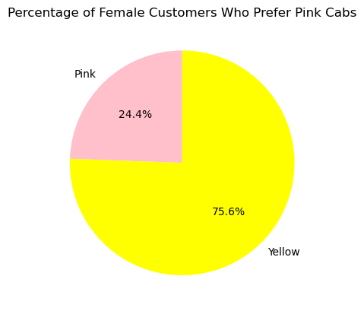
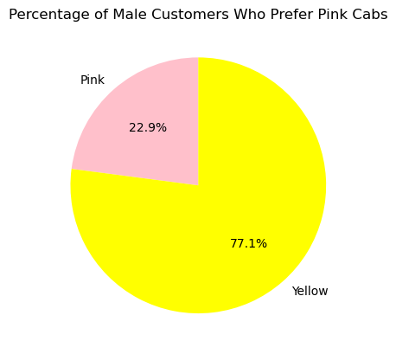
Exploratory Data Analysis
Cab preference by Gender

Slide 38
Exploratory Data Analysis
Cab preference by Gender
According to the data, it can be observed that the majority of female users (77.1%) prefer yellow cabs, while a minority (24.4%) prefer pink cabs.
This contradicts the prior assumption that females would prefer pink cabs over yellow ones.
It is important to note that this data is based on a sample of female users, and may not be representative of the entire population of female users.
On the other hand, the proportion of males taking service from the yellow cab (75.6%) is statistically significantly higher than the proportion of males taking service from the pink cab (24.4%).

Slide 39
Recommendation

Slide 40
Recommendation
Recommendation:
The mean number of customers for the yellow cabs during the last quarter of each year is statistically significantly higher than the mean number of customers for the pink cabs.
A strong positive correlation was found between KM Travelled, Price Charged, Cost of Trip, and profit, suggesting that an increase in customers would result in an increase in profit for the cab company.
The yellow cab had a higher proportion of city visits compared to the pink cab. The yellow cab had a higher proportion of users in both the Young (18-40) and Old (40-65) age groups compared to the pink cab.
The mean kilometers travelled by the yellow cab was approximately 2.88 times more than the mean kilometers travelled by the pink cab.
Both male and female users had a higher preference for the yellow cab over the pink cab.
Based on data analysis, it is concluded that the yellow cab has higher performance metrics than pink cab. Therefore, investing in the yellow cab would likely yield a higher return on investment.

Slide 41
Thank You

