Slide 1

SWE312 User Interface Design Phase 4
Team 2
Ali Al-Muslim: 201755830
Khalifa Alhomely: 201694520
Omar Pervez Khan: 201746350
Munther Alsayed: 201740410
Abdulrahman Abdulltif: 201744290

Slide 2
Phase 1

Slide 3
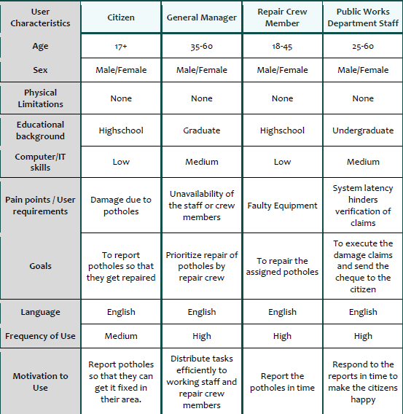
User Analysis

Slide 4
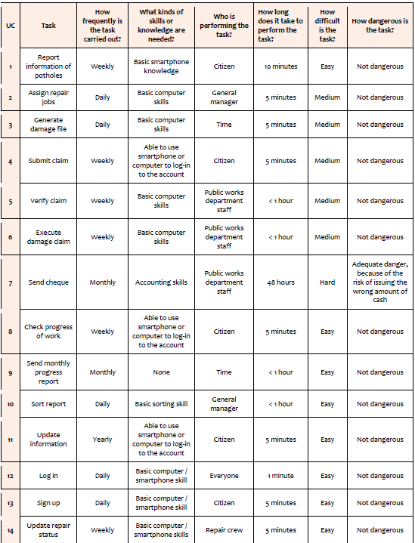
Task Analysis

Slide 5
Use case model

Slide 6
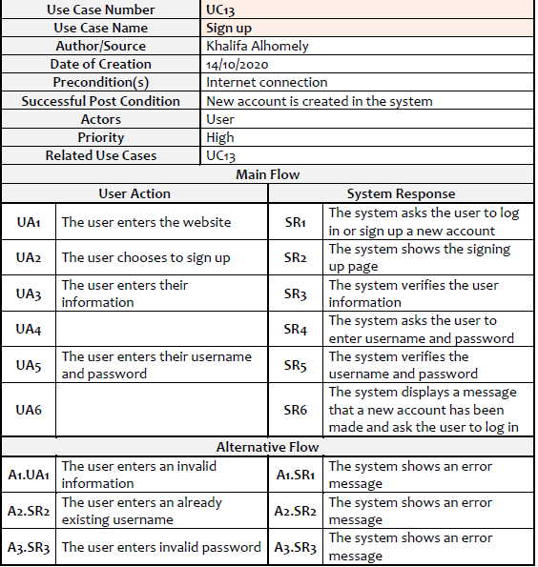
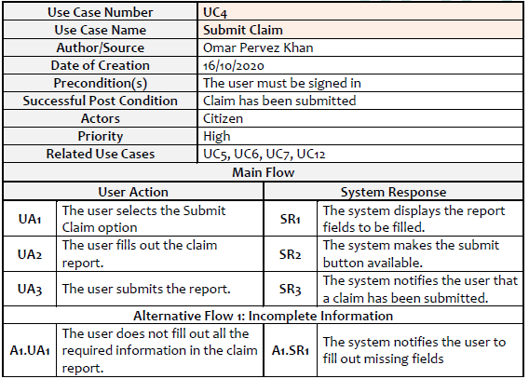
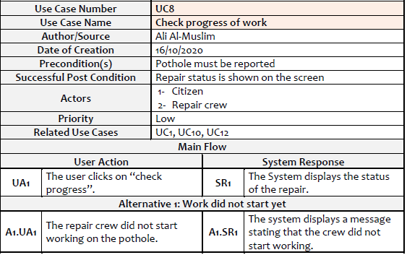
Use Case Descriptions

Slide 7
Phase 2

Slide 8
Low Fidelity Prototypes

Slide 9
Phase 3

Slide 10
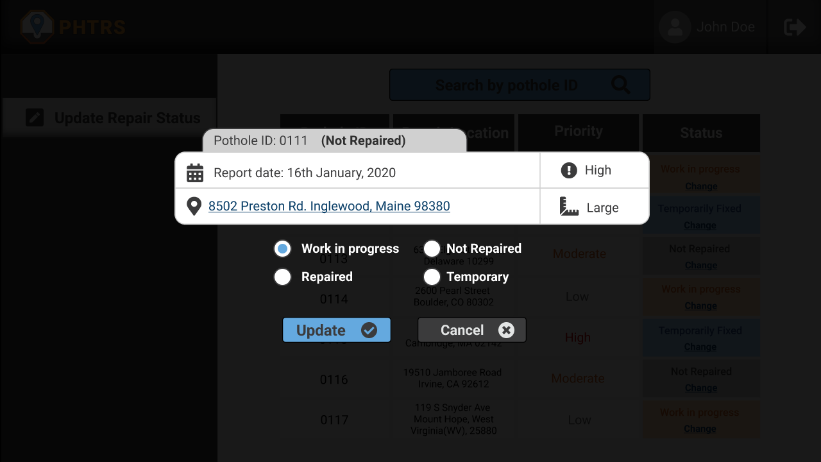
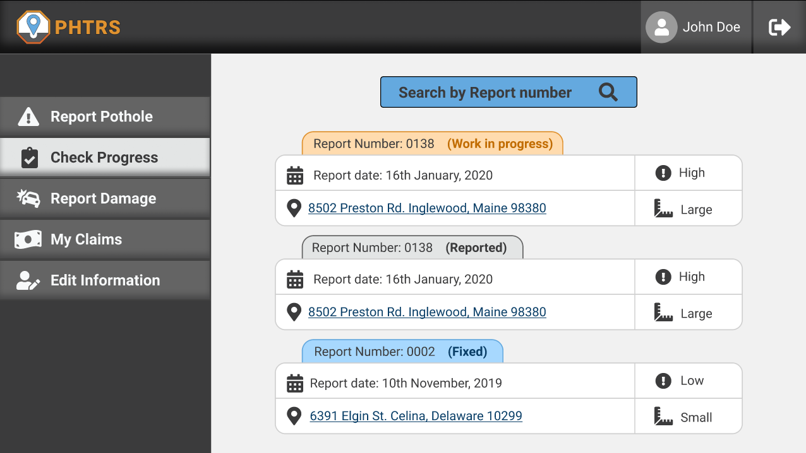
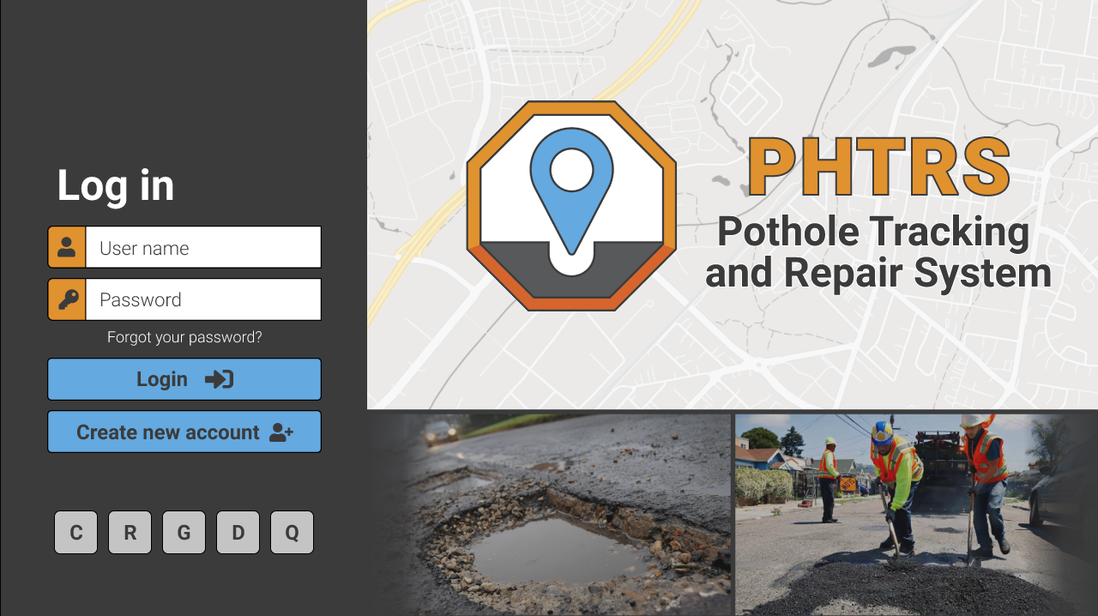
High Fidelity Prototypes

Slide 11
Evaluation criteria
In our project of building a Web Based pothole tracking and repair system (PHTRS), we have come up with 6 criteria to evaluate our system:
1) Page Layout
2) Readability
3) Graphics
4) Color
5) Input
6) Subjective Satisfaction

Slide 12
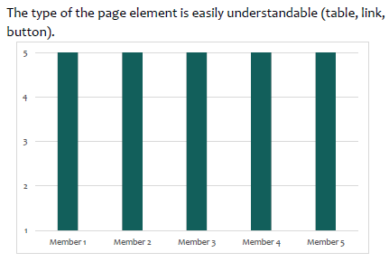
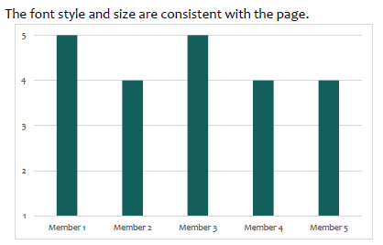
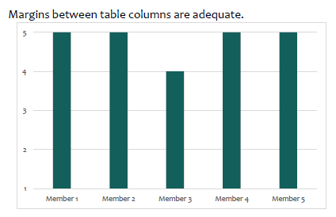
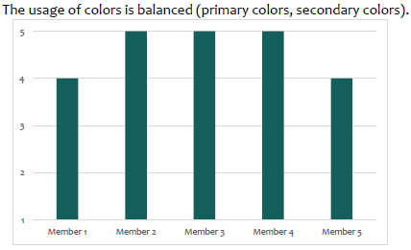
Evaluation Results

Slide 13

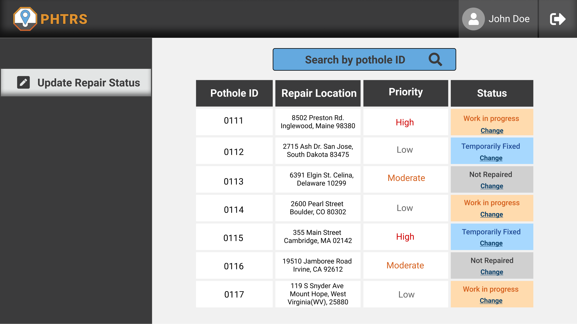
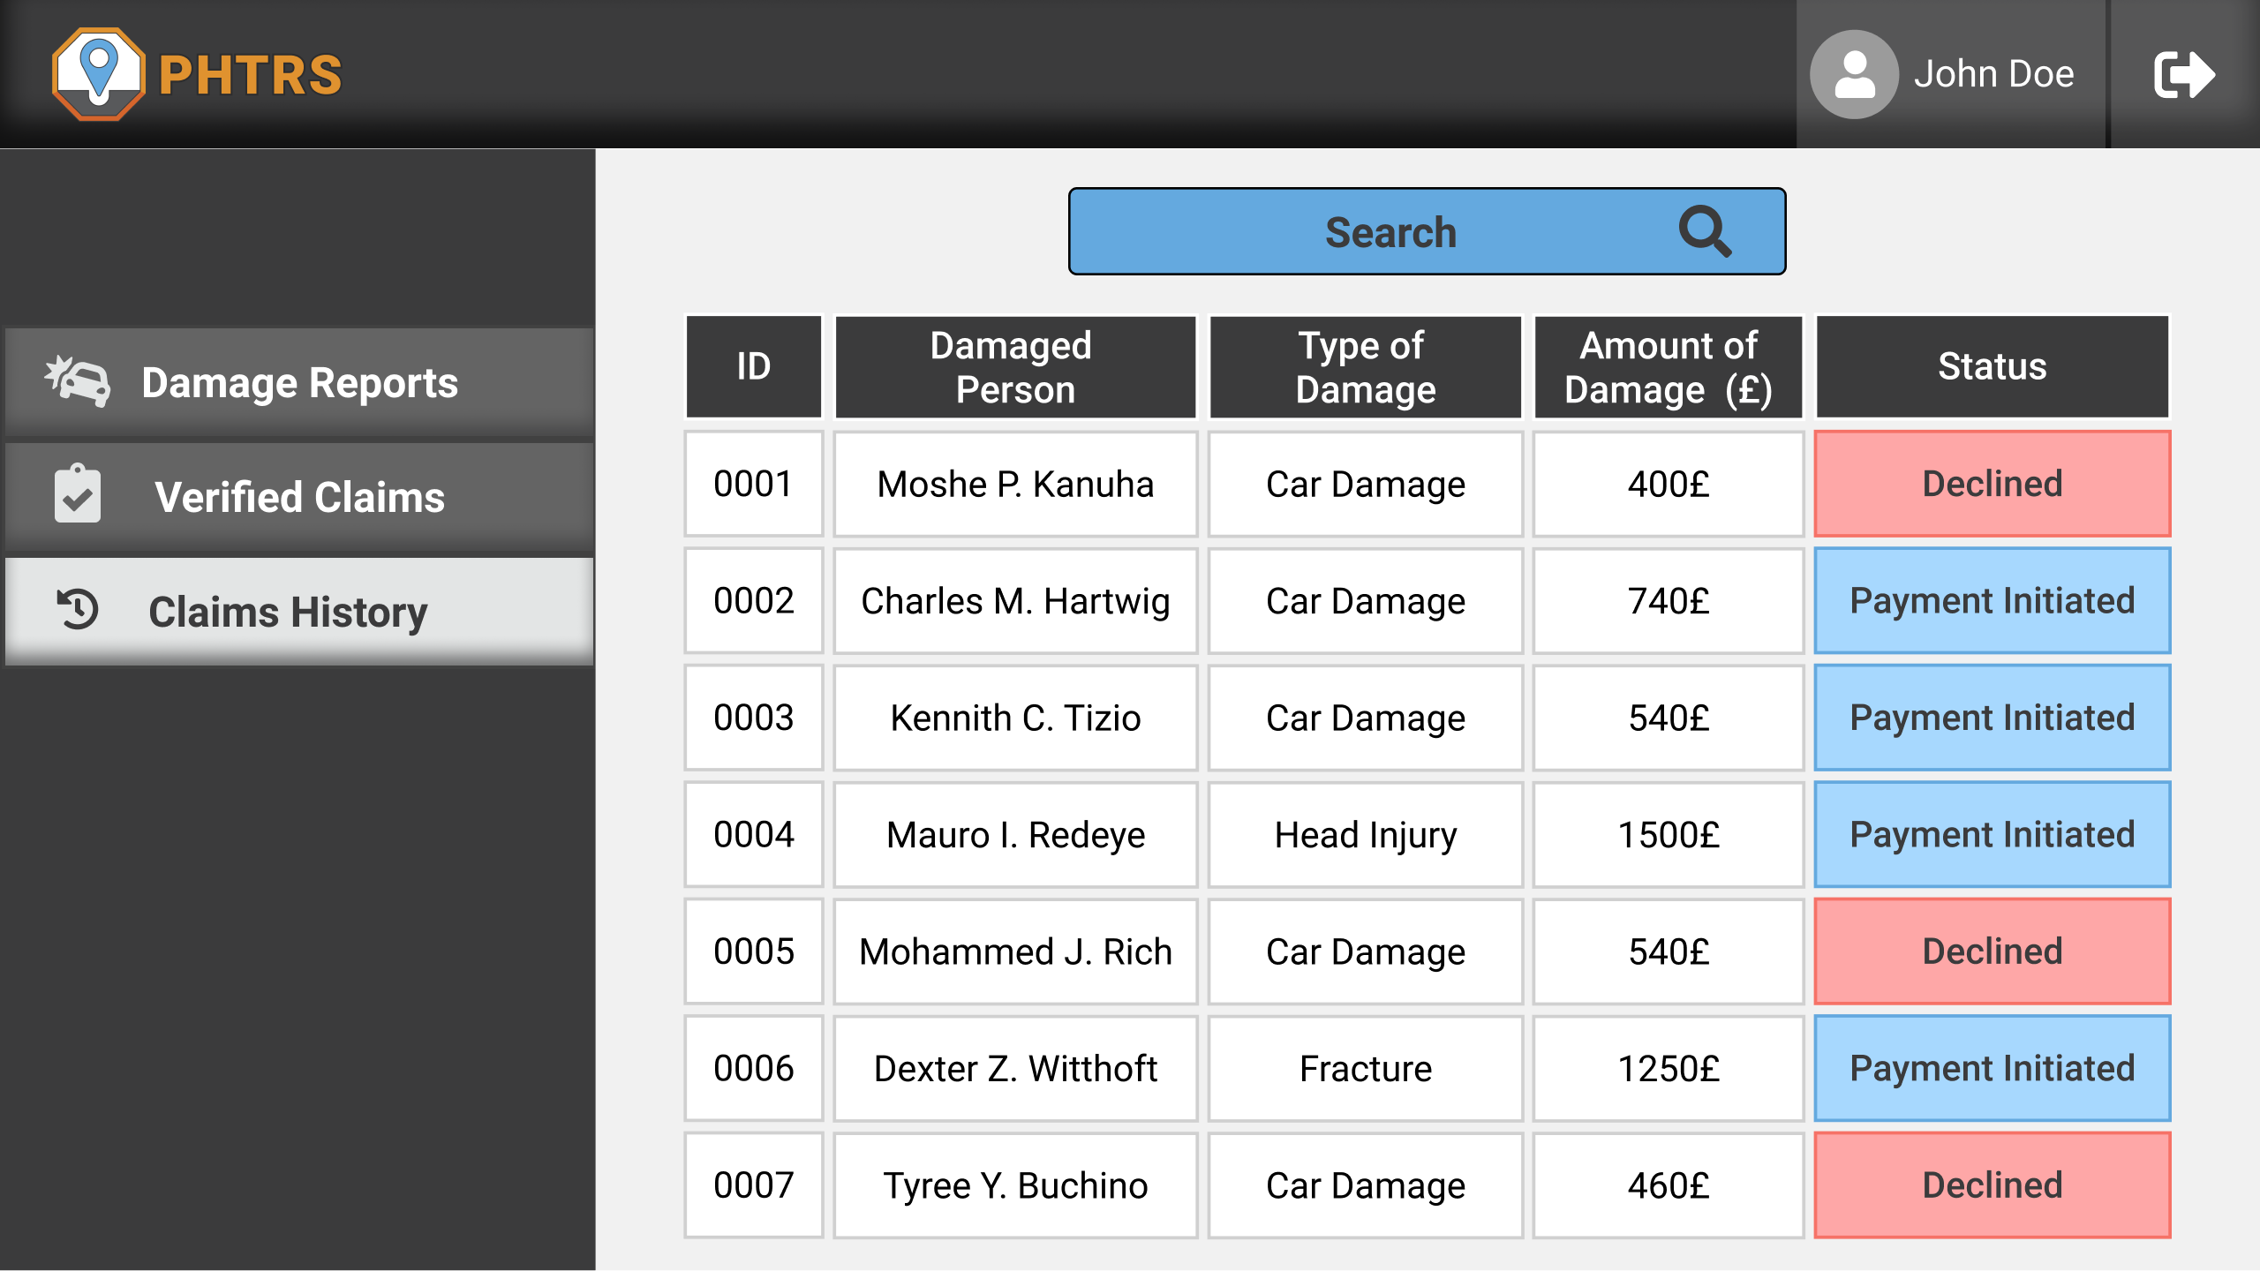
The improvements
Adding search feature for check progress page, update status page, and all the general manager pages.

Slide 14
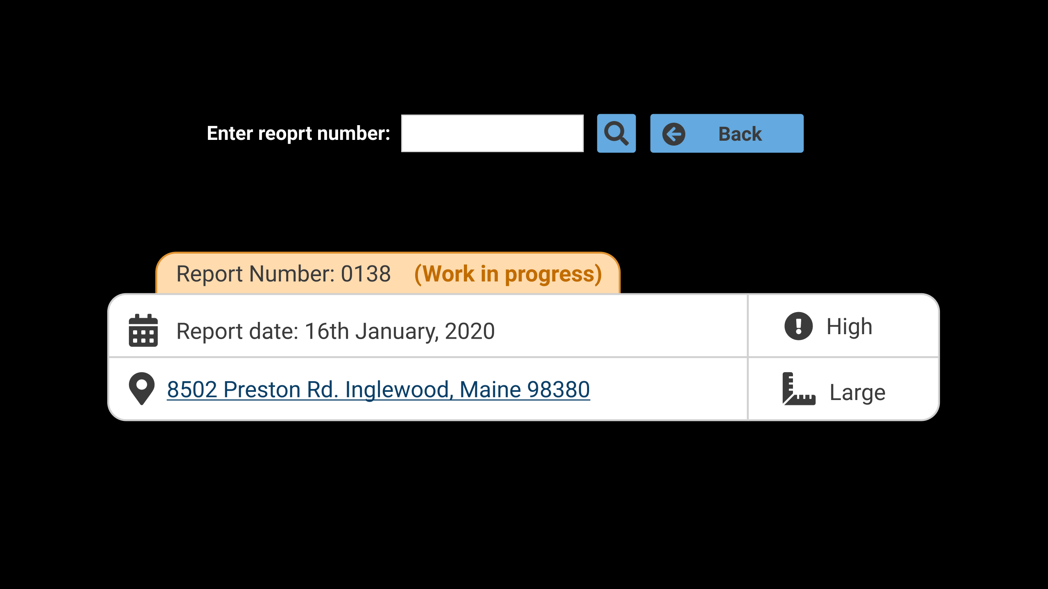
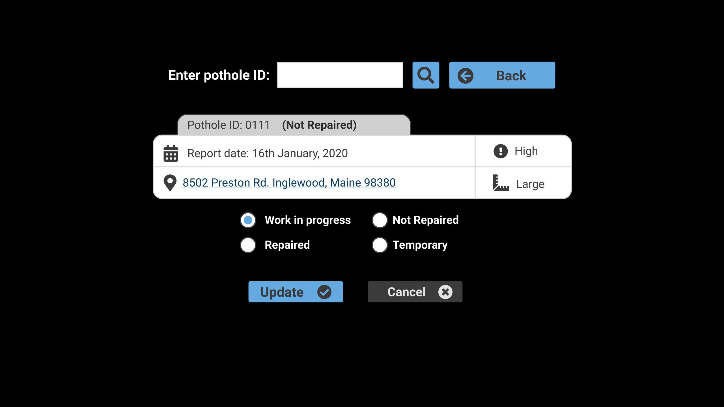
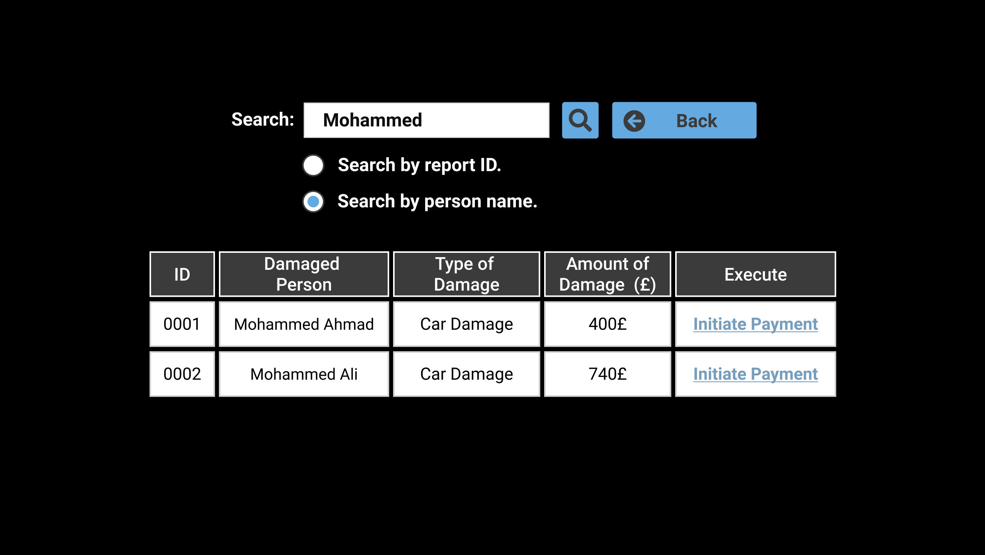
The improvements
Adding search feature for check progress page, update status page, and all the general manager pages.

Slide 15

Prototype link after the improvements
https://www.figma.com/proto/KJmHzITm0d07DfQXSAjRYr/PHTRS-prototype

