Slide 1
Outline and Steps to Accomplish Project
Team: Deep Learning Firefighters

Slide 2
Team Introduction

Slide 3
Team Introduction
Hannah Wurzel
Rishabh Sharma
2nd year MSDS student
Undergrad: Comp. Sci. (Math Minor)
Currently on Co-Op as ML Engineer in Defense and Space Industry
1st year MSDS student (3rd quarter)
Undergrad: Comp. Sci. & Engineering
Currently Researching under social NLP Lab and IRC Lab
Connor Roth
Varun Sharma
2nd year MSDS student
Undergrad: Economics
Completed Co-Op in Insurance Industry, accepted full-time offer
1st year MSDS student (3rd quarter)
Undergrad: Comp. Sci. & Engineering
Worked as junior software engineer in India
Currently working part-time

Slide 4
General Project Overview

Slide 5
General Project Overview and Stakeholders
Wildfires are some of the most unpredictable and disastrous natural phenomenons. These blazes can span millions upon millions of acres, destroying everything in their path. In our modern-day world, it has become imperative to find a better way to detect these catastrophes to minimize the damage being done across the globe.
Our group, the Deep Learning Firefighters, aims to detect wildfires and their boundaries using computer vision techniques on aerial imageries.
Stakeholders include the following:
Environmentalists: National park services, fire safety experts
Government entities
Individuals: computer scientists, data analysts

Slide 6
Datasets of Interest

Slide 7
FLAME 1 Dataset: Overview
 | File Type | Description
Raw Video (All) | MP4 | 966s footage from Zenmuse X4S camera
Raw Video (Specific Burn Patch) | MP4 | 400s footage from Zenmuse X4S camera
Raw Video (thermal - White Hot) | MOV | 89s footage from FLIR Vue Pro R thermal camera
Raw Video (thermal - Green Hot) | MOV | 305s from FLIR Vue Pro R thermal camera
Raw Video (thermal fusion) | MOV | 25-min footage from FLIR Vue Pro R thermal camera
Raw Video (Phantom Drone) | MOV | 17-min footage from DJI Phantom 3 camera
Training / Validation Images (Classification) | JPG | 39,375 frames, either “Fire” or “No Fire”
Test Images (Classification) | JPG | 8,617 frames, either “FIre” or “No Fire”
Images (Segmentation) | JPG | 2,003 frames for Train / Test / Val
Masks Annotation (Segmentation) | JPG | 2,003 ground truth mask frames for Train / Test / Val

Slide 8
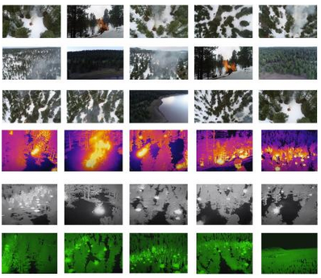
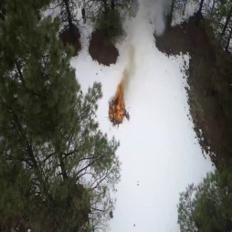
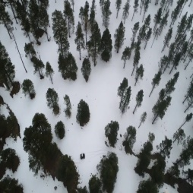
FLAME 1 Dataset Examples
Thumbnail Overview
“FIRE” vs. “NO FIRE” Images
Collection of screenshots of different aspects of dataset in one thumbnail
Labeled “FIRE” in Training Set
Labeled “NO FIRE” in Training Set

Slide 9
FLAME 2 Dataset: Overview
 | File Type | Description
Video Pairs #1-7 | MP4 | Side-by-Side RGB/IR footage from Mavic 2 Enterprise Advanced dual RGB/IR camera
Original Resolution Frame Pairs | JPG | 53,541 side-by-side RGB/IR frame pairs extracted from videos of varying sizes. Labeled with “Fire/NoFire” and “Smoke/NoSmoke”.
254p Frame Pairs | JPG | Same as above, but scaled to 254 x 254 and cropped so that RGB/IR frame pairs are similar in Field of View
Frame Pair Labels | TXT | Outlines “Fire/NoFire” and “Smoke/NoSmoke” labels for frame pairs
Note: Supplementary materials include…
README.txt / README.pdf
Burn Plan
RGB Pointcloud.laz
RGB Orthomosaic.jpg
Weather Forecast.jpg
RGB Preburn Video 1.MP4
RGB Preburn Video 2.MP4

Slide 10
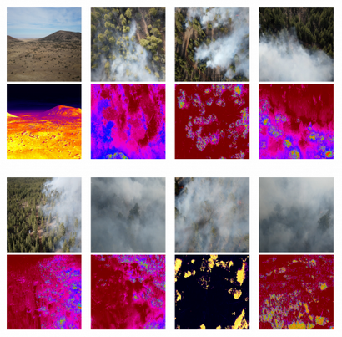
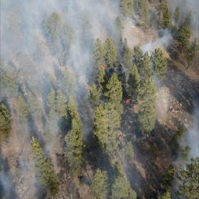
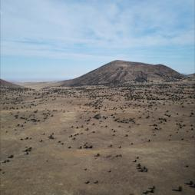
FLAME 2 Dataset Examples
Thumbnail Overview
“FIRE” vs. “NO FIRE” Images
Collection of screenshots of different aspects of dataset in one thumbnail
Labeled “FIRE” and “SMOKE” in Training Set
Labeled “NO FIRE” and “NO SMOKE” in Training Set

Slide 11
CMS Global Fire Atlas Dataset
Name | Description
Global_fire_atlas_V1_X_YYYY.zip (28 Shapefiles) | These files are annual Shapefiles (.shp) in compressed .zip format where: X is perimeter or ignitions and YYYY is 2003-2016. The perimeter files are polygon areas. The ignition files provide the point locations of the pixel where a fire started.
Global_fire_atlas_X_yearly_YYYY.tif (56 yearly files) | Yearly data in GeoTIFF (.tif) format (500-m) where: X is day of burn, fire line, speed, or direction, and YYYY is 2003-2016. These underlying 500-m gridded layers reflect the day-to-day behavior of the individual fires.
Global_fire_atlas_X_monthly_YYYY.tif (98 monthly files) | Monthly data in GeoTIFF (.tif) format (0.25-degree) where: X is ignitions, size, duration, fire line, speed, direction, or spread, and YYYY is 2003-2016. Monthly data are provided as one 12-band geotiff per year. The monthly data are averages taken based on the fraction of burned area of each individual fire within the respective month and 0.25-degree grid cell.

Slide 12
Perimeters and Attributes of CSA Atlas
Latitude and Longitude | Latitudinal and Longitudinal coordinates.
Size and perimeter | In km squares.
Start and End date | Start and end date of the fire spread.
Expansion | Rate of expansion in km per hour.
Fire line | Average daily fire length.
Expansion | Average Daily fire expansion
Speed | Speed of fire spread
direction | Dominant direction of spread
Land cover | Dominant land cover type (numerical)

Slide 13
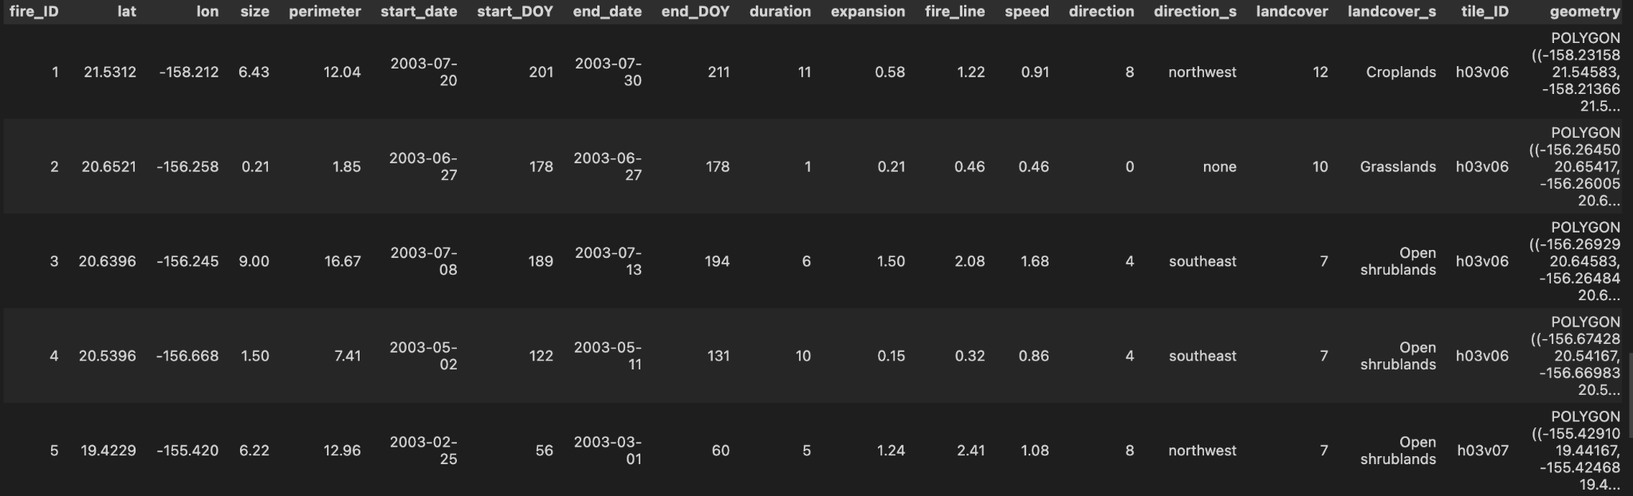
CSA Atlas DataBase

Slide 14
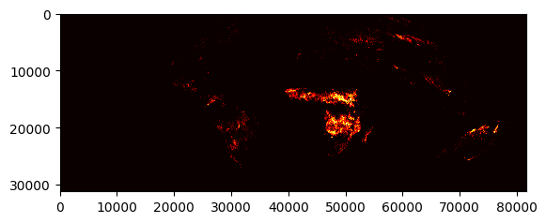
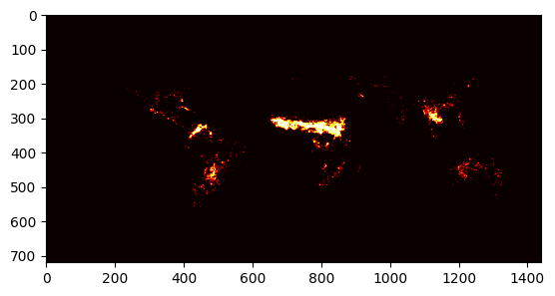
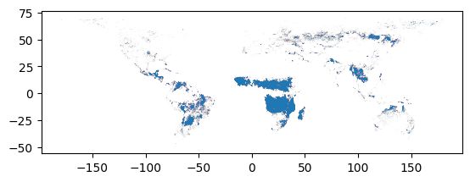
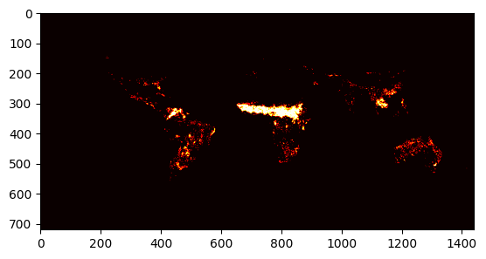
CMS Global Fire Atlas Examples
DAY OF BURN
AIR FLOW DIRECTION
PERIMETER
DURATION

Slide 15
Initial Steps:
Research and Importing Data

Slide 16
Review Existing Literature
Fire can be difficult to detect due to its dynamic and ever-changing state. However, many studies have shown success with the use of varying versions of a convolutional neural network (CNN).
Cheng [1]: utilized a fast R-CNN which is a two-stage detection algorithm. The first stage was to detect the regions that most likely contain a fire. The second stage was responsible for classifying those regions as containing a fire or not. Cheng’s results surpass previous models with an accuracy rate of 97.83%.
Shamsoshoara et al. [2]: applied a deep convolutional neural network (DCNN) which processes the red, green, and blue layers of an image simultaneously. This model saw a 76.23% accuracy on the test set.

Slide 17
Importing Data: FLAME Datasets
1
Establish file paths to image folders
2
Iterate through train and test datasets - establish dataframes for each containing…
a
File name
b
Label
c
Additional relevant features / metadata
Notes:
In order to build an accurate forest fire prediction model, it is necessary to import the relevant datasets. This involves establishing file paths to image folders and iterating through train and test datasets to establish data frames for each. The established file paths store the testing and training images which can be accessed later to build our model. For building the model, we shall need to iterate through the training and testing images and creating a dataframe for each of them which shall include information such as its filename, label, and any other relevant features. We can organize the images by adding labels to them such as True/False and any other relevant features that we may wish to include in the model. This data organization further assists us by making the analysis process expected to be carried out in the future much easier.

Slide 18
Importing Data: CMS Global Fire Atlas Dataset
1
Since Shape files consist of .shp, .shx, and .dbf formats…
a
Unpacking them using the geopandas for better readability of pixel polygons and analysis for different attributes.
b
Converting the db file to pandas dataframe
2
For Yearly and Monthly Files…
a
Reading the GeoTiff files as an image using rasterio to run analytics
b
Loading them into visualization tools for effective visualization

Slide 19
EDA: FLAME Datasets

Slide 20
EDA: FLAME Datasets
1
View sampling of images (true and false labels)
2
Examine image sizing (graphically)
3
Examine image label distribution
4
Examine pixel data (RGB channels) by label
5
Compute “mean image” - overall and by label

Slide 21
EDA: CMS Global Fire Atlas Dataset

Slide 22
EDA: CMS Global Fire Atlas Dataset
1
EDA on Distribution of wildfire across the globe using the GeoTIFF Data file and analyzing attributes like day of burn, fire line, speed, or direction.
2
Exploring the correlation between fire size and duration, or between fire ignition locations and their spread directions.
3
Analyzing the data files across different years, to understand how wildfire has changed over the year to understand the course of change with environmental factors
4
Visualize the data files in a spatial context, such as a map. Analyze the spatial patterns and distributions of the fires across different regions or continents
5
Hierarchical clustering, to group similar fires together based on their characteristics, such as size, duration, ignition location, etc.

Slide 23
EDA: Global Fire Atlas Dataset (cont’d)
6
Use time series analysis using techniques like ARIMA and bi-LSTM models for exponential smoothing and forecasting the fire activity over the time, also while analyzing the seasonal decomposition.

Slide 24
Data Processing

Slide 25
Data Processing
 | Preprocessing | Data Augmentation (optional) | Feature Selection (optional)
Overall Reasoning | Ensures data consistency and makes analysis easier | Generates new data from existing, which increases dataset size and model accuracy | Reduce dimensionality of data and increase model accuracy
Options to Pursue | Standardize images to the same height and width | De-texturize Decolorize Edge enhance Salient edge maps Flipping/rotating images | Principal Component Analysis (PCA) Correlation-Based Feature Selection (CFS)
Notes:
Preprocessing and feature selection are necessary for any model as they play a critical role in improving its accuracy. Here, preprocessing includes standardizing images to the same height and width. This ensures data consistency and makes analysis easier.
Data augmentation generates new data from existing data to increase the size of the dataset and model accuracy. In the case of forest fire prediction, it can be done by de-texturizing, decolorizing, edge enhancing, generating salient edge maps, and flipping/rotating the images.
Feature selection mainly reduces the dimensionality of the data while simultaneously increasing model accuracy. Here, it can be done using techniques such as principal component analysis (PCA) and correlation-based feature selection (CFS).
With the help of preprocessing, data augmentation and feature selection, we can greatly improve the accuracy of our models and better predict forest fires.

Slide 26
Model Training, Testing, and Eval

Slide 27
Model Training, Testing, and Results Evaluation
Model Training
Model Testing
Results Evaluation
Create models for…
Detecting presence of forest fire
Border / boundary detection of forest fire
Identify ideal hyperparameters (gridsearch)
Use models to predict results on test set image frames
Compare results between expected and actual labels
Evaluate accuracy, precision, recall, etc. metrics to assess overall performance
Discuss additional work outside scope of project

Slide 28
Thank You!

Slide 29
Works Cited

Slide 30
Works Cited
[1] Cheng, X. 2021. Research on application of the feature transfer method based on fast R-CNN in smoke image recognition, Advances in Multimedia. 2021.
[2] Shamsoshoara, A., Afghah, F., Razi, A., Zheng, L., Fulé, P. Z., & Blasch, E. (2021). Aerial imagery pile burn detection using Deep learning: The flame dataset. Computer Networks, 193, 108001. https://doi.org/10.1016/j.comnet.2021.108001

