Slide 1

Google Cloud

Slide 2
Using Google Cloud
Google SDK
Dashboard
Cloud Storage
Cloud VMs
Dataproc clusters
AI Notebooks
Billing

Slide 3
The Google SDK
To use Google Cloud products on your local machine, you must install the Google SDK
For windows, install the Google Cloud SDK using the link: https://cloud.google.com/sdk
You may either access your clusters and VMs using the Google Cloud Shell or using Cygwin
To install Google Cloud SDK on Cygwin, make sure the latest version of Python is installed as well as openssh and curl in Cygwin
Navigate to the folder that contains the Google Cloud SDK and then run:
./google-cloud-sdk/install.sh

Slide 4
The Google SDK
To install Google SDK on a Mac, go to https://cloud.google.com/sdk
Follow the instructions in the documentation for Mac

Slide 5
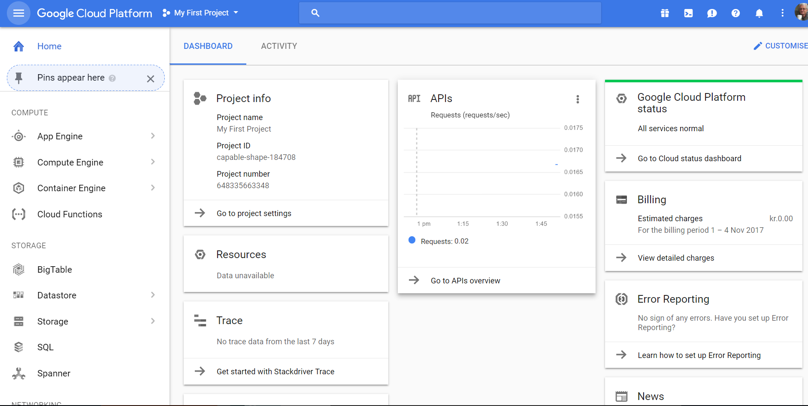
The Dashboard
When first logging in to https://console.cloud.google.com you will see the dashboard
The dashboard contains information about billing, usage and general information about your account

Slide 6
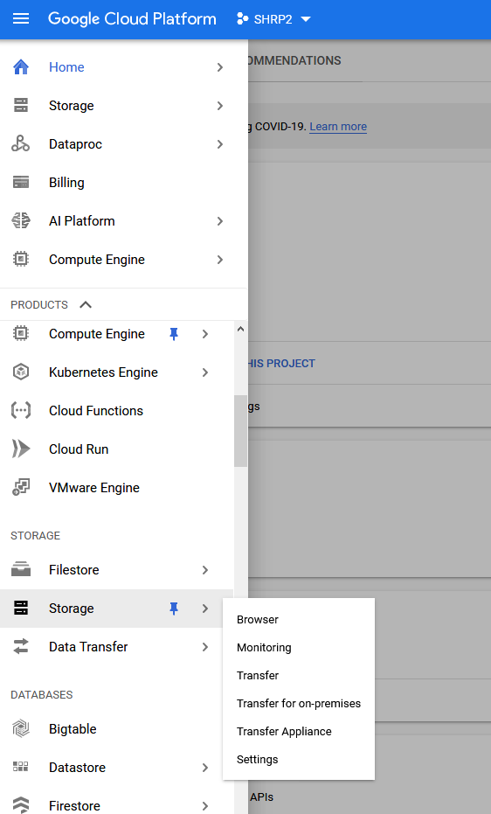
Cloud Storage
We may access cloud storage using the sidebar menu
Select the browser to create storage buckets to access your files from other VMs and clusters in Google Cloud

Slide 7
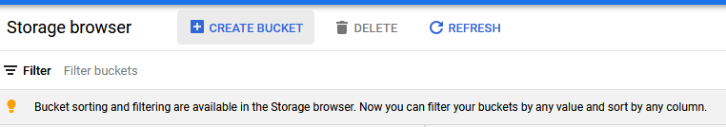
Creating a storage bucket
Select “create bucket”

Slide 8
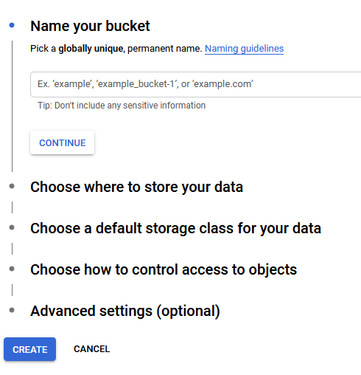
Creating a Storage Bucket
Follow the instructions to create a bucket and make sure you put all your buckets and VMs in the same location (it is recommended to select a location closer to you, most likely in the east coast)
You may access your files from a VM or cluster created through your account using the address:
gs://bucket-name/file-name

Slide 9
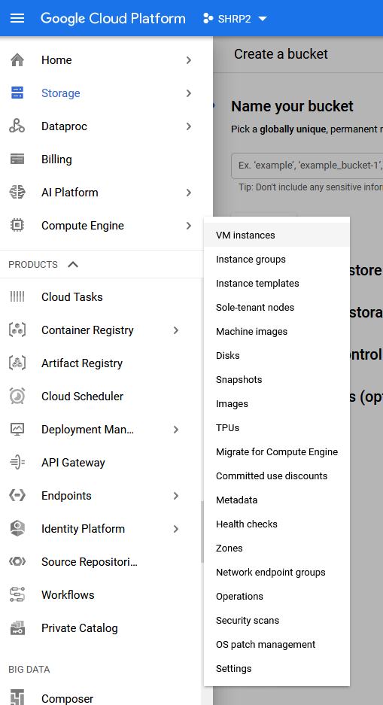
Cloud VMs
To create a single VM (which may be more cost effective and can be used for creating an initial proof of concept), select VM instances from the compute engine menu in the sidebar

Slide 10

Creating an Instance
To create an instance click “create instance”
Follow the instructions to create an instance, preferably close to where you are located and in the same region as your storage

Slide 11
Accessing your VM
To access your VM, navigate to your VM using the Google Shell or Cygwin in Windows or the command line in Mac
To access the VM use the command:
gcloud compute ssh vm_name --project=project_name --zone=vm_zone
For example:
gcloud compute ssh vm001 –project=my_first_project --zone=us-east4-a

Slide 12
Dataproc Clusters
Dataproc clusters are clusters that have Apache Spark pre-installed
They are more expensive than creating a cluster yourself by combining VMs
On the other hand, these clusters provide features like automated cluster management and security configurations

Slide 13
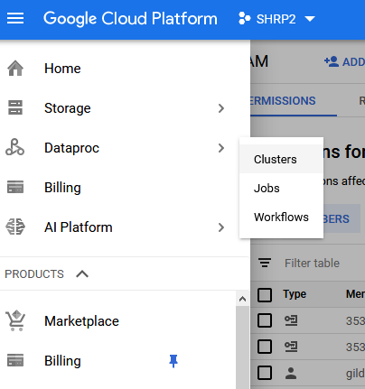
Dataproc
select dataproc clusters from the menu

Slide 14
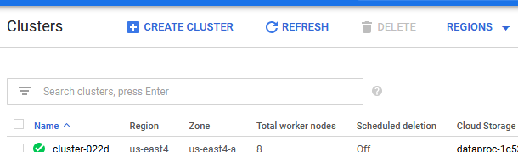
Dataproc
Create a cluster
Try to balance performance and cost when selecting a cluster (only select a large number of nodes if you need them)
Make sure to put every resource you create in the same zone, preferably in one of the zones in US East
Note: Dataproc clusters cannot be stopped, only deleted. Therefore, delete the cluster when do not need it to avoid depleting all of your Google credits

Slide 15
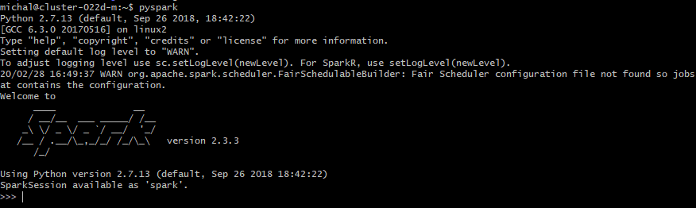
Accessing the Dataproc cluster
To access your cluster, make sure to connect to the head node rather than the child nodes, for example:
gcloud compute ssh cluster_name-m --project=project_name --zone=vm_zone
After logging in, enter pyspark into the shell and you should see the Spark logo to indicate that Spark is installed correctly

Slide 16

Adding More Tools to a Dataproc Cluster
This github repository contains multiple initialization actions that you may want to use in your dataproc cluster
To add an initialization script to your dataproc cluster click “advanced options” when creating a cluster
Enter the location of the initialization action script
Doing this will ensure that the tool you need will be installed at cluster creation

Slide 17
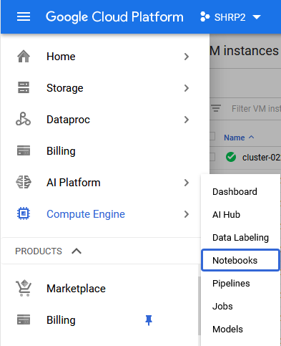
AI Notebooks
AI notebooks are large VMs that are customized to perform deep learning tasks
To create an AI notebook, select AI platform and then notebooks

Slide 18
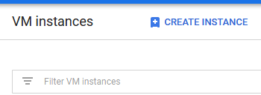
Creating AI Notebooks
To create an AI notebook, click “create instance” and follow the steps
Make sure to balance your performance and cost needs when creating an instance
Ensure your notebook is in the same region as your storage and as close as possible to your physical location

Slide 19
Accessing Your AI Notebook
To access your notebook, enter the following in your shell/command line:
gcloud compute ssh --project project_name --zone project_zone notebook_vm_name -- -L 8080:localhost:8080
The command will grant you access to port 8080 in your VM from port 8080 in your local machine
Then open your chrome browser and navigate to:
http://localhost:8080/lab?
You should see a Jupyter UI where you can create notebooks in the cloud

Slide 20
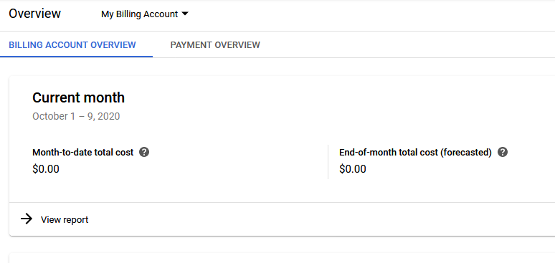
Billing
It is crucial to monitor your remaining credits regularly to know which machines you should downside or delete
Select Billing from the sidebar menu to review your monthly costs and your most expensive products

