Slide 1

Technical Setup

Slide 2
Using Spark
Google Colaboratory
Google Dataproc cluster
Databricks notebooks

Slide 3
Colaboratory
A free framework from Google for using notebooks
Since this is a Linux VM in the cloud, we can install Spark on the machine in a few easy steps
Since this is a free product, there are issues – the machine will disconnect after a few minutes of inactivity

Slide 4
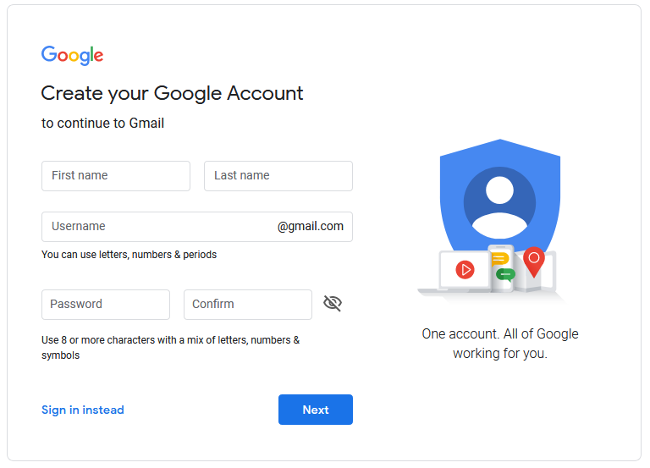
Colaboratory
Step 1: Create a Google account

Slide 5
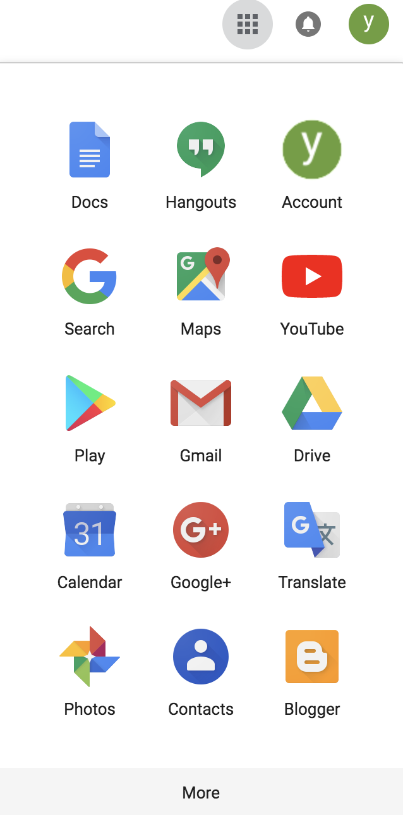
Colaboratory
Step 2: Connect Colab to your Google Drive

Slide 6
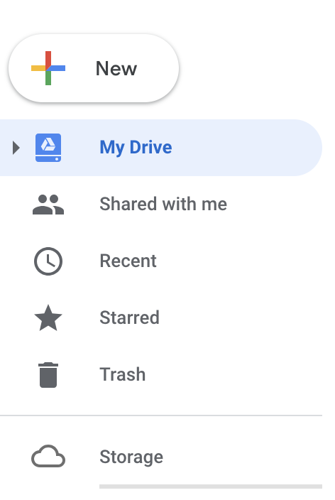
Colaboratory
Click on the new button

Slide 7
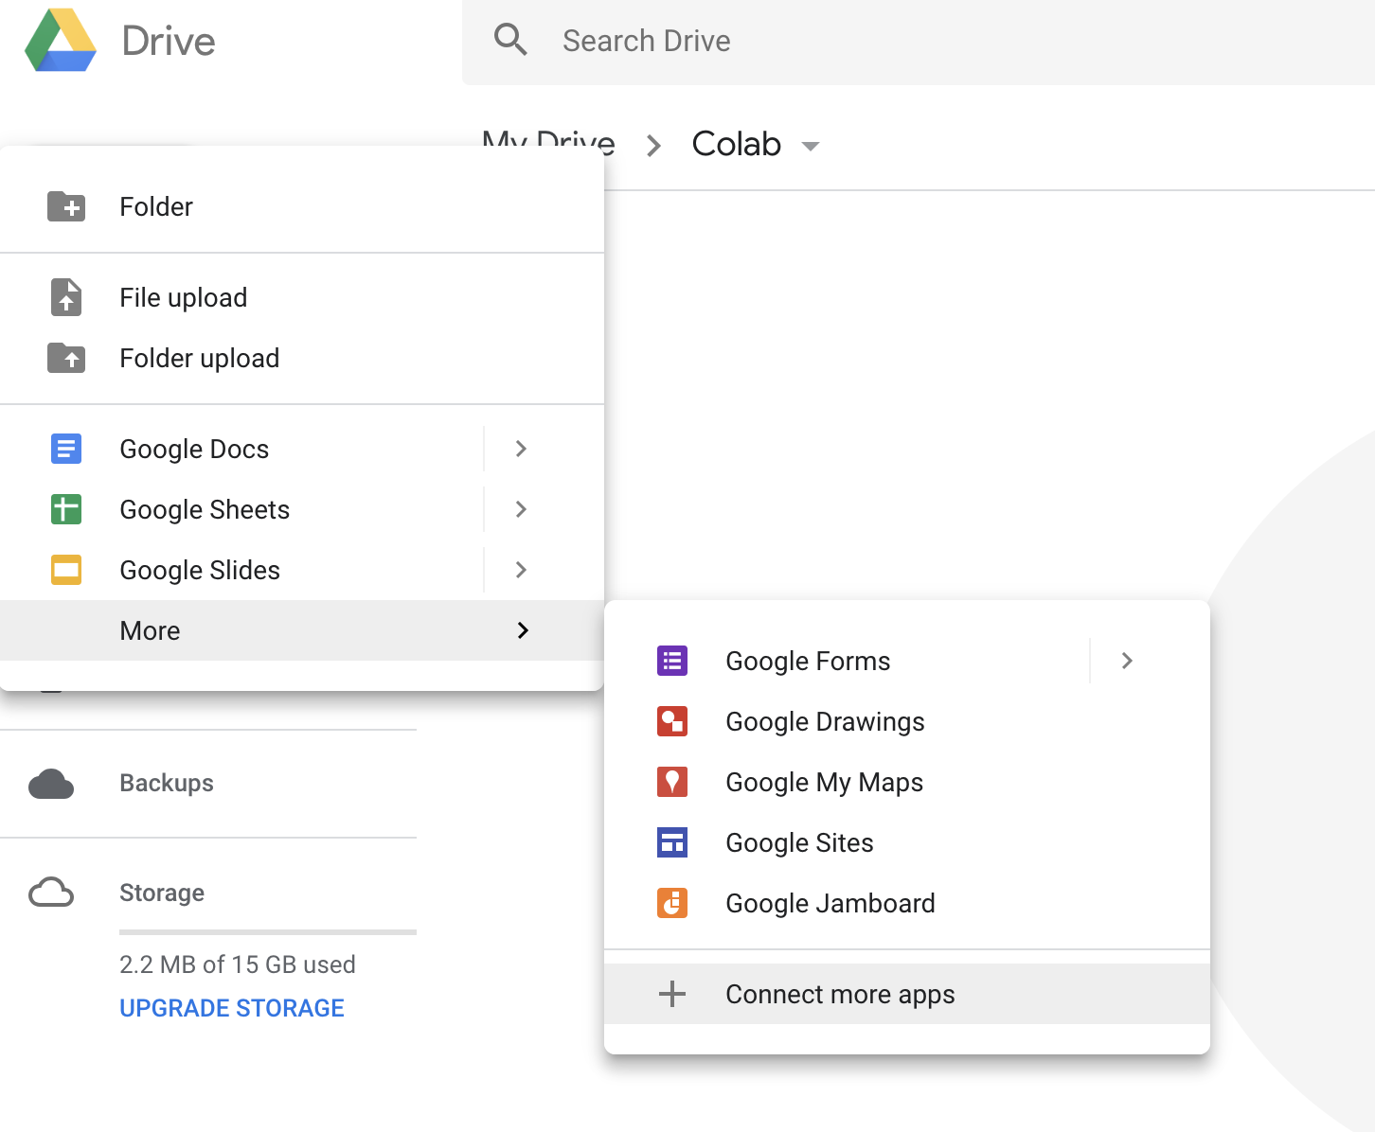
Colaboratory
Select “connect more apps”

Slide 8
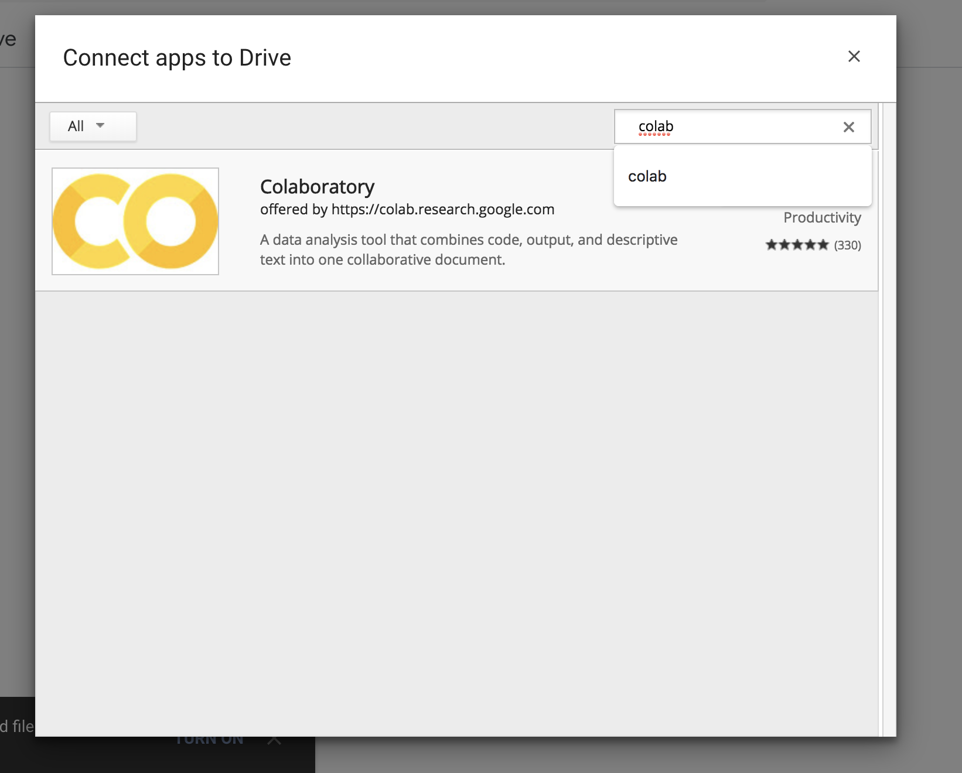
Colaboratory

Slide 9
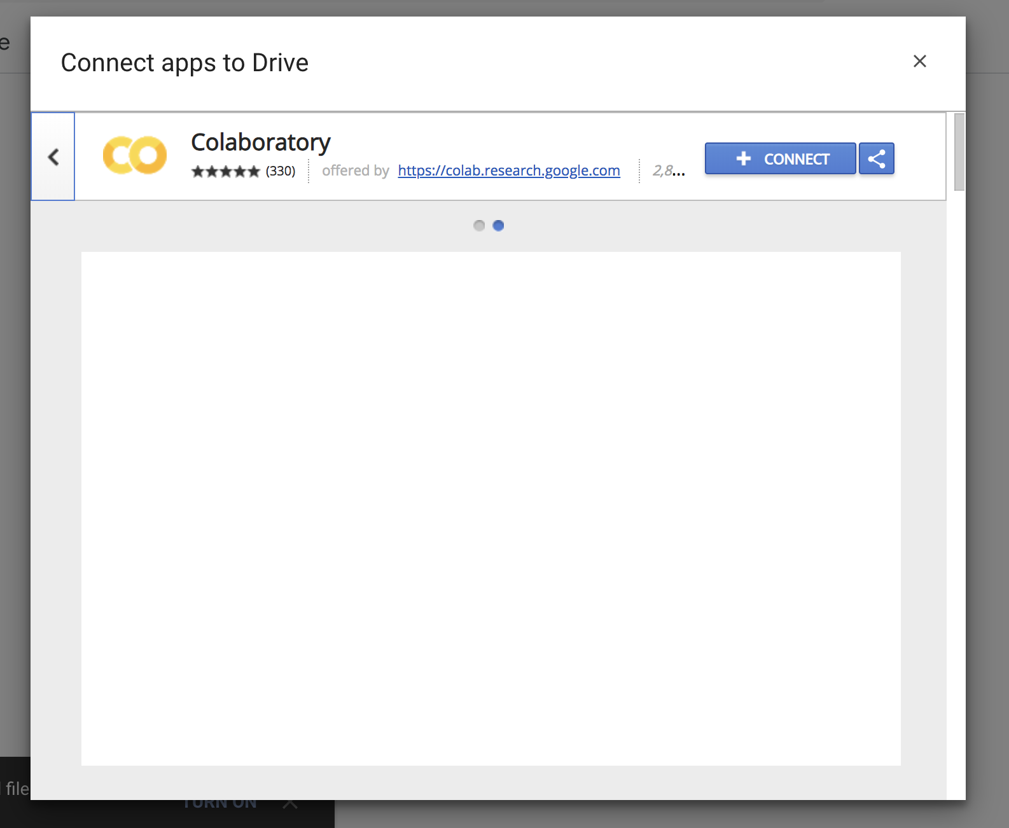
Colaboratory

Slide 10
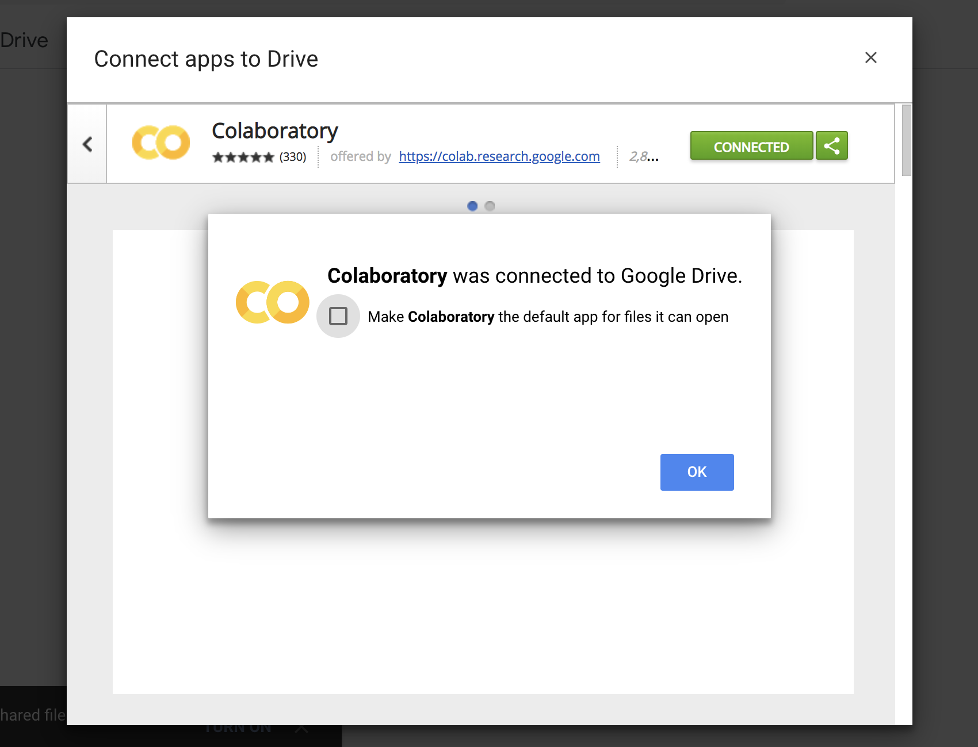
Colaboratory

Slide 11
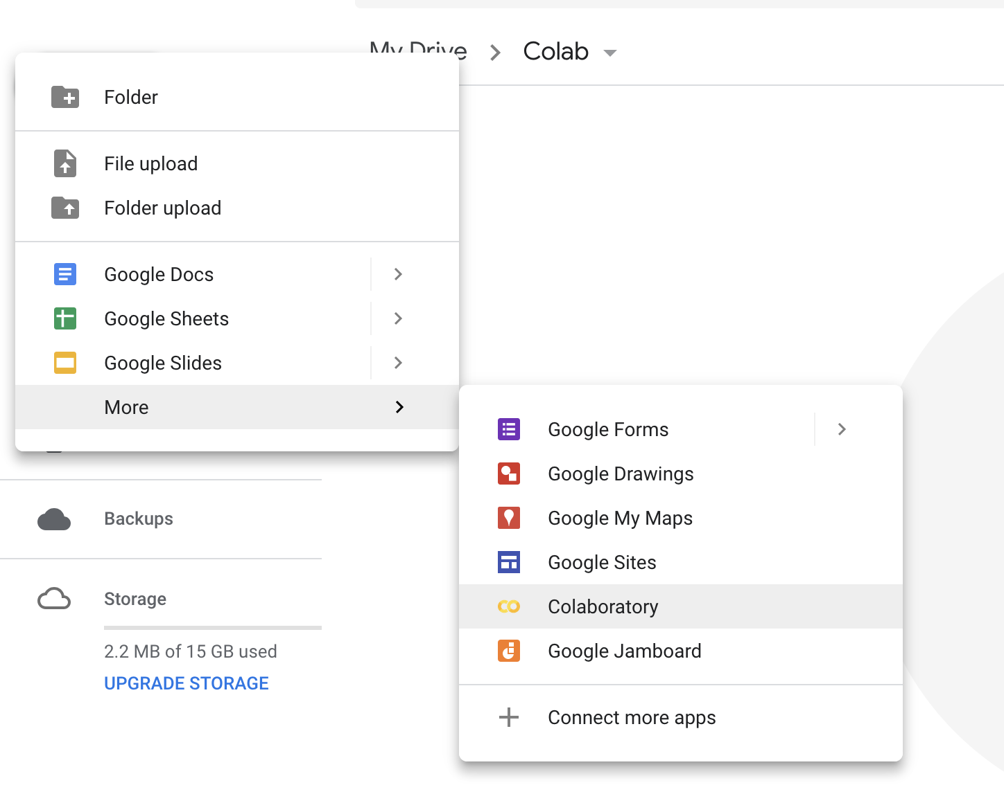
Colaboratory
You will now see the Colaboratory app in Google Drive

Slide 12
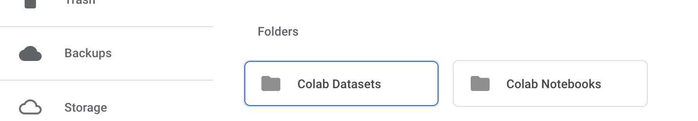
Colaboratory
Create 2 folders – one for notebooks and one for files

Slide 13
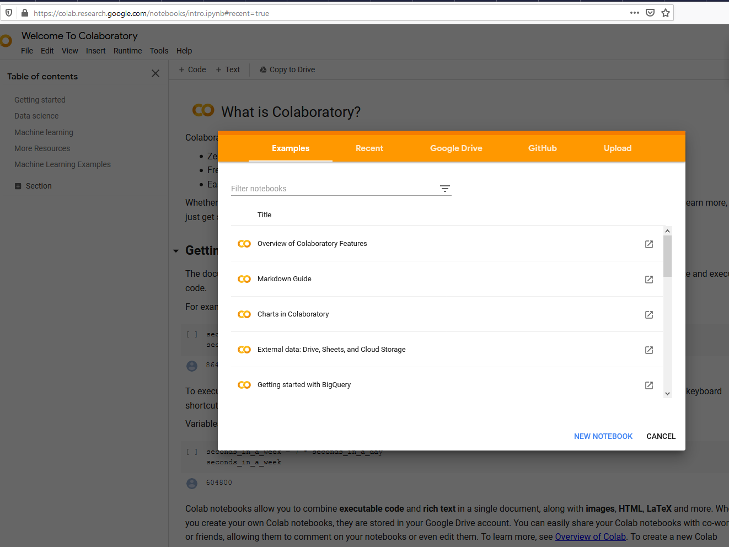
Colaboratory
Step 3 – visit colab.research.google.com and create a new notebook

Slide 14
Colaboratory
Step 4 – Installing PySpark dependencies
Hadoop
Adding JAVA_HOME and SPARK_HOME to the environment variable
Installing PySpark
Mounting the Google Drive

Slide 15
Colaboratory
!apt-get install openjdk-8-jdk-headless -qq > /dev/null
!wget -q https://www-eu.apache.org/dist/spark/spark-2.4.5/spark-2.4.5-bin-hadoop2.7.tgz
!tar xf spark-2.4.5-bin-hadoop2.7.tgz
import os
os.environ["JAVA_HOME"] = "/usr/lib/jvm/java-8-openjdk-amd64"
os.environ["SPARK_HOME"] = "/content/spark-2.4.5-bin-hadoop2.7"
!pip install -q findspark
!pip install pyspark
from google.colab import drive
drive.mount('/content/gdrive')

Slide 16
Dataproc
A Dataproc cluster comes preinstalled with Spark
We will typically use the PySpark REPL or spark-submit with Python scripts
Caution – delete you cluster when you are done working or you will waste all of your Google credits!

Slide 17
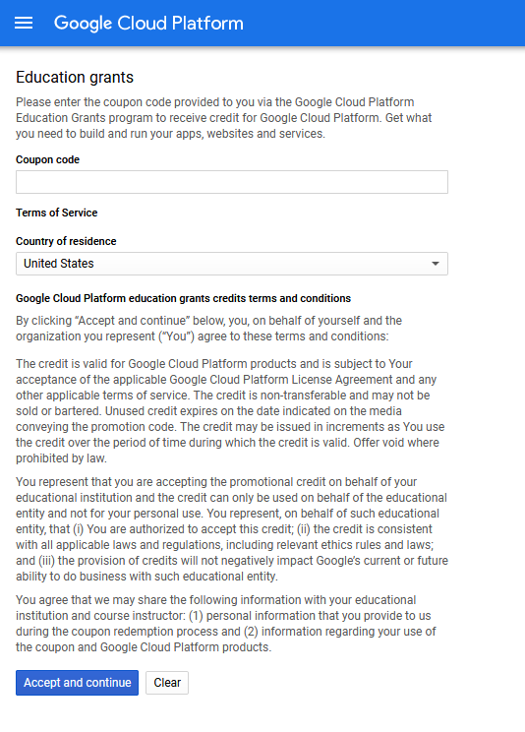
Dataproc
Step 1 – create a Google account
Step 2 – set up the Google cloud account
Redeem your credits

Slide 18
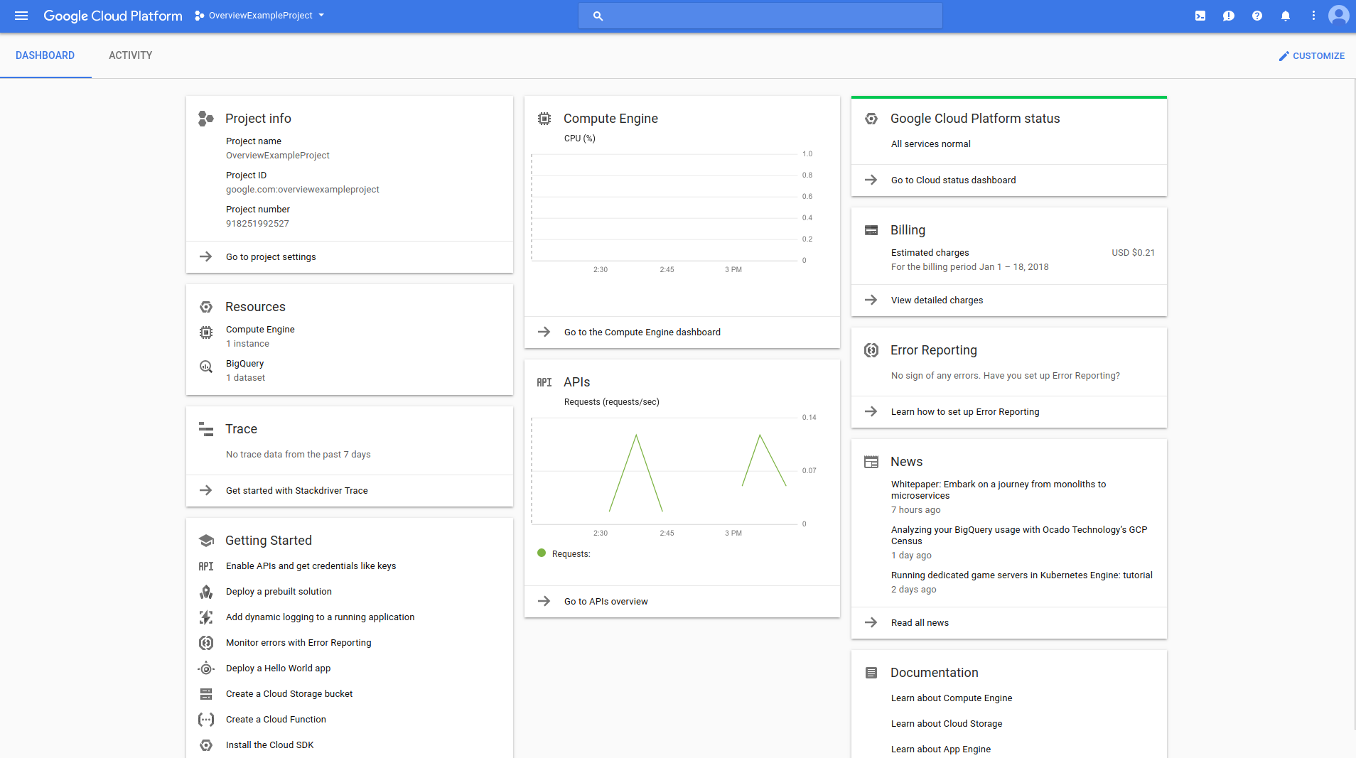
Dataproc
visit console.cloud.google.com

Slide 19
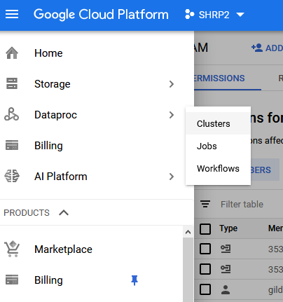
Dataproc
select dataproc clusters from the menu

Slide 20
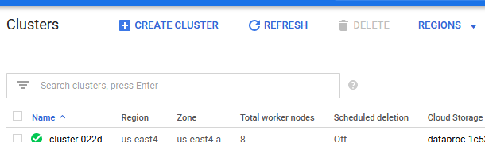
Dataproc
Create a cluster
Try to balance performance and cost when selecting a cluster
Make sure to put every resource you create in the same zone, preferably in one of the zones in US East

Slide 21
Dataproc
Step 3 – install Google SDK:
Follow these instructions
Step 4 – connect to your cluster from the terminal (Mac) or the Google Cloud SDK shell (Windows) using the command:
gcloud compute ssh clustername --project=projectname --zone=clusterzone
(replace clustername, projectname, and clusterzone with the specific values for your cluster)

Slide 22
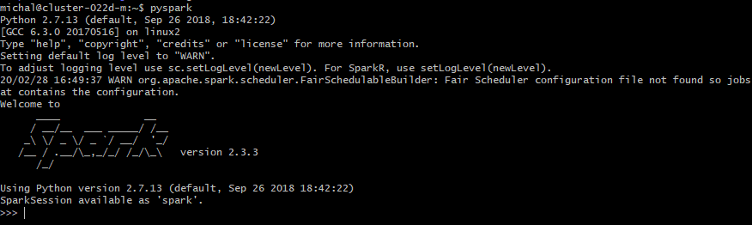
Dataproc
Step 5 – start up Spark
To start PySpark type pyspark into the shell

Slide 23
Databricks notebooks
Databricks provides you with a free trial to their notebooks
The instructions are in the documentation here:

