Slide 1
Emotion Detection using fer2013 Dataset
Anurag Shakya MT21013
Jayesh Joshi MT21035
Risabh Sinha
MT21069

Slide 2
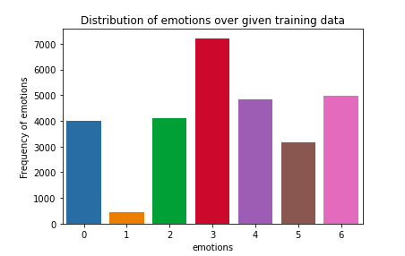

Data
FER 2013 Dataset (Human accuracy on this dataset : 68±5%)
Min - Max Normalization
Data Augmentation
Horizontal Flip
Horizontal and Vertical Shift
Random Zoom
Random Rotation

Slide 3
Existing Literature
“Facial Expression Recognition Through Machine Learning”
Extracted spatial features, texture features
Predict by using KNN
“Facial Expression Recognition Using SVM Classifier”
Face localization
Eye and mouth detection
Classifying the extracted feature using SVM
“Challenges in Representation Learning: A report on three machine learning contests”
Dataset
Feature Extraction not helpful
"Gradient-based learning applied to document recognition,"
LeNet-5
Multi-class classification of small images
CNN outperforms other models
“Convolutional Neural Networks for Facial Expression Recognition”
Deeper NNs better than shallow for this task
Feature Extraction not helpful
“Batch Normalization: Accelerating Deep Network Training by Reducing Internal Covariate Shift”
Reduce Internal Covariate Shift
Use Higher Learning Rates
Less careful about initialization

Slide 4
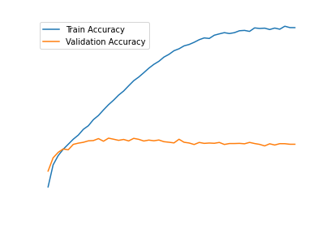
BaseLine Models
SVM
Convolutional Neural Network (Test Accuracy: 0.492, Test F1 Score : 0.42 )

Slide 5
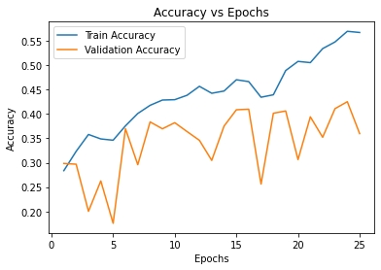
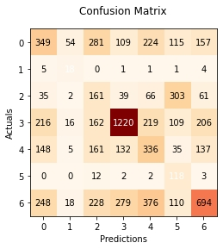
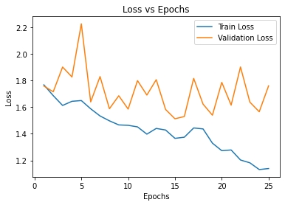
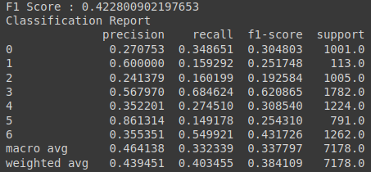
Transfer Learning (on ResNet50)
Accuracy : 41%
F1 Score : 0.42
Overfitting can be seen from the graphs
Class wise f1 score not good

Slide 6
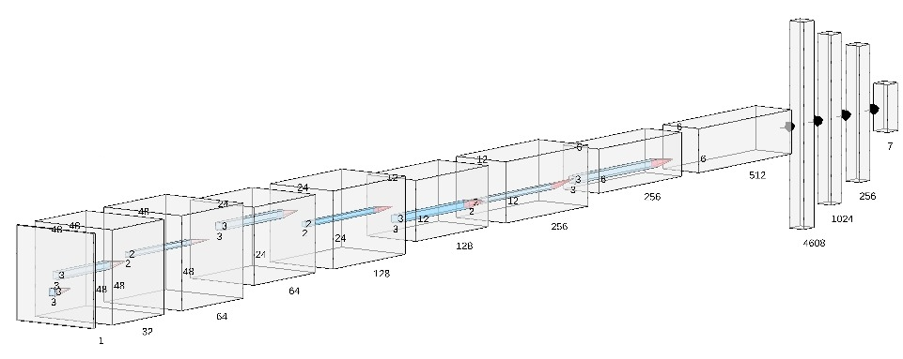
CNN Architecture with DropOut Layers
Designed CNN Architecture
Used Dropout Layers to minimize overfitting
5 conv layers, out of which first two are directly connected and rest are connected to max pool + dropout(50%)
Three fully connected layers in the end.

Slide 7
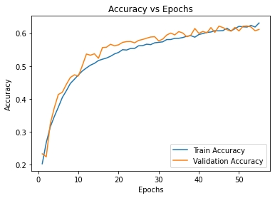
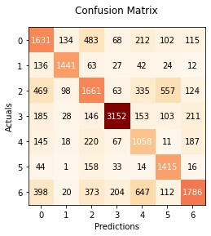
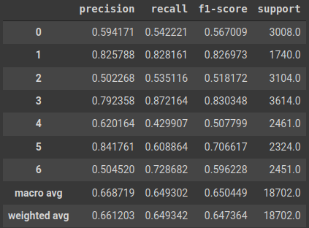
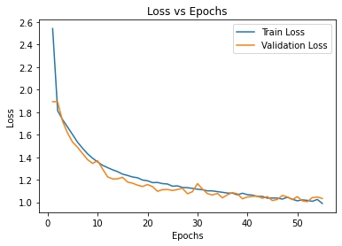
Results
Accuracy : 64.21% F1-Score : 0.66
Good class-wise F1 Score, No overfitting

Slide 8
Thank You!
Please ask questions if any

