Slide 1
CURBING HOUSING PRICES INFLATION
Risa Fheng

Slide 2
Assumptions
Dataset
Inconsistent Data Types
The 5 distinct HDB resale datasets spanning 1990 to 2020 capture the same data can be combined into one dataset with 819,743 rows and 11 columns
remaining_lease is an integer counting years from 2015 to 2016 and a string counting years and months from 2017, reconciled to an integer counting total months for model compatibility
Duplicates
Incorrect Data Input
1,815 rows were retained as identical units in the same town, block and storey range can be genuinely sold within the same month
13% of records between 2012 and 2014 had inconsistent storey_range categories from the rest of the dataset and were removed to prevent model bias

Slide 3
Data Exploration
You can delete this slide when you’re done editing the presentation
VARIABLE | INSIGHT
month | Seasonal decompose revealed distinct periodic fluctuations
town | Variations in price ranges of houses sold differ by towns
storey_range | Lower floors are sold more but also have lower starting resale prices compared to higher floors
floor_area_sqm | Lower floor areas tend to have lower prices but higher floor areas prices can range from low to high
flat_model | Variations in price ranges of houses sold differ by flat_model
lease_commence_date | Houses sold follow a normal distribution, with minimum price increasing with lease_commence_date, indicating higher prices for newer houses
remaining_lease | If remaining_lease is lesser than 600 months, maximum resale price is capped

Slide 4
Data Preparation
You can delete this slide when you’re done editing the presentation
MANIPULATION | VARIABLE | INSIGHT
New Variable | month_only | Integer, derived from month to capture seasonality based on the month only
Standardization | flat_model | String, capitalized for uniformity
Normalization | remaining_lease | Integer, converting years and months into total months for uniformity
Imputation |  | Integer, replace NaN with -1
One-hot encoding on categorical features
Removal of block and street_name for Ridge and Lasso Regression
Model Evaluation Metrics
Mean Absolute Error (MAE): financial measure that tells on average how many dollars the model differs by; robust to outliers as it treats all errors linearly
R2 Score: measures how effectively the features capture market movements; normalized score allows comparison of models regardless of year

Slide 5
Models
Models
LightGBM: fast, memory efficient and natively supports categorical features without massive one-hot encoding
Ridge/Lasso Regression: regularization benefits and easy interpretability on high-dimensional data
 | Tuned LightGBM | LightGBM | Ridge Regression | Lasso Regression
MAE | 10,910.05 | 14,249.49 | 31,079.80 | 31,079.42
R2 Score | 0.988173 | 0.978719 | 0.912922 | 0.912923
Tuned LightGBM using 5 fold cross validation performed the best by achieving low MAE and high R2 score, making it suitable for rapid in-house deployment
Top 5 features can be categorised into
  Location: based on block, street_name and town
  Time: based on month
  Floor Area: based on floor_area_sqm

Slide 6
Link Analysis
Stratified sampling (0.1%) to create a manageable 820 node relational map
Component | VARIABLE | REASONING
Nodes | Individual Property Listings | Each node represents a unique transaction
Edges | Linked if same street_name and flat_type | Units on the same street and of same type are direct competitors and thus prices pegged to each other
Node Colour | Town | Allows identification of interconnected towns
Node Size | Resale Price | Higher resale prices have larger nodes, easily identifying price outliers within a cluster

Slide 7
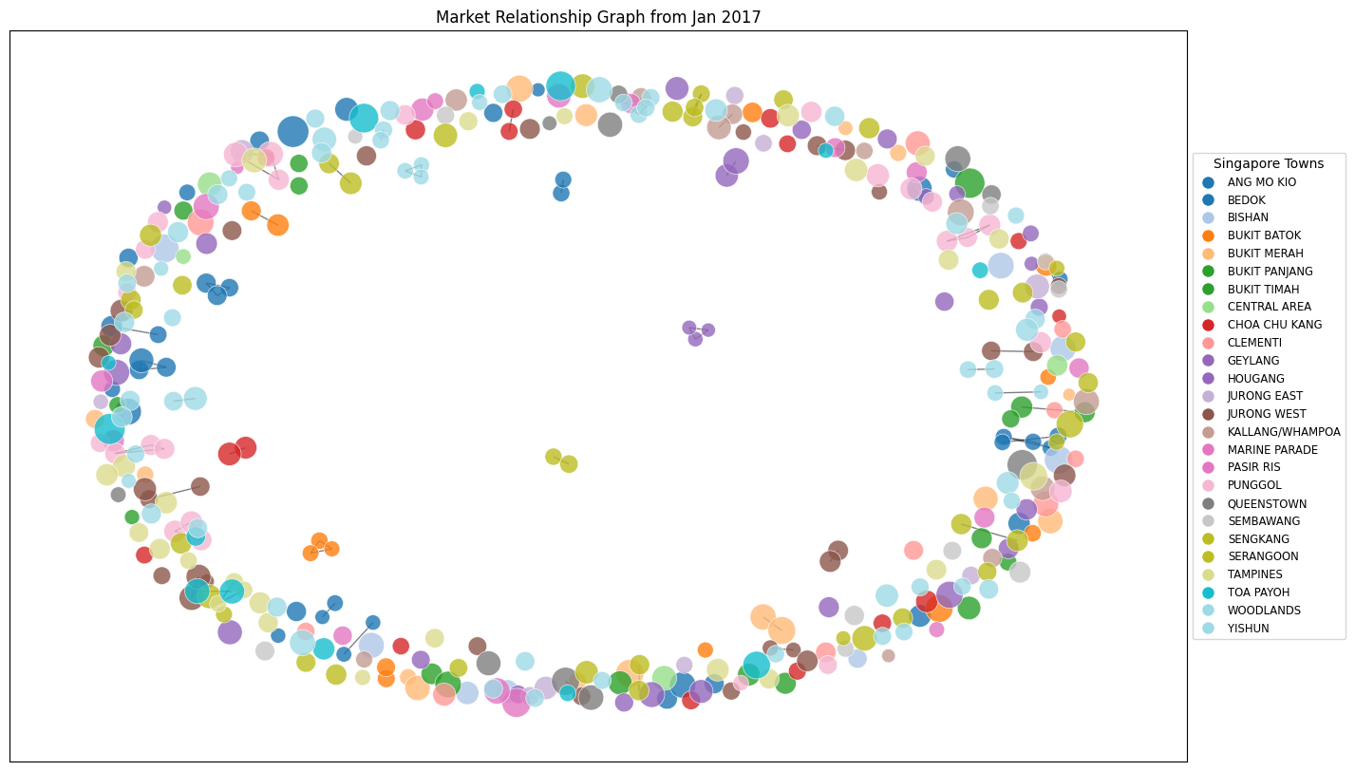
Link Analysis
Connected Components: large tightly knit clusters of single colours indicate price setters
  Monitor high density clusters for early intervention
Isolated Nodes: unique listings with no comparable listings
  Monitor isolated flats as they can set artificially high prices and influence wider town inflation
Bridge Nodes: nodes between major clusters are alternative listings
  Redirect buyers to alternative listings to smooth demand for major clusters

Slide 8
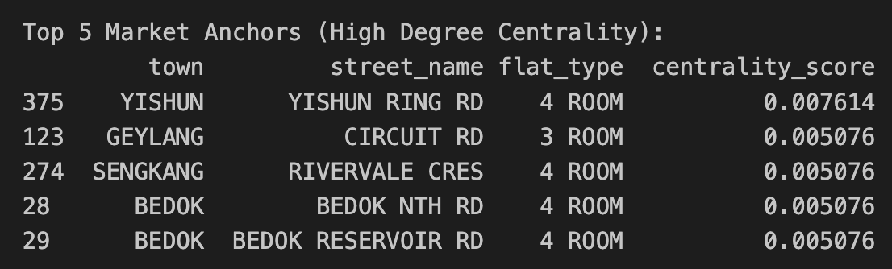
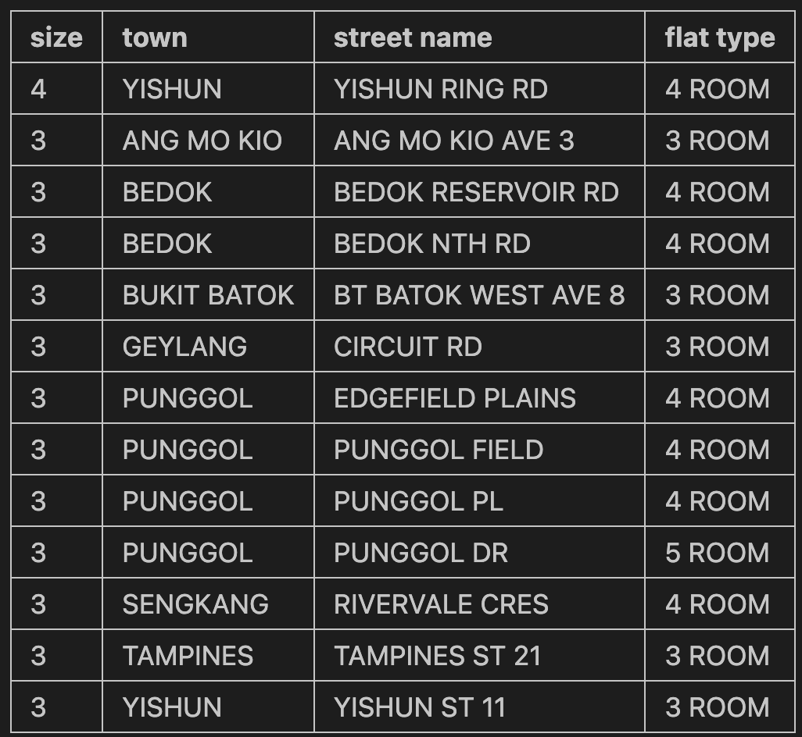
Link Analysis
Graph Algorithms
Degree Centrality: measures the number of directly comparable flats, identifies price anchors (i.e. units with the most local comparables that stabilize a neighbourhood’s value)
Connected Components: identifies clusters of similar properties on the same street such that large components represent high-liquidity with possibility of bidding wars and small components represent niche markets with higher price volatility

Slide 9
Strategies
Location Specific
Implementing a price monitoring alert in high density clusters can allow for early intervention before the entire cluster pushes prices up.
Introducing zoning cooling measures in popular towns can reduce demand by pushing buyers to look at other more affordable towns since the perceived value drops with the increased overall price.
Implementing enhanced valuation checks for isolated flats will prevent artificially high prices that can influence wider town inflation.
Seasonal Peak Periods
Synchronize Build-To-Order (BTO) launch dates to precede peak months identified by the model. By pre-saturating the market with supply just before high demand periods, the the annual price curve can be smoothed out.
Floor Area
Pivoting Build-To-Order (BTO) launches to include a higher percentage of bigger units can encourage buyers to BTO and reduce demand for larger resales.

Slide 10
Further Exploration
External Data Integration to improve prediction
  Distance to nearest MRT station: are properties nearer MRT stations more expensive?
  Previous property: are buyers downgrading or upgrading?
  Number in household: are buyers willing to pay more for higher floor space because they need the space and with more people they can afford higher prices?
Deployment
  Instead of loading pickle models and running code on a notebook, we can create a dashboard for non-technical policy offers to easily generate insights based on the latest data available
Evaluate Affordability
  Link the resale price predictor with household income data from Census
  If property prices grow much faster than household income, review CPF housing grants for specific demographics in specific towns

