Slide 1
Sensor
Mathieu Risakota
6217000119

Slide 2

Make a project by combining what you love..

Slide 3
Purpose of the project ?
Being able to play what you want wherever you want.
You can use everything
Really light and convinient

Slide 4
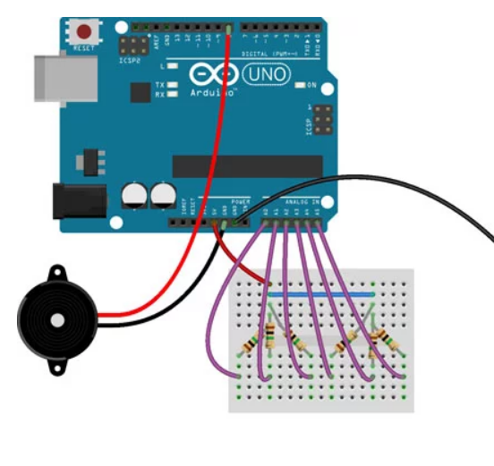
How does it work ?

