Slide 1
White Box Testing
Group 4
Danish Hasan MSCS-20001
Muhammad Abu Bakar MSCS-20013
Muhammad Awais MSCS-20074
Musa Khan MSCS-20065

Slide 2
Employee Time Reporting
A demo of a expense management system for employees of a company.
Can add/delete employees, their groups, their hours worked etc.
Can also generate ADP reports of a particular employee.
Languages:
Java
Javascript

Slide 3
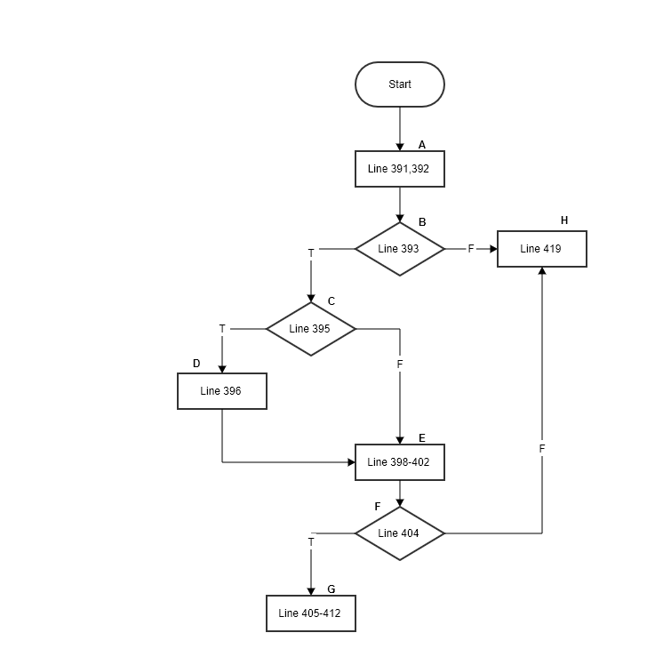
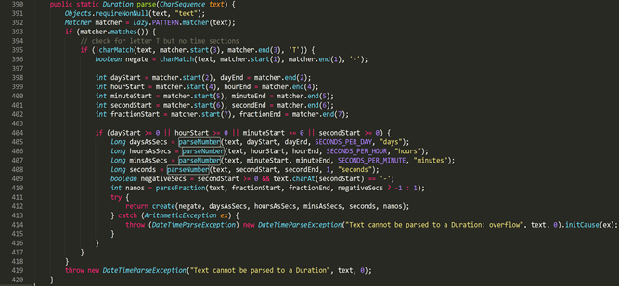
Function
https://github.com/openjdk/jdk/tree/master/src/java.base/share/classes/java/time/Duration.java

Slide 4
Branch coverage
Test case# | Input | Output | Expected Output | Pass/Fail | Comments
1 | text = “PT6H” | “6 hours” | “6 hours” | Pass | Covers B393T, B395F, B404T
2 | text = “G3D” | Exception | Exception | Pass | Covers B393F
3 | text= “-PT6H3M” | “-6 Hours and -3 minutes” | “-6 Hours and -3 minutes” | Pass | Covers B393T, B395T
4 | text= “PTDHM” | Exception | Exception | Pass | Covers B404F

Slide 5
Condition coverage (Short Circuit)
Test case# | Input | Output | Expected Output | Pass/Fail | Comments
1 | text= “PT-6D-6H6M” | “-6 Days and -6 Hours and 6 minutes” | “-6 Days and -6 Hours and 6 minutes” | Pass | Covers C393T, C395T, C404-1F, C404-2F, C404-3T
2 | text= “PT-6D-6H-6M6S” | “-6 Days and -6 Hours and -6 minutes and 6 seconds” | “-6 Days and -6 Hours and -6 minutes and 6 seconds” | Pass | Covers C393T, C395T, C404-1F, C404-2F, C404-3F, C404-4T
3 | text= “PT-6D-6H-6M-6S” | Exception | Exception | Pass | Covers C393T, C395T, C404-1F, C404-2F, C404-3F, C404-4F

Slide 6
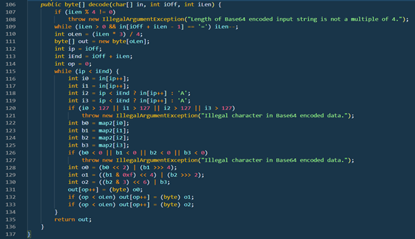
Function timesheet-master\src\main\java\timeSheet\util\properties\Base64Coder.java

Slide 7
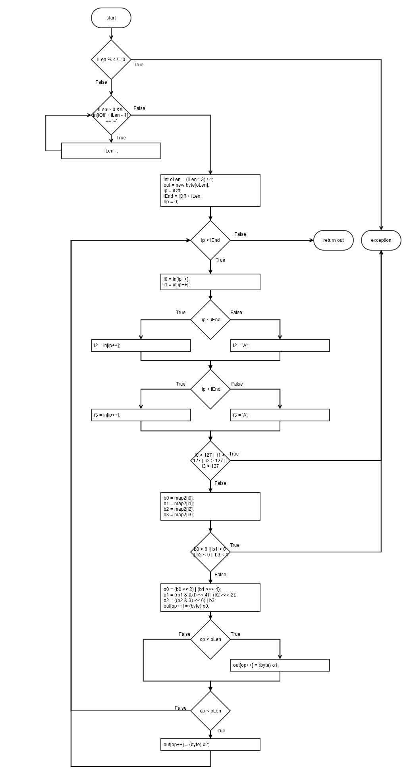
CFG

Slide 8
Boundary Interior
Test case# | Input | Output | Expected Output | Pass/Fail | Comments
1 | In[] = ‘QUJD’ iOff = 0 iLen = 4 | ‘ABC’ | ‘ABC’ | Pass | Covers 118T, 119T, 132T, 133T
2 | In[] = ‘QQ==’ iOff = 0 iLen = 4 | ‘A’ | ‘A’ | Pass | Covers 118F, 119F, 132F, 133F
3 | In[] = ‘QUI=’ iOff = 0 iLen = 4 | ‘AB’ | ‘AB’ | Pass | Covers 118T, 119F, 132T, 133F

Slide 9
Loop Boundary Consider N=12 for loop. (Note that for valid input N-1 must be 8 and N+1 must be 16)
Test case# | Input | Output | Expected Output | Pass/Fail | Comments
1 | In[] = ‘QUJD’ iOff = 0 iLen = 4 | ‘ABC’ | ‘ABC’ | Pass | Covers 115F once
2 | In[] = ‘QUJDREU=’ iOff = 0 iLen = 8 | ‘ABCDE’ | ‘ABCDE’ | Pass | Covers 115T for N-1
3 | In[] = ‘QUJDREVGRw== ’iOff = 0 iLen = 12 | ‘ABCDEFG’ | ‘ABCDEFG’ | Pass | Covers 115T for N
4 | In[] = ‘QUJDREVGR0hJSg==’ iOff = 0 iLen = 16 | ‘ABCDEFGHIJ’ | ‘ABCDEFGHIJ’ | Pass | Covers 115T for N+1

Slide 10
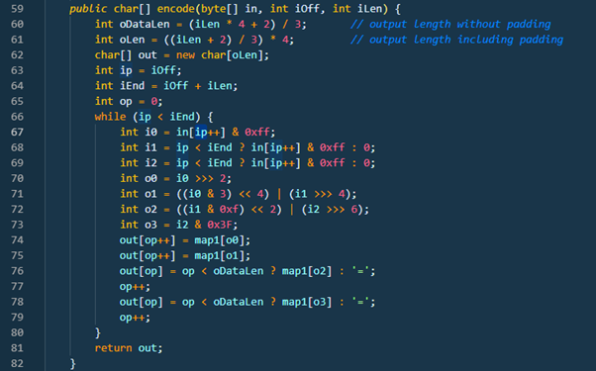
Function timesheet-master\src\main\java\timeSheet\util\properties\Base64Coder.java

Slide 11
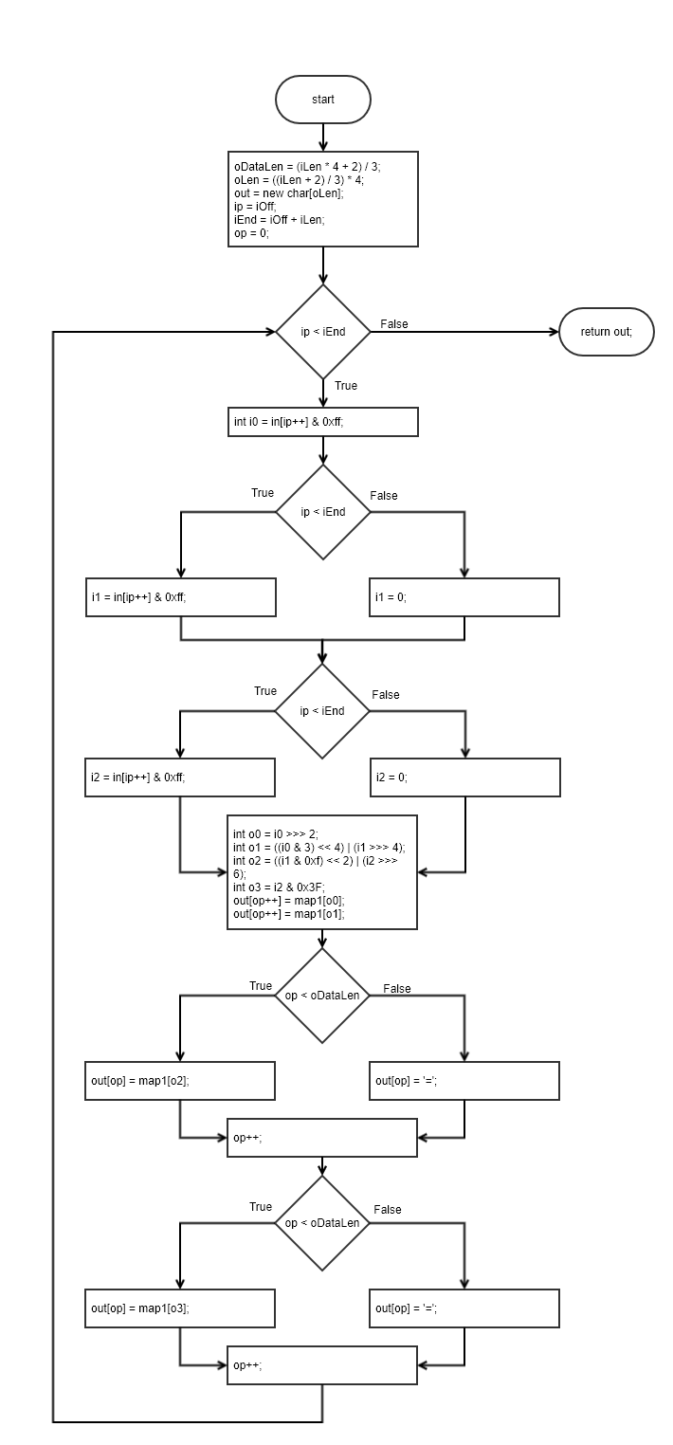
CFG

Slide 12
Basis Path
Path 1: 66F
Path 2: 66T, 68T, 69T, 76T, 78T
Path 3: 66T, 68T, 69F, 76T, 78F
Path 4: 66T, 68F, 69F, 76F, 78F
Note that no logical path is possible to cause 69T while 68F. Same is case with 76F and 78T. Similarly, conditions in 76 and 78 also depend upon same factor as 68, 69 so it is not possible for 68T but 76F and vice versa.

Slide 13
Basis Path
Test case# | Input | Output | Expected Output | Pass/Fail | Comments
1 | In[] = {‘A’, ‘B’, ‘C’}; iOff = 0; iLen = 3; | QUJD | QUJD | Pass | Covers Path2
2 | In[] = {‘A’, ‘B’, ‘C’}; iOff = 0; iLen = 1; | QQ== | QQ== | Pass | Covers Path4
3 | In[] = {‘A’, ‘B’, ‘C’}; iOff = 0; iLen = 0; | Empty String | Empty String | Pass | Covers Path1
4 | In[] = {‘A’, ‘B’, ‘C’}; iOff = 0; iLen = 2; | QUI= | QUI= | Pass | Covers Path3

Slide 14
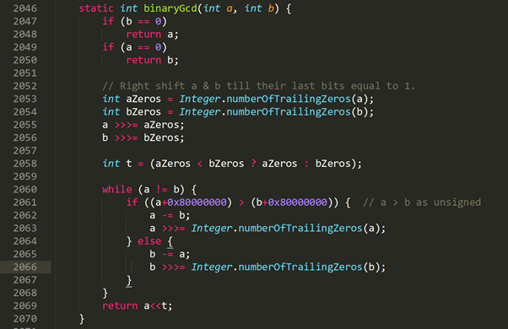
Function https://github.com/openjdk/jdk/tree/master/src/java.base/share/classes/java/math/ MutableBigInteger.java

Slide 15
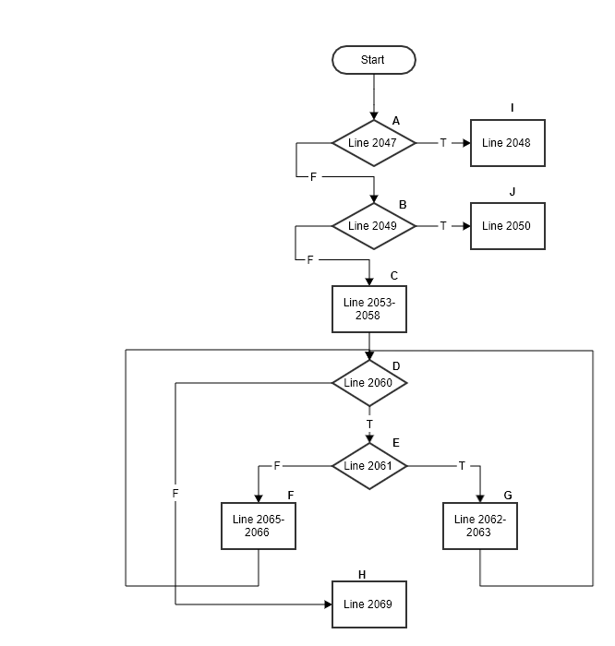
CFG

Slide 16
Data Flow
Variable # | Variable Name | Definitions | Uses | DU Pairs
1 | a | 2046, 2055, 2062, 2063 | 2048, 2049, 2053, 2055, 2060, 2061, 2062, 2063, 2065, 2069 | <2046, 2048> <2046, 2049> <2046, 2053> <2046, 2055> <2055, 2060> <2055, 2061> <2055, 2062> <2055, 2065> <2055, 2069> <2062, 2063> <2063, 2060> <2063, 2061> <2063, 2062> <2063, 2069>

Slide 17
Data Flow
Test case# | Input | Output | Expected Output | Pass/Fail | Comments
1 | a = 15 b = 0 | 15 | 15 | Pass | For a covers <2046, 2048>
2 | a = 12 b = 12 | 12 | 12 | Pass | For a covers: <2046, 2049> <2046, 2055> <2055, 2060> <2055, 2069>
3 | a = 98 b =56 | 14 | 14 | Pass | For a covers <2046, 2049> <2046, 2053> <2046, 2055> <2055, 2060> <2055, 2061> <2055, 2062> <2062, 2063> <2063, 2060> <2063, 2061> <2063, 2062> <2063, 2069>
4 | a = 56 b =98 | 14 | 14 | Pass | For a covers <2046, 2049> <2046, 2053> <2046, 2055> <2055, 2060> <2055, 2061> <2055, 2065> <2055, 2069>

Slide 18
Contribution
Danish:
Submission 1: Setup and run the web application, resolved all errors to run the project successfully Submission 2 & 3: Chose functions 1, 4, 5 and wrote test cases for these functions
_______________________________________________
Abu Bakar:
Submission 1: Documented the environment setup and prepared report . Submission 2 & 3: Chose functions 2, 3, 6 and wrote test cases for these functions
Awais:
Submission 1: was not part of group.
Submission 2 & 3: Chose functions 8, 9, 10 and wrote test cases for these functions _______________________________________________
Musa:
No Contribution

Slide 19

Some interesting content
KLEE is a dynamic symbolic execution engine built on top of the LLVM compiler infrastructure, capable of automatically generating tests that achieve high coverage on a diverse set of complex and environmentally-intensive programs.
https://klee.github.io/

Slide 20
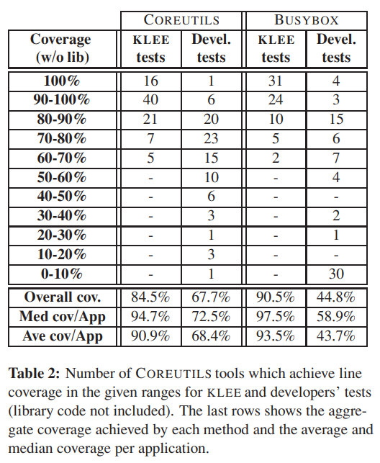
KLEE Findings
Conclusion from OSDI 2008 paper:
“... In total, we used KLEE to check 452 applications (with over 430K lines of code), where it found 56 serious bugs, including ten in COREUTILS, arguably the most heavily tested collection of open-source applications. ... ”
Source: https://www.usenix.org/legacy/event/osdi08/tech/full_papers/cadar/cadar.pdf

Slide 21
KLEE Example
https://klee.github.io/tutorials/testing-function/
Once linked, compiled and executed, we get the report summary (details can be looked up in logs)
KLEE: output directory = "klee-out-0"
KLEE: done: total instructions = 33
KLEE: done: completed paths = 3
KLEE: done: partially completed paths = 0
KLEE: done: generated tests = 3
int get_sign(int x) {
if (x == 0)
return 0;
if (x < 0)
return -1;
else
return 1;
}

Slide 22
Fin.
Q/A

