Slide 1
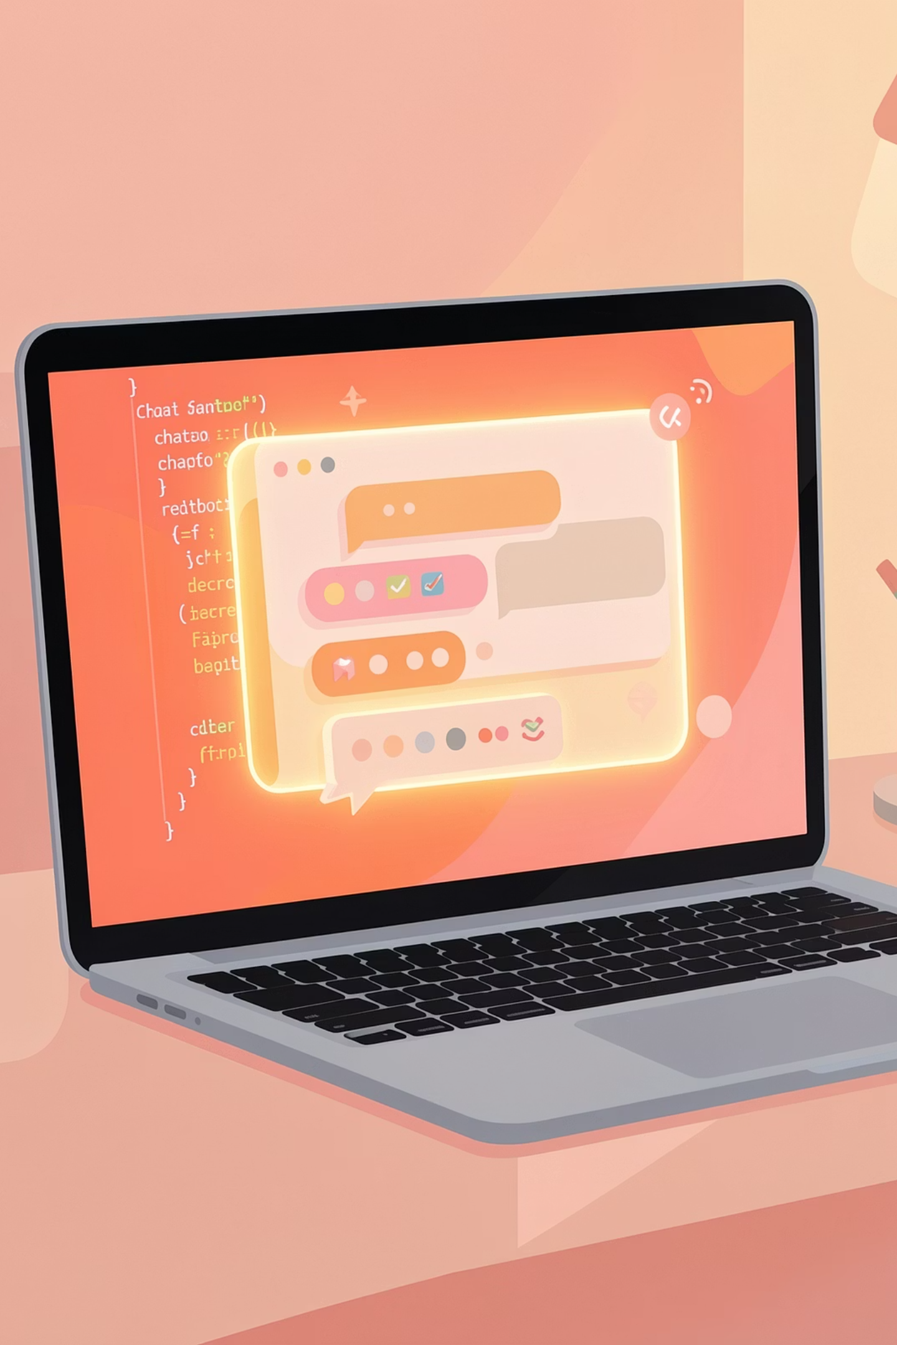















Mini AI Chatbot using Python
A beginner-friendly project that demonstrates Python core features — functions, loops, conditionals, and dictionaries — to build a working, keyword-driven chatbot with file logging.
PYTHON PROJECT
BEGINNER FRIENDLY
CORE PYTHON

Slide 2
Project Overview
What Are We Building?
The goal of this project is to create a Mini AI Chatbot using only Python's core features — no external libraries required. The chatbot reads user input, identifies keywords, and returns appropriate responses. Every conversation is automatically saved to a file for later review.
🎯 Aim
📖 Read Input
Create a functional Mini AI Chatbot using Python core features like functions, loops, and dictionaries.
Accept and process user messages in real time through the terminal.
🔍 Identify Keywords
💾 Save Chat
Match user input against predefined keywords to select the right response.
Log every conversation automatically to a chat_history.txt file.

Slide 3
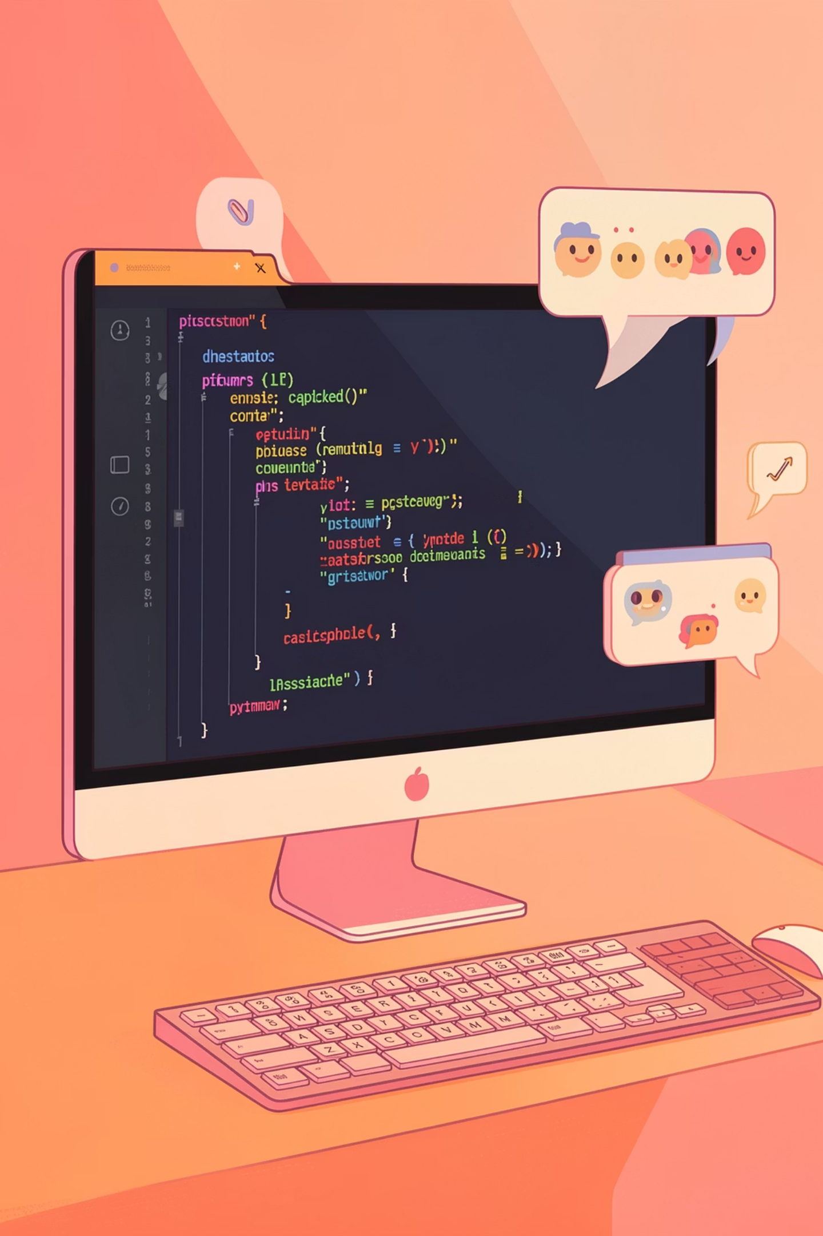

Features
What the Chatbot Can Do
This Mini AI Chatbot is simple yet fully functional. It covers the essential building blocks of conversational AI while staying accessible for beginners.
Keyword-Based Responses
The bot detects keywords like hello, python, or name and returns a relevant pre-defined reply instantly.
Graceful Exit Option
Users can end the conversation by typing bye or quit. The bot responds warmly before closing the session.
File Logging
Every message exchanged is automatically saved to chat_history.txt, creating a persistent record of the conversation.
Future Scope
The project is designed to scale — with room to add Machine Learning, NLP, and Voice Recognition in later versions.

Slide 4
Code Structure
Project Files & Organisation
The chatbot is split across multiple Python files, each with a clear responsibility. This modular approach makes the code easy to understand, test, and extend.
📁 Project Folder
chatbot_basic.py
chatbot_file.py
chatbot_basic.py
chatbot_file.py
chatbot_responses.py
chat_history.txt
The simplest version — a basic chatbot with hardcoded responses and a main loop.
Extended version with file logging and a larger keyword-response dictionary.
chatbot_responses.py
chat_history.txt
Optional module that stores all responses in a separate dictionary for clean organisation.
Auto-generated file that records every conversation session with timestamps.

Slide 5




Under the Hood
Python Core Features Used
This project is an excellent way to practise fundamental Python concepts. Each feature of the chatbot maps directly to a core Python concept, making it a perfect learning exercise.
Functions
Loops
Reusable blocks of code that handle input, matching, and responses separately.
A while loop keeps the chatbot running until the user types an exit command.
Conditionals
Dictionaries
if-elif-else statements check user input and decide which response to return.
Keyword-response pairs are stored in a Python dictionary for fast and clean lookups.

Slide 6




Live Demo
Sample Chatbot Output
Here is what a real conversation with the Mini AI Chatbot looks like. The bot responds naturally to greetings, questions about itself, and topic-based queries.
🧑 You
🤖 Bot
hello
Hello! How can I help you?
🧑 You
🤖 Bot
what is your name
I am your Mini AI Chatbot.
🧑 You
🤖 Bot
tell me about python
Python is a powerful and easy programming language.
🧑 You
🤖 Bot
how are you
I'm fine, thank you!
🧑 You
🤖 Bot
bye
Bye Risana, take care! 👋

Slide 7
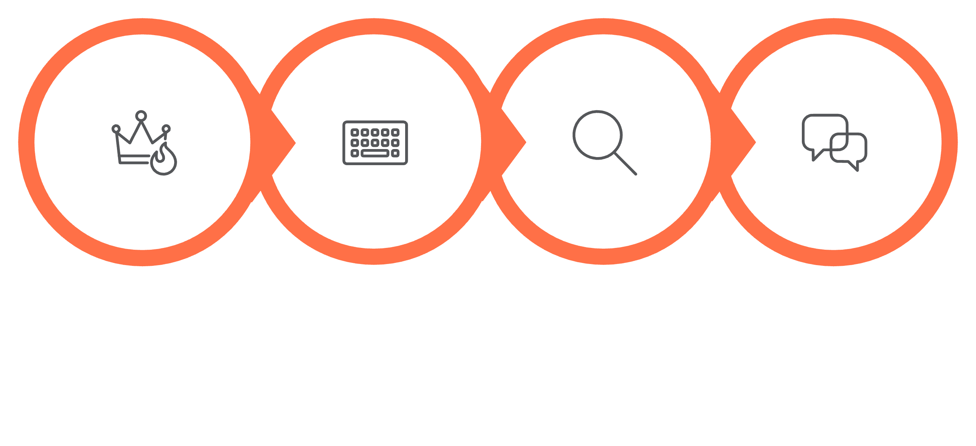
Logic Flow
How the Chatbot Works
The chatbot follows a clear, repeatable loop. Understanding this flow helps you debug, extend, and improve the bot with confidence.
Match Keywords
Respond or Exit
Start Chatbot
Read Input
The loop continues until the user types an exit command like bye or quit, at which point the bot saves the session and closes gracefully.

Slide 8
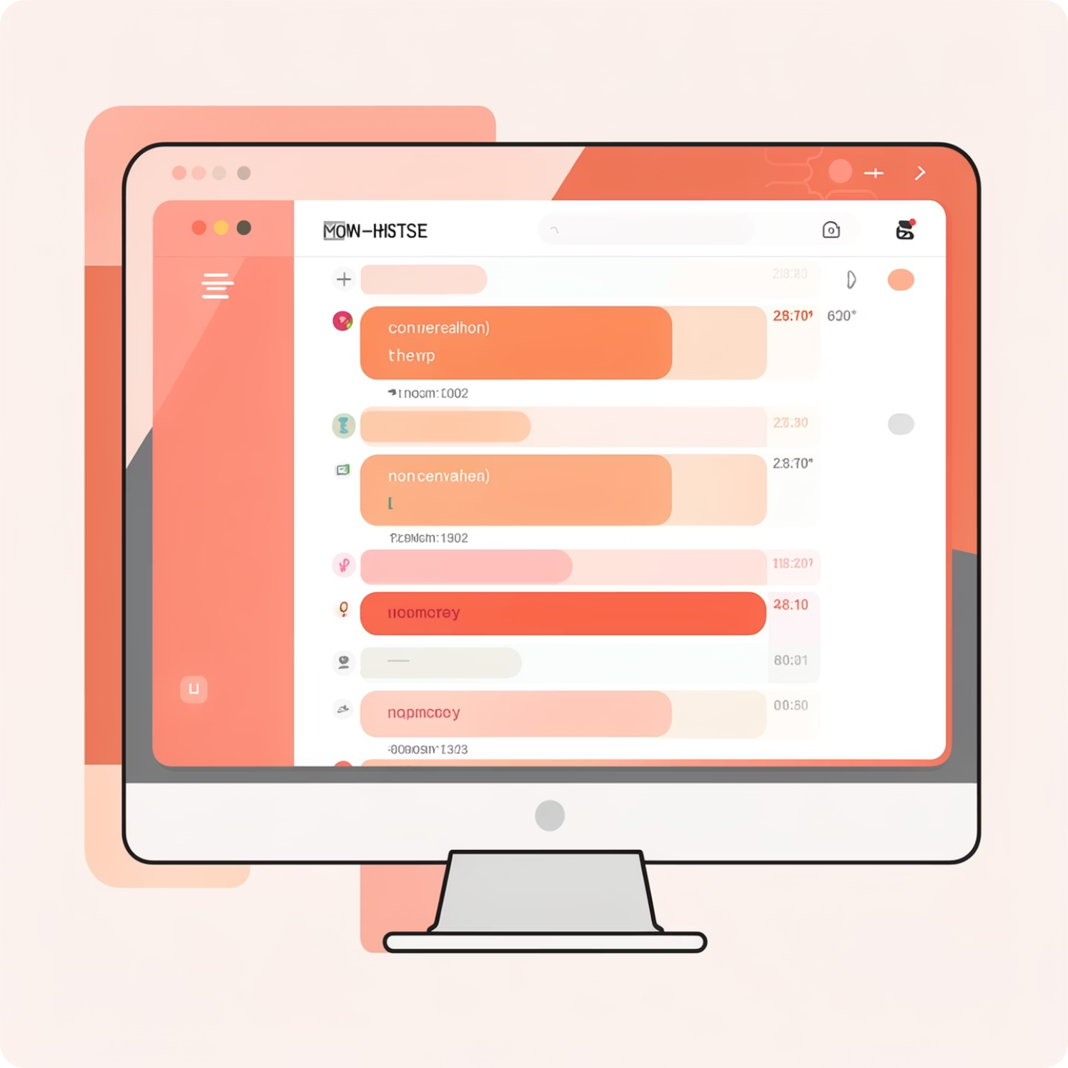

File Logging
Saving Conversations to a File
One of the standout features of this chatbot is automatic file logging. Every message exchanged during a session is written to chat_history.txt in real time.
This is achieved using Python's built-in open() function in append mode ('a'), which adds new lines without overwriting previous conversations.
File logging is useful for debugging, reviewing conversations, and building training data for future ML models.
Step 1
Step 2
Open file with open('chat_history.txt', 'a')
Write user and bot messages using file.write()
Step 3
Close the file with file.close() after each session

Slide 9
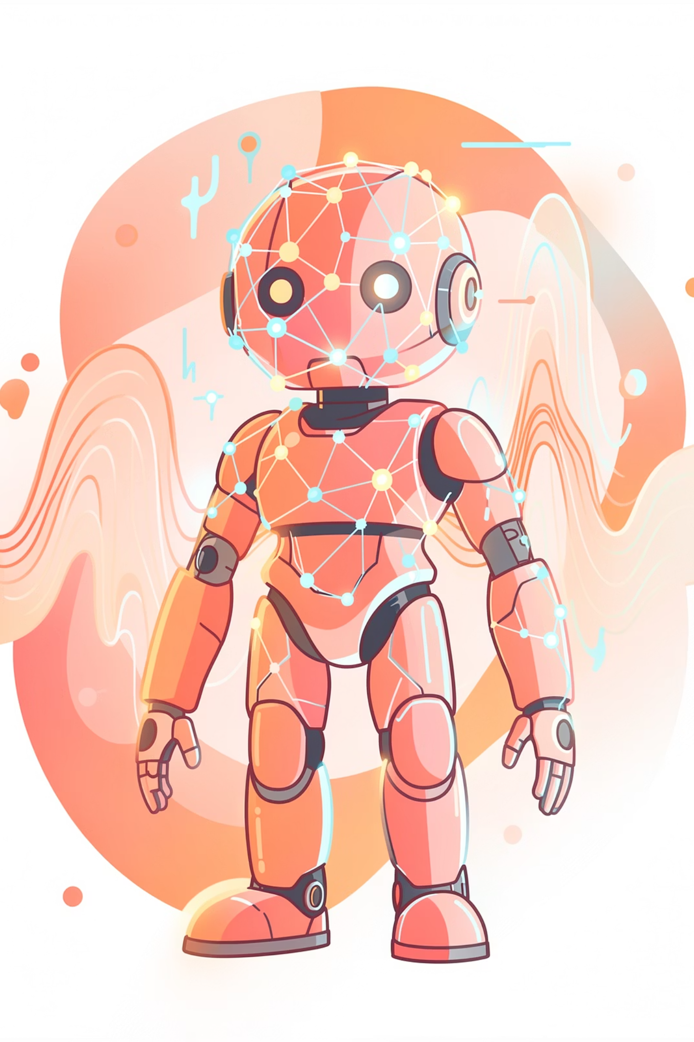
Looking Ahead
Future Scope & Enhancements
The Mini AI Chatbot is just the beginning. With a solid foundation in place, there are exciting possibilities to make it smarter, more natural, and more interactive.
Machine Learning
Train a model on conversation data so the bot learns and improves its responses over time.
Natural Language Processing
Use NLP libraries like spaCy or NLTK to understand context, intent, and sentiment beyond keywords.
Voice Recognition
Add speech-to-text and text-to-speech so users can talk to the bot instead of typing.
GUI or Web Interface
Build a graphical interface using Tkinter or deploy a web version with Flask for a richer experience.

Slide 10

Summary
Conclusion & Key Takeaways
This project demonstrates that you can build a fully functional chatbot using only Python's core features — no complex libraries needed. It is a perfect starting point for anyone learning Python or exploring conversational AI.
Thank You!
Presented by Risana
Date: 11 November 2025
1
Applied Core Python
2
Beginner-Friendly & Scalable
Functions, loops, conditionals, and dictionaries all come together in one practical project.
Happy Coding! 🐍
Simple to understand, yet designed to grow with Machine Learning and NLP additions.
3
Full Functionality Demonstrated
Chat history logging and sample output confirm the bot works end-to-end.
🎉 Well done! You now have a working Mini AI Chatbot built entirely with Python core features.

