Slide 1

Privacy and Security

Slide 2


Slide 3

THIRD PARTY WEBSITES

Slide 5
Basic TIPS
Don’t click on emails, or links from unknown people.
Delete Unused Accounts
Don't Auto Save passwords

Slide 6

Use Private Browsing

Slide 7

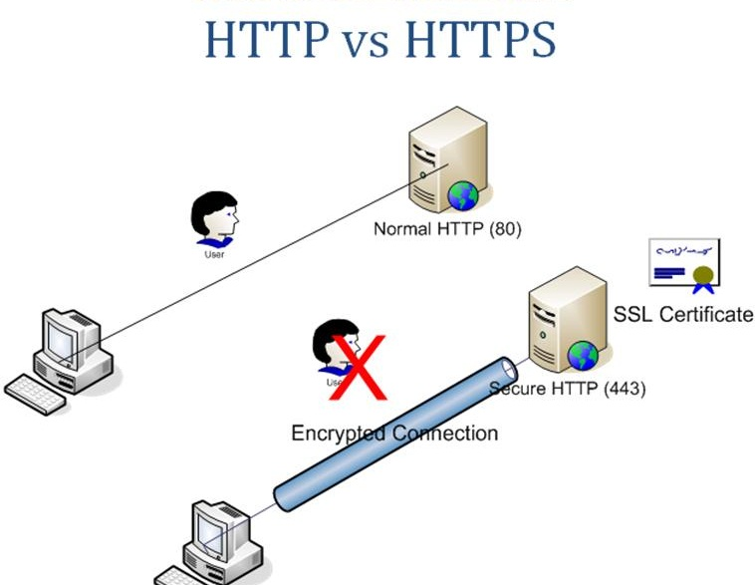

Slide 8
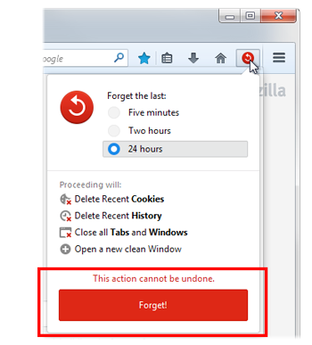
Forget button

Slide 9
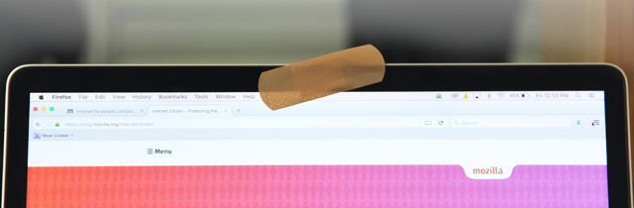
Cover Your Web cam

Slide 10
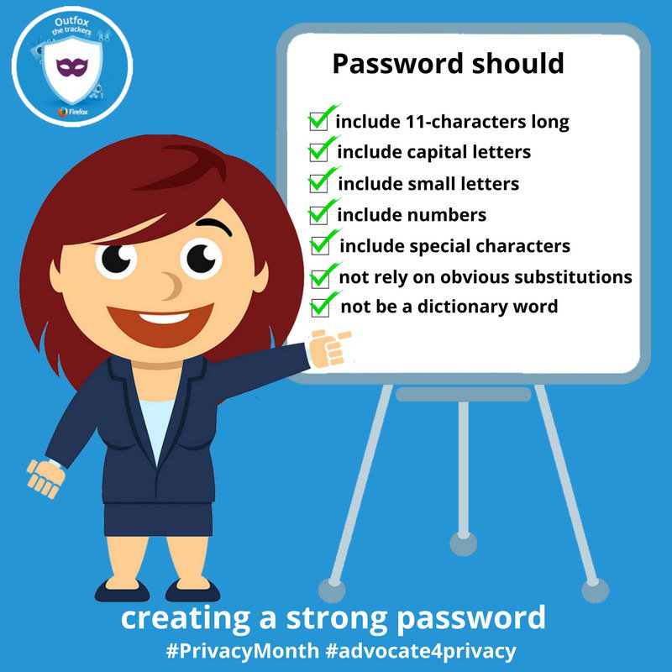
Secure passwordS

Slide 11



Secure Alternatives

Slide 12
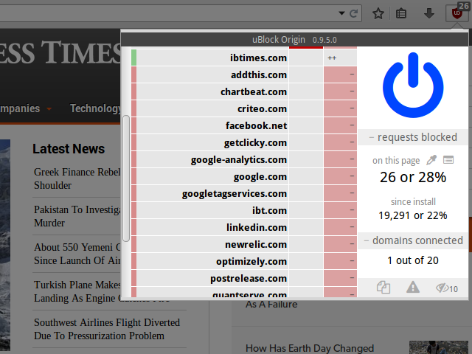


Add-ons

Slide 13
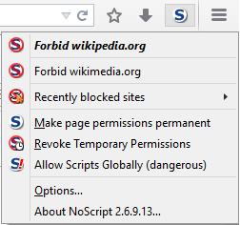
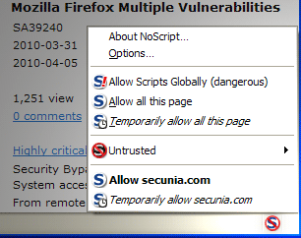
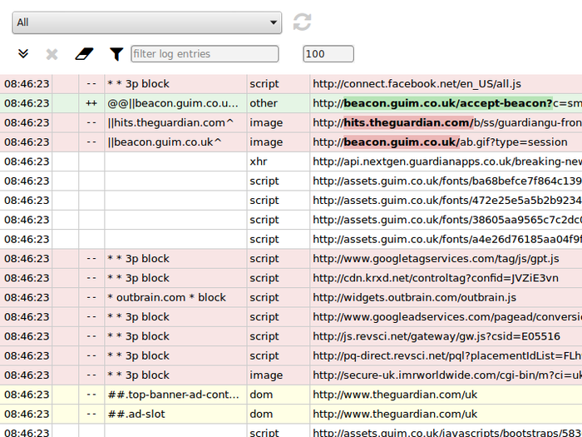
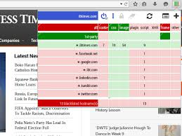

Slide 14


Slide 15



