Slide 1



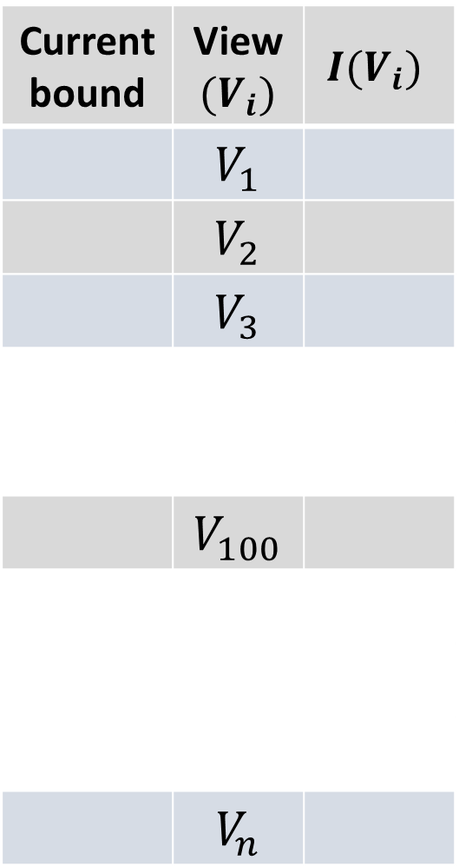






Currentbound | View $(V_{i})$ | $$I(V_{i})$$
 | $$V_{1}$$
 | $$V_{2}$$
 | $$V_{3}$$
 | $$V_{100}$$
 | $$V_{n}$$
$$V_{i}$$
is sorted by
$$setDist (V_{i}, S)$$
Sampling based on
Prediction Interval (PI)
$$V_{s_{1}}$$
$$V_{s_{3}}$$
$$V_{s_{2}}$$
$$V_{s_{5}}$$
$$V_{s_{4}}$$
$$set S$$
$$X or\text{V} \backslash S$$

