Slide 1

Chonnam National University Advanced Network Lab
Modeling and Discovering Human Behavior from Smartphone Sensing Life-Log Data
Rischan Mafrur
May, 27 2015
Notes:
1

Slide 2
Outline
Introduction
Background and Problem Statements
Methods
Data Preprocessing and Features Extraction
Our approach details
Goal
Discovering user behavior based on their smartphone life-log
Modeling human behavior for user identification

Slide 3
Thesis Background and Problem Statements
Common approach -> one features for one purpose.
User has different types and brand of smartphone.
We could not expect the human actions and activities.
There is no ideal data collection which running for 24 hour non-stop.
There is no ideal data collection that can record all of data without any data loss.
We decide to use many of sensors rather than focus only one sensor. Our proposed method tried to deal with those situations.

Slide 4
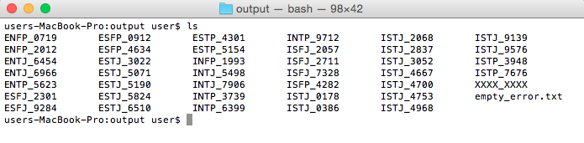
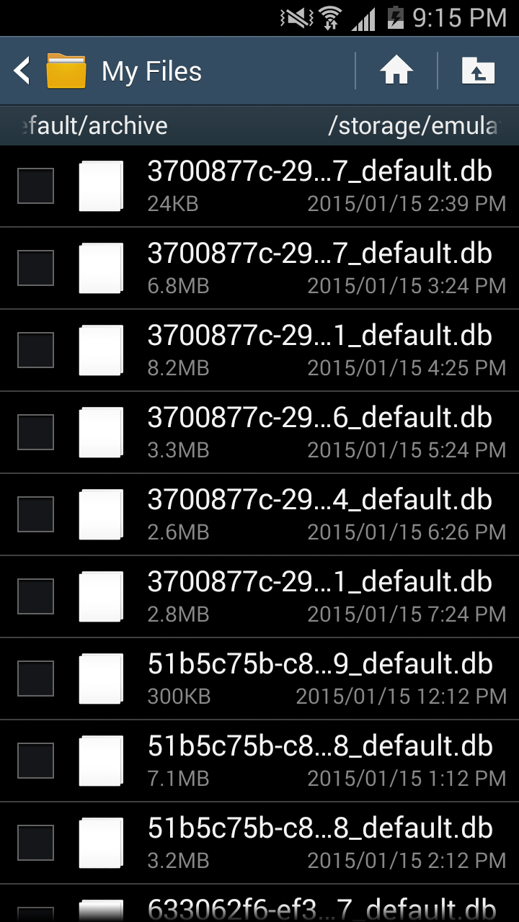
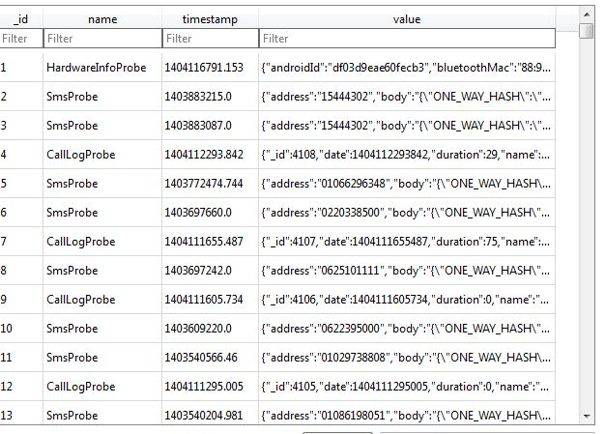
Raw Data looks like

Slide 5
Human Behavior
Alice is research’s student in one of university in Korea.
Almost every day, he wakes up, takes a shower, breakfast, and goes to his campus at 8:40 AM.
He is living in dormitory, he walks from dormitory to his lab (campus) takes 10 minutes.
Usually, he arrives in his lab at 9 AM and then sits on his chair and starts working.

Slide 6
Human behavior in case of smartphone sensing
What is the human behavior in case of smartphone sensing?.
Human daily activities which carried out continuously
In terms of human daily activities, we have to consider about four things:
What kind of activity (e.g meeting, studying, exercising)
When (e.g around 9 AM)
Location (e.g Lab)
Human Interaction (e.g all lab’s members)
Possibilities : same activity in different time and location, different activity in same time and location, etc.

Slide 7
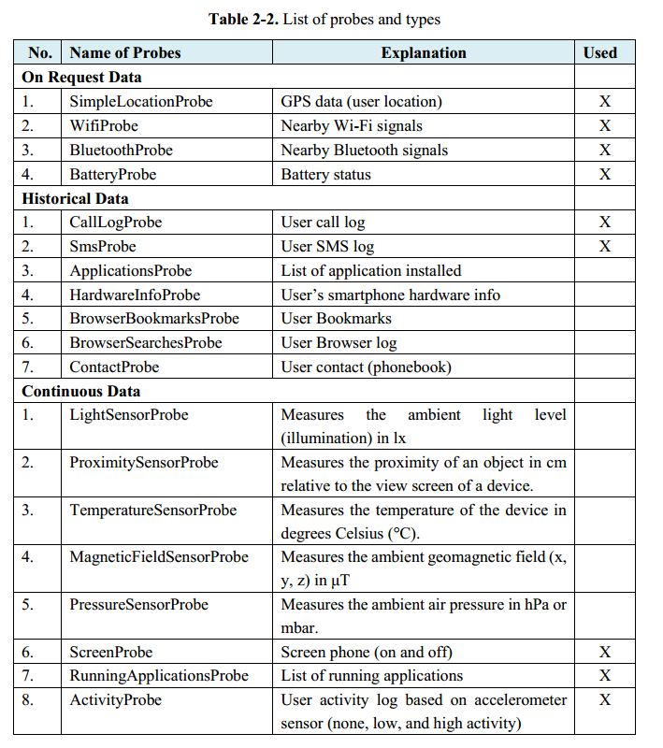
Dataset & Features Description
Proposed Features (every single data has timestamp)
What kind of Human Activity
Activity [none, low, high]
Human Location
GPS [longitude, latitude]
Bluetooth [list of nearby Bluetooth]
Wi-Fi [lists of nearby AP]
Human Interaction (Human->Human)
Call [incoming, outgoing, missed]
SMS [sent, received]
Run apps [social network apps]
Human Interaction (Human -> Smartphone)
Battery [time charging]
Run apps [name of apps]
Screen [screen ON, screen OFF]

Slide 8
Technical Explanation

Slide 9
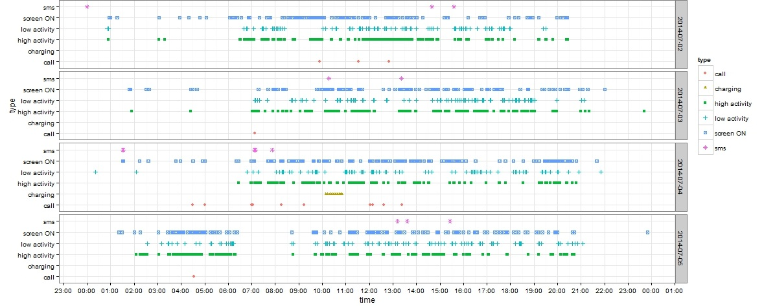
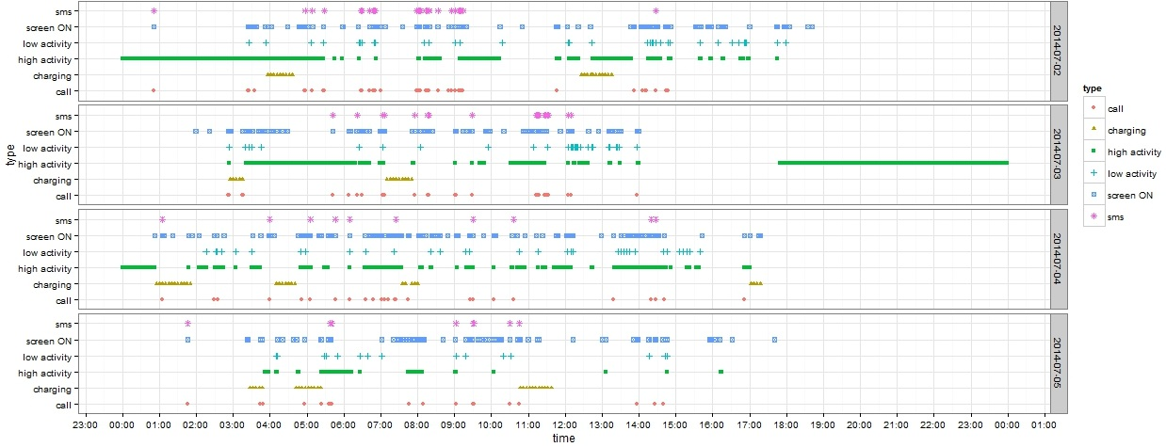
Example data plot from two of students
We store the data from all of students in archive file.
The size of all of data after extracted is around 28.7 GB. Extracted data contain 47 directories in different name for each student’s data.
We used 37 students data.

Slide 10
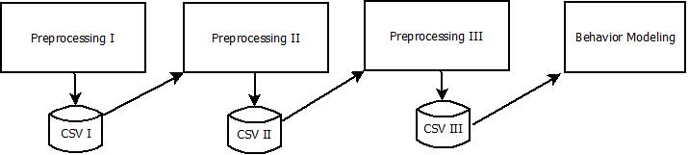
Pre-Processing Summarization
Preprocessing I
Data cleansing
Removing duplication and noisy data
Select the most important data
Preprocessing II
Features Extraction applied in here
Preprocessing III
Features Aggregation
Adding new values based on features
Fitting the features data before modeling behavior applied

Slide 11
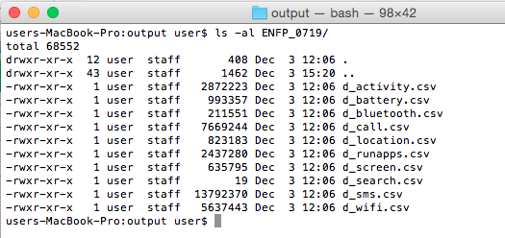
Preprocessing I
Funf lib has problem in historical data such as SMS and call log.
We use 86400 second interval, means the application copy those data from android database system to our application database once every day.
It makes duplication in our database.
The function of this module are:
Removing duplication
Data cleansing
Select the most important data

Slide 12
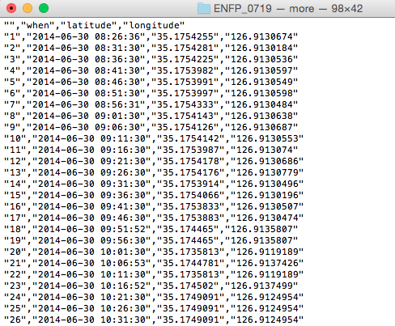
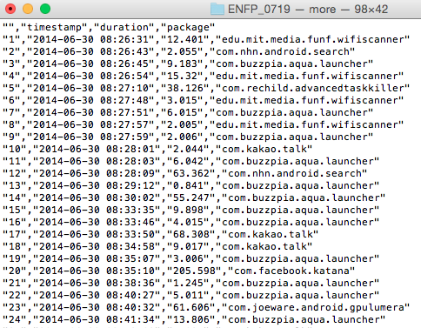
Preprocessing I output data looks like

Slide 13
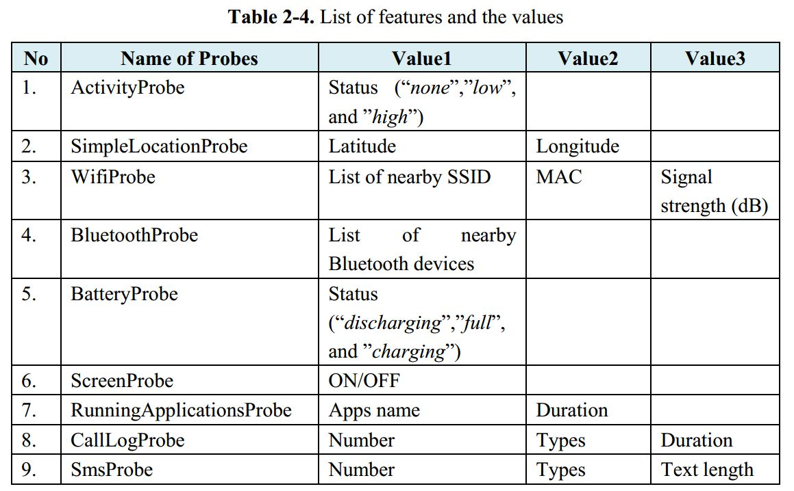
Pre-processing II (Features Extraction)

Slide 14
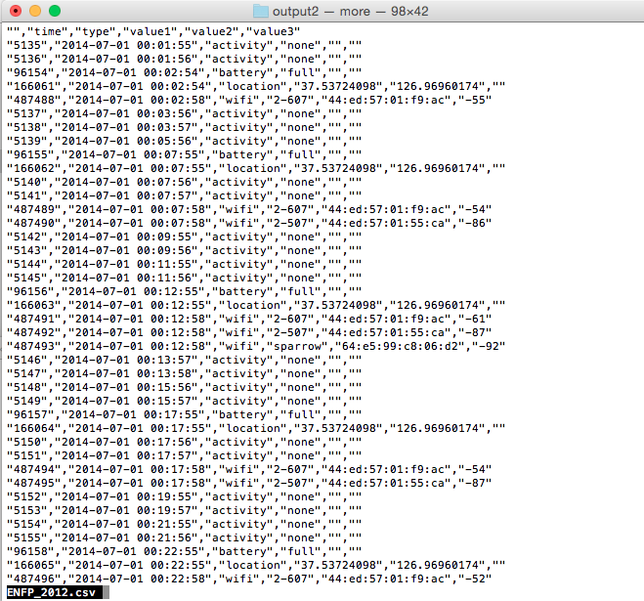
Preprocessing II output data looks like

Slide 15
Preprocessing III
Temporal Granularity (round time value)
< :30 -> round down
> :30 -> round up
Changing Location value to (“same”,”little”,”long”)
0.0001 degree = 11.1132 m (“little”: “between 0.001 ~ 0.005”)
Aggregate values of Wi-Fi and Bluetooth
Removing values such as text length and duration from SMS log and call log, duration from running application probe, MAC and signal strength from nearby Wi-Fi probe.

Slide 16
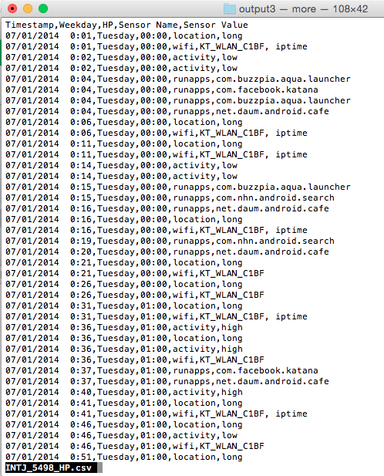
Output of Preprocessing III

Slide 17
Discovering Human Behavior
The data that we have are set of activities.
Behavior means activities which is carried out continuously.
Behavior means set of group activities which has (* similar time, location and similar activity in different days).
Day1
Week1
Day2
Week1
Day3
Week1
Day4
Week1
Day5
Week1
Day6
Week1
Day7
Week1
Day1
Week2

Slide 18
Finding Similar Patterns
Time | Sensor Name | Sensor Value
13:00 | location | same
13:00 | wifi | 1-AP, iptime
14:00 | runapps | kakao
14:00 | location | long
15:00 | runapps | kakao
15:00 | location | little
Time | Sensor Name | Sensor Value
13:00 | location | same
13:00 | wifi | 1-AP, iptime
14:00 | battery | charging
14:00 | wifi | D-link
15:00 | runapps | kakao
15:00 | location | little
Group-1 = 13:00,location,same | 13:00,wifi,1-AP,iptime
Group-1 = 13:00,location,same | 13:00,wifi,1-AP,iptime
Group-2 = 15:00,runapps,kakao | 15:00, location, little
Group-2 = 15:00,runapps,kakao | 15:00, location, little

Slide 19
Algorithm (Similarity Detection)
Data : D, w
Result : All Detected Group in a Window
grpAll, grpTemp, grpPrevious<- NULL
dataValue, dataValueNext <- NULL
while (D in w) for all of D do
dataValue <- D.current.day
dataValueNext <- D.next.day
grpTemp <- findingSimilarPatterns(dataValue, dataValueNext)
if (grpTemp in grpPrevious)then
grpNew <- merge(grpPrevious, grpTemp)
grpAll <- add(grpNew)
else
grpAll <- add(grpTemp)
Behavior Profiling/Modeling
We collect all of intersection data between Groups, and mark those data as the user behaviors.

Slide 20
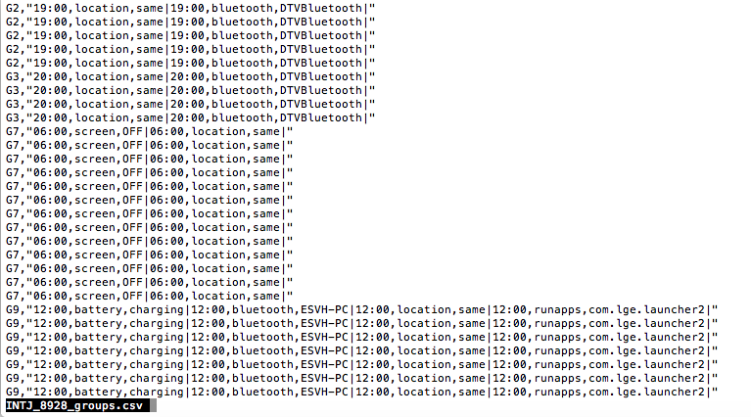
Grouping Result

Slide 21
Testing for Human Identification

Slide 22
Performance Evaluation
Total of dataset around 1 month 20 days
We Divide all of dataset to two parts
First month for creating model (first dataset)
Remaining dataset for testing performance (second dataset)
Modeling user behavior based on first data,
B1: Behavior model/profile.
Extract and Process the second dataset.
Apply similarity detection to second dataset with same setting.
B2: Set of behavior group result from second dataset.
Is the all of B2 identified by Behavior model/profile (B1)?.
How many groups of activities (B2) which identified by behavior model(B1), The percentage of data identified.
Implement this approach for Identification

Slide 23
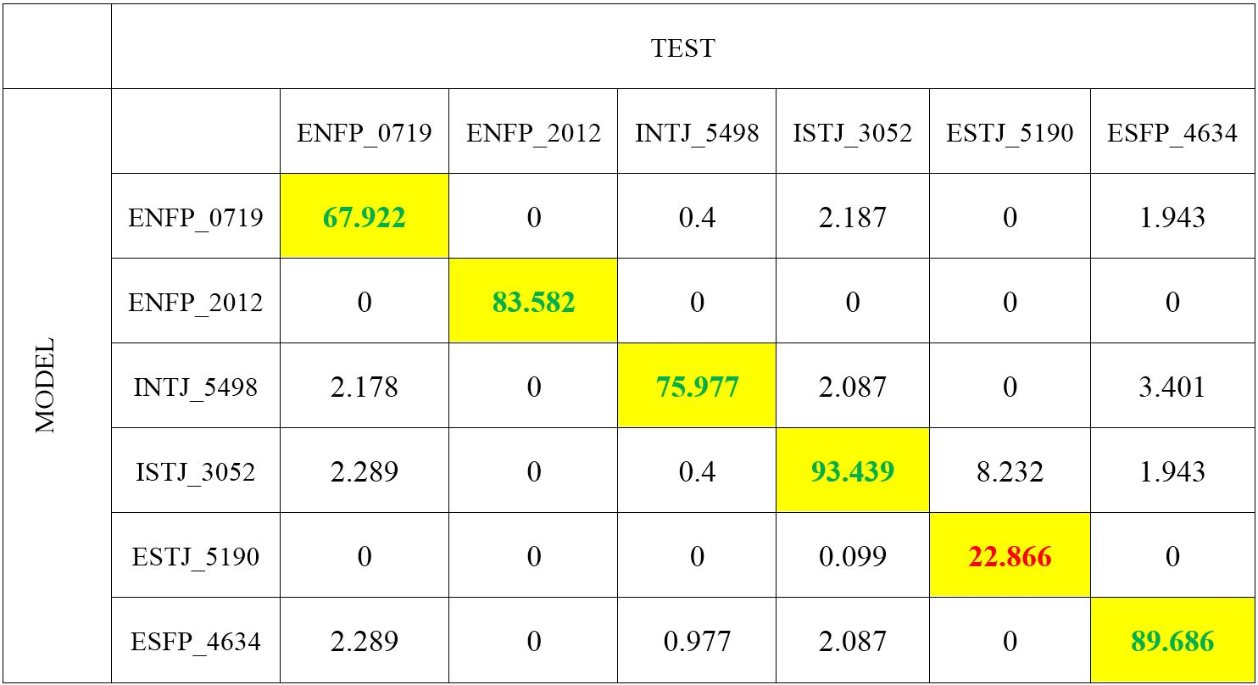
Identification result (Only 6 students)

Slide 24
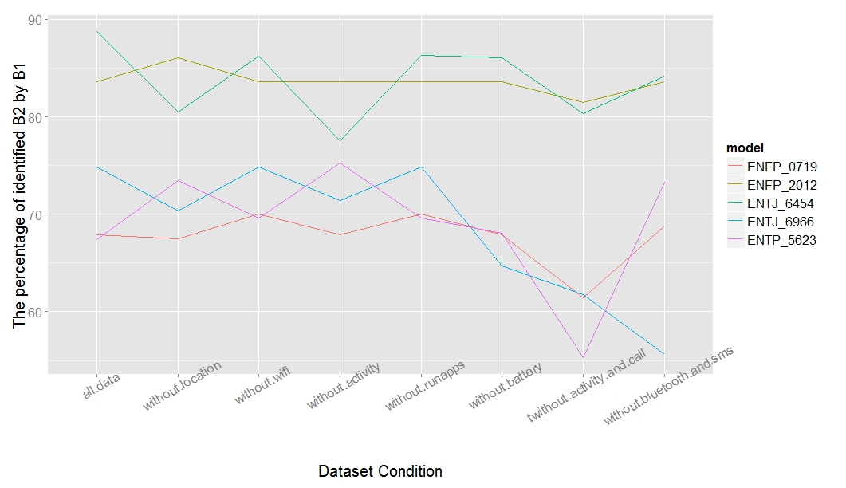
Testing Performance by Removing Some Features

Slide 25
Conclusion and Future Works
Conclusion
In this thesis, we proposed approach that can used for user identification by building human behavior model based on smartphone life-log data.
We use and combine of many sensors instead only focus on one sensors because we realize that sometimes user does not has data from one or more sensors.
Based on our result, we can see that our approach is good enough for user identification. We have tried also to remove one or more features and then observe the accuracy values.
Future Works
Change the size of window
Use different time precision
Use size window in vertical when compare between days

