Slide 1

Chonnam National University Advanced Network Lab
Modeling and Discovering Human Behavior from Smartphone Sensing Life-Log Data
Rischan Mafrur
March, 26 2015
Notes:
1

Slide 2
Outline
Introduction
Background and Problem Statements
Methods
Data Preprocessing and Features Extraction
Our approach
Goal
Modeling and discovering user behavior based on their smartphone life-log
Modeling human behavior for user identification

Slide 3
Human Behavior
Alice is research’s student in one of university in Korea.
Almost every day, he wakes up, takes a shower, breakfast, and goes to his campus at 8:40 AM.
He is living in dormitory, he walks from dormitory to his lab (campus) takes 10 minutes.
Usually, he arrives in his lab at 9 AM and then sits on his chair and starts working.
This example is one of the human daily routine in working day. Based on this story, we can used Alice’s smartphone sensor data to define and build Alice’s behavior model.

Slide 4
Thesis Background and Problem Statements
Common approach which is using one feature is good to know that feature is reliable or not. The problem when we use only one feature is the lack of sensor accuracy, data loss, and we have to think about realistic data.
User has different types and brand of smartphone and each smartphone has different types of sensors and hardware specification and capabilities.
We could not expect the human actions and their activities, they will do actions and activities as they want.
There is no ideal data collection that can record user personal data for every day 24 hour non-stop, it will drain the battery and spend smartphone resource.
There is no ideal data collection that can record all of data without any data loss.
We decide to use many of sensors rather than focus only one sensor, we have to realize that the data from smartphone are heterogeneous data because the data came from multiple sensors and multiple source information.
Our proposed method tried to deal with those situations.

Slide 5
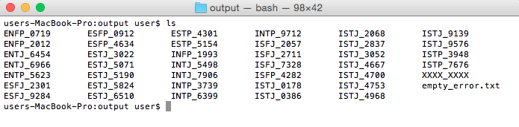
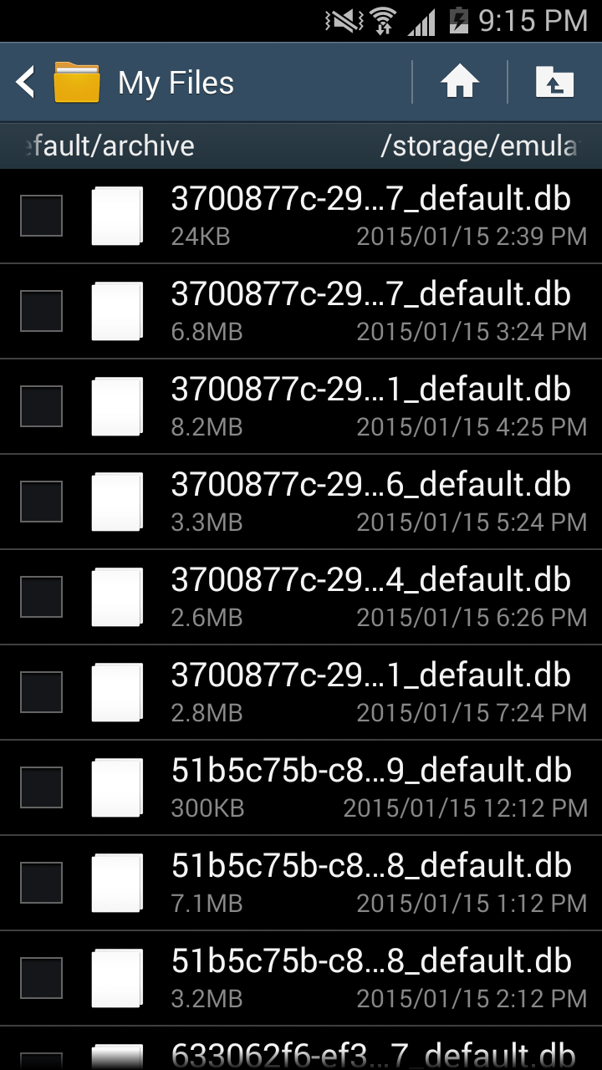
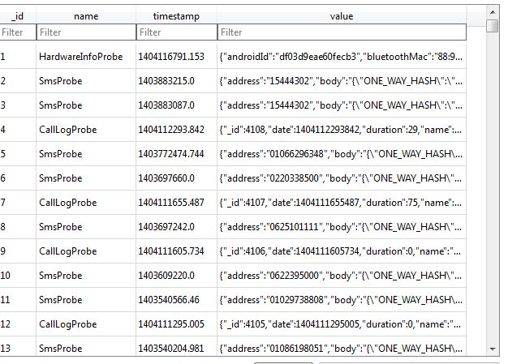
Raw Data looks like

Slide 6
In terms of human behavior
What is the human behavior in case of smartphone sensing?.
Human daily activities which carried out continuously
In terms of human daily activities, we have to consider about four things:
What kind of activity (e.g meeting, study, exercise)
When (e.g around 9 AM)
Location (e.g Lab)
Human Interaction (e.g all lab’s members)
Possibilities : same activity in different time and location, different activity in same time and location, etc.

Slide 7
Features
Proposed Features (every single data has timestamp)
What kind of Human Activity
Activity [none, low, high]
Human Location
GPS [longitude, latitude]
Bluetooth [list of nearby Bluetooth]
Wi-Fi [lists of nearby AP]
Human Interaction (Human->Human)
Call [incoming, outgoing, missed]
SMS [sent, received]
Run apps [social network apps]
Human Interaction (Human -> Smartphone)
Battery [time charging]
Run apps [name of apps]
Screen [screen ON, screen OFF]

Slide 8
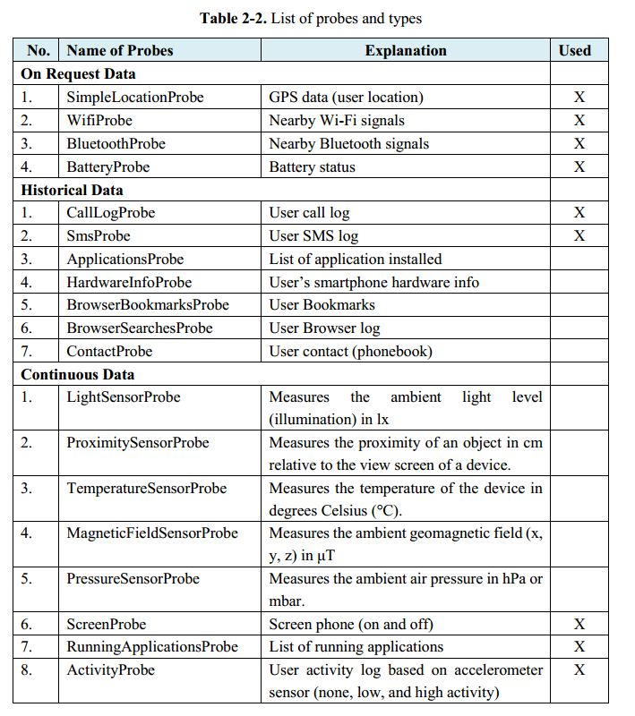
Dataset Description
We store the data from all of students in archive file.
The size of all of data after extracted is around 28.7 GB. Extracted data contain 47 directories in different name for each student’s data.
We used 37 students data.

Slide 9
Technical Explanation

Slide 10
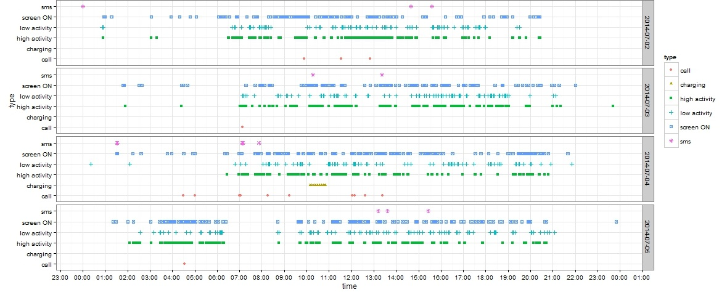
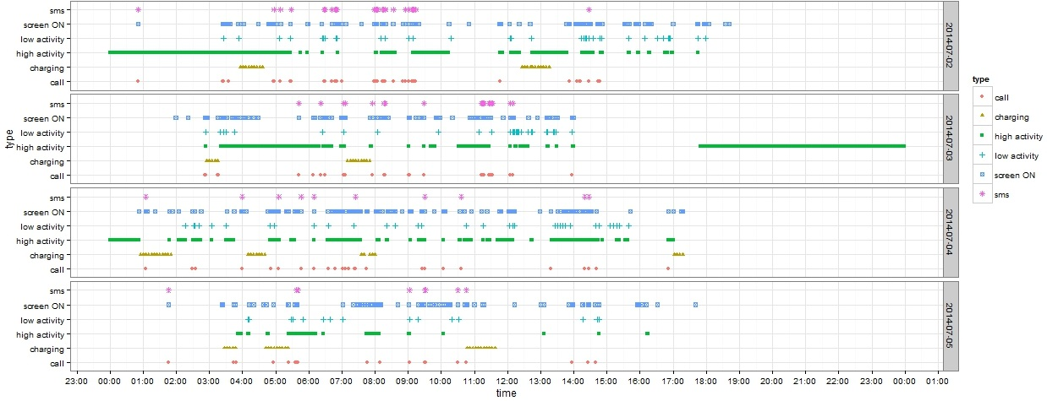
Example data plot from two of students

Slide 11
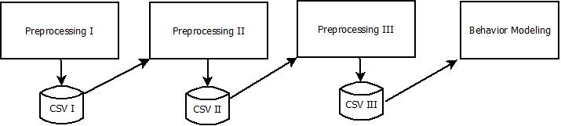
Pre-Processing Summarization
Preprocessing I
Data cleansing
Removing duplication and noisy data
Select the most important data
Preprocessing II
Features Extraction applied in here
Preprocessing III
Features Aggregation
Adding new values based on features
Fitting the dataset before modeling behavior applied

Slide 12
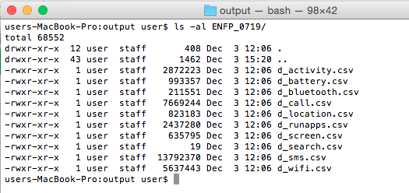
Preprocessing I
Funf lib has problem in historical data such as SMS and call log.
We use 86400 second interval, means the application copy those data from android database system to our application database once every day.
It makes duplication in our database.
The function of this module are:
Removing duplication
Data cleansing
Features separation

Slide 13
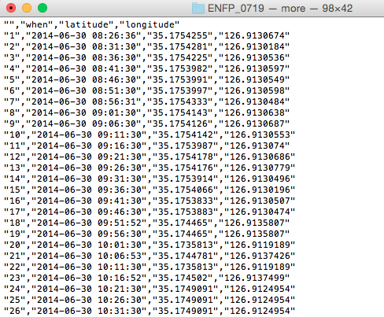
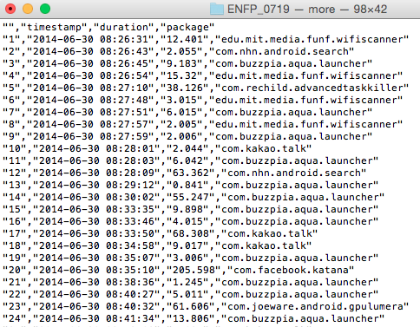
Preprocessing I output data looks like

Slide 14
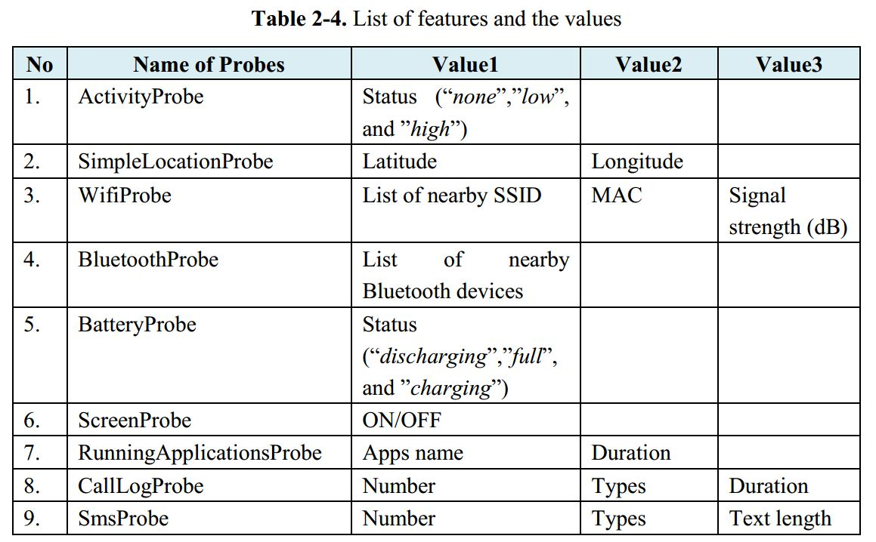
Pre-processing II (Features Extraction)

Slide 15
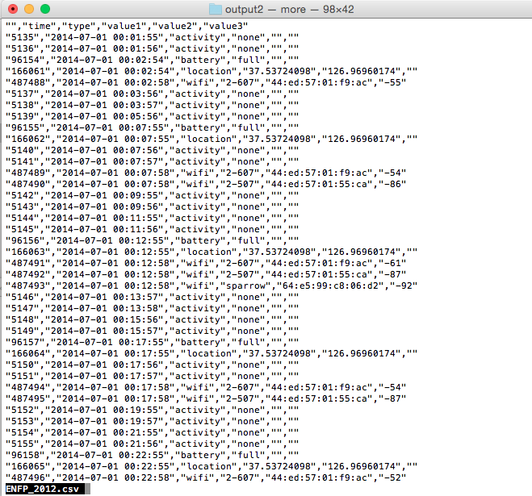
Preprocessing II output data looks like

Slide 16
Preprocessing III
Temporal Granularity (round time value)
< :30 -> round down
> :30 -> round up
Changing Location value to (“same”,”little”,”long”)
0.0001 degree = 11.1132 m (“little”: “between 0.0001 ~ 0.0005”)
Battery : shows != discharging
Screen Status : screen OFF only
Aggregate values of Wi-Fi and Bluetooth
Removing values such as text length and duration from SMS log and call log, duration from running application probe, MAC and signal strength from nearby Wi-Fi probe.

Slide 17
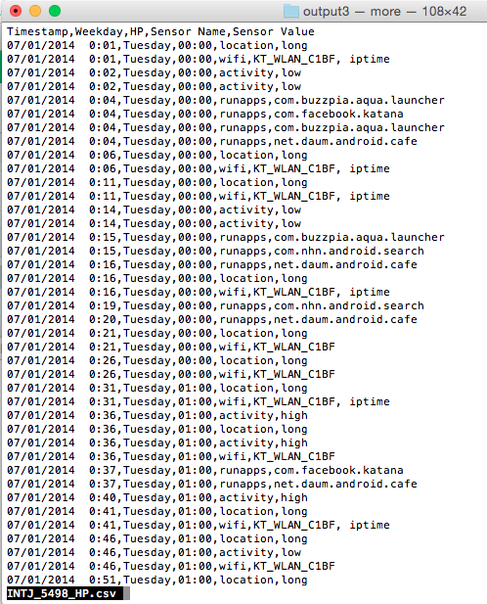
Output of Preprocessing III

Slide 18
Discovering Human Behaviors
The data that we have are set of activities.
Behavior means activities which is carried out continuously.
Behavior means set of group activities which has (* similar time and similar activity).
Day1
Week1
Day2
Week1
Day3
Week1
Day4
Week1
Day5
Week1
Day6
Week1
Day7
Week1
Day1
Week2

Slide 19
Finding Similar Patterns
Time | Sensor Name | Sensor Value
13:00 | location | same
13:00 | wifi | 1-AP, iptime
14:00 | runapps | kakao
14:00 | location | long
15:00 | runapps | kakao
15:00 | location | little
Time | Sensor Name | Sensor Value
13:00 | location | same
13:00 | wifi | 1-AP, iptime
14:00 | battery | charging
14:00 | wifi | D-link
15:00 | runapps | kakao
15:00 | location | little
Group-1 = 13:00,location,same | 13:00,wifi,1-AP,iptime
Group-1 = 13:00,location,same | 13:00,wifi,1-AP,iptime
Group-2 = 15:00,runapps,kakao | 15:00, location, little
Group-2 = 15:00,runapps,kakao | 15:00, location, little

Slide 20
Algorithm (Similarity Detection)
Data : D, w
Result : All Detected Group in a Window
grpAll, grpTemp, grpPrevious<- NULL
dataValue, dataValueNext <- NULL
while (D in w) for all of D do
dataValue <- D.current.day
dataValueNext <- D.next.day
grpTemp <- findingSimilarPatterns(dataValue, dataValueNext)
if (grpTemp in grpPrevious)then
grpNew <- merge(grpPrevious, grpTemp)
grpAll <- add(grpNew)
else
grpAll <- add(grpTemp)
Behavior Profiling/Modeling
We collect all of intersection data between Groups, and mark those data as the user behaviors.

Slide 21
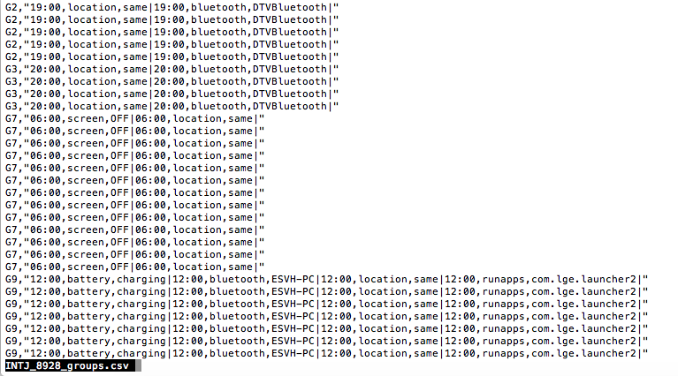
Grouping Result

Slide 22
Performance Evaluation
Total of dataset around 1 month 20 days
We Divide all of dataset to two parts
First month for creating model (first dataset)
Remaining dataset for testing performance (second dataset)
Modeling user behavior based on first data,
B1: Behavior model/profile.
Extract and Process the second dataset.
Apply similarity detection to second dataset with same setting.
B2: Set of behavior group result from second dataset.
Is the all of B2 identified by Behavior model/profile (B1).
Calculate group detection, The percentage of data identified.
Implement this approach for Identification

Slide 23
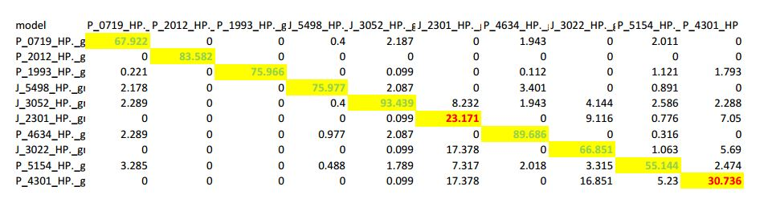
Confusion matrix (Only 10 students)

