Slide 1

Chonnam National University Advanced Network Lab
Modeling and Discovering Human Behavior from Smartphone Sensing Life-Log Data
Rischan Mafrur
June 1, 2015
Supervised by Professor Deokjai Choi
Notes:
1

Slide 2
Outlines
Introduction
Background and Problem Statements
Methods
Data Collection
Data Preprocessing and Features Extraction
Our approach details
Goal
Discovering user behavior based on their smartphone life-log
Modeling human behavior, evaluated for user identification

Slide 3
Thesis Background and Problem Statements
Common approaches
Most of previous works is focus on one sensor for one purpose.
Realistic Dataset
User has different types and brand of smartphone.
We could not expect the human actions and activities.
There is no ideal data collection which running for 24 hour non-stop.
There is no ideal data collection that can record all of data without any data loss.
We decide to use many of sensors rather than focus only one sensor. Our proposed method tried to deal with those situations.

Slide 4
Data Collection
To collect user personal data from their smartphone, we developed an Android application data collector based on Funf library.
This application follows opportunistic sensing method.
We asked 47 students to use our application around less than 2 months.
The size of all of the data is around 28.7 GB.
In this research, We used only 37 students data.
The raw data looks like can be seen in the next slide.

Slide 5
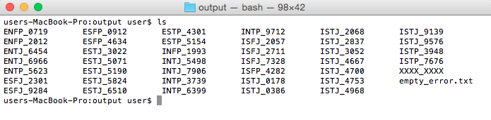
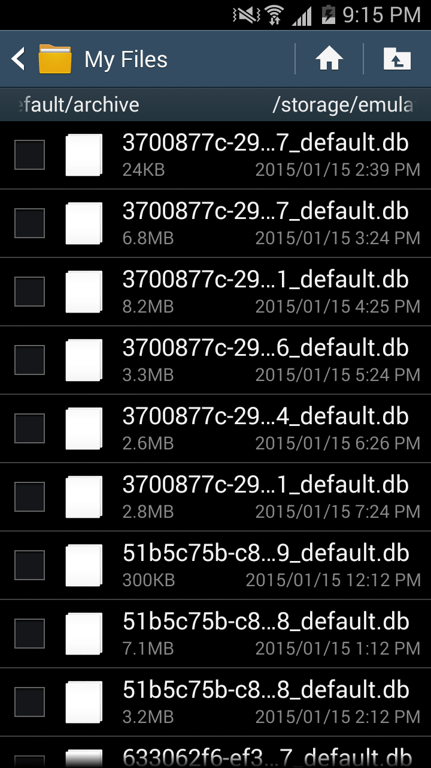
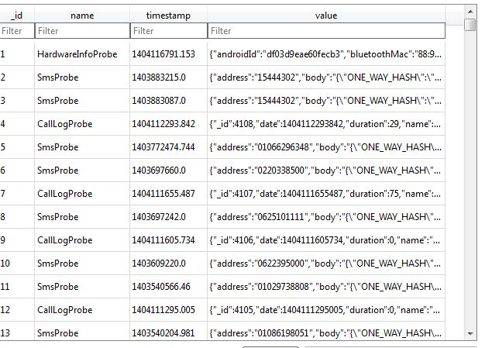
Raw Data looks like

Slide 6
Human behavior in case of smartphone sensing
What is the human behavior in case of smartphone sensing?.
Human daily activities which carried out continuously
In terms of human daily activities, we have to consider about four things:
What kind of activity (e.g meeting, studying, exercising)
When (e.g around 9 AM)
Location (e.g Lab)
Human Interaction (e.g all lab’s members)
What, When, Where, Who/with Whom

Slide 7
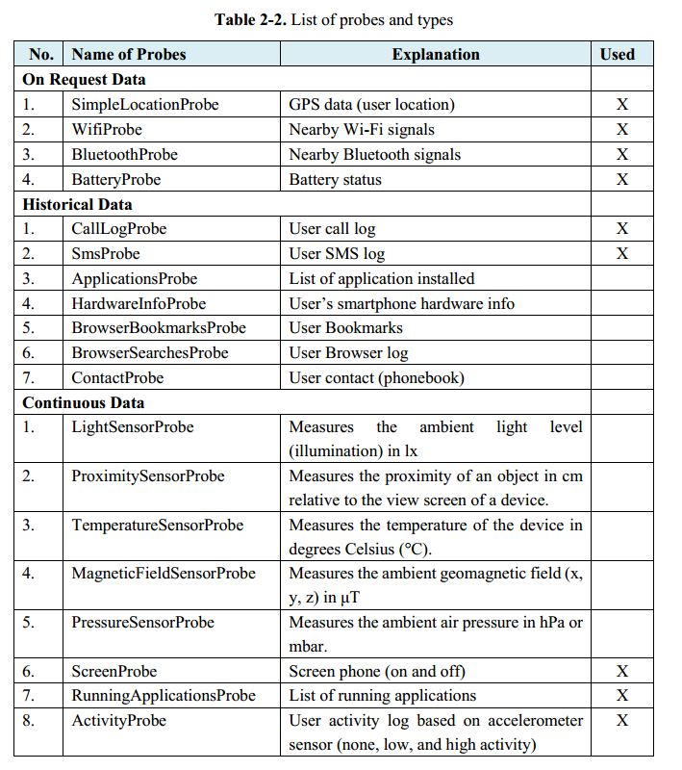
Proposed Sensors Description
Proposed Sensors data
(every single data has timestamp)
What kind of Human Activity
Activity [none, low, high]
Human Location
GPS [longitude, latitude]
Nearby Bluetooth [list of nearby Bluetooth]
Nearby Wi-Fi [lists of nearby AP]
Human Interaction (Human->Human)
Call [incoming, outgoing, missed]
SMS [sent, received]
Human Interaction (Human -> Smartphone)
Battery [time charging]
Run apps [name of apps]
Screen [screen ON, screen OFF]

Slide 8
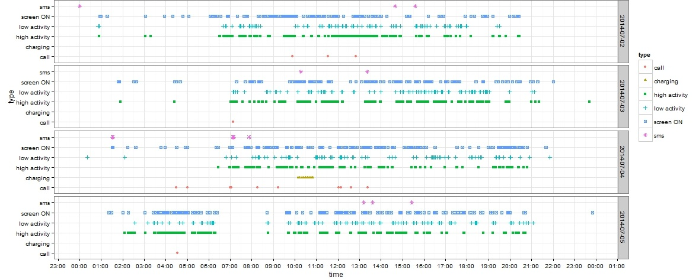
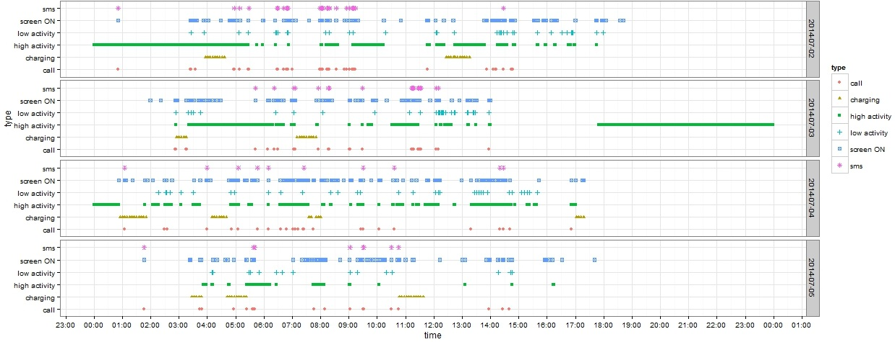
Example data plot from two students

Slide 9
Technical Explanation

Slide 10
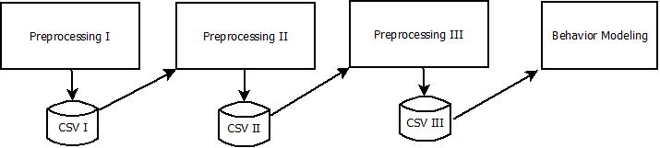
Pre-Processing Summarization
Preprocessing I
Data cleansing
Removing duplication and noisy data
Select the most important data
Preprocessing II
Features Extraction applied in here
Preprocessing III
Features Aggregation
Adding new values based on features
Fitting the features data before modeling behavior applied
Source code can be access on http://github.com/rischanlab/Rfunf

Slide 11
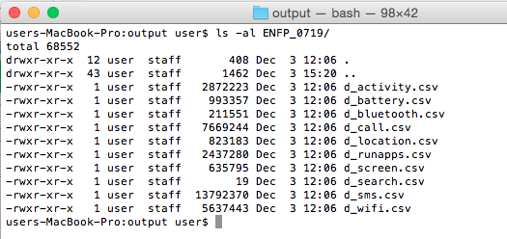
Preprocessing I
The function of this module are:
Removing duplication
Data cleansing
Select the most important data

Slide 12
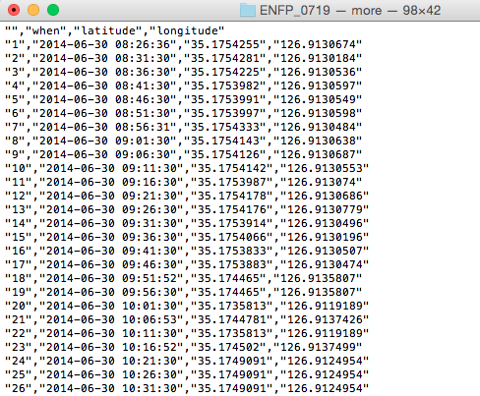
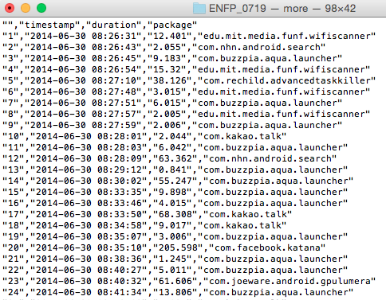
Preprocessing I output data looks like

Slide 13
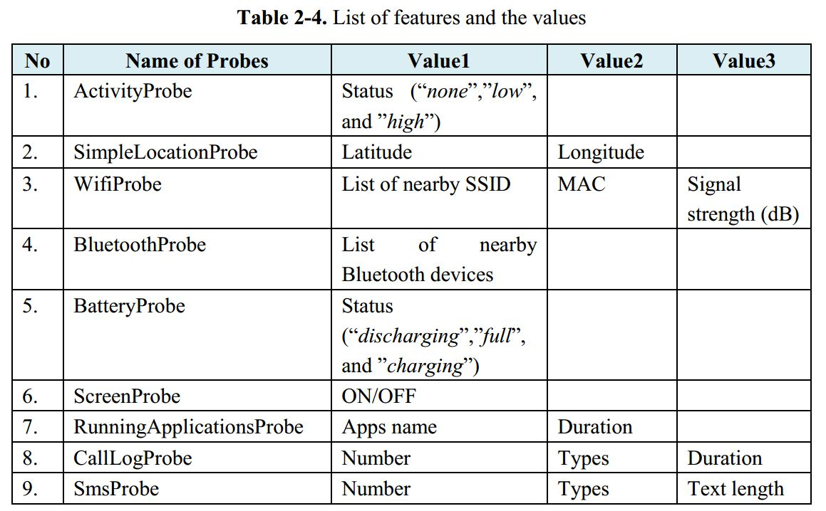
Pre-processing II (Features Extraction)
List of Sensors Data and Features Values.

Slide 14
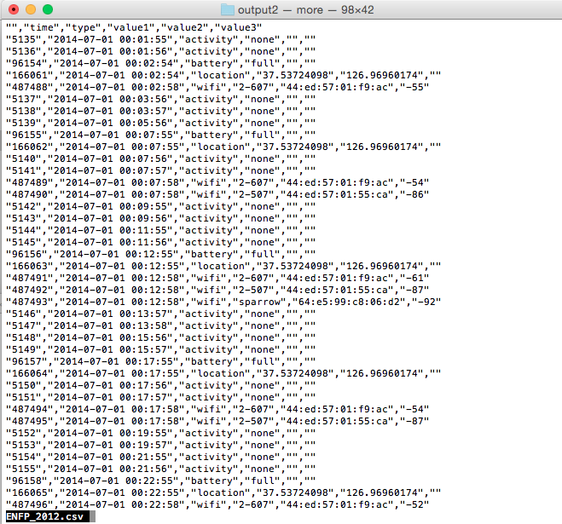
Preprocessing II output data looks like

Slide 15
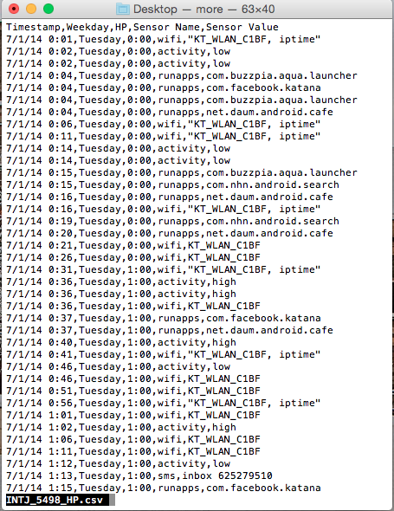
Preprocessing III
Machine Time -> Human Time (round time values)
< :30 -> round down
> :30 -> round up
Change the Location value to (“same”,”little”,”long”)
0.0001 degree = 11.1132 m (“little”: “between 0.001 ~ 0.005”)

Slide 16
Discovering Human Behavior (Finding Similar Patterns)
Day1
Week1
Day2
Week1
Day3
Week1
Day4
Week1
Day5
Week1
Day6
Week1
Day7
Week1
Day1
Week2
Time | Sensor Name | Sensor Value
13:00 | location | same
13:00 | wifi | 1-AP, iptime
14:00 | runapps | kakao
14:00 | location | long
15:00 | runapps | kakao
15:00 | location | little
Time | Sensor Name | Sensor Value
13:00 | location | same
13:00 | wifi | 1-AP, iptime
14:00 | battery | charging
14:00 | wifi | D-link
15:00 | runapps | kakao
15:00 | location | little
Group-1 = 13:00,location,same | 13:00,wifi,1-AP,iptime
Group-1 = 13:00,location,same | 13:00,wifi,1-AP,iptime
Group-2 = 15:00,runapps,kakao | 15:00, location, little
Group-2 = 15:00,runapps,kakao | 15:00, location, little

Slide 17
Algorithm (Similarity Detection)
Data : D, w
Result : All Detected Group in a Window
grpAll, grpTemp, grpPrevious<- NULL
dataValue, dataValueNext <- NULL
while (D in w) for all of D do
dataValue <- D.current.day
dataValueNext <- D.next.day
grpTemp <- findingSimilarPatterns(dataValue, dataValueNext)
if (grpTemp in grpPrevious)then
grpNew <- merge(grpPrevious, grpTemp)
grpAll <- add(grpNew)
else
grpAll <- add(grpTemp)
Behavior Profiling/Modeling
We collect all of intersection data between Groups, and mark those data as the user behaviors.

Slide 18
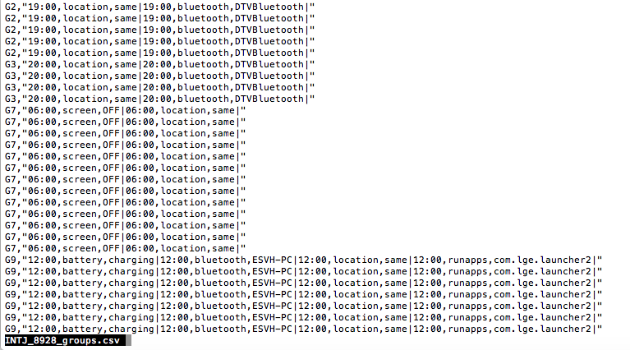
Grouping Result

Slide 19
Testing for Human Identification

Slide 20
Performance Evaluation
The total dataset collected around 1 month 20 days
We Divide all dataset to two parts
First month for creating model (first dataset)
Remaining dataset for testing performance (second dataset)
Modeling user behavior based on first dataset,
B1: Behavior model/profile.
Extract and Process the second dataset.
Apply similarity detection to second dataset with same setting.
B2: Set of behavior groups from second dataset.
Is all of B2 identified by (B1)?.
How many set of group activities (B2) which identified by (B1), Calculate the percentage of data identified.
Show result in Table.

Slide 21
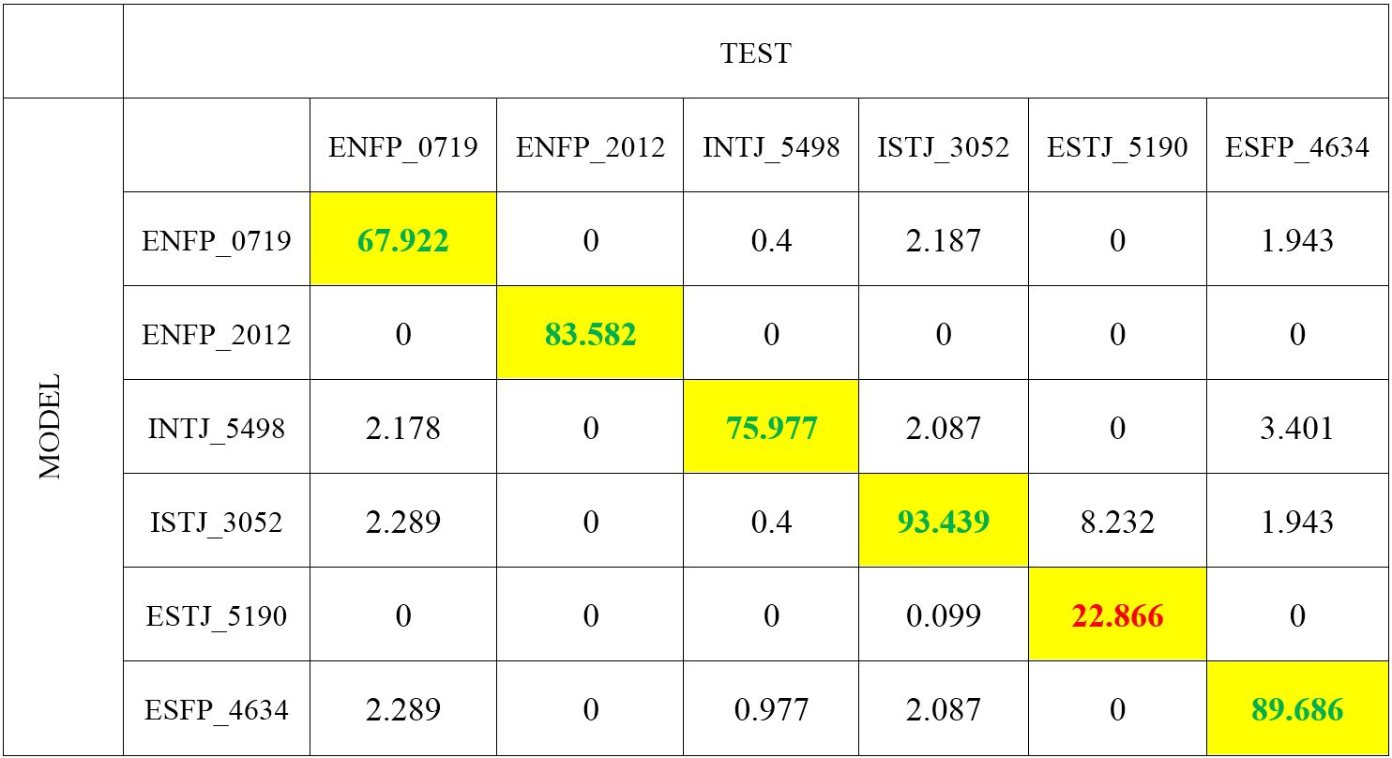
Identification result (Only 6 students)
Full Table can be seen on Appendix, page : 42.

Slide 22
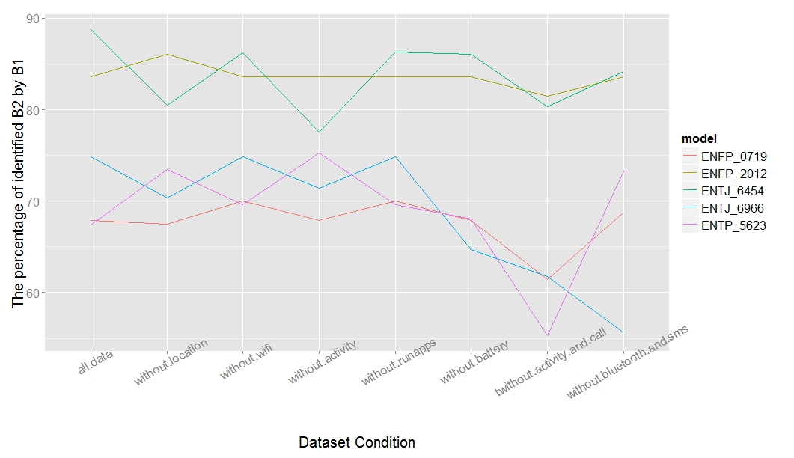
Testing Performance by Removing Some Data Sensors
Full Figure can be seen on Appendix, page : 48.

Slide 23
Conclusions
In this thesis, we have proposed a approach for daily behavioral pattern mining or discovering human behavior from multiple information (data sensors).
We use and combine many sensors instead only focus on one sensors because we realize about realistic dataset.
To evaluate our model, we use our model for human identification.
Based on identification result, we can see that our model is good enough for user identification. We have tried to remove one or more data sensors and accuracy values is still good enough.

Slide 24


Slide 25
Future Works
Change the size of window (find optimal window), current size is static (2 days).
Use different time precision (10, 15, 30 minutes), current is one hour.
Use window in vertical when compare between days (It will compare between same days in different week).
Update Model (It will make system better and better but how about storage).
Find best number of days for creating model.
Big goal of this research is to develop smart personal assistant.

