Slide 1

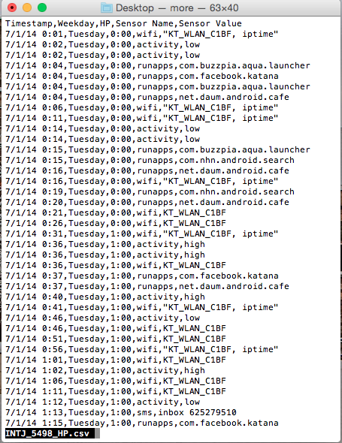
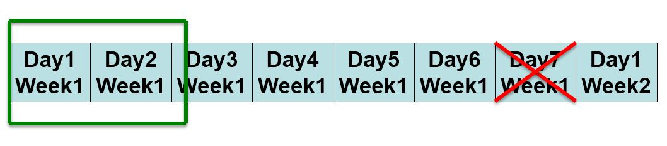
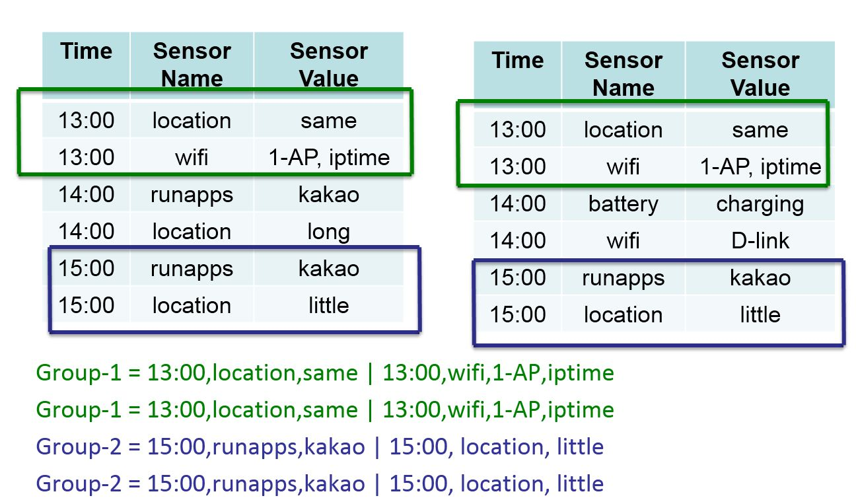
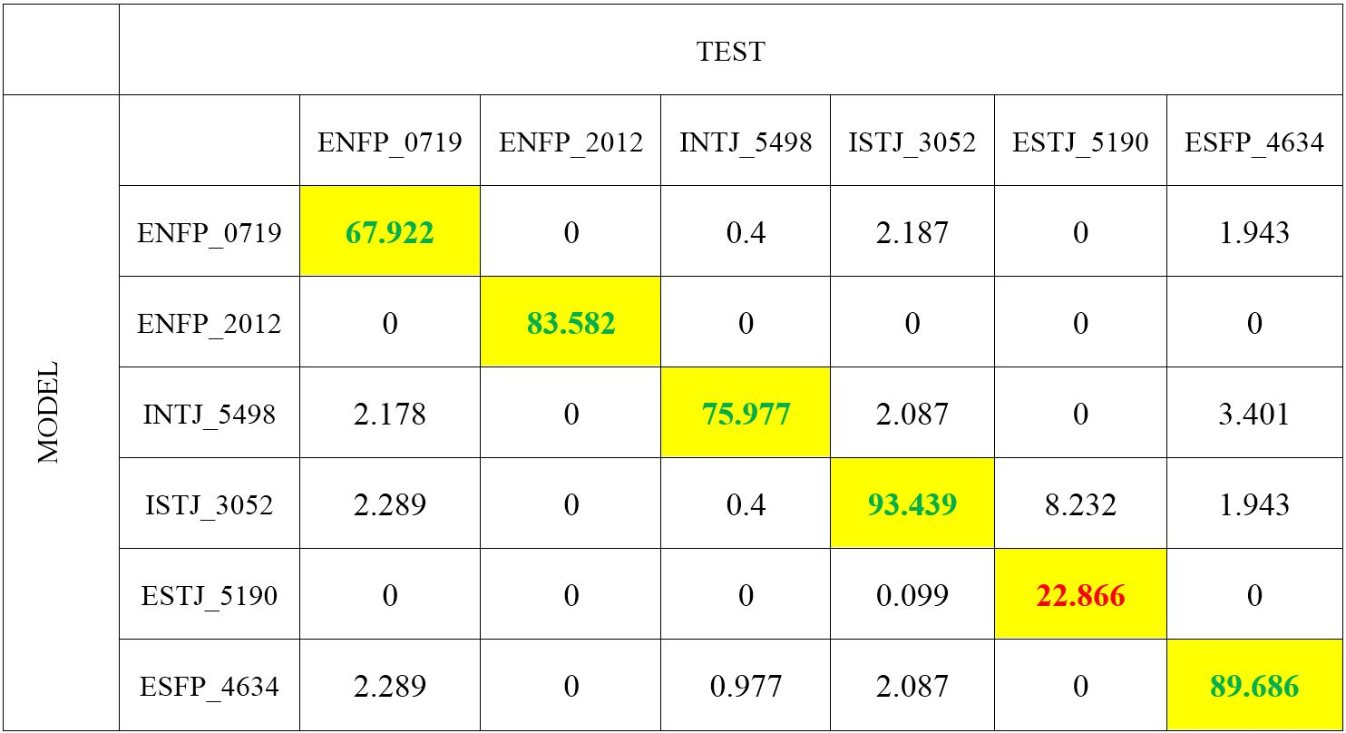
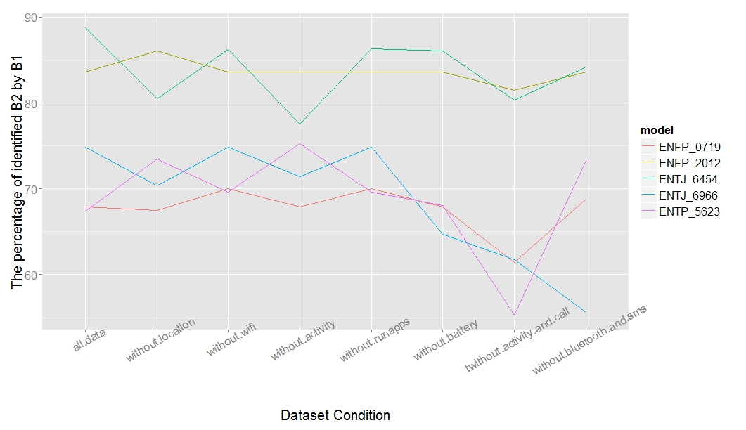
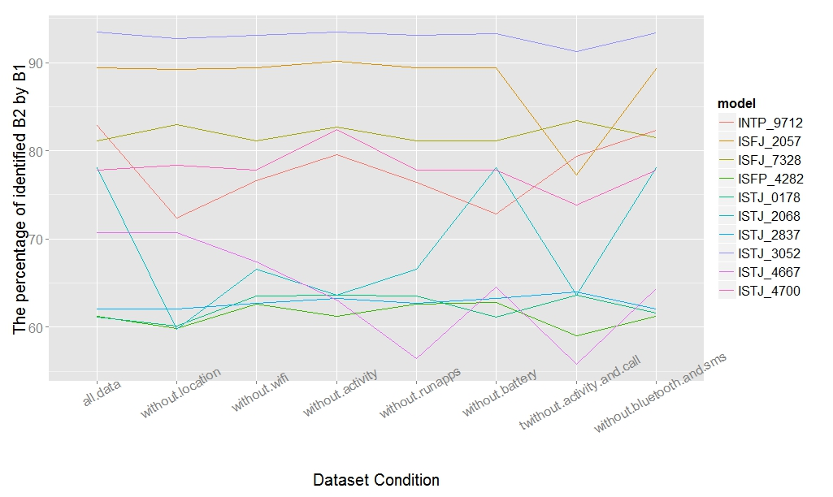
Modeling and Discovering Human Behavior from Smartphone Sensing Life-Log Data
Rischan Mafrur and Deokjai Choi*
School of Electronic and Computer Engineering, Chonnam National University, Buk-gu, Gwangju, 500-757, Korea
Discussion
Research about sensing framework has conducted by many researcher. Based on the sensor and log capability of smartphone, we can develop many useful system or application in different domain such as healthcare [1], transportation [2], personal and social behavior [3], and etc. Most of the research focus only for one goal such as CRNTC+ [4] which only focus on health care application and etc. Most of sensing framework also based on participatory method which need user intervention and sometimes bothering user.
Advanced Network Lab,
Chonnam National University
Gwangju, South Korea
Introduction
Today, personal data is becoming a new economic asset. The data that we generated from our smartphone, our interaction in social media, its like oil in the Internet. An increasing of personal data in the internet cause some issue such as privacy issue, complexity processing, and etc. That will require a highly reliable, available, serviceable, and secure infrastructure at its core and robust innovation. This paper propose a new concept, design and implementation of sensing as a service framework. The goals of this paper are: 1) to provide rich application as a service based on users personal data log; 2) to bridging the user and third party such as developers in term of developing applications and researcher for research based on user personal data; 3) to develop reliable, available, serviceable and secure sensing as a service framework.
Contributions of this research as follows:
We focus on sensing framework development which is can collect as much as possible personal user data with high quality of data.
The proposed framework is based on opportunistic method for collecting data because we want to increase user coziness.
To analyzing the data, we focus on unsupervised learning.
This framework can be used for many purposes, everyone who need personal user data in their research or their system can use this framework.
This framework can be bridge between user and application developer or researchers.
This framework consist of three main components: Personal data collector application based on opportunistic sensing method, the result of analyzing and visualizing the data that can be accessed by the users and REST API that can be used by third party for research or other authorized application, equipped with documentation.
Data Collection and Processing
Result of User Identification
Personal Data Collector Application
Table Identification
In this research we did not develop our application from scratch. We use Funf library and we named the application as senseF. The size of the data that we can collect is influenced by the activity of the users. Based on our experiment users with high activity can result bigger size data around 1GB each month and vice versa, the users with less activity will result smaller size data. To protect user privacy, we use encryption method (hash) to sensitive data such as phone number in contact, text message log, phone call log, and etc. The list of data that we collect are: GPS, Wi-Fi, Bluetooth, Battery, Call, SMS, and Contact log, Application installed and running, Hardware Info, Browser Bookmark and Search log, Activity log, Screen status, Sensors (Accelerometer, Magnetic Field, Temperature, Proximity, Light, Pressure)
Data Processing
This table is not confusion matrix table, it just looks like confusion matrix table. The value means the percentage of B2 (behavior data from test dataset) which is successfully identified by B1 (behavior model). We can see that our proposed features and our approach can be used for identification. Based on the result and our observation, our approach can achieved good enough accuracy even some of users has bad accuracy (under 30%).
Figure A shows how the framework works. First, user have to register to the web portal. The web portal provide the information about how to use the portal and the link to the senseF application. senseF application is develop based on opportunistic sensing method. So after it installed by the user, the application will collect the data automatically without intervention from the user.
Conclusion
Model Performance Testing
In this paper, we proposed approach that can used for user identification by building human behavior model. We use and combine of many sensors instead only focus on one sensors because we realize that sometimes user does not has data from one or more sensors. Based on our result, we can see that our approach is good enough for user identification.
We have tried also to remove one or more features and then observe the accuracy values. The result shows that even one or more features have been removed but our system still can be used for identification. It means our system can handle the problem if one or more data sensors from users smartphone not available. Some of result from our system can achieve up to more than 80 % accuracy but any four of them have less than 30 % accuracy. In this paper, we have explained also why four students have bad accuracy. The reasons are students who have bad accuracy, their dataset are too small and they have different behavior for almost each day which our approach does not capable to handle it. Despite some of accuracy values are under 30 % but those values still can be used for identification because those values are the highest one compared to others. It means that our approach still good enough for identification system.
Human Behavior Identification
Performance Evaluation by Removing some Sensors Data
References
P. Pierleoni, L. Pernini, A. Belli, and L. Palma, “An android-based heart monitoring system for the elderly and for patients with heart disease” International Journal of Telemedicine and Applications, vol. 2014,p. 11, 2014.
B. Hoh, T. Iwuchukwu, Q. Jacobson, D. Work, A. M. Bayen, J. C. Herrera, M. Gruteser, and M. Annavaram, “Enhancing privacy and accuracy in probe vehicle-based traffic monitoring via virtual trip lines” Mobile Computing, IEEE Transactions, vol. 11(5), pp. 849–864, May 2012.
R. LiKamWa, Y. Liu, N. D. Lane, and L. Zhong, “Can your smartphone infer your mood?” in PhoneSense workshop, 2011.
Spina, G., Roberts, F., Weppner, J. , Lukowicz, P. , Amft, O., “Crntc+: A smartphone-based sensor processing framework for prototyping personal healthcare applications” in 2013 7th International Conference on Pervasive Computing Technologies for Healthcare (PervasiveHealth), 2013.
IETF, “The oauth 2.0 authorization framework” Oct. 2012. http://tools.ietf.org/html/rfc6749.
Performance Evaluation by Removing some Sensors DataData Visualization and Analysis. To process and analyze the data, we use R language. To visualize, we use shiny, one of web application framework which support to turn data analysis into interactive web application. Figure a and b show the example of web layout when opened by using mobile phone browser. Figure c shows the example of web layout using PC browser. Actually many system or research topics that can be produced from user personal data, now we still focus on personal activity and scheduling system such as when users open the page of daily activity they will see the message likes ”.
Advanced Network Lab

