Slide 1

Chonnam National University Advanced Network Lab
Modeling and Discovering Human Behavior from Smartphone Sensing Life-Log Data
Rischan Mafrur
March, 9 2015
Notes:
1

Slide 2
Outline
Introduction
Background and Problem Statements
Methods
Data Preprocessing and Feature Extraction
Techniques
Goal
Building Human Behavior model which can describe about theirs daily activities. It’s can be used for behavior Identification

Slide 3
Thesis Background and Problem Statement
Common approach which is using one feature is good to know that feature is reliable or not. The problem when we use only one feature is the lack of sensor accuracy, data loss, and we have to think about realistic data.
In realistic environment, user has different type and brand of smartphone and each smartphone has different type of sensors and hardware specification and capabilities.
We could not expect the human actions and their activities, they will do actions and activities as they want.
There is no ideal data collection that can record user personal data for every day 24 hour non-stop, it will drain the battery and spend smartphone resource.
There is no ideal data collection that can record all of data without any data loss.
We decide to use many of sensors rather than focus only one sensor, we have to realize that the data from smartphone are heterogeneous data because the data came from multiple sensors and multiple source information. And based on those heterogeneous data, we want to know whether those features are reliable or not.

Slide 4
In terms of human behavior
What is the human behavior in case of smartphone sensing?.
Human daily activities which carried out continuously
In terms of human daily activities, we have to consider about four things:
What kind of activity (e.g meeting, study, exercise)
When (e.g around 9 AM)
Location (e.g Lab)
With Whom (e.g all lab’s members)
Possibilities : same activity in different time and location, different activity in same time and location, etc.

Slide 5
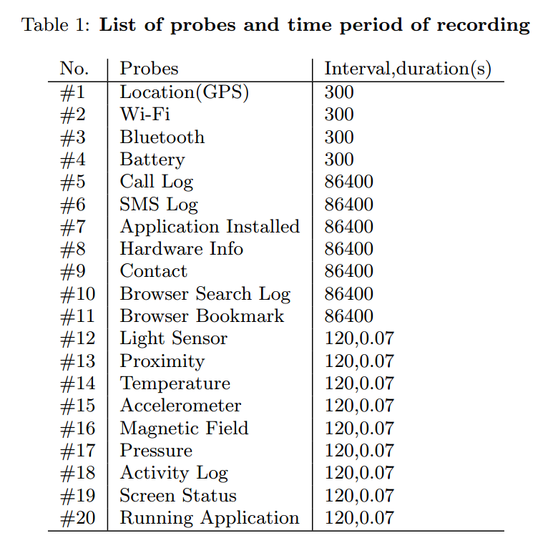
Data
Available data : 39 students
Less than two months

Slide 6
Features
Proposed Features (every single data has timestamp)
What kind of Human Activity
Activity [none, low, high]
Human Location
GPS [longitude, latitude]
Bluetooth [list of nearby Bluetooth]
Wi-Fi [lists of nearby AP]
With Whom (Human->Human Interaction)
Call [incoming, outgoing, missed]
SMS [sent, received]
Run apps [social network apps]
With Whom (Human -> Smartphone interaction)
Battery [time charging]
Run apps [name of apps]
Screen [screen ON, screen OFF]

Slide 7
Methods
Proposed Techniques
Extracting Features from raw data
Considering about Temporal Granularity.
Discovering Frequent (continues) patterns (sequence mining)
Similarity Pattern Detection

Slide 8
Technical Explanation

Slide 9
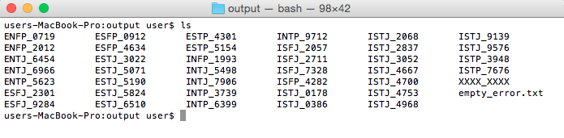
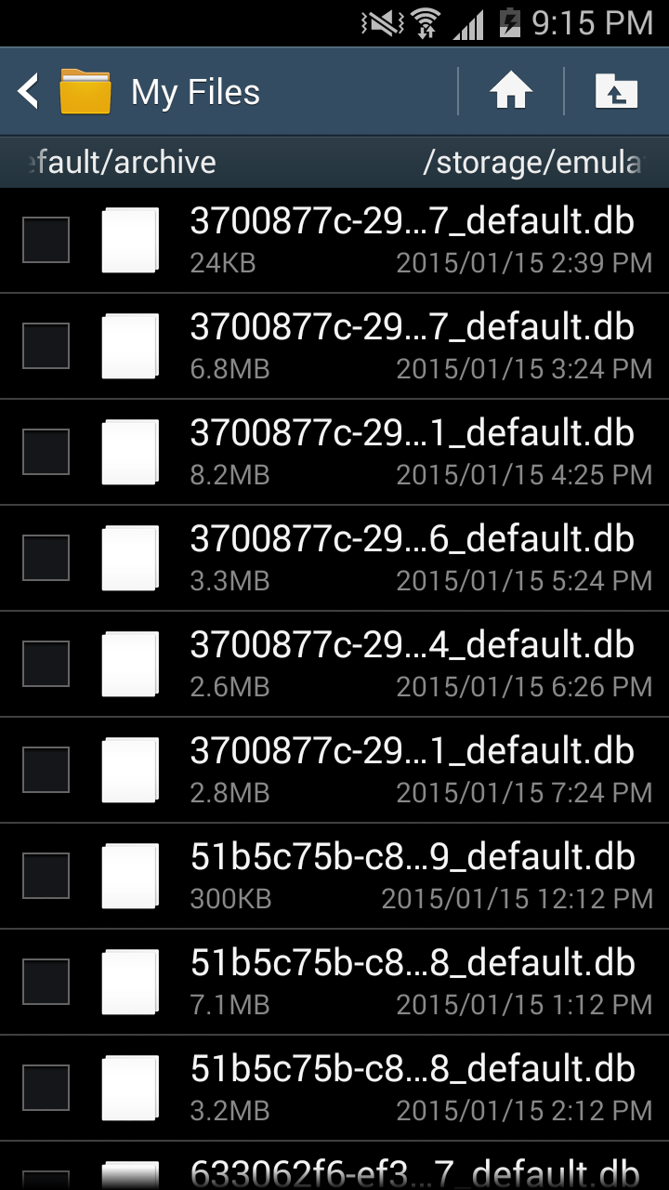
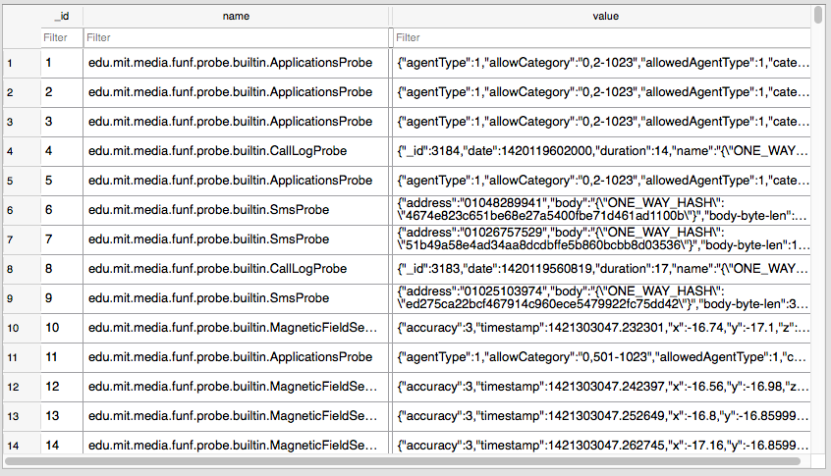
Data Preprocessing
Raw Data

Slide 10
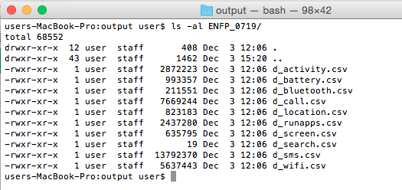
Preprocessing I

Slide 11
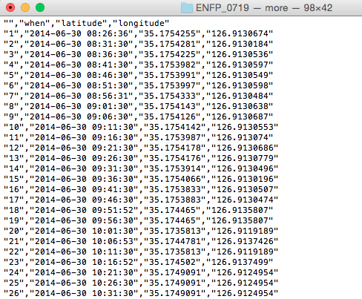
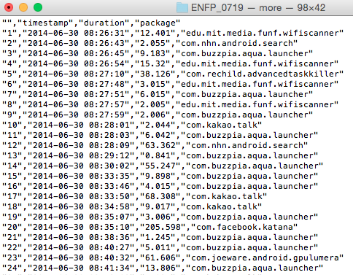
Preprocessing I cont…

Slide 12
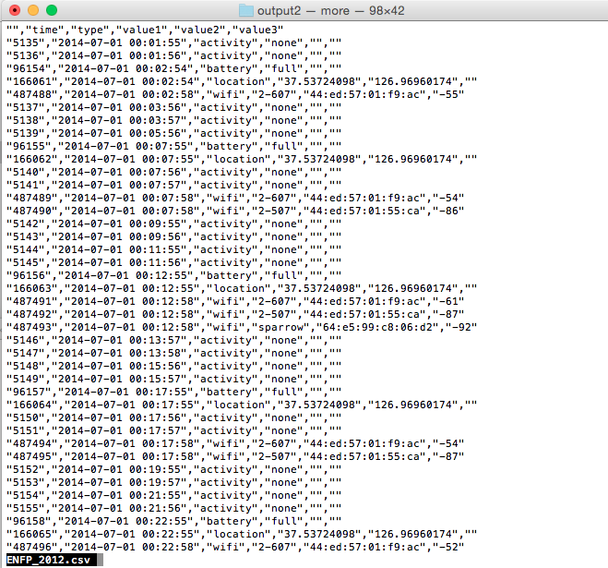
Output Preprocessing I

Slide 13
Preprocessing III
Temporal Granularity (round time value)
< :30 -> round down
> :30 -> round up
Changing Location value to (“same”,”little”,”long”)
0.0001 degree = 11.1132 m (“little”: “between 0.0001 ~ 0.0005”)
Battery : shows != discharging
Screen Status : shows screen OFF only
Activity : shows low and high
Aggregate values of Wi-Fi and Bluetooth

Slide 14
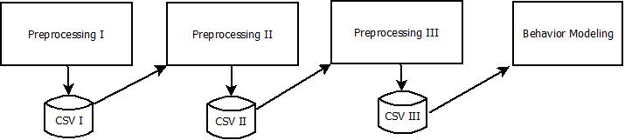
Pre-Processing Summarization
Preprocessing I
Data cleansing
Removing duplication and noisy data
Preprocessing II
Features Extraction
Preprocessing III
Features Aggregation
Adding new values based on features

Slide 15
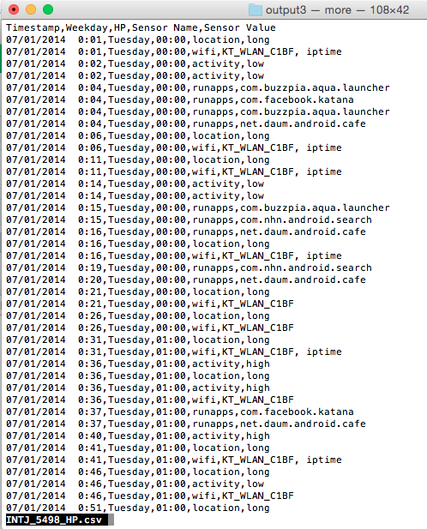
Output of Preprocessing III

Slide 16
Grouping and Creating Behavior Model
Creating Human Behavior Model does not cares about what kind of activities, when, and where but we care about pattern and motif identification.
Window Size : 2
Number of days : 30 days (5 weeks)
Window Number : 15 window number
Group -> set of similar activities
B -> Behavior -> Set of Groups
Profiling -> Intersection Group between windows

Slide 17
Our Approach
The data that we have are set of activities.
Behavior means activities which is carried out continuously.
Behavior means set of group activities which has (* similar time, similar location, similar activity).
Day1
Week1
Day2
Week1
Day3
Week1
Day4
Week1
Day5
Week1
Day6
Week1
Day7
Week1
Day1
Week2

Slide 18
Finding Similar Patterns
Time | Sensor Name | Sensor Value
13:00 | location | same
13:00 | wifi | 1-AP, iptime
14:00 | runapps | kakao
14:00 | location | long
15:00 | runapps | kakao
15:00 | location | little
Time | Sensor Name | Sensor Value
13:00 | location | same
13:00 | wifi | 1-AP, iptime
14:00 | battery | charging
14:00 | wifi | D-link
15:00 | runapps | kakao
15:00 | location | little
Group-1 = 13:00,location,same | 13:00,wifi,1-AP,iptime
Group-1 = 13:00,location,same | 13:00,wifi,1-AP,iptime
Group-2 = 15:00,runapps,kakao | 15:00, location, little
Group-2 = 15:00,runapps,kakao | 15:00, location, little

Slide 19
Algorithm (Similarity Detection)
Data : D, w
Result : All Detected Group in a Window
grpAll, grpTemp, grpPrevious<- NULL
dataValue, dataValueNext <- NULL
while (D in w) for all of D do
dataValue <- D.current.day
dataValueNext <- D.next.day
grpTemp <- findingSimilarPatterns(dataValue, dataValueNext)
if (grpTemp in grpPrevious)then
grpNew <- merge(grpPrevious, grpTemp)
grpAll <- add(grpNew)
else
grpAll <- add(grpTemp)
Behavior Profiling/Modeling
We collect all of intersection data between Groups, and mark those data as the user behaviors.

Slide 20
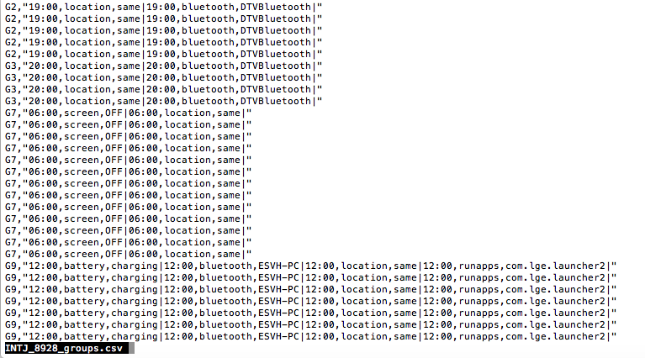
Grouping Result

Slide 21
Performance Evaluation
Divide all of dataset to two parts (around 8 weeks)
50% for creating model (first dataset)
50% for testing performance (second dataset)
Modeling user behavior based on first data,
Output1: Behavior model/profile.
Extract and Process the second dataset.
Apply similarity detection to second dataset.
Output2: Group result from second dataset.
Compare the Output2 to the Behavior model/profile.
Calculate group detection, how many groups identified as behavior model, how many groups identified as new behavior.
Implement this approach for Identification

