Slide 1
Recent changes

Slide 2
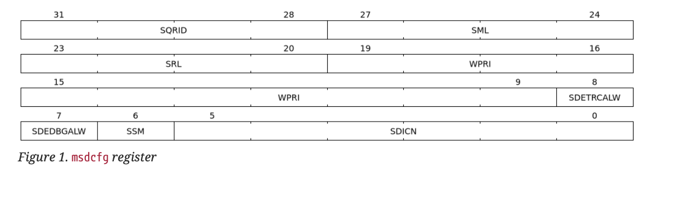
Align the CSR control knob with smmtt
Sub-machine mode debug/trace control
Per-hart field sdedbgalw/sdetrcalw inside M-mode CSR msdcfg
External debug security spec will refer to smmtt spec

Slide 3
Trace control signals
Add a new signal sec_check to bundle a vector with halted signal
[sec_check, halted] | Tracing? | Disable reason
00 | Yes | n/a
01 | No | entering Debug Mode
10 | No | due to security rules
11 | No | reserved for future

Slide 4
Recent Arch Open

Slide 5
Error reporting – Arch open
https://github.com/riscv-non-isa/riscv-external-debug-security/issues/16
Separate error indicator for reset/resethaltreq/keepalive/ndmreset should have indicator (not via abstractcs.cmderr)

Slide 6
Zedsec (ISA extension)
Notes:
Zedsec

Slide 7
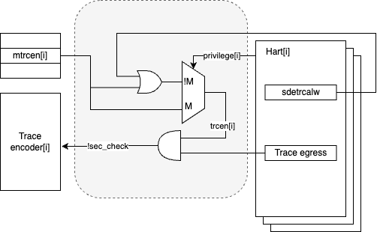
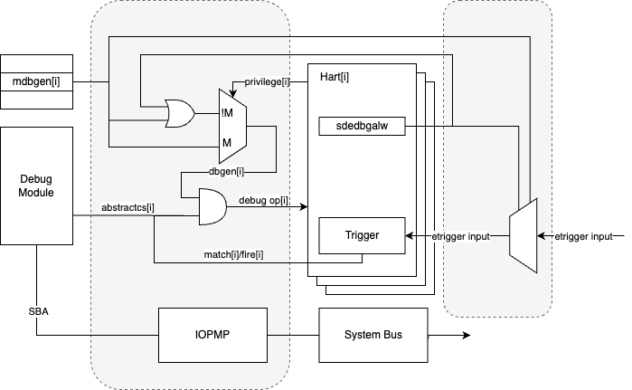
Overview
M-mode debug/trace controlled by external entity (RoT or HW) via a new port to hart
Sub M-mode debug/trace controlled by M–mode FW via M-mode CSR
Checker logic shall be close to hart to avoid TOCTOU issue

Slide 8
Debugger Access Privilege Mode
Specified by external debugger via the `dcsr.prv`` and `dcsr.v`
Max debugger access privilege determined by mdbgen and sdbgen
Raise security fault error (cmderr 6) when exceed max debugger privilege
mdbgen | Msdcfg.sdedbgalw | Max Debuger Priv. Mode
1 | Don’t care | M
0 | 1 | S (HS)
0 | 0 | N/A

Slide 9
Debug Control
Machine Mode Debug Control
Input port mdbgen for each hart.
Sub-machine Mode Debug Control
Per-hart field sdedbgalw inside M-mode CSR msdcfg

Slide 10
Debug Control
mdbgen | sdbgen | Debug-able Priv. Mode*
1 | Don’t care | All
0 | 1 | All except M
0 | 0 | None
*means the privilege modes that could enter Debug Mode and serve abstract commands

Slide 11
Per privilege trace control
Machine Mode Trace Control
Input port mtrcen for each hart.
Submachine Mode Trace Control
Per-hart field sdetrcalw inside M-mode CSR msdcfg

Slide 12
Trace control
mtrcen | strcen | Trace-able Priv. Mode
1 | Don’t care | All
0 | 1 | All except M
0 | 0 | None

Slide 13
Trace control signals
Add a new signal sec_check to bundle a vector with halted signal
[sec_check, halted] | Tracing? | Disable reason
00 | Yes | n/a
01 | No | entering Debug Mode
10 | No | due to security rules
11 | No | reserved for future

Slide 14
Trigger
CSR accessibility
Register | W/O Zedsec | W/ Zedsec
tselect(0x7a0) | Always | No change
tdata1(0x7a1) | Always | No change
tdata2(0x7a2) | Always | No change
tdata3(0x7a3) | Always | No change
tinfo(0x7a4) | Always | No change
tcontrol(0x7a5) | Always | Debugger Priv. Mode = M
scontext(0x5a8) | Always | Debugger Priv. Mode >= sub-M
hcontext(0x6a8) | Always | Debugger Priv. Mode >= sub-M
mcontext(0x7a8) | Always | Debugger Priv. Mode = M
mscontext(0x7aa) | Always | Debugger Priv. Mode = M

Slide 15
Trigger
Tdata1 fields accessibility
Field | Accessible Debugger privilege
vs | >=Sub-M
vu | >=Sub-M
m | =M
s | >=Sub-M
u | >=Sub-M

Slide 16
Trigger
Match/fire only in debug-able Priv. Mode (action = enter Debug Mode)
Relaxed `dmode`
W/O Zedsec | W/ Zedsec
0 (both): Both Debug and M-mode can write the tdata registers at the selected tselect. 1 (dmode): Only Debug Mode can write the tdata registers at the selected tselect. Writes from other modes are ignored. This bit is only writable from Debug Mode. | Both M mode and debugger with M mode privilege could write this bit and the tdata registers at the selected tselect.

Slide 17
Trigger - open
External trigger
External trigger inputs are platform specific
The inputs source should be constrained by mdbgen[i] and sdbgen

Slide 18
Debug Module Security Extension(non-ISA extension)

Slide 19
Extension Discovery
Add discovery fields in dmstatus
Field | Bit | Description | Access | Reset
allsecured | 21 | The field is 1 when all currently selected hart are secured and not running in debuggable privilege levels | R | 0
anysecured | 20 | The field is 1 when any currently selected hart is secured and not running in debuggable privilege levels | R | 0
Notes:
Link to github issue?

Slide 20
Debug Operations
Halt, Abstract Command, Instruction Buffer will be checked against Debug-able Priv. Mode.
The behavior will be defined in zedsec
Reset, Keepalive
Relaxed permission checks
Relaxedpriv must be hardwired to 0.
Memory access address
Aamvirtual is ignored if mdbgen is 0
Debug operations | Condition
hartreset | Only when M-mode is debuggable
resethaltreq | Only when M-mode debuggable
ndmreset | Never, hardwire to 0
keepalive | Only when M-mode debuggable

Slide 21
System bus access
If implemented, bus initiator protection mechanisms must be added between SBA and memory bus.
IOPMP, WorldGuard etc.
How many SID/WID assigned to DM is implantation-specific
Failed system bus access attempts result in a bus security fault error (sberror 6) or IOPMP/WorldGuard error.

Slide 22
Error reporting
Security fault error (cmderr 6)in abstractcs.cmderr
To signal errors that debugger set illegal privilege level for debug access
Bus security fault error (sberror 6)
To signal errors trigger by system bus access.

