Slide 1
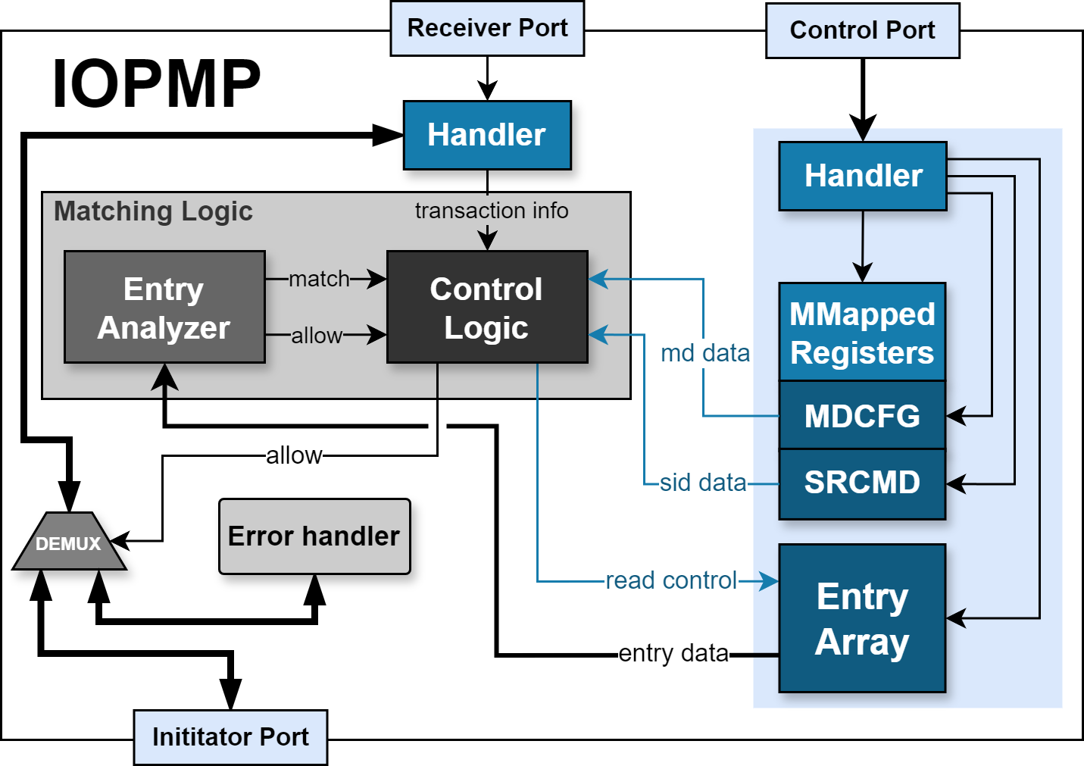
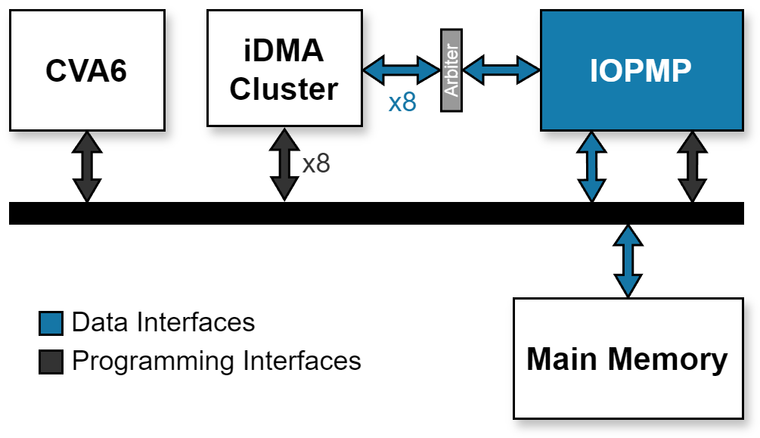



Open-source RISC-V Input/Output Physical Memory Protection (IOPMP) IP
Luís Cunha
Francisco Marques
Manuel Rodríguez
Tiago Gomes
Bruno Sá
Sandro Pinto
Centro ALGORITMI/LASI - Universidade do Minho, Zero-Day Labs
Abstract
This work describes the design and implementation of an open-source I/O Physical Memory Protection (IOPMP) IP compliant with the RISC-V IOPMP Architecture Specification (version 1.0.0-draft5). So far, we have designed and implemented an IP with the mandatory features supporting the Full model. We functionally validated and evaluated this IP within a CVA6-based SoC. Future plans include updating the IP to comply with the ratified specification and expanding its capabilities, such as incorporating additional operation models (e.g., Dynamic-K) and optional features (e.g., MDLCK). Finally, we intend to open-source the IP for the RISC-V community.
Manuel Rodríguez
University of Minho
RISC-V IOPMP Overview
Each entry defines a physical address range and access rules (Entry Array)
Entries are grouped into Memory Domains (MDCFG)
The SRCMD table defines which MDs belong to which Source Identifiers (SID)
Implemented Features:
Includes all mandatory features
Support for the Full Model
Support for Source-Enforcement (SE) Mode
Support for programmable Priority Entries
Parameterizable number of SIDs, MDs, and entries
Open-source IP
License: SHL-2.1
Evaluation
Functional Validation
Hardware Resources
Two hardware configurations tested (verilated model and FPGA):
CVA6-based SoC with IOPMP-SE managing a single iDMA
CVA6-based SoC with the IOPMP managing multiple iDMAs
Extended a Bare-metal tests framework allowing the validation of the developed IP
Work-in-Progress: Validate the IP in more complex SW Stacks (OpenSBI + Linux)
Configuration | LUT (203800) | FF (407600) | BRAM (445)
No IOPMP (1) | 77894 (38.22%) | 52946 (12.99%) | 53 (11.91%)
IOPMP-SE (2) | 80681 (+1.37%) | 54535 (+0.39%) | 57 (0.90%)
IOPMP (3) | 81000 (+1.52%) | 55030 (+0.51%) | 57 (0.90%)
Hardware resources used in a Genesys2:
(1) Single-core CVA6-based SoC; (2) Original SoC with an IOPMP-SE; (3) Original SoC with an IOPMP (8 Sources).
Both configurations have 32 Entries and 16 MDs.
Most hardware resources are consumed by the Matching Logic, more specifically with the Entry Analyzer as it is the main responsible for the verification process
Although the Entry Array resides within the IP, area savings were achieved by using specialized hardware primitives
The SRCMD and MDCFG tables do not represent a significant influence on area consumption

