Slide 1
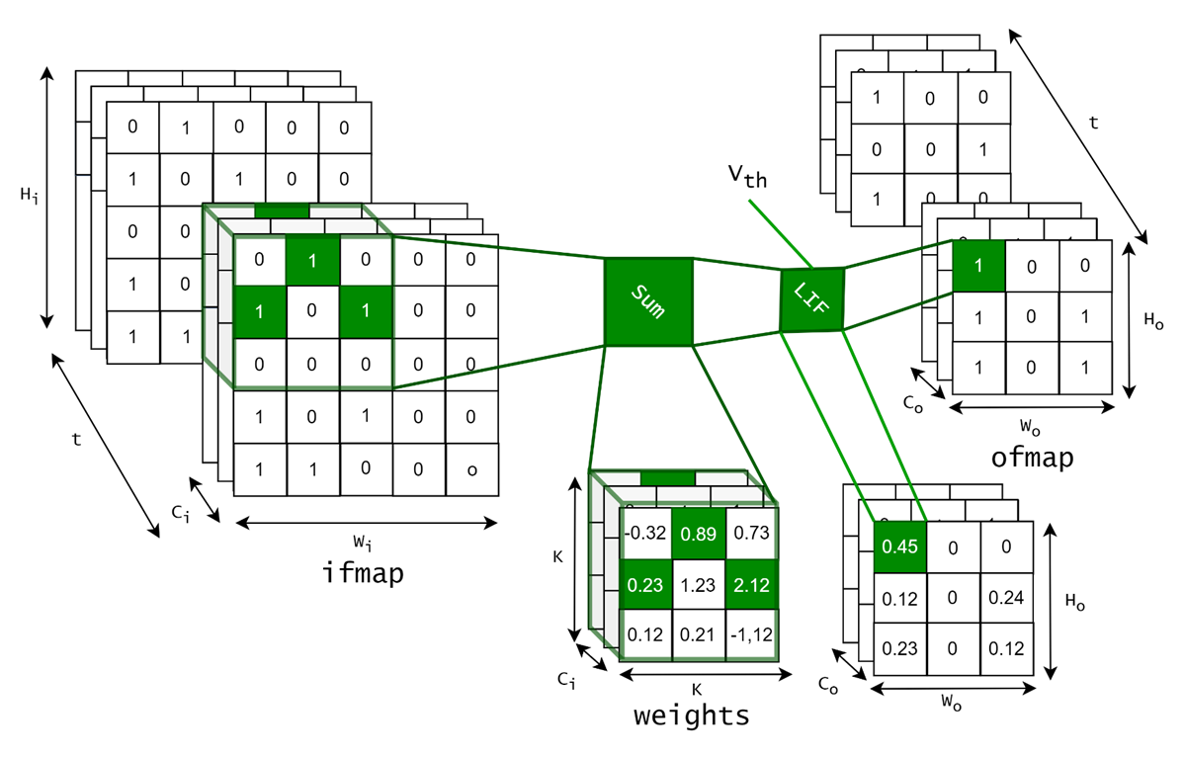
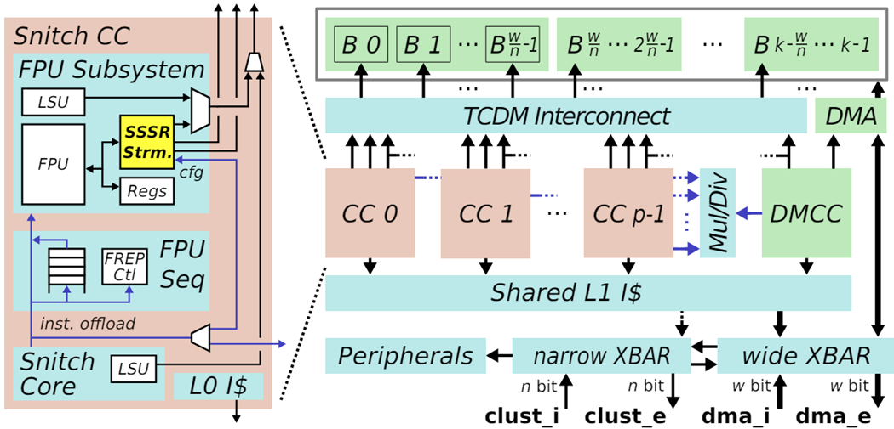
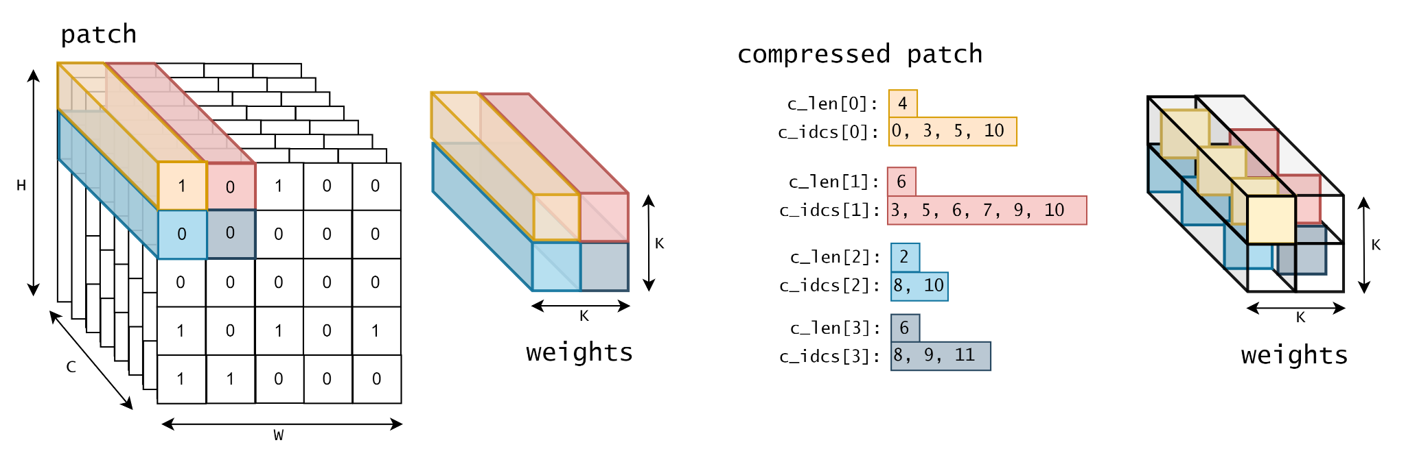
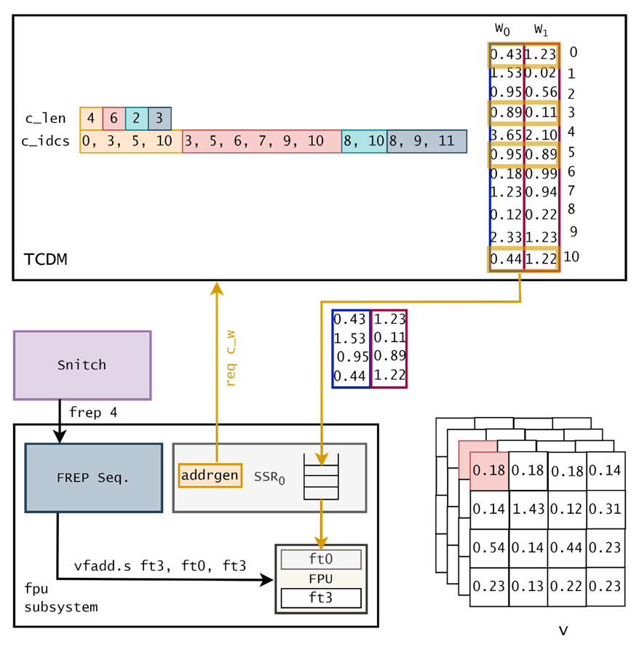
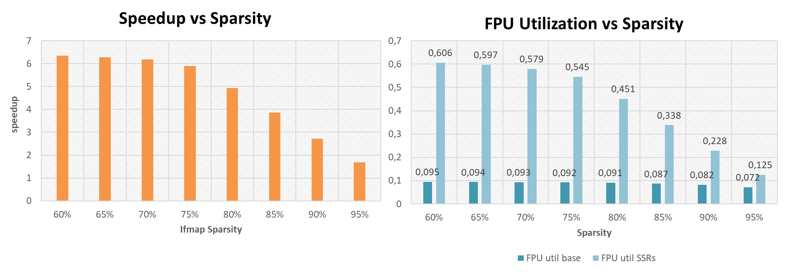
Motivation and Contribution
The quest for highly-efficient, low-latency machine intelligence systems led researchers to build Neuromorphic systems drawing inspiration from the human brain. Neuromorphic models are based on computations and algorithms based on Spiking Neural Networks.
SNNs introduce features such as spike based communications between neurons, activation sparsity and complex activation functions, but same ANNs topology.
Neuromorphic processors/accelerators are often entirely designed only for SNN models, making them an expensive and not flexible solution.
We map SNNs on Snitch cluster: an 8 + 1 core cluster based on RV32G CPUs enhanced with double-precision FPU, Indirect Stream Semantic Registers (ISSRs) floating-point HW loops (FREP) and smallFloat SIMD extensions.
Methodology
We compress each SCNNs channel in a run-lengh format discarding the values
The DMA performs im2row on the compressed ifmaps while the weights are stationary in TCDM. All the transfers are performed in a double buffered fashion to hide memory transfer latency
C_idcs and c_len configure the streamer to perform the indirection on the weights are used by the ISSRs streamers to perform a streaming indirection on the weights.
The Leaky-Integrate and Fire activation function is encoded as a sequence of RISC-V instructions
Summary of Findings
This work we proposed a kernel library for Spiking Neural Networks on an open-source RV32G core cluster
Our SW accelerated ISSRs method always outperforms the sparse baseline even though above 80% it starts to be bounded by the frequent DMA programming related to the transfer of many tensors. The FPU utilization is significantly improved thanks to the streaming architecture.
[1] P. Scheffler et al., "Sparse Stream Semantic Registers: A Lightweight ISA Extension Accelerating General Sparse Linear Algebra," in IEEE Transactions on Parallel and Distributed Systems, 2023
[2] F. Zaruba et al.,, "Snitch: A Tiny Pseudo Dual-Issue Processor for Area and Energy Efficient Execution of Floating-Point Intensive Workloads," in IEEE Transactions on Computers, 2021

