Slide 1
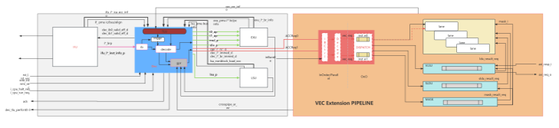
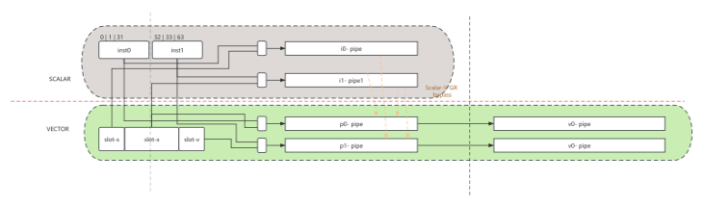
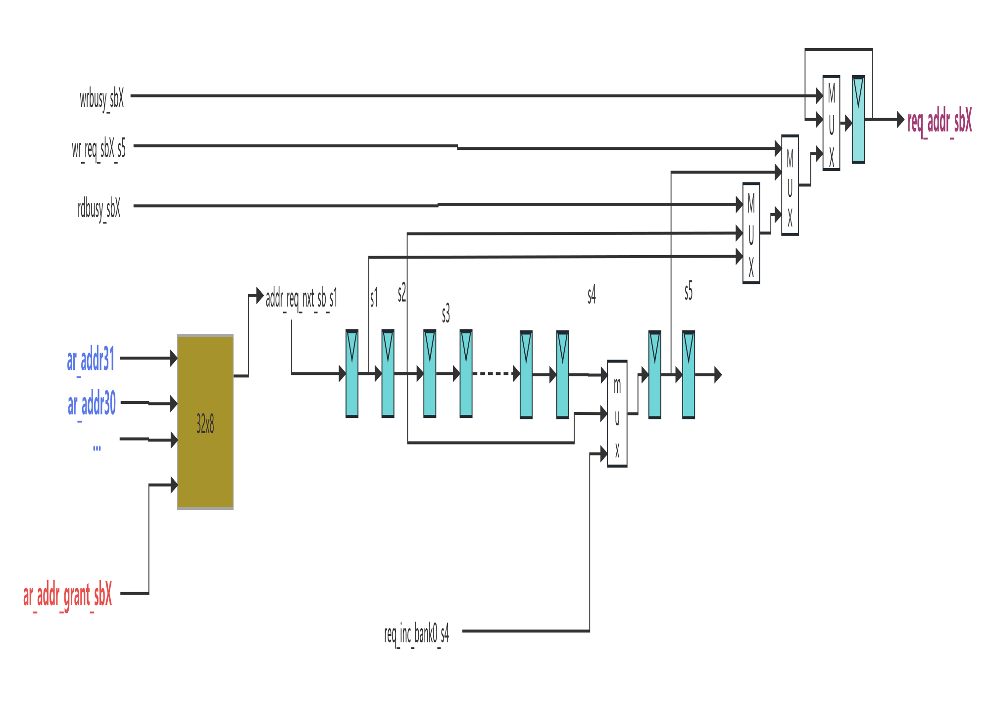
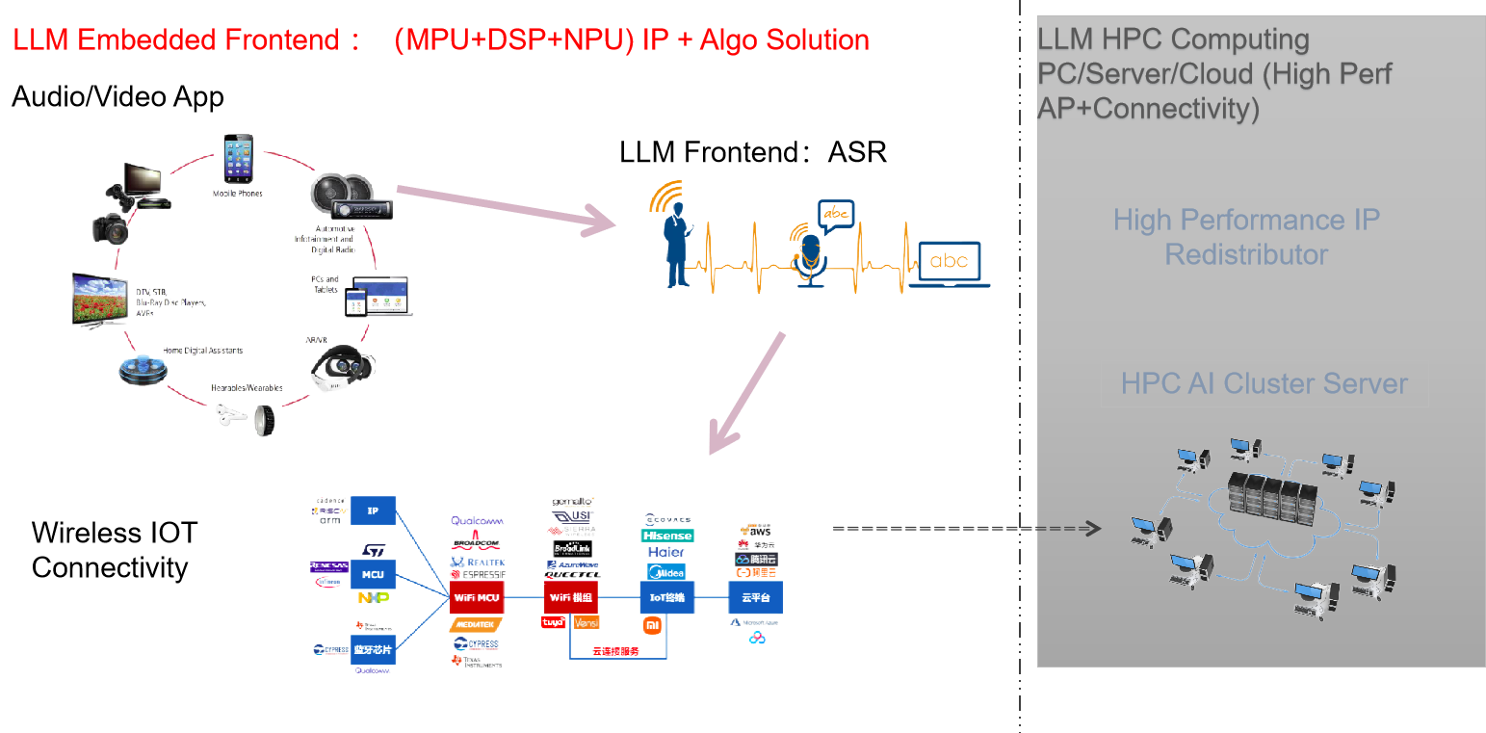
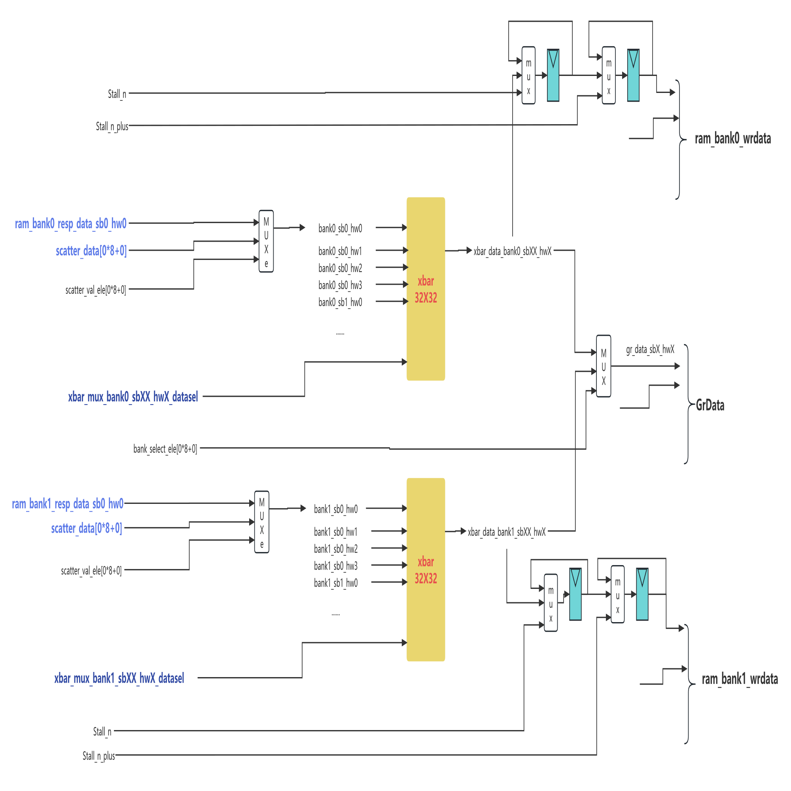
A Static Multi-Issue Fused In-Order RISC-V Vector CPU Arch. For High Efficient Real-Time Computing
uArch
Fusion
Innovaion
uArch Overview
VLIW/Vector Extension
Flexibl G/S Engine for Random indexed sram accss
subbank address request
High perf w/ Low power Story Landscape
contact : info@acemicro.cn
Gather/Scatter Muxed Data Arbitration Out
by ACE Technology Studio

