Slide 1

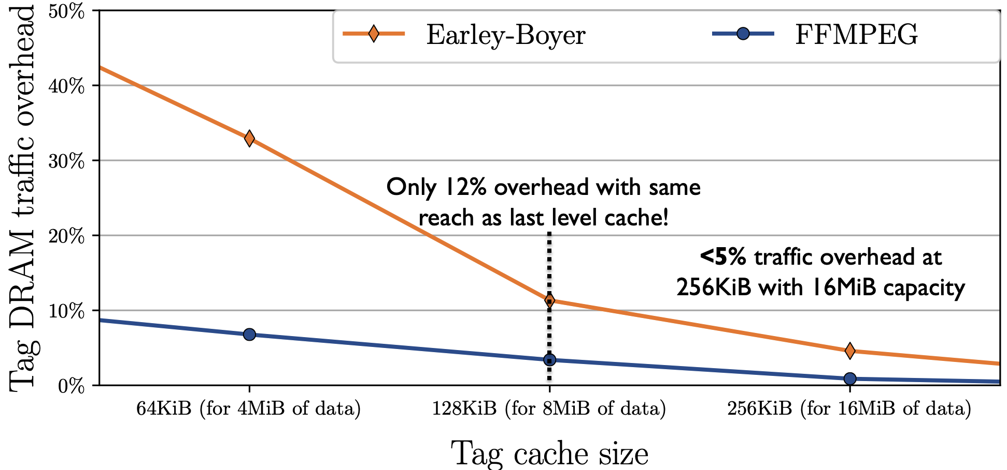
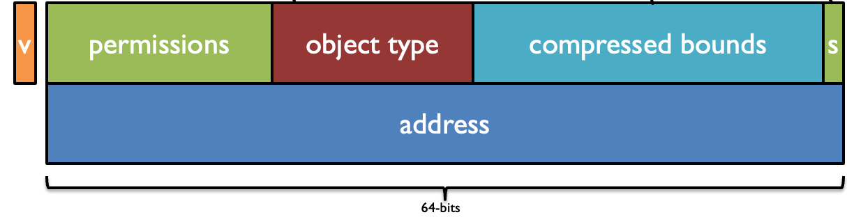
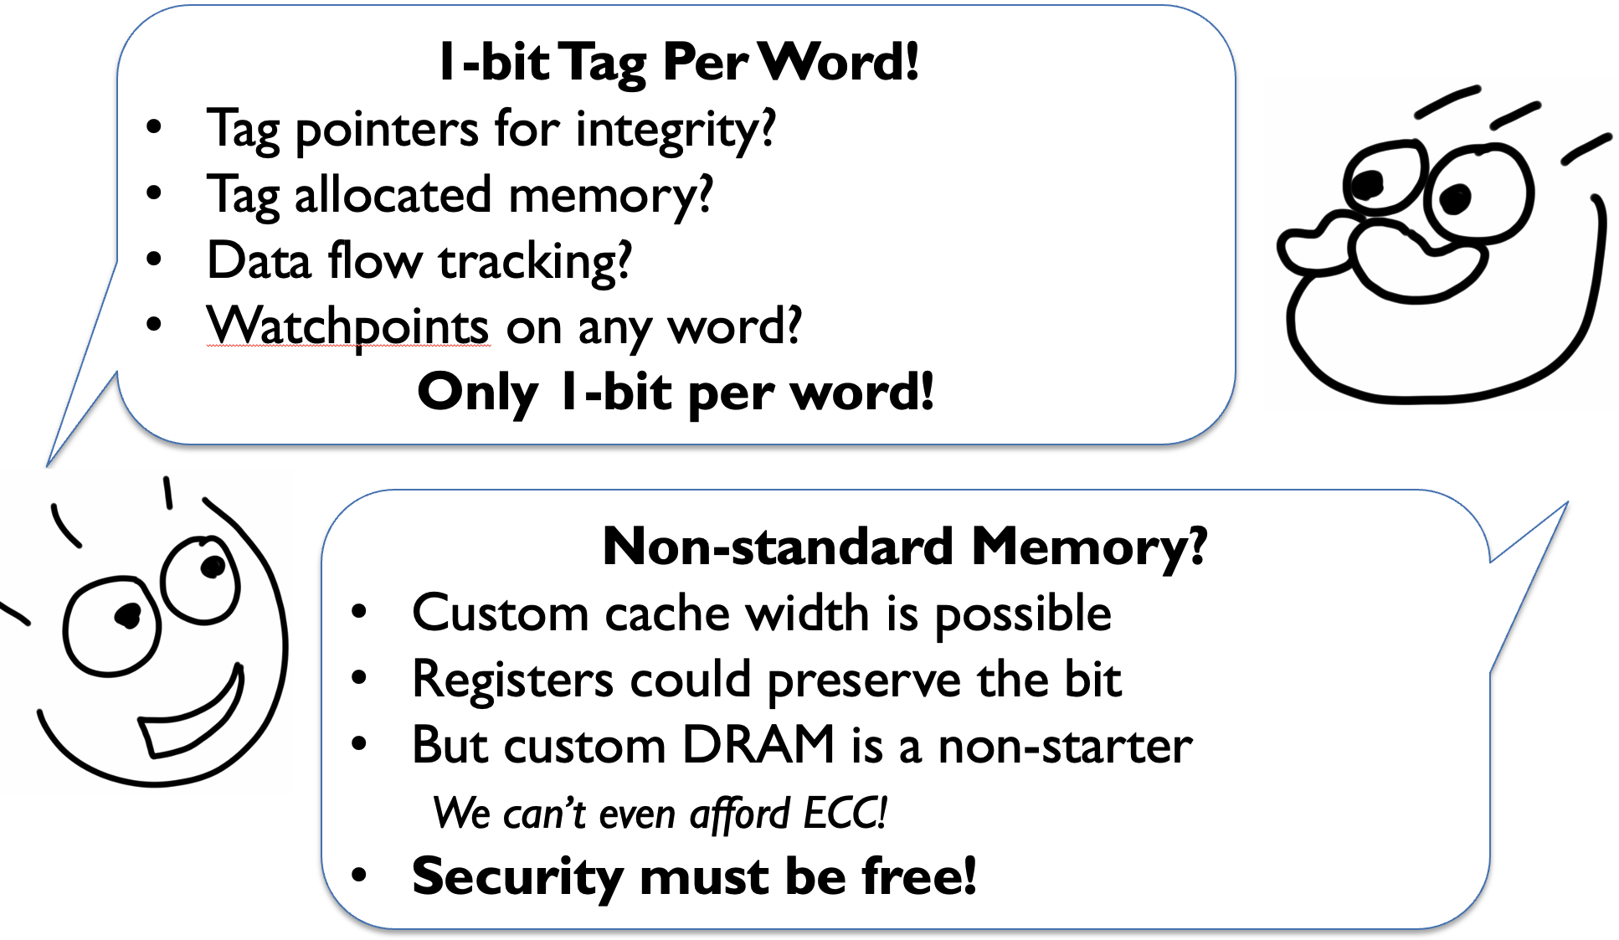
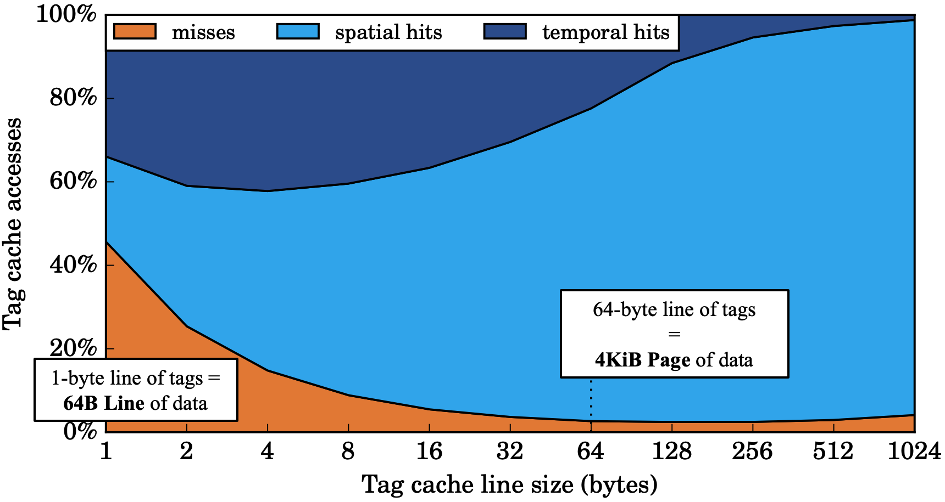
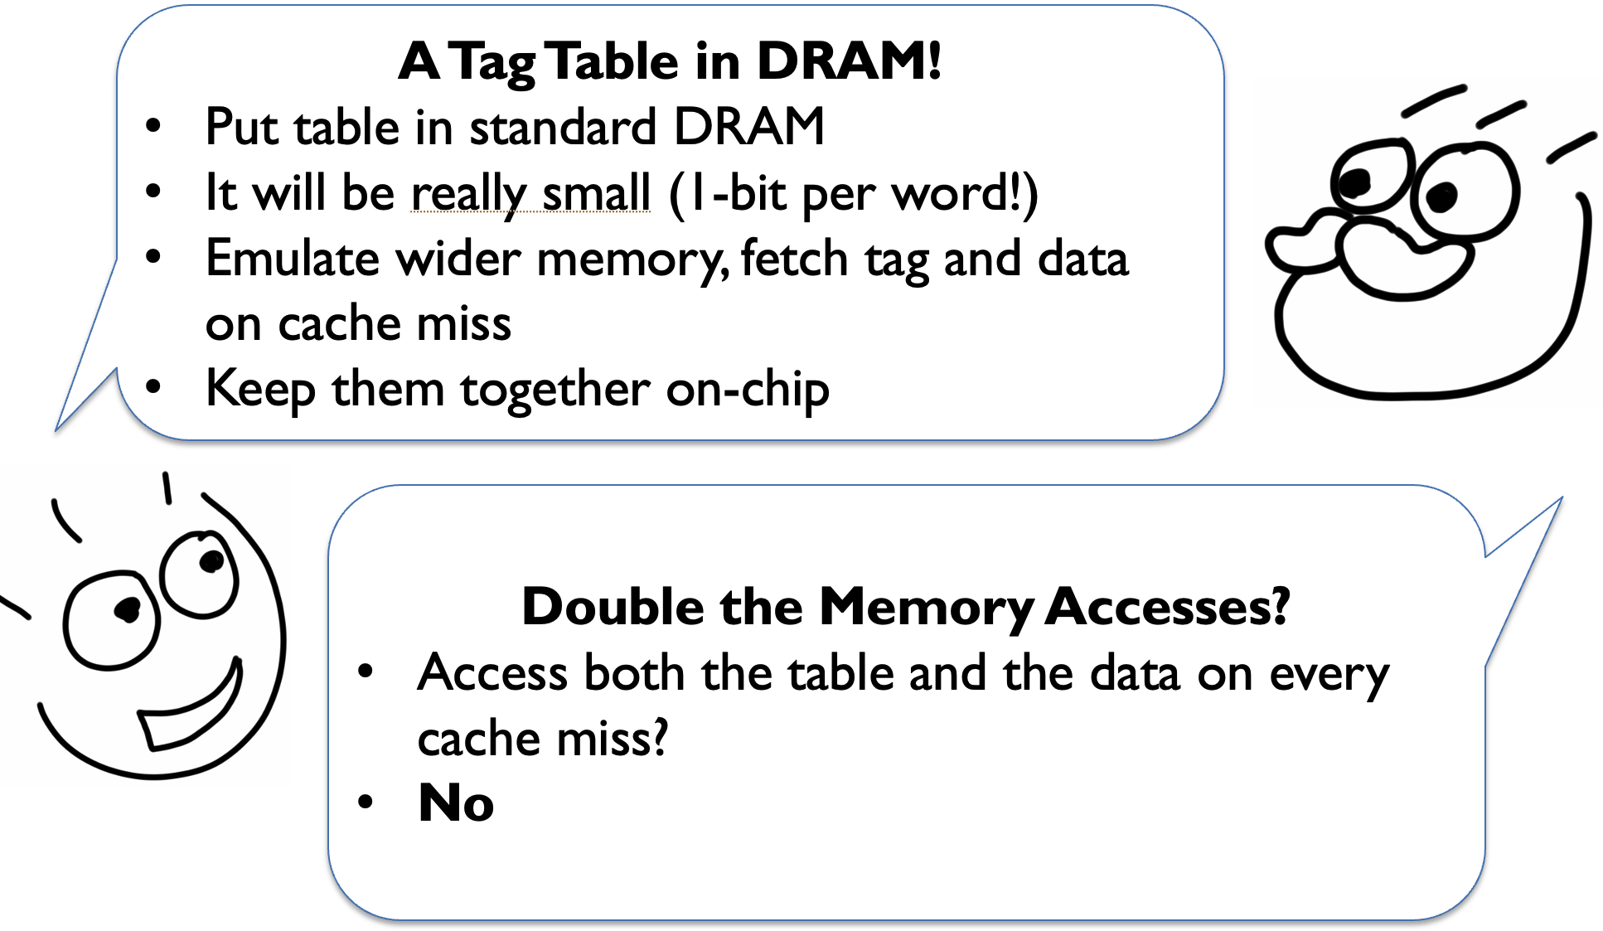
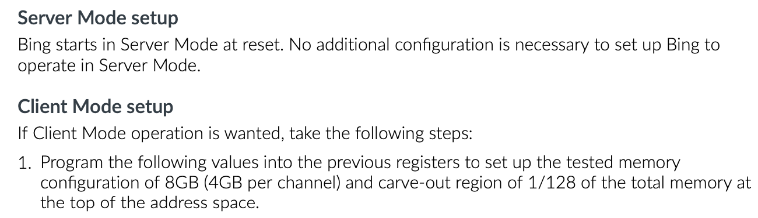
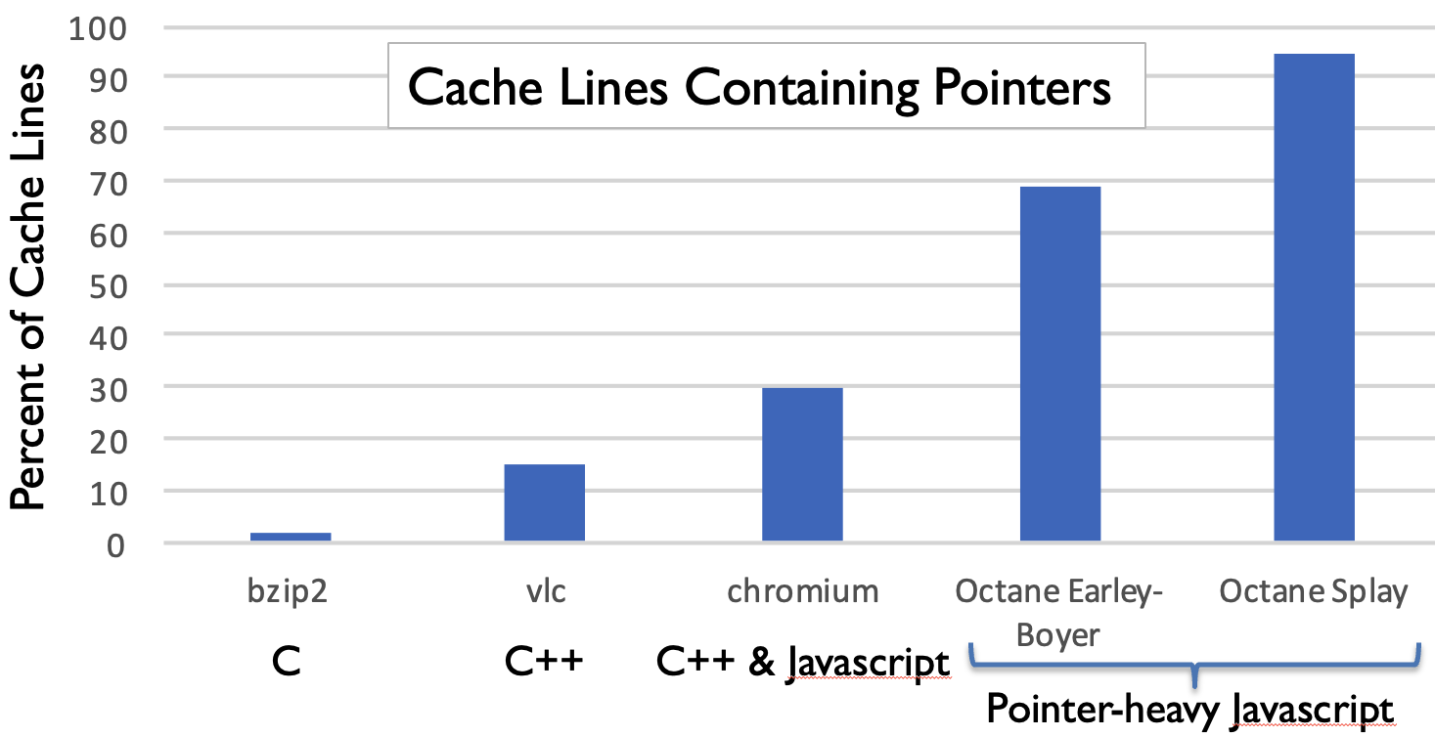
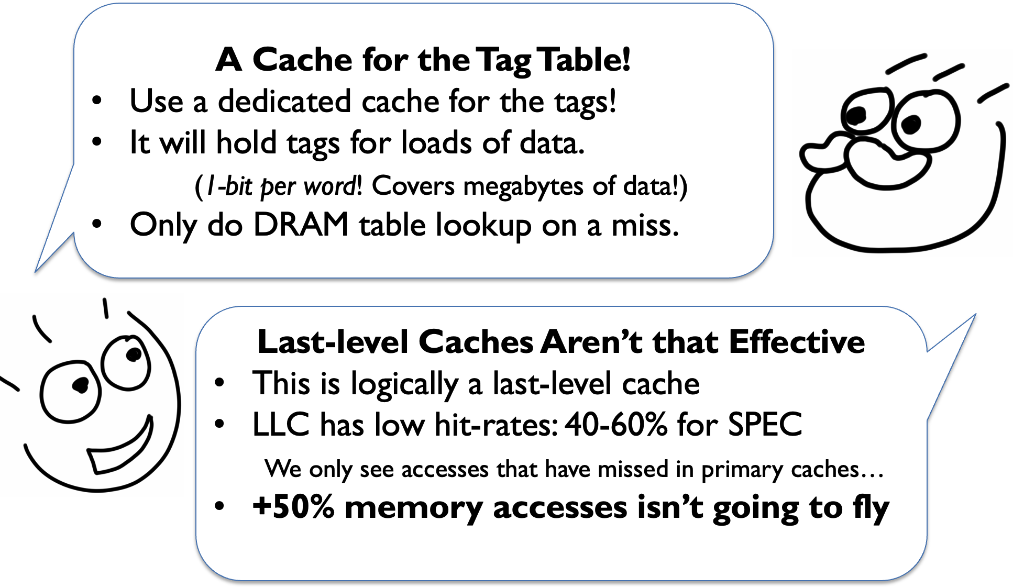
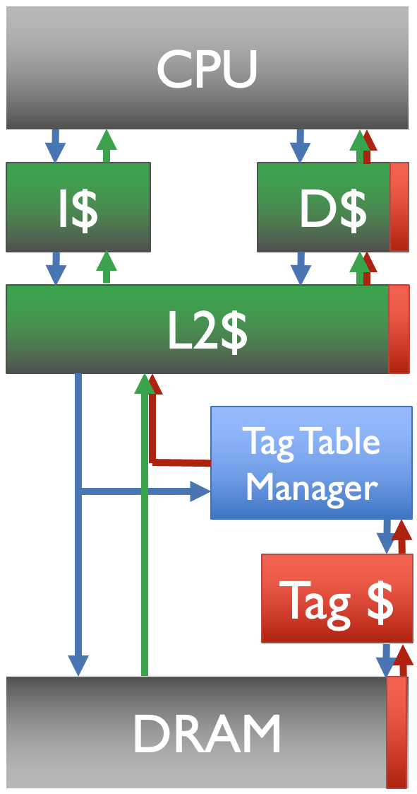
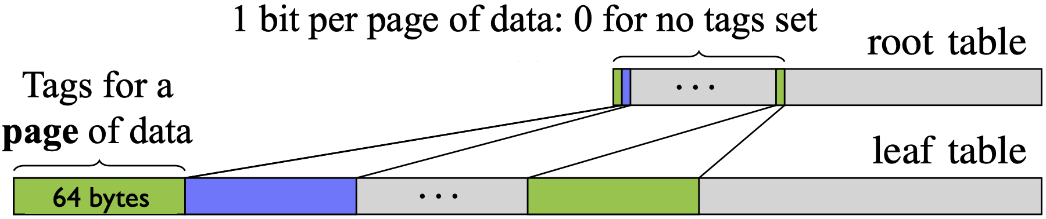
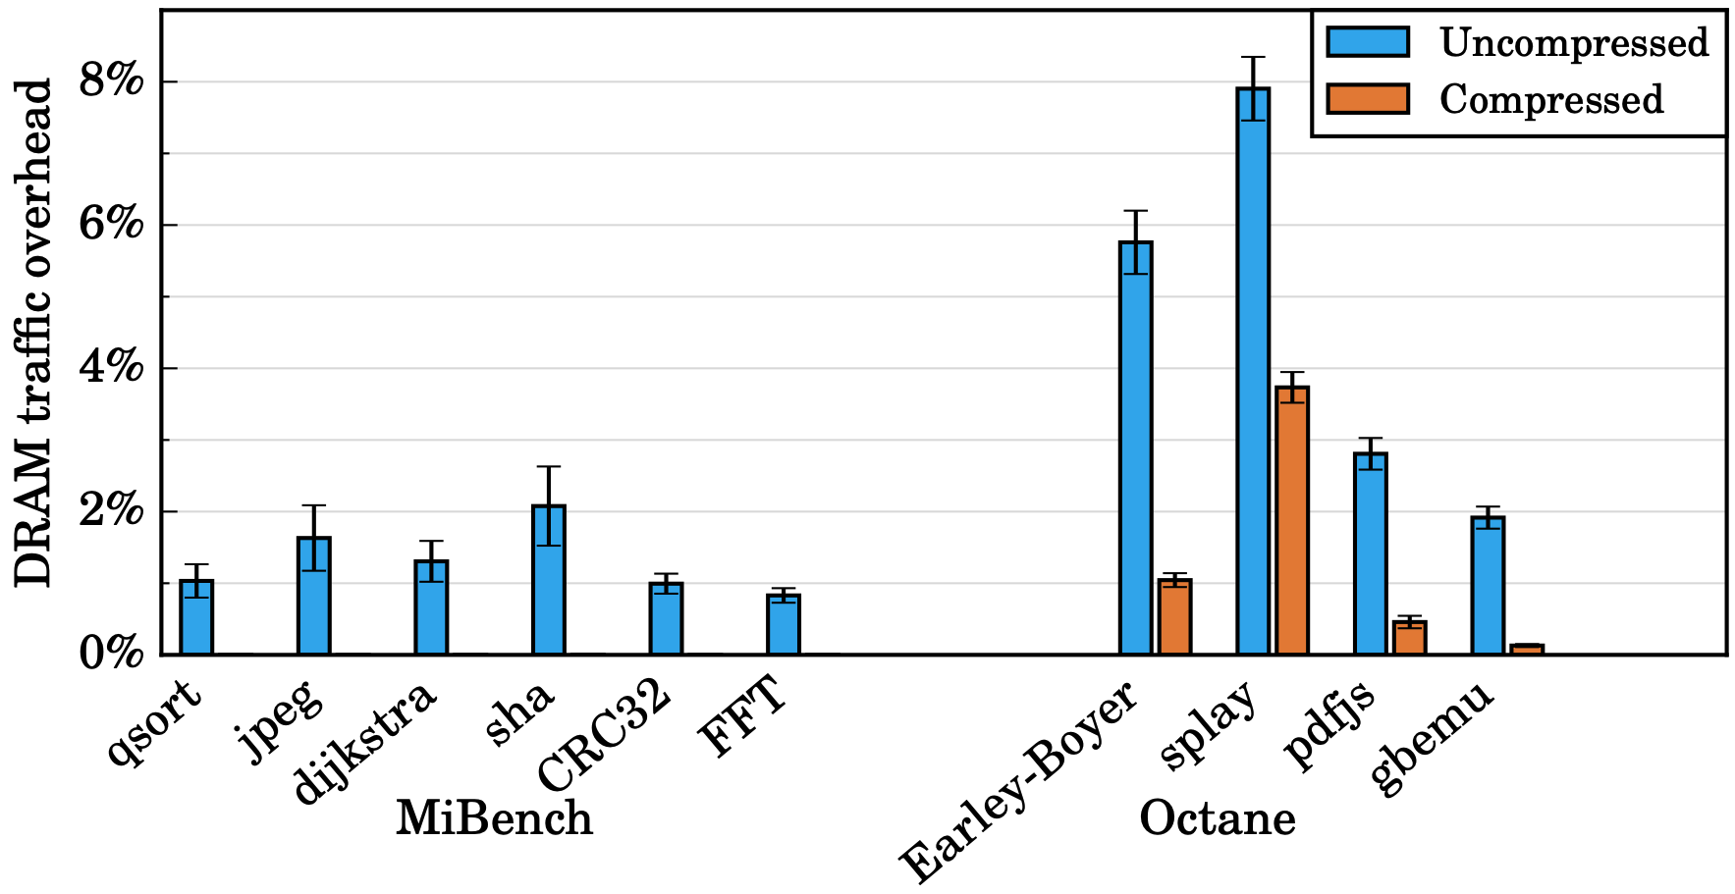
Tag Management in CHERI-RISC-V Systems
Jonathan Woodruff, Alexandre Joannou, Peter Rugg, and Simon W. Moore
Department of Computer Science and Technology, University of Cambridge
jonathan.woodruff@cl.cam.ac.uk
Project URL: cheri-cpu.org
UNIVERSITY OF
CAMBRIDGE
Computer Science & Technology
CHERI-RISC-V Tagged Memory
Modelling tagged memory with Gem5 traces
Multi-granularity Compressed Tag Cache
The proposed CHERI-RISC-V standard specifies 1-bit of tag per XLEN*2-width word of memory.
These out-of-band tags indicate whether or not each XLEN*2-word of memory is a valid capability pointer.
These tags protect the integrity of capability pointers in memory, preventing them from being corrupted. Tagged memory is crucial for capability unforgeability, ensuring that programs can only ever reference memory to which they have received valid capability pointers.
We traced all DRAM access in Earley-Boyer (a pointer-heavy javascript benchmark) and FFMPEG (a data-heavy C application) and replayed these against a tag controller + cache model.
Inspired by hierarchical tag tables, the Arm Morello platform introduced a multi-granularity cache compression system for tags.
Tag Table Manager
0?
Tag $
Zero Tag $
DRAM
Figure 1. A 129-bit CHERI capability (sv64)
Figure 3. Miss rate for a cache of a simple tag table
Figure 7. Tag cache with a dedicated cache for zero lines.
Johnny Proposes Tagged Memory
Miss rate much lower than a typical last-level cache. Why?
Dedicated cache banks for cache lines with no bits set. Tag table in DRAM is flat, but zero lines cache more efficiently. Parallel lookup in both Tag Caches allows high throughput more simply than a sequential, hierarchical lookup. However, it does require initial reads of zero tag lines from DRAM.
Wider DRAM / Repurposed ECC Bits
The Arm Morello platform additionally supports a mode that stores tag bits in ECC memory to avoid any additional memory transactions for tag memory.
Figure 3. Miss rate for a cache of a simple tag table
Spatial locality pays off on a page-scale granularity
Tag Compression
Figure 8. Excerpt from Morello specification detailing both ECC and cached tag-table options.
Pointer occurrence in memory is not random. Some regions have many pointers, and others have none.
Tag Table Manager
DRAM
Figure 9. ECC-support provides natively tagged DRAM.
System-on-chip Integration Challenges
Commercial CHERI-RISC-V processors may be integrated with a larger system-on-chip, sharing memory with potentially higher-performance processors and GPUs. Introducing additional complexity in the memory path may not be acceptable.
Figure 4. Pointer density found in memory dumps of programs
The Tagged Memory Challenge
Straightforward hierarchical scheme: a root table with one bit for each cache line in our original tag table, now dubbed leaf table.
CPU/GPU System
Tag Table Manager
Add 1 bit per word of memory
Make it “free”
Figure 5. Two-level tag table to reduce tag cache footprint
Tag $
Tag Filter with PMAs
DRAM
Figure 10. A super-page-scale PMA bitmap before DRAM.
We can combine physical memory attributes, controlled by software, with a localized tag controller situated in a tag-aware interconnect island. A simplified tag filter at the main RAM controller can track non-tag-aware writes to tag-preserving blocks, notifying the tag controller.
In collaboration with
Figure 2. A simple tag hierarchy
Figure 6. Traffic overhead of tag management when running applications in CHERI hardware (FPGA).

