Slide 1



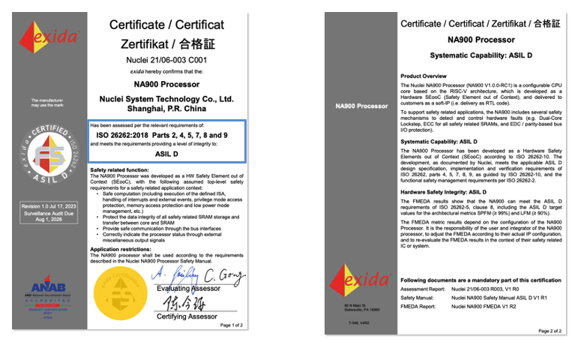
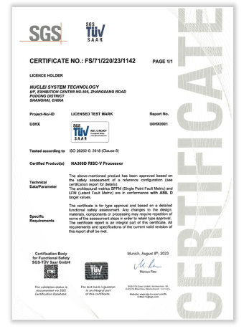
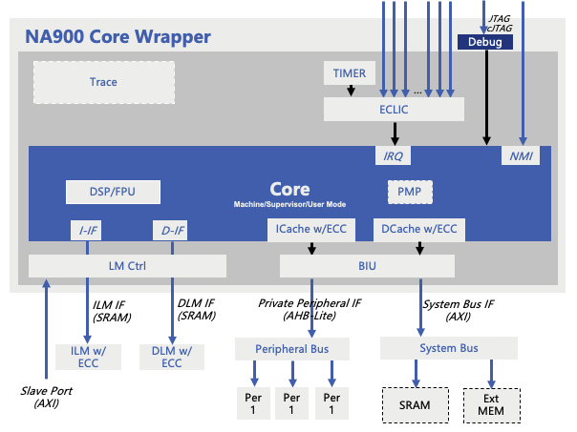
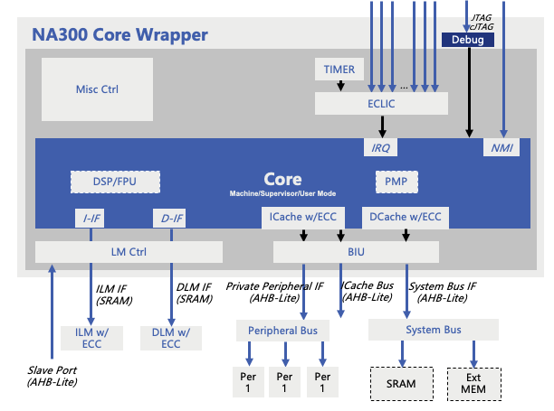
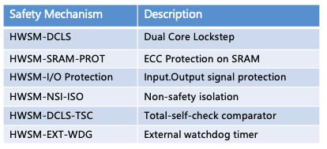
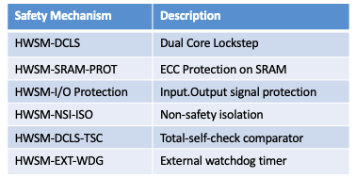
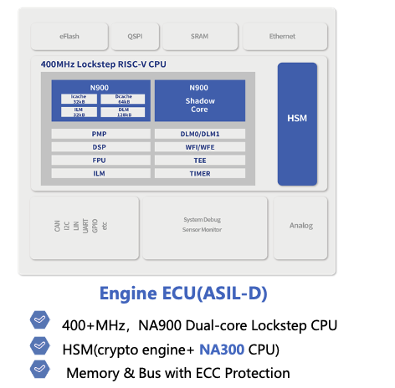
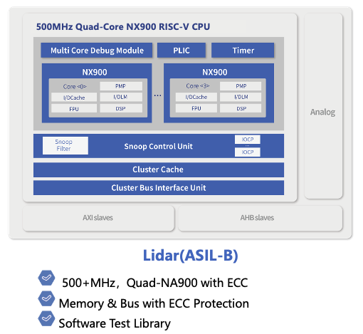
Empower the Automotive Revolution
NA900 — 1st ISO26262 ASIL-D
Product Certified RISC-V CPU IP
NA300 — ISO26262 ASIL-D Ready
RISC-V CPU IP
Nuclei NA Series & Application
Nuclei NA Customers:
Comm
ADAS
MCU
Ethernet
Lidar
UWB

