Slide 1

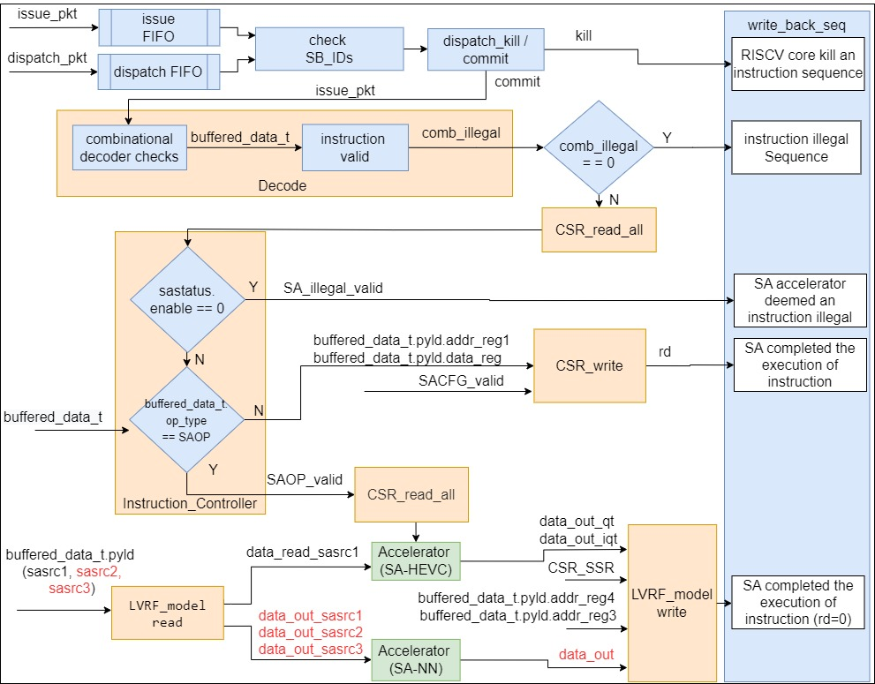
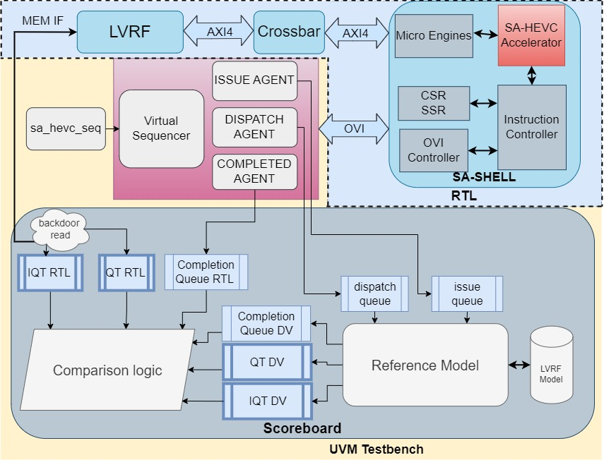
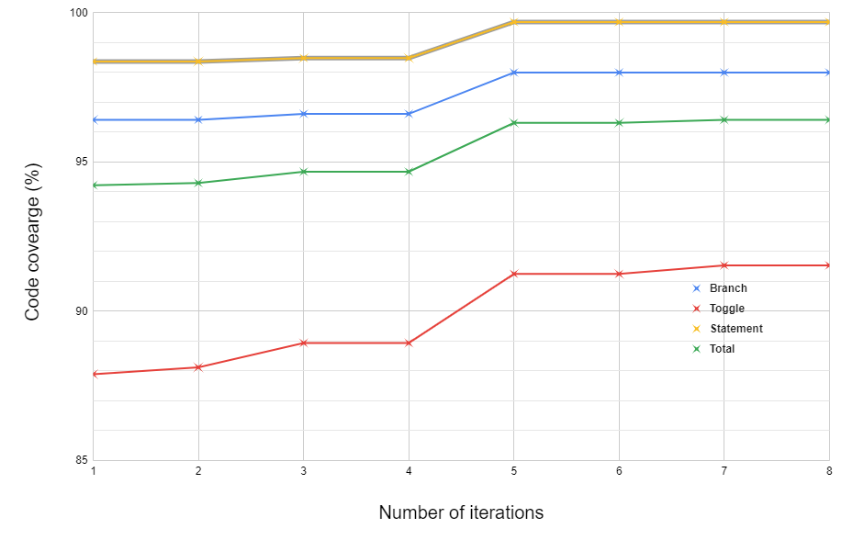
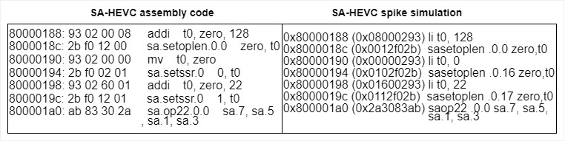



An Interchangeable UVM Environment for Verifying Multiple Systolic Arrays
Junaid Ahmed^{1*}, Oscar Palomar¹, Teresa Cervero Garcia¹, Mehmet Alp Sarkisla² and Luka Mrković³
{junaid.ahmed, oscar.palomar, teresa.cervero}@bsc.es, Luka.Mrkovic@fer.hr, alp.sarkisla@tubitak.gov.tr
¹Barcelona Supercomputing Center (BSC), Barcelona, Spain
²The Scientific and Technological Research Council of Turkey
³Faculty of Electrical Engineering and Computing, University of Zagreb
https://meep-project.eu/
Reconfigurable Reference Model
Motivation
To verify multiple accelerators using the same UVM environment.
Developed a configurable and extensible UVM environment for the verification of two systolic arrays (SA-HEVC and SA-NN).
Developed a customized reference model for two accelerators.
Added support of custom extension (Xmeepsa) [1] to Spike simulator for co-simulation.
Generated constraint randomized instructions based on RISC-V custom extension (Xmeepsa) [1] for coverage analysis.
The reference model of SA-SHELL is developed in System Verilog, and the reference models which are specific to SA- HEVC and SA-NN are written in C/C++. These models are combined with the SA-SHELL model written in System Verilog which has similar functionality for both accelerators. Functions specific to accelerators are imported as DPI methods in the UVM scoreboard. The labels marked in red are specific to only the SA-NN reference model.
UVM Testbench
To reduce the overhead and increase the reusability of verification components across the stack, this work presents a new configurable UVM environment suitable to verify two different systolic array accelerators by configuring a set of parameters.
Fig 2. Reference Model
Coverage
Fig 1. UVM TESTBENCH
The testbench for SA-HEVC is shown in Fig 1. The testbench communicates with the DUTs via an OVI interface.
The virtual sequencer manages and sends the virtual sequence to the agents.
The driver receives instruction packets and drives them on the virtual interface. Also, it sends the same transaction packets to issue and dispatch queues of the scoreboard.
The monitor performs the data sampling operation using a virtual interface. It sends the transaction objects to the scoreboard and subscriber for comparison and functional coverage analysis respectively.
The scoreboard ensures transaction-level data correctness and verifies the sequence of instructions. The scoreboard logic is distributed into various components: synchronization logic, backdoor LVRF interface, reference model and a comparison logic. The FIFOs/Queues are used for synchronizing. Instructions are usually issued first and dispatched later, so these FIFOs are also needed to synchronize the issue and dispatch packets. Furthermore, there are several FIFOs used to synchronize data between design and reference models.
Fig 3. Coverage Results
Spike co-simulation
Fig 4. Spike co-simulation
References
[1] Ivy Peng, Roger Pearce, and Maya Gokhale. “On the Memory Underutilization: Exploring Disaggregated Memory on HPC Systems”. In: Intern. Symp. on Computer Arch. and High Performance Computing. 2020, pp. 183–190.
MEEP Partners:

