Slide 1
Cross-Platform AI Workload Profiling:
Comparing workload behavior across Jetson, Raspberry Pi, Arduino UNO Q, and RISC-V.
By Paul Chukwu

Slide 2
MOTIVATION AND GOAL
AI WORKLOAD PROFILING ON A PHYSICAL CORE
2
Why profile an AI workload?
The Hardware-Software Gap
Kernel Bottlenecks
The Need for Visibility
How this project help?
Compare RISC-V with other devices
Identify Bottlenecks
Drive Hardware-Software Co-Design

Slide 3
Different Direction From Fatima
AI WORKLOAD PROFILING ON A PHYSICAL CORE
3
Still related but now we will:
Take the same workloads and profiling methodology and run them on real edge-computing hardware to understand how the workload behaves under different hardware architectures and resource constraints.
I will be using:
Jetson Orin Nano combines a 6-core Arm Cortex-A78AE CPU with an Ampere GPU
Pi 5 uses a quad-core Cortex-A76 CPU;
UNO Q combines a Cortex-A53 Linux processor with a Cortex-M33 microcontroller.

Slide 4
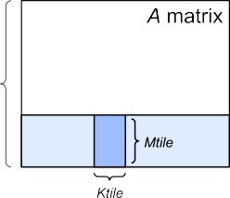
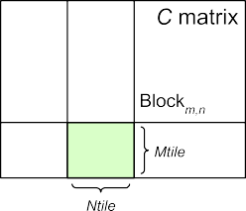
BENCHMARKING WITH GEMM & SIMULATING WITH GEM5
AI WORKLOAD PROFILING ON A PHYSICAL CORE
3
Why GEMM?
The core mathematical operation (C = A x B) powering modern AI models, machine learning algorithms, and LLMs.
Dominates execution time and heavily taxes processor resources.
Easy to verify, highly optimized, and acts as the ultimate benchmark for processor limits.
Source: nvidia docs

Slide 5
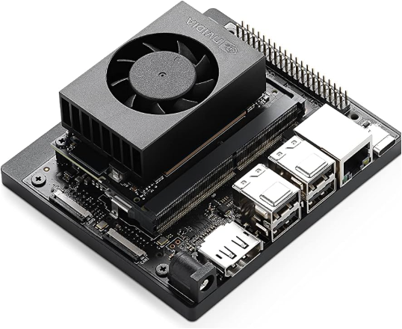
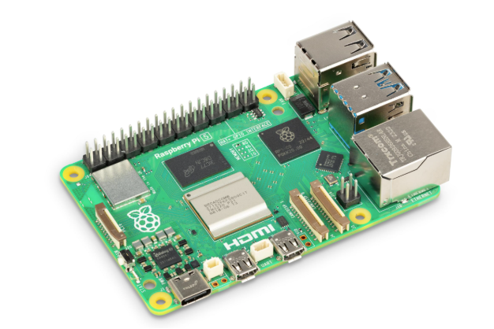
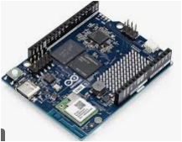
AI WORKLOAD PROFILING ON A PHYSICAL CORE
4
Why Physical Hardware?
No simulations but actual results.
Real execution time.
Resource utilization.
Temperature, power consumption, and accelerator behavior.

Slide 6
THE PATH FORWARD
AI WORKLOAD PROFILING ON A RISC-V CORE
7
Next Steps To achieve Ultimate Goal
Test on real time systems like the jetson nano, raspberry pi.
Compare the results on the varying hardware.

Slide 7



THANK YOU
linkedIN

