Slide 1
CHAPTER 6 | LABORATORY | 45 MINUTES
Assembly Lab 2: A Marker You Can Steer
See the input bits as lamps, move a marker, clamp it, add a second axis: four verified steps
Audience: computer architecture students (RISC-V assembly track)
Playing with RISC-V: Assembly, C, and Retro Games on the PRG32 Platform
Notes:
Teaching support for Chapter 6 of the textbook. Practical, step-by-step session: learners work at their machines; keep each step to its time box. Preparation: Working toolchain; PRG32-QT for the proof step. Step files: labs/06-asm-state-and-input/step1..4.

Slide 2
Learning objectives
1
Display the input bitmask one bit per lamp
2
Move state with independent button tests
3
Clamp to exact limits and test the edges
4
Repeat the pattern on a second axis
5
Explain which registers survive a call
Notes:
State the objectives; return to this slide at the end.

Slide 3
Plan of the session
11'
10'
10'
8'
6'
1
2
3
4
5
Lamps: see the bits
Move
Clamp
Second axis
Bug hunt
Notes:
Total: 45 minutes.

Slide 4
How every step works
1
Each step is a complete file in labs/: read what is new, then run it
2
From the textbook folder: labs/run.sh STEP_FILE PREFIX builds and starts it
3
Set PRG32_HOME to your PRG32 checkout; set PRG32_URL to run on a board or PRG32-QT, otherwise QEMU starts
4
The screenshot on each slide is that exact file, built and executed
5
After each step: change one thing, predict, run

Slide 5
01
Lamps
Step 1: see the bits before you use them

Slide 6
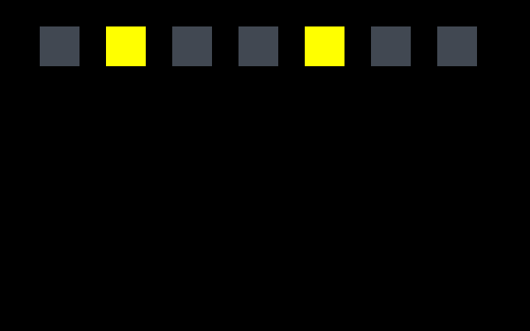
Step 1: one lamp per bit
# Seven lamps, one per button bit: lit when the bit is 1.
li s0, 0
lamp_loop:
li t0, 40
mul a0, s0, t0
addi a0, a0, 24 # x = 24 + bit * 40
li a1, 16
li a2, 24
li a3, 24
la t0, buttons
lw t1, 0(t0)
srl t1, t1, s0 # move bit number s0 down to bit 0
andi t1, t1, 1
li a4, GREY
beqz t1, 1f
li a4, YELLOW
1: call prg32_gfx_rect
addi s0, s0, 1
Screenshot: this step, built and run
A loop: s0 is the bit number. srl moves that bit down to position 0, andi keeps it. Screenshot: RIGHT and A held (0x12).
Notes:
Source: labs/06-asm-state-and-input/step1_lamps.S

Slide 7
Run step 1
1
labs/run.sh 06-asm-state-and-input/step1_lamps.S steer
Step 1 | about 6 min
Expected result
2
Hold each button alone: which lamp lights?
3
Hold LEFT and A together
Lamp 0 LEFT, 1 RIGHT, 2 UP, 3 DOWN, 4 A, 5 B, 6 START. Mask = 1 shifted left by the lamp number.
4
Fill in a table: button, lamp number, mask value
Notes:
Screenshot: this step, built and run: labs/06-asm-state-and-input/expected/step1_lamps.png

Slide 8
Why s0, and why it is saved
1
The loop counter must survive seven calls to prg32_gfx_rect
2
t and a registers may be destroyed by any call
3
s registers are preserved by the callee
4
So WE must preserve s0 for OUR caller: sw s0, 8(sp) in the prologue

Slide 9
Check your understanding
Lamps 1 and 4 are lit. What did prg32_input_read return?
0x05
0x12
A
B
0x14
0x21
C
D
Notes:
Answer: B. bit 1 (2) + bit 4 (16) = 18 = 0x12.

Slide 10
02
Move
Step 2: input changes state

Slide 11
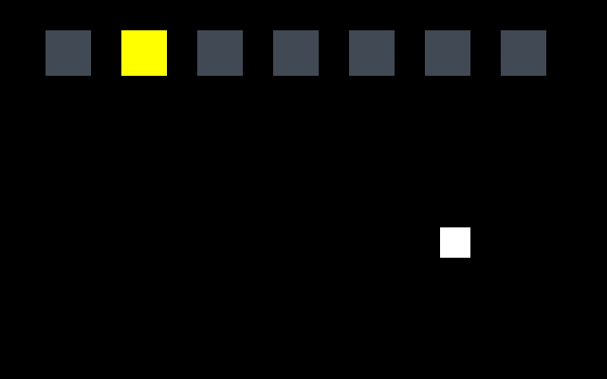
Step 2: LEFT and RIGHT move x
la t1, marker_x
lw t2, 0(t1) # t2 = marker_x
andi t3, t0, BTN_LEFT # isolate the LEFT bit
beqz t3, 1f # clear: skip
addi t2, t2, -SPEED
1: andi t3, t0, BTN_RIGHT
beqz t3, 2f
addi t2, t2, SPEED
2:
Screenshot: this step, built and run
Load x once, adjust it through both tests, store it once. Each test: andi isolates the bit, beqz skips when clear.
Notes:
Source: labs/06-asm-state-and-input/step2_move.S

Slide 12
Run step 2
1
labs/run.sh 06-asm-state-and-input/step2_move.S steer
Step 2 | about 5 min
Expected result
2
Hold RIGHT: the marker moves 2 pixels per frame
3
Hold LEFT and RIGHT together: what happens, and why?
The marker follows the keys (screenshot: RIGHT for 40 frames, x = 232). With both held the two adjustments cancel.
4
Change SPEED to 6
Notes:
Screenshot: this step, built and run: labs/06-asm-state-and-input/expected/step2_move.png

Slide 13
Prove it in the debugger
1
Import the step 2 cartridge into PRG32-QT, debug mode
Step 3
about 5 min
2
Breakpoint on 'andi t3, t0, BTN_LEFT' in steer_update
Expected result
t0 = 2; t3 = 0 then 2; t2 increases by exactly 2; the sw writes it back.
3
Hold RIGHT, Resume, then step to the sw
4
Record t0, t2 before and after the addi

Slide 14
See the problem
1
Hold RIGHT for five seconds
Step 4
about 3 min
Expected result
2
Where is the marker now?
Off the screen: marker_x keeps growing past 320. It returns only after you undo every step.
3
Hold LEFT until it comes back: how long?

Slide 15
03
Clamp
Step 3: stay on the screen

Slide 16
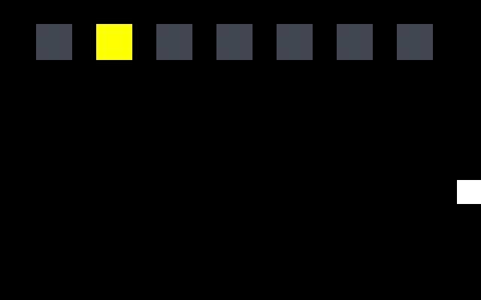
Step 3: a two-sided clamp
bgez t2, 3f # x < 0 ? clamp to 0
li t2, 0
3: li t3, MAX_X
ble t2, t3, 4f # x > 304 ? clamp to 304
mv t2, t3
4:
Screenshot: this step, built and run
Below zero: replace by 0. Above 304: replace by 304. Inserted between the tests and the single store.
Notes:
Source: labs/06-asm-state-and-input/step3_clamp.S

Slide 17
Run step 3 and test the edges
1
labs/run.sh 06-asm-state-and-input/step3_clamp.S steer
Step 5 | about 5 min
Expected result
2
Hold RIGHT until it stops
3
In PRG32-QT read marker_x from memory at each edge
The marker stops flush with the right edge (screenshot: RIGHT for 120 frames). Memory shows 0 and 0x130 = 304 = 320 - 16.
4
Why 304?
Notes:
Screenshot: this step, built and run: labs/06-asm-state-and-input/expected/step3_clamp.png

Slide 18
An off-by-one, on purpose
1
Change 'ble t2, t3, 4f' to 'blt t2, t3, 4f'
Step 6
about 4 min
Expected result
2
Predict: does the behaviour change at exactly 304?
No visible change: at exactly 304 the value is replaced by 304. Boundary conditions deserve a test, even when both versions happen to work.
3
Run and check; then restore

Slide 19
Check your understanding
A 24-pixel-wide marker: which MAX_X?
320
304
A
B
296
344
C
D
Notes:
Answer: C. 320 - 24.

Slide 20
04
Second axis
Step 4: the same pattern again

Slide 21
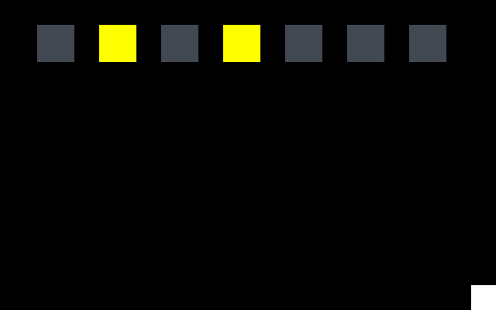
Step 4: UP and DOWN
la t1, marker_y
lw t2, 0(t1)
andi t3, t0, BTN_UP
beqz t3, 5f
addi t2, t2, -SPEED # up is a SMALLER y
5: andi t3, t0, BTN_DOWN
beqz t3, 6f
addi t2, t2, SPEED
6: li t3, MIN_Y
bge t2, t3, 7f
mv t2, t3
7: li t3, MAX_Y
ble t2, t3, 8f
mv t2, t3
Screenshot: this step, built and run
Same shape with masks 4 and 8 and limits 60..184. UP subtracts: a smaller y is higher on the screen.
Notes:
Source: labs/06-asm-state-and-input/step4_two_axes.S

Slide 22
Run step 4
1
labs/run.sh 06-asm-state-and-input/step4_two_axes.S steer
Step 7 | about 5 min
Expected result
2
Move to all four corners of the allowed area
3
Which instruction makes UP go up?
The marker stops at each limit (screenshot: RIGHT and DOWN for 80 frames, bottom-right corner). addi t2, t2, -SPEED moves up.
4
Change MIN_Y to 0: what does the marker cover?
Notes:
Screenshot: this step, built and run: labs/06-asm-state-and-input/expected/step4_two_axes.png

Slide 23
Notice the repetition
1
x and y use the same instructions with different masks and limits
2
In C you would write one function
3
In assembly too: value in a0, limits in a1 and a2, result in a0
4
A leaf function like that needs no frame

Slide 24
05
Bug hunt
A planted fault: find it with evidence

Slide 25
This update has one bug
call prg32_input_read
la t1, marker_x
lw t2, 0(t1)
andi t3, a0, 1
beqz t3, 1f
addi t2, t2, -2
1: call prg32_ticks_ms # someone added this
andi t3, a0, 2
beqz t3, 2f
addi t2, t2, 2
2: sw t2, 0(t1)
1
LEFT works
2
RIGHT does not
3
Sometimes x becomes garbage

Slide 26
Find it
1
Which registers are still needed after the second call?
Step 8
about 5 min
2
State a hypothesis in one sentence
Expected result
a0, t1 and t2 are used after a call that may destroy all three. Fix: keep the input in an s register saved in the frame, as step 1 does with s0.
3
Which breakpoint and register would confirm it?
4
Write the fix

Slide 27
You can now
1
Read the input mask bit by bit
2
Move state with andi and beqz
3
Clamp to computed limits
4
Reuse a pattern on a second axis
5
Say which registers survive a call

Slide 28
Next steps and reading
Before the next session
Reading and sources
Read Chapter 7: graphics and collision
Optional: write clamp as a leaf function
The next lab reuses the move-and-clamp pattern for a paddle
Textbook, Chapter 6
labs/06-asm-state-and-input/ in the textbook repository
PRG32 docs/learn/labs/lab_02_input.md

