Slide 1
CHAPTER 11 | LABORATORY | 45 MINUTES
C Lab 3: Refactor, Refine, Ship
Four verified steps: named constants and a helper, fixed-point motion, lives and edges, a submitted score
Audience: computer programming students (C track)
Playing with RISC-V: Assembly, C, and Retro Games on the PRG32 Platform
Notes:
Teaching support for Chapter 11 of the textbook. Practical, step-by-step session: learners work at their machines; keep each step to its time box. Preparation: Step files: labs/11-c-capstone/step1..4 (prefix refine_c). Step 1 behaves exactly like the end of C Lab 1.

Slide 2
Learning objectives
1
Refactor without changing behaviour
2
Use Q8 fixed point for position and velocity
3
Avoid integer-division traps
4
Detect button edges; manage lives and game over
5
Submit a score exactly once
6
Ship and document a cartridge
Notes:
State the objectives; return to this slide at the end.

Slide 3
Plan of the session
9'
12'
11'
6'
7'
1
2
3
4
5
Refactor
Fixed point
Lives and edges
Score
Ship
Notes:
Total: 45 minutes.

Slide 4
How every step works
1
Each step is a complete file in labs/: read what is new, then run it
2
From the textbook folder: labs/run.sh STEP_FILE PREFIX builds and starts it
3
Set PRG32_HOME to your PRG32 checkout; set PRG32_URL to run on a board or PRG32-QT, otherwise QEMU starts
4
The screenshot on each slide is that exact file, built and executed
5
After each step: change one thing, predict, run

Slide 5
01
Refactor
Step 1: same behaviour, better code

Slide 6
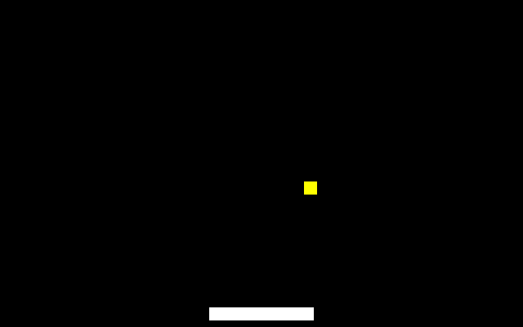
Step 1: names and a helper
static int clamp(int value, int low, int high) {
if (value < low) { return low; }
if (value > high) { return high; }
return value;
}
Screenshot: this step, built and run
clamp replaces four ifs. Constants replace 64, 188, 8; limits become visible computations.
Notes:
Source: labs/11-c-capstone/step1_refactor.c

Slide 7
Run step 1
1
labs/run.sh 11-c-capstone/step1_refactor.c refine_c
Step 1 | about 5 min
Expected result
2
Play: it must behave exactly like C Lab 1
3
Change PADDLE_W to 32
Identical behaviour; with 32 the paddle, its right limit and its hitbox all follow from one edit.
4
Check picture, limit and collision
Notes:
Screenshot: this step, built and run: labs/11-c-capstone/expected/step1_refactor.png

Slide 8
Check your understanding
Why is clamp declared static?
To keep its value between calls
To keep the name private to this file
A
B
To make it faster
Helpers must be static
C
D
Notes:
Answer: B. On a function, static limits linkage.

Slide 9
02
Fixed point
Step 2: speeds between whole pixels

Slide 10
Q8 at a glance
Real value | Stored integer | How
1.0 | 256 | value * Q
1.5 | 384 | 3 * Q / 2
0.25 | 64 | Q / 4
back to pixels | v / 256 | divide by Q
Notes:
Q = 256: eight fractional bits. Positions and velocities share the scale, so adding them needs no conversion.

Slide 11
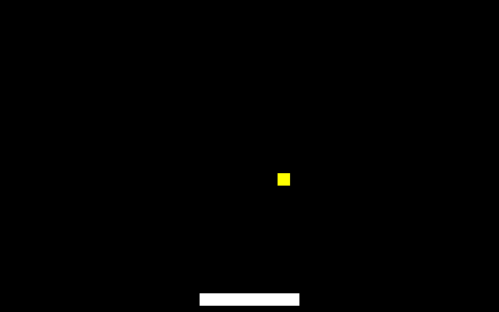
Step 2: the ball in Q8
ball_xq += ball_dxq;
ball_yq += ball_dyq;
if (ball_xq < 0 || ball_xq > (PRG32_GAME_W - BALL_SIZE) * Q)
{ ball_dxq = -ball_dxq; }
if (ball_yq < 0) { ball_dyq = -ball_dyq; }
if (ball_yq > PRG32_GAME_H * Q) { refine_c_init(); }
if (ball_dyq > 0 &&
prg32_sprite_hitbox(ball_xq / Q, ball_yq / Q, BALL_SIZE,
BALL_SIZE,
paddle_x, PADDLE_Y, PADDLE_W,
PADDLE_H)) {
score += 1;
ball_dyq = -(ball_dyq * 21 / 20); /* up, and 5% faster */
if (ball_dyq < -4 * Q) { ball_dyq = -4 * Q; }
}
Screenshot: this step, built and run
Limits are compared in Q units; only the hitbox and draw divide by Q. Each hit multiplies the speed by 21/20.
Notes:
Source: labs/11-c-capstone/step2_fixed_point.c

Slide 12
Run step 2
1
labs/run.sh 11-c-capstone/step2_fixed_point.c refine_c
Step 2 | about 7 min
Expected result
2
Time one crossing: 312 pixels at 1.5 per frame
3
Set ball_dxq = Q / 4 in init: what do you see?
208 frames, about 7 seconds. At 0.25 the ball moves one pixel every fourth frame. (21 / 20) is integer division: 1, so the speed-up vanishes.
4
Change '* 21 / 20' to '* (21 / 20)'
Notes:
Screenshot: this step, built and run: labs/11-c-capstone/expected/step2_fixed_point.png

Slide 13
Integer traps
1
21 / 20 is 1; 3 / 2 is 1
3 * Q / 2
2
Multiply first, divide last: x * 21 / 20
3
x * 21 must fit in 32 bits before the division
= 384, not 256
4
Never add a Q8 value to a plain pixel count

Slide 14
Check your understanding
In Q8, what is stored for 2.75?
275
704
A
B
2.75
11
C
D
Notes:
Answer: B. 2.75 * 256 = 704.

Slide 15
03
Lives and edges
Step 3

Slide 16
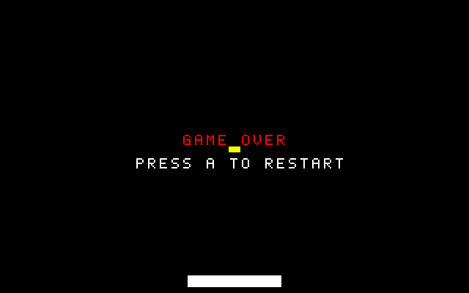
Step 3: edges, and game over
uint32_t pressed = input & ~previous_input; /* edges, not
levels */
previous_input = input;
if (game_over) {
if (pressed & PRG32_BTN_A) {
refine_c_init();
}
return;
}
Screenshot: this step, built and run
pressed has a bit set only in the frame a button goes down. While game_over, update does nothing but wait for that edge.
Notes:
Source: labs/11-c-capstone/step3_lives.c

Slide 17
Step 3: losing a life
if (ball_yq > PRG32_GAME_H * Q) { /* missed */
prg32_audio_note(0, 0, 48, 255, 150);
lives -= 1;
serve();
if (lives == 0) {
game_over = 1;
}
}
if (ball_dyq > 0 &&
1
A low note on a miss
2
serve() restarts the ball only
3
At zero lives: game_over = 1
4
Runs once: the ball is re-served
Notes:
Source: labs/11-c-capstone/step3_lives.c

Slide 18
Run step 3
1
labs/run.sh 11-c-capstone/step3_lives.c refine_c
Step 3 | about 7 min
Expected result
2
Lose three balls without moving
3
Press A once to restart
Three squares count the lives; then GAME OVER (screenshot: no input for 700 frames). With the level instead of the edge, holding A restarts instantly and you never see the message.
4
Change 'pressed & PRG32_BTN_A' to 'input & PRG32_BTN_A' and hold A through a game over
Notes:
Screenshot: this step, built and run: labs/11-c-capstone/expected/step3_lives.png

Slide 19
04
Score
Step 4

Slide 20
Step 4: submit once
if (lives == 0) {
game_over = 1;
prg32_score_submit_current_player("refine-pong",
(uint32_t)score);
}
Screenshot: this step, built and run
The call sits where game_over becomes 1: a place that executes exactly once per game.
Notes:
Source: labs/11-c-capstone/step4_score_submit.c

Slide 21
Run step 4
1
labs/run.sh 11-c-capstone/step4_score_submit.c refine_c
Step 4
about 5 min
2
Play a game to the end
Expected result
One entry for refine-pong under the configured player name. Inside 'if (game_over)' at the top of update it would be submitted 30 times a second.
3
Open the scoreboard in the device's setup menu
4
Where would the call be WRONG, and what would you see?

Slide 22
05
Ship
A file and a note

Slide 23
Build and inspect by hand
1
cd $PRG32_HOME
Step 5
about 5 min
Expected result
2
python3 -m prg32 cartridge build ../Playing-with-RISC-V_PRG32_textbook/labs/11-c-capstone/step4_score_submit.c --portable --entry-prefix refine_c --name refine-pong --out work/refine-pong.prg32
code=3280 mem=3316: 36 bytes of variables that start at zero (.bss). About 5% of the 64 KiB budget.
3
python3 -m prg32 cartridge summary work/refine-pong.prg32

Slide 24
How the cartridge grew
Step | code | mem | What was added
1 refactor | 2908 | 2932 | baseline
2 fixed point | 2968 | 2992 | +60: Q8 arithmetic
3 lives | 3248 | 3284 | +280: edges, game over, text, notes
4 score | 3280 | 3316 | +32: one call
Notes:
Real sizes from the build logs.

Slide 25
Write the design note
1
One sentence: what the game is
Step 6
about 5 min
2
A table: each state variable and what changes it
Expected result
Half a page from which a classmate can understand the source in five minutes.
3
The helpers you have and why
4
One thing you would do next

Slide 26
You can now
1
Refactor safely
2
Move and accelerate with fixed point
3
Use edges for one-shot actions
4
Place a once-only action correctly
5
Read a cartridge's size budget

Slide 27
Next steps and reading
Before the next session
Reading and sources
Read Chapter 16: what the compiler did with this C
Read Chapter 17 if you intend to publish
Hand in the design note with the cartridge
Textbook, Chapter 11
labs/11-c-capstone/ and labs/masters/refine_c.master.c
PRG32 docs/cartridge_store/score_api.md

