Slide 1
CHAPTER 1 | LABORATORY | 45 MINUTES
Orientation Lab: Meet the Platform
Run a cartridge, find the frame loop, read your first RISC-V listing; no toolchain required
Audience: first-year computer architecture and programming students
Playing with RISC-V: Assembly, C, and Retro Games on the PRG32 Platform
Notes:
Teaching support for Chapter 1 of the textbook. Practical, step-by-step session: learners work at their machines; keep each step to its time box. Preparation: PRG32-QT installed on lab machines, or a projector running it; network access to the public Cartridge Store and to GitHub.

Slide 2
Learning objectives
1
Run a published cartridge and describe what it does frame by frame
2
Locate init, update, and draw in a real source file
3
Navigate the PRG32 repository and its documentation
4
Read a short RISC-V listing and predict its effect
5
State one question you want this course to answer
Notes:
State the objectives; return to this slide at the end.

Slide 3
Plan of the session
10'
10'
10'
10'
5'
1
2
3
4
5
Play: a cartridge from the Store
Observe: the frame loop
Explore: the repository
Read: first RISC-V
Reflect
Notes:
Total: 45 minutes.

Slide 4
How this lab works
1
Work in pairs: one drives, one reads the slide; swap every step
2
Each step has a time box and an expected result
3
If your result differs, stop and find out why before moving on
4
Write answers in your lab notebook: you will reuse them in Chapter 2

Slide 5
01
Play
A cartridge from the public Store

Slide 6
Start PRG32-QT
1
Launch PRG32-QT on your machine
Step 1
about 3 min
Expected result
2
Find the Setup screen and the Cartridge Store entry
The Setup screen of the application, with a Store browser. Settings shows Accurate, Optimal, and Unlimited.
3
Open Settings and read the three performance profiles

Slide 7
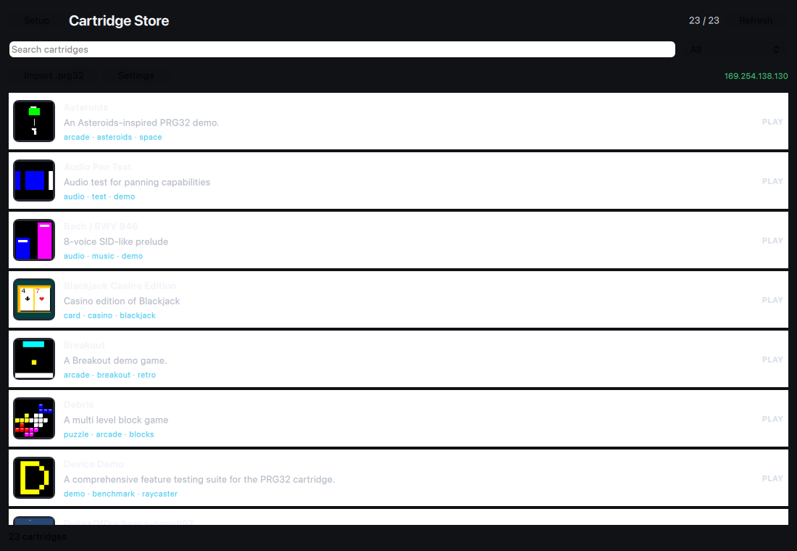
The Cartridge Store inside PRG32-QT
Browsing the public catalogue; downloads are architecture-aware

Slide 8
Download and run a game
1
Browse the catalogue and pick an arcade game
Step 2
about 5 min
2
Open its page: read the summary, authors, and version
Expected result
A colophon (credits and controls) appears first, then the game runs in a 320 by 200 viewport.
3
Download it and choose Run Cartridge
4
Play for two minutes with the arrow keys, Z, and X

Slide 9
Controls on a keyboard
PRG32 control | Keyboard
Joystick | Arrow keys or W A S D
Button A | Z or J
Button B | X or K
Start / Select | Enter or Space

Slide 10
Check your understanding
Before the game started you saw a credits screen. What is it called?
The manifest
The colophon
A
B
The header
The splash
C
D
Notes:
Answer: B. The colophon is a JSON block in the cartridge's metadata trailer: credits, licence, controls.

Slide 11
02
Observe
Find the frame loop in what you just played

Slide 12
Describe one frame
1
Play again, slowly
Step 3
about 4 min
2
List every object that moves
Expected result
A table with three columns: object, what changes it, when. This is the game's state and its update rules.
3
For each one, write what changes it: a button, time, or a collision
4
Write what never changes

Slide 13
Map your notes onto the contract
init
read input
update
draw
what was set up once?
which buttons matter?
your 'what changes it' column
your 'object' column
Every row of your table is a line of update; every object is a call in draw.

Slide 14
Slow the machine down
1
In Settings, enable 'Run cartridges in RISC-V debug mode'
Step 4
about 5 min
2
Run the same cartridge
Expected result
The debugger panel appears beside the game. In slow motion you can see individual frames; Step executes one instruction.
3
Set the speed to 0.1x and watch
4
Press Pause, then Step a few times
Notes:
Do not explain registers yet; the aim is to see that a game is a sequence of small steps.

Slide 15
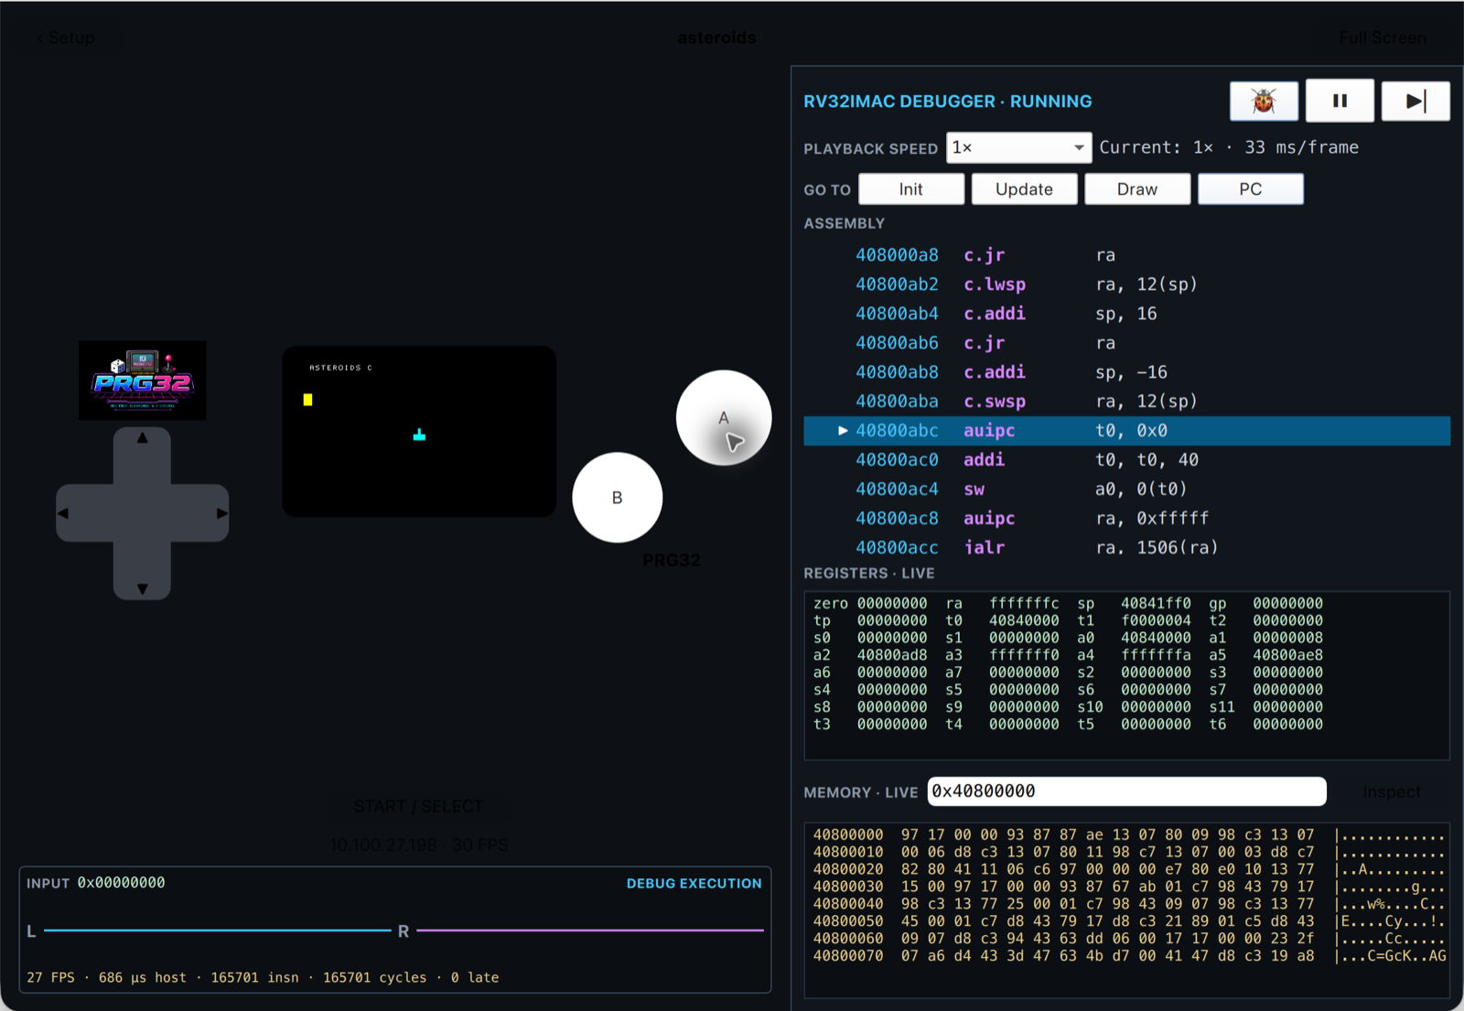
What you are looking at
Game, live assembly, registers, and memory in PRG32-QT

Slide 16
Check your understanding
Paused in the debugger, what does one press of Step execute?
One frame
One call of update
A
B
One RISC-V instruction
One line of C
C
D
Notes:
Answer: C. The debugger steps single RV32IMAC instructions.

Slide 17
03
Explore
The repository is part of the course material

Slide 18
Find your way around PRG32
1
Open github.com/riscv-prg32/PRG32
Step 5
about 4 min
2
Read the first screen of the README
Expected result
You can say what PRG32 is in one sentence and where the examples live. Each game has ascii, graphics, and c versions.
3
Open docs/usage/getting_started.md
4
Open examples/games and count the games

Slide 19
Where things are
Path | What it holds
components/prg32/include/prg32.h | The public interface: every call a game can make
examples/games/<name>/ | Each game in ASCII assembly, graphics assembly, and C
docs/learn/ | Tutorials and labs
docs/software/cartridges.md | The cartridge format and workflow
cartridges/ | Complete Store-ready examples with metadata

Slide 20
Open the same game twice
1
Open examples/games/pong/graphics/game.S
Step 6
about 5 min
2
Open examples/games/pong/c/game.c
Expected result
pong_graphics_init/update/draw in the assembly file; pong_c_init/update/draw in the C file. Same shape, two languages.
3
In each, find the three entry points
4
Note the prefix each file uses

Slide 21
04
Read
Your first RISC-V listing

Slide 22
The smallest program that runs
.option norelax
.section .text
.global hello_init
.global hello_update
.global hello_draw
hello_init:
ret # return to the framework
hello_update:
ret
hello_draw:
ret
1
.global exports a name so the runtime can find it
2
Three labels: the three entry points
3
ret returns to the framework: this game does nothing, correctly
Notes:
Source: examples/asm_first_contact/hello_world_asm.S

Slide 23
Predict before you know
1
Read the listing on the previous slide
Step 7
about 4 min
2
Write what you expect on screen when this cartridge runs
Expected result
A blank game: the runtime calls three functions that return at once. Prediction first, explanation in Chapter 5.
3
Write what you think 'ret' means
4
Compare with your neighbour

Slide 24
One step further: drawing something
.option norelax
.section .text
.global blank_init
.global blank_update
.global blank_draw
blank_init:
ret
blank_update:
ret
blank_draw:
addi sp, sp, -16
sw ra, 12(sp)
li a0, 0 # RGB565 black
call prg32_gfx_clear # fill the 320x200 viewport
lw ra, 12(sp)
addi sp, sp, 16
ret
1
li loads a number into a register
2
call transfers control to a framework function
3
Arguments travel in registers a0, a1, a2...
Notes:
Students should recognise shapes, not understand every line.
Source: examples/asm_graphics_game/hello_world_graphics.S

Slide 25
Annotate the listing
1
Copy five lines of the graphics listing into your notebook
Step 8
about 5 min
2
Beside each, write a guess at what it does
Expected result
An annotated listing with honest confidence marks. Unsure is the expected answer today.
3
Mark each guess: sure, unsure, no idea
4
Keep the page: you will correct it after Chapter 5

Slide 26
05
Reflect
What do you want to be able to explain?

Slide 27
Discussion in pairs, then in plenary
1
What surprised you about how little code a game needs?
2
Where did you see the three functions?
3
What did slow motion show that normal speed hid?
4
Why might an open instruction set matter to your career?

Slide 28
Exit ticket
1
Write one sentence: what is PRG32?
Step 9
about 3 min
Expected result
2
Write one sentence: why RISC-V?
Three sentences handed in. The questions seed the first minutes of the next lecture.
3
Write one question you want answered by the end of term

Slide 29
You can now
1
Run a Store cartridge in PRG32-QT
2
Describe a game as state plus update rules
3
Find init, update, and draw in assembly and in C
4
Navigate the repository and its docs
5
Recognise li, call, and ret in a listing

Slide 30
Next steps and reading
Before the next session
Reading and sources
Install the toolchain at home (Chapter 3) or book a lab slot
Read Chapter 2 before the next lecture
Keep your annotated listing
Textbook, Chapters 1 and 4
PRG32-QT README: github.com/riscv-prg32/PRG32-QT
PRG32 docs/usage/getting_started.md

