Slide 1
CHAPTER 4 | LECTURE | 45 MINUTES
A Third Target: Playing and Debugging with PRG32-QT
An interpreter for portable cartridges, and what it lets you see that native execution hides
Audience: first-year computer architecture and programming students
Playing with RISC-V: Assembly, C, and Retro Games on the PRG32 Platform
Notes:
Teaching support for Chapter 4 of the textbook. Front lecture: about 45 minutes including the questions.

Slide 2
Learning objectives
1
Distinguish native execution, emulation of a chip, and interpretation of a cartridge
2
Explain why a portable cartridge runs on a host that is not the firmware
3
Choose a performance profile and state its limits
4
Use the debugger's controls and views
5
Drive PRG32-QT from the prg32 tool
6
Pick the right target for a task
Notes:
State the objectives; return to this slide at the end.

Slide 3
Agenda
9'
7'
6'
13'
5'
5'
1
2
3
4
5
6
Three ways to run a cartridge
Portability and the ABI
Performance profiles
The debugger
Automation
Choosing a target
Notes:
Total: 45 minutes.

Slide 4
To see a register change, something has to stop between two instructions.
PRG32-QT executes each RISC-V instruction itself, so it can.

Slide 5
Three hosts for one cartridge
 | ESP32-C6 board | Espressif QEMU | PRG32-QT
How code runs | Native | Native on emulated C3 | Interpreted RV32IMAC
Needs ESP-IDF | Yes | Yes | No, to play
Cartridge arrives by | Wi-Fi, Store | Staging | Import, Store, HTTP
Instruction stepping | JTAG + GDB | GDB | Built in
Runs on | The kit | Desktop | Desktop, mobile, TV, Pi

Slide 6
Three words, three meanings
1
Native
2
Emulation
3
Interpretation
The processor executes your instructions directly. The board.
A program models a whole chip; the real firmware runs inside it. QEMU.
A program reads your cartridge's instructions one by one and performs them. PRG32-QT.

Slide 7
What PRG32-QT is
1
A C++20 and Qt 6 application; its runtime core is Qt-free
2
Validates the PRG2 header, CRC, ABI, and features, like the firmware
3
Executes RV32IMAC, including compressed instructions
4
Implements the cartridge ABI: graphics, input, audio, tiles, scores
5
Windows, Linux, Raspberry Pi OS, macOS, iOS, Android, Apple TV, Android TV

Slide 8
Check your understanding
In PRG32-QT, what executes the cartridge's add instruction?
The laptop's CPU, directly
The ESP32-C6
A
B
A C++ interpreter loop that decodes it and updates a register array
The Cartridge Store
C
D
Notes:
Answer: C. An interpreter: fetch, decode, execute in software.

Slide 9
01
Portability
Why a host that is not the firmware can run your game

Slide 10
Two ways to call the runtime
Firmware-specific (legacy)
Portable (ABI table)
Cartridge linked against one firmware image
Calls jump to fixed addresses
Breaks when the firmware is rebuilt
Current tools refuse to build it
Cartridge calls entry number N
The host supplies the table
Header records the ABI hash it expects
Any compatible host can run it

Slide 11
What a host checks before running
Magic PRG2
CRC32
ABI major and hash
Required features
Run
is it a cartridge?
is it intact?
do we speak the same table?
do we have them?
init, update, draw
An incompatible cartridge is refused with a message. It is never executed. ABI 1.6 has 139 entries.

Slide 12
Stubs and trampolines: what the debugger shows first
prg32_gfx_rect: # one stub per runtime function
la t0, __prg32_abi # where the table pointer was saved
lw t0, 0(t0) # t0 = address of the ABI table
lw t1, OFFSET(t0) # OFFSET = 20 + index * 4
jr t1 # jump; a0..a7 untouched
prg32_entry_update: # what the host really calls
addi sp, sp, -16
sw ra, 12(sp)
la t0, __prg32_abi
sw a0, 0(t0) # the host passes the table in a0
call pong_update # your function
lw ra, 12(sp)
addi sp, sp, 16
ret
1
Select Update: you land in the trampoline
2
It saves the ABI table pointer
3
Then calls your function
Notes:
Shape of the code emitted by the cartridge builder.

Slide 13
How PRG32-QT reports a broken cartridge
Message | Typical cause
instruction budget exhausted | an endless loop: for example ra not saved before a call
instruction fetch outside cartridge memory | a jump to garbage: for example sp not restored
ABI hash or feature mismatch | built for a table this host does not provide
Notes:
The first two were reproduced with deliberately broken lab cartridges.

Slide 14
Downloaded cartridges are passive guest data
1
PRG32-QT never loads cartridge code as host native code
2
A cartridge can only do what the ABI offers
3
Unavailable services return safe values instead of crashing
4
This is why running a stranger's game is reasonable

Slide 15
02
Performance profiles
A laptop is far faster than a 160 MHz microcontroller

Slide 16
Three profiles
Profile | Behaviour | Use it to
Accurate (default) | Charges each instruction class and ABI call a fixed cost at 160 MHz and a 33 ms frame | Get an early warning of late frames
Optimal | Paces the game at 30 frames per second | Play comfortably
Unlimited | As fast as the host allows | Fast-forward tests

Slide 17
Accurate mode is a model, not a measurement
1
It reproduces behaviour visible to a portable cartridge
model
2
It is not a cycle-exact ESP32-C6 simulation
3
A late-frame count here is a hypothesis
not measurement
4
Confirm any performance claim on real hardware (Appendix B)

Slide 18
03
The debugger
A microscope for the frame loop

Slide 19
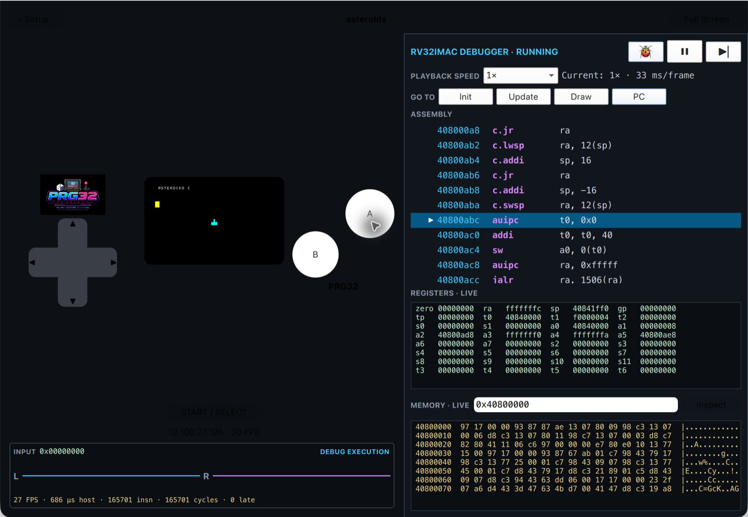
The debugger panel
The running game, the assembly listing with the next instruction highlighted, registers, and memory

Slide 20
Execution controls
Control | Effect
Pause / Resume | Stop and continue; input is frozen while paused
Step | Execute exactly the highlighted instruction
Speed | 0.01x to 4x playback
Bug toggle | Instruction-level debugging on, or normal whole-frame execution
Gutter click | Set or clear a breakpoint

Slide 21
Four views of the code
1
Init
2
Update
Jump the listing to the init entry point. Nothing executes.
Jump to the per-frame update entry point.
3
Draw
4
PC
Jump to the per-frame draw entry point.
Follow the live program counter. Selected automatically by a step or a breakpoint.

Slide 22
Registers and memory
1
All 32 integer registers in hexadecimal; zero stays zero
0x40800000
2
Type an address to see 128 bytes in hexadecimal and ASCII
3
The cartridge is loaded at 0x40800000
cartridge load address
4
A .data variable can be watched changing while you play

Slide 23
A debugging recipe
1
2
3
4
Choose a view
Set a breakpoint
Resume and act
Step and read
Select Update: you see the first instruction of your per-frame logic.
Click the gutter beside an instruction of interest.
Play; hold the buttons you care about.
When it stops, step and read the registers.

Slide 24
What you can verify with it
1
call writes the return address into ra
2
The input bitmask arrives in a0 after prg32_input_read
3
A branch is taken or not, depending on a register
4
A store changes exactly four bytes of memory
Notes:
Each is a claim the assembly track asks students to imagine; here they watch it.

Slide 25
Check your understanding
A breakpoint never triggers. Which is NOT a plausible reason?
The bug toggle is off
The instruction is never executed
A
B
Fullscreen hides the panel but the game runs
Breakpoints only work in C cartridges
C
D
Notes:
Answer: D. The debugger works on RISC-V instructions, whatever language produced them.

Slide 26
Telemetry under the screen
1
The merged input bitmask from UI, keyboard, and controllers
2
Left and right audio waveforms, last 64 samples
3
Host execution time and observed FPS
4
Retired instructions, virtual cycles, late frames in Accurate mode

Slide 27
04
Automation and choice
The debugger as a laboratory instrument

Slide 28
Driving PRG32-QT from the toolchain
#!/usr/bin/env bash
# PRG32-QT advertises its device API as _prg32._tcp.local.
QT=http://prg32-host.local:8080
python3 -m prg32 runtime --url "$QT"
python3 -m prg32 esp32c6 upload-and-run build/lemon-catcher.prg32 \
--url "$QT" --slot cart0
python3 -m prg32 debug enable --url "$QT"
python3 -m prg32 debug pause --url "$QT"
python3 -m prg32 debug step --url "$QT"
python3 -m prg32 debug state --url "$QT"
python3 -m prg32 debug speed --speed 0.25 --url "$QT"
python3 -m prg32 debug resume --url "$QT"
1
Advertised by mDNS as _prg32._tcp.local.
2
Same upload command as for a board
3
/api/debug exists only on PRG32-QT
Notes:
Source: scripts/prg32qt/deploy_and_debug.sh

Slide 29
The device API is for a trusted network
1
It accepts uploads and debugger commands from anyone who can reach the port
2
Use it on a classroom or home network
3
Never expose it to the Internet
4
The same caution applies to a board's HTTP interface

Slide 30
A working rhythm with three hosts
1
2
3
PRG32-QT
QEMU
Board
Develop and debug: builds take seconds, wrong branches can be watched.
Confirm with the real firmware: loader, bands, setup menu.
Finish where time, sound, and the joystick are real.

Slide 31
Checkpoint
1
You can explain native, emulated, and interpreted execution
2
You can say why a portable cartridge runs in PRG32-QT
3
You can pause, step, and set a breakpoint
4
You know where a cartridge is loaded in memory
5
You can say why FPS in PRG32-QT is not evidence about the board

Slide 32
Next steps and reading
Before the next session
Reading and sources
Install PRG32-QT before the lab
Bring a cartridge you built in the setup lab
Read docs/DEBUGGING.md in the PRG32-QT repository
Textbook, Chapter 4
PRG32-QT README and docs/DEBUGGING.md
PRG32-QT docs/PERFORMANCE-EMULATION.md and NETWORKING.md
PRG32 docs/software/abi.md

