Slide 1
CHAPTER 8 | LABORATORY | 45 MINUTES
Assembly Lab 4: Extend It, Sound It, Ship It
Score, an event sound, a pause on a button edge, then a cartridge on two hosts: steps 7 to 9
Audience: computer architecture students (RISC-V assembly track)
Playing with RISC-V: Assembly, C, and Retro Games on the PRG32 Platform
Notes:
Teaching support for Chapter 8 of the textbook. Practical, step-by-step session: learners work at their machines; keep each step to its time box. Preparation: Continues Lab 3. Step files: labs/08-asm-capstone/step7..9. PRG32-QT for the edge proof; a board per bench if available.

Slide 2
Learning objectives
1
Add a feature as state, rule and picture
2
Keep a counter honest with a guard
3
Play a mixer note on an event
4
Tell a button level from a button edge
5
Build, inspect and deliver a cartridge
Notes:
State the objectives; return to this slide at the end.

Slide 3
Plan of the session
12'
8'
13'
12'
1
2
3
4
Score
Sound
Pause on an edge
Ship and review
Notes:
Total: 45 minutes.

Slide 4
How every step works
1
Each step is a complete file in labs/: read what is new, then run it
2
From the textbook folder: labs/run.sh STEP_FILE PREFIX builds and starts it
3
Set PRG32_HOME to your PRG32 checkout; set PRG32_URL to run on a board or PRG32-QT, otherwise QEMU starts
4
The screenshot on each slide is that exact file, built and executed
5
After each step: change one thing, predict, run

Slide 5
Every feature is three edits
1
2
3
State
Rule
Picture
A new word in .data.
Lines in update that change it.
Lines in draw that show it.
Notes:
Score: score / +1 in the guarded bounce / a bar. Pause: paused and previous_input / toggle on the edge of A / the frozen game itself.

Slide 6
01
Score
Step 7

Slide 7
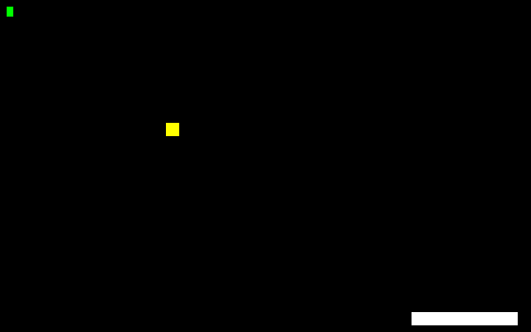
Step 7: the rule, inside the guard
blez t1, update_done # guard: bounce only while moving down
neg t1, t1
sw t1, 0(t0)
la t0, score
lw t1, 0(t0)
addi t1, t1, 1 # inside the guard: one hit, one point
sw t1, 0(t0)
Screenshot: this step, built and run
The increment sits after the blez guard, so it runs exactly once per bounce. Load, add 1, store.
Notes:
Source: labs/08-asm-capstone/step7_score.S

Slide 8
Step 7: the picture
# --- score: a bar 4 pixels long per point, at most 312
la t0, score
lw t1, 0(t0)
slli a2, t1, 2 # width = score * 4
li t2, 312
ble a2, t2, 1f
mv a2, t2
1: li a0, 4
li a1, 4
li a3, 6
li a4, GREEN
call prg32_gfx_rect
Screenshot: this step, built and run
Width = score shifted left by 2 (times 4), clamped to 312 so the bar can never leave the screen.
Notes:
Source: labs/08-asm-capstone/step7_score.S

Slide 9
Run step 7
1
labs/run.sh 08-asm-capstone/step7_score.S pong
Step 1 | about 6 min
Expected result
2
Score five points: the bar is 20 pixels long
3
Read score in PRG32-QT memory after each bounce
+1 per bounce, never +2. With a shift of 4 each point is 16 pixels and the clamp at 312 matters after 19 points.
4
Change slli a2, t1, 2 to slli a2, t1, 4
Notes:
Screenshot: this step, built and run: labs/08-asm-capstone/expected/step7_score.png

Slide 10
Check your understanding
Why slli by 2 rather than mul by 4?
mul is not available
A shift is the idiomatic one-instruction multiply by a power of two
A
B
mul needs a frame
slli is more precise
C
D
Notes:
Answer: B. Both work on RV32IM; the shift needs no second register.

Slide 11
02
Sound
Step 8

Slide 12
Step 8: a note on the event
li a0, 0 # channel
li a1, 0 # instrument
li a2, 72 # MIDI note 72 = C5
li a3, 255 # volume
li a4, 60 # milliseconds
call prg32_audio_note # t registers are dead after this call
Screenshot: this step, built and run
Five arguments; the call returns at once and the mixer plays the note. It sits after the score update on purpose.
Notes:
Source: labs/08-asm-capstone/step8_sound.S

Slide 13
Run step 8
1
labs/run.sh 08-asm-capstone/step8_sound.S pong
Step 2 | about 6 min
Expected result
2
Listen: one note per bounce
3
Change note 72 to 60, then 84
A C5 at each paddle hit. Between lw and sw the call would sit while t0 and t1 are live: caller-saved registers are not guaranteed to survive a call.
4
Why may the six sound lines NOT go between the lw and the sw of the score update?
Notes:
Reasoning question: on some hosts the registers happen to survive, which is exactly why this bug is dangerous.
Screenshot: this step, built and run: labs/08-asm-capstone/expected/step8_sound.png

Slide 14
prg32_audio_note in registers
Register | Argument | Here
a0 | channel, 0-7 | 0
a1 | instrument | 0 (default)
a2 | MIDI note | 72 = C5
a3 | volume, 0-255 | 255
a4 | duration, ms | 60

Slide 15
03
Pause
Step 9: an edge, not a level

Slide 16
Level and edge
Level: is A down?
Edge: did A just go down?
input AND mask
True on every frame it is held
A toggle on a level flickers 30 times a second
input AND NOT previous AND mask
True for one frame per press
One press, one toggle

Slide 17
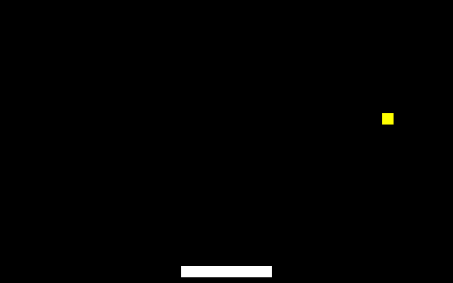
Step 9: detecting the edge
# --- pause: toggle on the EDGE of A, not on its level
call prg32_input_read
mv s0, a0 # s0 survives the calls below
la t0, previous_input
lw t1, 0(t0) # buttons held last frame
sw s0, 0(t0) # remember this frame for the next one
not t1, t1
and t1, s0, t1 # set now AND clear before = newly pressed
andi t1, t1, BTN_A
beqz t1, 9f
la t0, paused
lw t2, 0(t0)
xori t2, t2, 1 # flip 0 <-> 1
sw t2, 0(t0)
9: la t0, paused
lw t2, 0(t0)
bnez t2, update_done # paused: skip the rest of update
Screenshot: this step, built and run
s0 keeps the input across calls. not + and gives the newly pressed bits. xori flips paused between 0 and 1.
Notes:
Source: labs/08-asm-capstone/step9_pause.S

Slide 18
Run step 9
1
labs/run.sh 08-asm-capstone/step9_pause.S pong
Step 3 | about 6 min
Expected result
2
Press A once: the game freezes. Again: it resumes
3
Hold A down for two seconds: how many toggles?
One toggle per press however long A is held (screenshot: paused by one press at frame 100).
4
Why is input read into s0 and not kept in a0?
Notes:
Screenshot: this step, built and run: labs/08-asm-capstone/expected/step9_pause.png

Slide 19
Prove it
1
In PRG32-QT, breakpoint on the xori
Step 4
about 5 min
2
Hold Z and press Resume twice
Expected result
Once per press. With the level instead of the edge it stops on every frame while Z is held.
3
How many times does it stop?
4
Now change 'and t1, s0, t1' to 'mv t1, s0' and repeat

Slide 20
Check your understanding
previous = 0x10, input = 0x11. Newly pressed?
A
LEFT
A
B
LEFT and A
Nothing
C
D
Notes:
Answer: B. 0x11 AND NOT 0x10 = 0x01.

Slide 21
04
Ship and review
A file someone else can run

Slide 22
Build and inspect by hand
1
cd $PRG32_HOME
Step 5
about 5 min
Expected result
2
python3 -m prg32 cartridge build ../Playing-with-RISC-V_PRG32_textbook/labs/08-asm-capstone/step9_pause.S --portable --entry-prefix pong --name my-pong --out work/my-pong.prg32
code=3160 mem=3160; import_model abi-table; header_size 100. About 560 bytes are your game; the rest is stubs.
3
python3 -m prg32 cartridge summary work/my-pong.prg32

Slide 23
Two hosts
1
python3 -m prg32 qemu upload work/my-pong.prg32 && python3 -m prg32 qemu run
Step 6
about 5 min
Expected result
2
Import the same file into PRG32-QT
Identical behaviour everywhere: the file does not know which host runs it.
3
Board: python3 -m prg32 esp32c6 upload work/my-pong.prg32 --url http://192.168.4.1

Slide 24
Swap and review
1
Give your .prg32, not the source, to another pair
Step 7
about 5 min
2
Play theirs for two minutes; try the edges
Expected result
A short, concrete review from players who never saw your code.
3
Write one defect and one thing you liked
4
Return the note

Slide 25
From here to the capstone
1
You have the loop: design, build, debug, ship, review
2
Pick one mechanic and write its state-rule-picture table
3
Keep every counter inside a guard
4
Chapter 17 publishes the result

Slide 26
You can now
1
Add a feature as three edits
2
Guard a counter
3
Play notes on events without clobbering registers
4
Implement and prove edge detection
5
Ship and review a cartridge

Slide 27
Next steps and reading
Before the next session
Reading and sources
Write your capstone proposal with a state-rule-picture table
Read Chapter 16
Optional: prepare a Store bundle (Chapter 17)
Textbook, Chapter 8
labs/08-asm-capstone/ and labs/masters/pong.master.S
PRG32 docs/learn/labs/lab_04_sound.md

