Slide 1
CHAPTER 9 | LABORATORY | 45 MINUTES
C Lab 1: Pong, One Function at a Time
Six verified steps from three empty functions to a scoring game
Audience: computer programming students (C track)
Playing with RISC-V: Assembly, C, and Retro Games on the PRG32 Platform
Notes:
Teaching support for Chapter 9 of the textbook. Practical, step-by-step session: learners work at their machines; keep each step to its time box. Preparation: Working toolchain. Step files: labs/09-c-first-contact/step1..6 (master: labs/masters/pong_c.master.c).

Slide 2
Learning objectives
1
Build and run a C cartridge
2
Keep state in file-scope variables and initialise it
3
Move and clamp a paddle from the input mask
4
Animate a ball and bounce it
5
Use a function's result as a condition
6
Count an event exactly once
Notes:
State the objectives; return to this slide at the end.

Slide 3
Plan of the session
6'
8'
8'
8'
8'
7'
1
2
3
4
5
6
Skeleton
State and draw
Paddle
Ball
Collision
Score
Notes:
Total: 45 minutes.

Slide 4
How every step works
1
Each step is a complete file in labs/: read what is new, then run it
2
From the textbook folder: labs/run.sh STEP_FILE PREFIX builds and starts it
3
Set PRG32_HOME to your PRG32 checkout; set PRG32_URL to run on a board or PRG32-QT, otherwise QEMU starts
4
The screenshot on each slide is that exact file, built and executed
5
After each step: change one thing, predict, run

Slide 5
01
Skeleton
Step 1

Slide 6
Step 1: three empty functions
/* C Lab 1: Pong, one function at a time. */
#include <stdint.h>
#include "prg32.h"
void pong_c_init(void) {
}
void pong_c_update(void) {
}
void pong_c_draw(void) {
}
1
prg32.h declares the runtime
2
The prefix pong_c names the game
3
No main: the runtime owns the loop
Notes:
Source: labs/09-c-first-contact/step1_skeleton.c

Slide 7

Run step 1
1
labs/run.sh 09-c-first-contact/step1_skeleton.c pong_c
Step 1 | about 5 min
Expected result
2
Read the build log: code= ?
3
Rename pong_c_draw to pong_draw and build again
A black screen, code=2604: the same size as an empty assembly cartridge. With the wrong name the builder cannot find the draw entry point.
4
Read the error; restore the name
Notes:
Screenshot: this step, built and run: labs/09-c-first-contact/expected/step1_skeleton.png

Slide 8
Why 2604 bytes for three empty functions
1
Your code is a few bytes
2604
2
The builder adds a stub for each of the 139 runtime functions
3
A cartridge does not link against the C library
bytes, almost all stubs
4
No printf, no malloc: nothing is behind your file but prg32.h

Slide 9
02
State and draw
Step 2

Slide 10
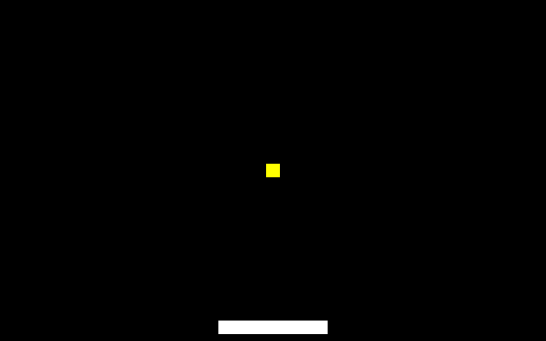
Step 2: state, init, draw
static int paddle_x;
static int ball_x;
static int ball_y;
static int ball_dx; /* horizontal velocity, pixels per frame */
static int ball_dy; /* vertical velocity */
void pong_c_init(void) {
paddle_x = 128;
ball_x = 156;
ball_y = 96;
ball_dx = 2;
ball_dy = 1;
}
void pong_c_update(void) {
}
void pong_c_draw(void) {
prg32_gfx_clear(PRG32_COLOR_BLACK);
prg32_gfx_rect(paddle_x, 188, 64, 8, PRG32_COLOR_WHITE);
prg32_gfx_rect(ball_x, ball_y, 8, 8, PRG32_COLOR_YELLOW);
Screenshot: this step, built and run
Five file-scope variables are the whole game state. init sets them once; draw paints from them.
Notes:
Source: labs/09-c-first-contact/step2_state_draw.c

Slide 11
Run step 2
1
labs/run.sh 09-c-first-contact/step2_state_draw.c pong_c
Step 2 | about 6 min
Expected result
2
Change paddle_x in init to 0, then 256
3
Move prg32_gfx_clear to the END of draw
A white paddle and a yellow ball. With clear last, the screen is black: it paints over what was drawn.
4
Restore it
Notes:
Screenshot: this step, built and run: labs/09-c-first-contact/expected/step2_state_draw.png

Slide 12
Check your understanding
Why are the variables declared outside every function?
It is faster
So that they keep their values between frames
A
B
The compiler requires it
So that other cartridges can read them
C
D
Notes:
Answer: B. File-scope variables live for the whole run; static keeps their names private to the file.

Slide 13
03
Paddle
Step 3

Slide 14
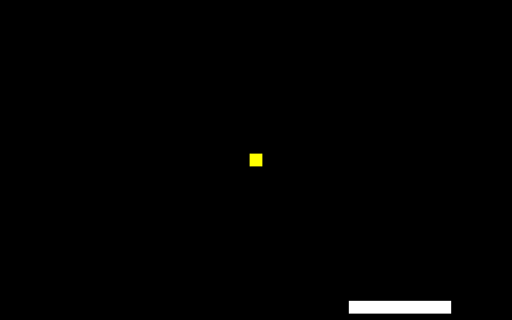
Step 3: input and clamp
void pong_c_update(void) {
uint32_t input = prg32_input_read();
if (input & PRG32_BTN_LEFT) {
paddle_x -= 3;
}
if (input & PRG32_BTN_RIGHT) {
paddle_x += 3;
}
if (paddle_x < 0) { paddle_x = 0; }
if (paddle_x > 256) { paddle_x = 256; } /* 320 - 64-wide paddle */
}
Screenshot: this step, built and run
One call returns every button. & tests one bit. Two ifs keep paddle_x within 0..256.
Notes:
Source: labs/09-c-first-contact/step3_paddle.c

Slide 15
Run step 3
1
labs/run.sh 09-c-first-contact/step3_paddle.c pong_c
Step 3 | about 6 min
Expected result
2
Hold RIGHT to the edge
3
Change 3 to 8: does it still stop exactly at the edge?
The paddle stops at 256 at any speed, because the clamp runs after the move (screenshot: RIGHT for 30 frames, x = 218). With == the test fails as soon as a second button is held.
4
Replace & by == in the LEFT test; hold LEFT and A together
Notes:
Screenshot: this step, built and run: labs/09-c-first-contact/expected/step3_paddle.png

Slide 16
04
Ball
Step 4

Slide 17
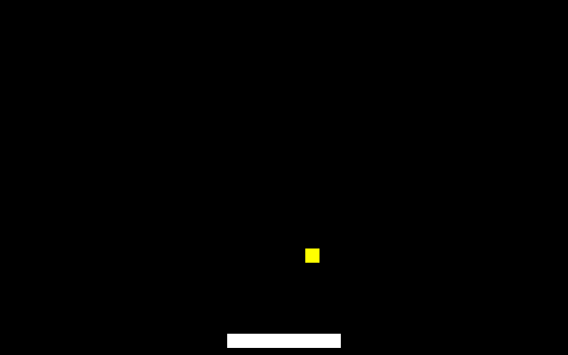
Step 4: velocity and bounce
ball_x += ball_dx;
ball_y += ball_dy;
if (ball_x < 0 || ball_x > 312) { /* 320 - 8-wide ball */
ball_dx = -ball_dx;
}
if (ball_y < 0 || ball_y > 192) { /* 200 - 8-high ball */
ball_dy = -ball_dy;
}
Screenshot: this step, built and run
Position += velocity, every frame. || means or. A unary minus reverses direction at each wall.
Notes:
Source: labs/09-c-first-contact/step4_ball.c

Slide 18
Run step 4
1
labs/run.sh 09-c-first-contact/step4_ball.c pong_c
Step 4 | about 6 min
Expected result
2
Time one horizontal crossing
3
Set ball_dx = 0 in init: predict, then run
About 5 seconds per crossing (312 pixels at 2 per frame). With 5 the ball can overshoot by a few pixels before turning: no clamp here.
4
Set ball_dx = 5: watch the right edge closely
Notes:
Screenshot: this step, built and run: labs/09-c-first-contact/expected/step4_ball.png

Slide 19
05
Collision
Step 5

Slide 20
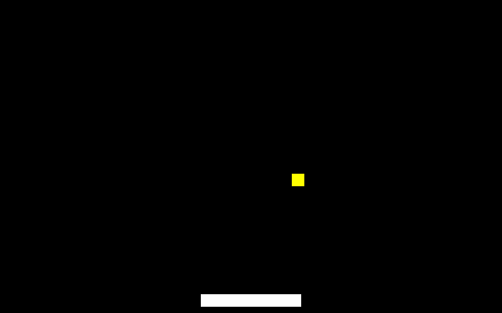
Step 5: one call, one decision
if (ball_y < 0) {
ball_dy = -ball_dy;
}
if (ball_y > 200) { /* missed: start the round again */
pong_c_init();
}
if (prg32_sprite_hitbox(ball_x, ball_y, 8, 8,
paddle_x, 188, 64, 8)) {
ball_dy = -1; /* assign, do not negate: safe to repeat */
}
}
Screenshot: this step, built and run
The bottom no longer bounces: a miss restarts the round. The hitbox result is used directly as the condition.
Notes:
Source: labs/09-c-first-contact/step5_collision.c

Slide 21
Run step 5
1
labs/run.sh 09-c-first-contact/step5_collision.c pong_c
Step 5 | about 6 min
Expected result
2
Keep the ball alive for ten bounces
3
Miss on purpose
A real game. With negation the ball can jitter inside the paddle; assigning -1 is safe to repeat on every overlapping frame.
4
Change 'ball_dy = -1' to 'ball_dy = -ball_dy' and hit the ball with the paddle's side
Notes:
Screenshot: this step, built and run: labs/09-c-first-contact/expected/step5_collision.png

Slide 22
Assign or negate
ball_dy = -1;
ball_dy = -ball_dy;
Idempotent: doing it twice changes nothing
Safe while the ball overlaps for several frames
Fixes the speed
Flips on every overlapping frame
Needs a guard: if (ball_dy > 0)
Keeps the speed

Slide 23
06
Score
Step 6

Slide 24
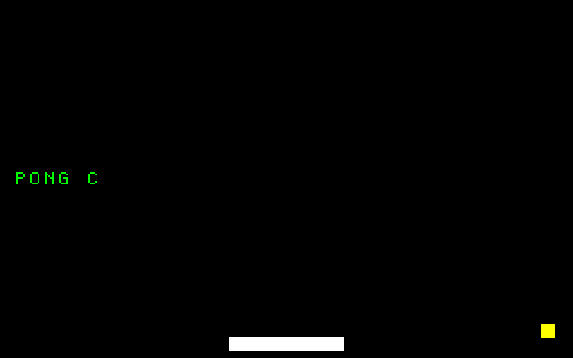
Step 6: count once
if (prg32_sprite_hitbox(ball_x, ball_y, 8, 8,
paddle_x, 188, 64, 8)) {
if (ball_dy > 0) {
score += 1; /* count only while moving down: once per hit */
}
ball_dy = -1; /* assign, do not negate: safe to repeat */
}
}
Screenshot: this step, built and run
The ball may overlap the paddle for several frames. ball_dy > 0 is true only on the first: one hit, one point.
Notes:
Source: labs/09-c-first-contact/step6_score.c

Slide 25
Run step 6
1
labs/run.sh 09-c-first-contact/step6_score.c pong_c
Step 6 | about 6 min
Expected result
2
Score five points: the bar is 20 pixels long
3
Remove the 'if (ball_dy > 0)' around score += 1
+4 pixels per hit. Without the guard the bar jumps by several points per hit: every overlapping frame counts.
4
How fast does the bar grow now?
Notes:
Screenshot: this step, built and run: labs/09-c-first-contact/expected/step6_score.png

Slide 26
Check your understanding
What does 'score * 4' as a rectangle width do when score is 0?
Crashes
Draws nothing: a rectangle of width 0
A
B
Draws a full-width bar
Draws one pixel
C
D
Notes:
Answer: B. Verified: a zero-width rectangle draws nothing.

Slide 27
What you built
1
59 lines of C; 2952 bytes of cartridge
59
2
Six variables of state
3
update: input, paddle, ball, walls, collision, score
4
draw: clear, paddle, ball, title, bar
lines of C
5
The assembly version of the same game is 139 lines

Slide 28
You can now
1
Build and run a C cartridge
2
Keep state at file scope
3
Read input with & and clamp with if
4
Animate with velocity
5
Use a return value as a condition
6
Guard a counter

Slide 29
Next steps and reading
Before the next session
Reading and sources
Read Chapter 10: arrays, structs, tile maps
Replace the repeated numbers with #define constants
The next lab starts from this game
Textbook, Chapter 9
labs/09-c-first-contact/ and labs/masters/pong_c.master.c
PRG32 docs/learn/tutorial_c_game.md

