Slide 1
CHAPTER 10 | LABORATORY | 45 MINUTES
C Lab 2: Bricks, Then a World
Part A adds an array of bricks in three steps; Part B builds a tile level and an actor in three more
Audience: computer programming students (C track)
Playing with RISC-V: Assembly, C, and Retro Games on the PRG32 Platform
Notes:
Teaching support for Chapter 10 of the textbook. Practical, step-by-step session: learners work at their machines; keep each step to its time box. Preparation: Step files in labs/10-c-structs-and-tiles: bricks_*_step1..3.c (prefix bricks_c) and plat_*_step1..3.c (prefix plat).

Slide 2
Learning objectives
1
Declare an array and loop over it to draw and to collide
2
Recognise an out-of-bounds index
3
Factor a repeated expression into a function
4
Build a level from tiles and flags
5
Drive an actor struct with the platform helpers
Notes:
State the objectives; return to this slide at the end.

Slide 3
Plan of the session
9'
12'
9'
9'
6'
1
2
3
4
5
Bricks: draw
Bricks: hit and win
World
Actor
Hazard
Notes:
Total: 45 minutes.

Slide 4
How every step works
1
Each step is a complete file in labs/: read what is new, then run it
2
From the textbook folder: labs/run.sh STEP_FILE PREFIX builds and starts it
3
Set PRG32_HOME to your PRG32 checkout; set PRG32_URL to run on a board or PRG32-QT, otherwise QEMU starts
4
The screenshot on each slide is that exact file, built and executed
5
After each step: change one thing, predict, run

Slide 5
01
Part A: bricks
An array and two loops

Slide 6
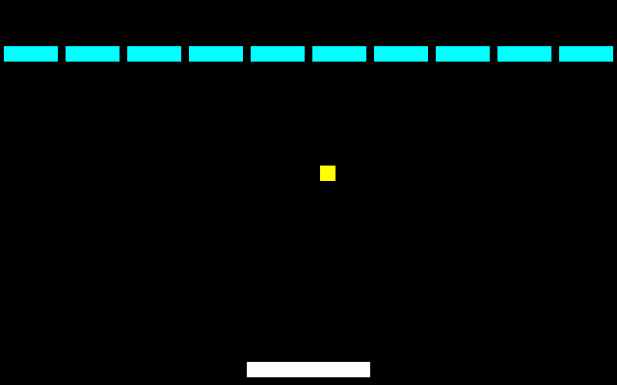
A1: ten bricks, one loop
void bricks_c_draw(void) {
prg32_gfx_clear(PRG32_COLOR_BLACK);
for (int i = 0; i < BRICKS; ++i) {
if (bricks[i]) {
prg32_gfx_rect(i * 32 + 2, 24, 28, 8, PRG32_COLOR_CYAN);
}
}
prg32_gfx_rect(paddle_x, 188, 64, 8, PRG32_COLOR_WHITE);
prg32_gfx_rect(ball_x, ball_y, 8, 8, PRG32_COLOR_YELLOW);
}
Screenshot: this step, built and run
bricks[i] is 1 while brick i is intact. One brick every 32 pixels: x = i * 32 + 2, 28 wide.
Notes:
Source: labs/10-c-structs-and-tiles/bricks_draw_step1.c

Slide 7
Run A1
1
labs/run.sh 10-c-structs-and-tiles/bricks_draw_step1.c bricks_c
Step 1 | about 5 min
Expected result
2
Count the bricks
3
Change the loop test to i <= BRICKS
Ten cyan bricks; the ball passes through them. With <= the loop reads one byte past the array: whatever happens to follow it in memory. C did not stop you.
4
What is bricks[10]?
Notes:
Screenshot: this step, built and run: labs/10-c-structs-and-tiles/expected/bricks_draw_step1.png

Slide 8
Check your understanding
uint8_t bricks[10]; what does 'bricks[10] = 0;' do?
Clears the last brick
Writes one byte past the array
A
B
Fails to compile
Grows the array
C
D
Notes:
Answer: B. Valid indices are 0..9, and nothing checks.

Slide 9
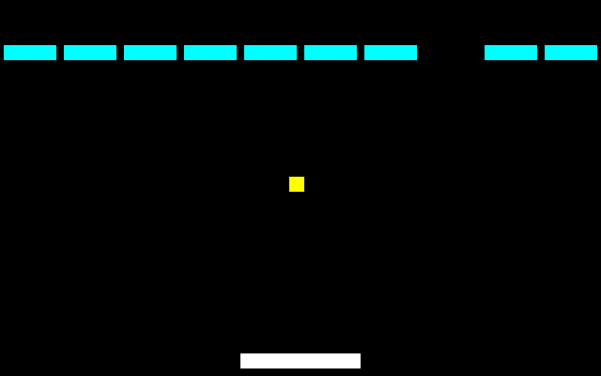
A2: hitting a brick
if (prg32_sprite_hitbox(ball_x, ball_y, 8, 8, paddle_x, 188, 64, 8)) {
ball_dy = -2;
}
for (int i = 0; i < BRICKS; ++i) {
if (bricks[i] && prg32_sprite_hitbox(ball_x, ball_y, 8, 8,
i * 32 + 2, 24, 28, 8)) {
bricks[i] = 0;
ball_dy = 2; /* send the ball back down */
break; /* at most one brick per frame */
}
}
}
Screenshot: this step, built and run
The same hitbox call, in a loop. && short-circuits: a destroyed brick is never tested. break: one brick per frame.
Notes:
Source: labs/10-c-structs-and-tiles/bricks_hit_step2.c

Slide 10
Run A2
1
labs/run.sh 10-c-structs-and-tiles/bricks_hit_step2.c bricks_c
Step 2 | about 6 min
Expected result
2
Destroy three bricks
3
Remove the 'break;'
Bricks vanish and the ball is sent down (screenshot: frame 120, one brick gone). Without break two adjacent bricks can go in one frame.
4
Aim the ball at the gap between two bricks
Notes:
Screenshot: this step, built and run: labs/10-c-structs-and-tiles/expected/bricks_hit_step2.png

Slide 11
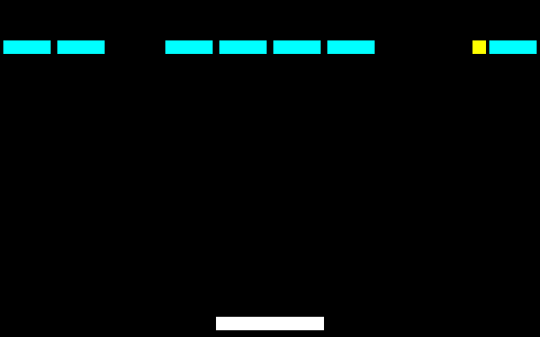
A3: one function owns the layout
static int brick_x(int i) { return i * 32 + 2; }
Screenshot: this step, built and run
The expression i * 32 + 2 appeared in draw and in update. Now it has a name, and the two cannot disagree.
Notes:
Source: labs/10-c-structs-and-tiles/bricks_win_step3.c

Slide 12
A3: counting what is left
int intact = 0;
for (int i = 0; i < BRICKS; ++i) {
intact += bricks[i];
}
if (intact == 0) {
reset_bricks(); /* cleared the row: bring it back */
}
1
A second loop sums the array
2
0 intact: the row comes back
3
A local variable: fresh every frame
Notes:
Source: labs/10-c-structs-and-tiles/bricks_win_step3.c

Slide 13
Run A3
1
labs/run.sh 10-c-structs-and-tiles/bricks_win_step3.c bricks_c
Step 3 | about 6 min
Expected result
2
In brick_x change 32 to 30
3
Do the picture and the collisions still agree?
Yes: one edit moved both. Clearing the row brings it back (screenshot: frame 300).
4
Clear the whole row
Notes:
Screenshot: this step, built and run: labs/10-c-structs-and-tiles/expected/bricks_win_step3.png

Slide 14
02
Part B: a world
Tiles, flags, an actor

Slide 15
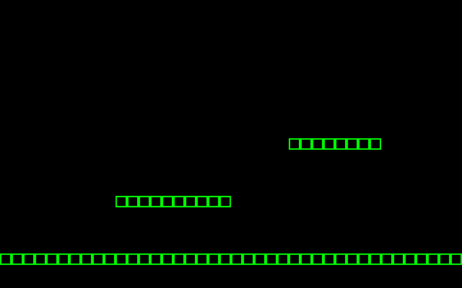
B1: a level from three runs
static void fill_world(void) {
prg32_playfield_clear(1, 0);
prg32_tile_define(2, solid, PRG32_COLOR_GREEN, PRG32_COLOR_BLACK);
put_run(1, 0, 63, 22, 2); /* the ground, whole width */
put_run(1, 10, 19, 17, 2); /* a platform */
put_run(1, 25, 32, 12, 2); /* a higher one */
}
Screenshot: this step, built and run
One 8-byte bitmap defines tile 2. put_run lays a horizontal run. Tile rows 22, 17, 12 are pixel rows 176, 136, 96.
Notes:
Source: labs/10-c-structs-and-tiles/plat_world_step1.c

Slide 16
Run B1
1
labs/run.sh 10-c-structs-and-tiles/plat_world_step1.c plat
Step 4 | about 5 min
Expected result
2
Add a fourth platform at tile row 8, columns 5 to 9
3
Change the bitmap: 0xff in every byte
A ground line and platforms of outlined tiles. (10, 17) is pixel (80, 136): multiply by 8.
4
Convert tile (10, 17) to pixels
Notes:
Screenshot: this step, built and run: labs/10-c-structs-and-tiles/expected/plat_world_step1.png

Slide 17
The playfield in numbers
Quantity | Value
Tile size | 8 x 8 pixels
Grid | 64 x 32 tiles = 512 x 256 pixels
Layers | 2
Bytes for one layer | 2048
Screen | 40 x 25 tiles visible
Notes:
A level is 2 KiB of tile numbers, not 128 KiB of pixels.

Slide 18
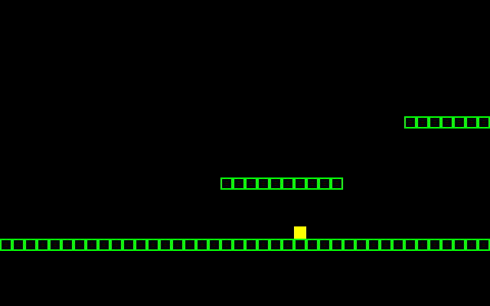
B2: an actor in the world
void plat_update(void) {
uint32_t input = prg32_input_read();
/* move_speed, jump_speed, gravity, max_fall */
uint16_t state = prg32_platform_actor_step(&player, input, 2, -7, 1, 5);
(void)state;
prg32_platform_camera_follow(&player, 64, 48);
}
Screenshot: this step, built and run
One struct holds position, velocity, size and state. &player passes its address so the helper can change it.
Notes:
Source: labs/10-c-structs-and-tiles/plat_actor_step2.c

Slide 19
Run B2
1
labs/run.sh 10-c-structs-and-tiles/plat_actor_step2.c plat
Step 5 | about 6 min
Expected result
2
Walk right and jump with A
3
Remove the prg32_platform_tile_flags line in init
The player walks, jumps and lands; the view scrolls (screenshot: RIGHT held, one jump). Without the SOLID flag the player falls through: a tile number has no behaviour until it is flagged.
4
What happens to the player?
Notes:
Screenshot: this step, built and run: labs/10-c-structs-and-tiles/expected/plat_actor_step2.png

Slide 20
prg32_platform_actor_t in memory
+0
x
4 bytes
int: position
+4
y
4 bytes
int
+8
vx
4 bytes
int: velocity
+12
vy
4 bytes
int
+16
w
2 bytes
uint16_t: size
+18
h
2 bytes
uint16_t
+20
state
2 bytes
uint16_t: flags set by the physics step
+22
layer, reserved
2 bytes
two uint8_t
24 bytes. The assembly track reaches the same fields as offsets from one base address: PRG32_PLATFORM_ACTOR_X_OFFSET is 0, ..._STATE_OFFSET is 20.

Slide 21
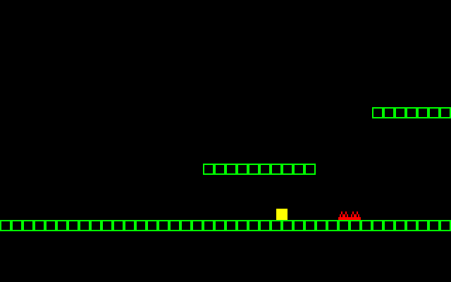
B3: a hazard
if (state & PRG32_PLATFORM_HAZARD) {
prg32_audio_note(0, 0, 48, 255, 80);
prg32_platform_actor_init(&player, 1, 32, 120, 8, 8); /* back to start */
}
Screenshot: this step, built and run
The physics step returns flags in one integer. & tests one of them, exactly like a button.
Notes:
Source: labs/10-c-structs-and-tiles/plat_hazard_step3.c

Slide 22
Run B3
1
labs/run.sh 10-c-structs-and-tiles/plat_hazard_step3.c plat
Step 6 | about 6 min
Expected result
2
Walk into the red spikes
3
Jump over them
Touching the spikes plays a low note and returns the player to the start (screenshot: just before contact).
4
Flag tile 5 as SOLID | HAZARD instead
Notes:
Screenshot: this step, built and run: labs/10-c-structs-and-tiles/expected/plat_hazard_step3.png

Slide 23
Check your understanding
The player falls through the ground. First thing to check?
Gravity
That the ground tile id is flagged SOLID
A
B
The tile's colour
The camera
C
D
Notes:
Answer: B. The map stores numbers; flags give them behaviour.

Slide 24
Review
1
Where did an array remove repetition?
2
What did brick_x protect you from?
3
What does &player let the helper do?
4
Which numbers were in tiles and which in pixels?

Slide 25
You can now
1
Loop over an array to draw and to collide
2
Spot an out-of-bounds index
3
Give a repeated expression a name
4
Build a level from tiles and flags
5
Use a struct with the platform helpers

Slide 26
Next steps and reading
Before the next session
Reading and sources
Add coins: PRG32_TILE_FLAG_COLLECT and PRG32_PLATFORM_COLLECT
Read Chapter 11
Compare with examples/games/platformer/c/game.c
Textbook, Chapter 10
labs/10-c-structs-and-tiles/ in the textbook repository
PRG32 docs/software/framework_manual.md

