Slide 1
CHAPTER 12 | LECTURE | 45 MINUTES
Mission 1: Your First Blocks
What a program is, where things go on the screen, and the three big blocks of every game
Audience: children aged 7 and over, led by a teacher (read aloud for the youngest)
Playing with RISC-V: Assembly, C, and Retro Games on the PRG32 Platform
Notes:
Teaching support for Chapter 12 of the textbook. Front lecture: about 45 minutes including the questions. Preparation: Start with the unplugged Robot game: clear some floor space. Have the Construction Kit open on the projector with an empty project.

Slide 2
Today you will learn to
1
Say what a program is
2
Find a place on the screen with x and y
3
Name the three big blocks
4
Say what a variable is
5
Tell the computer to draw a square
Notes:
State the objectives; return to this slide at the end.

Slide 3
Agenda
8'
7'
10'
10'
10'
1
2
3
4
5
Robot game
What is a program?
The screen is a grid
Three big blocks
Boxes with names
Notes:
Total: 45 minutes.

Slide 4
Today you become a programmer.
A programmer tells a computer exactly what to do.

Slide 5
01
The Robot game
No computers yet!

Slide 6
How to play Robot
1
2
3
Pick a robot
Give orders
Reach the goal
One friend is the robot. Robots only do what they are told.
One step forward. Turn left. Pick up the pencil.
Get your robot from the door to the window.
Notes:
Play twice. The second time, let the robot be very literal: it walks into a chair if nobody says stop.

Slide 7
What did we find out?
1
The robot does not guess
2
The order of the instructions matters
3
If you forget one step, it goes wrong
4
You can fix it by changing the instructions

Slide 8
02
What is a program?
Instructions for a computer

Slide 9
Three new words
1
Program
2
Programmer
3
Bug
A list of instructions for a computer.
The person who writes the program. Today: you.
A mistake in a program. Everybody makes them.

Slide 10
Computers are fast, not clever
1
A computer follows instructions one after another
2
It does exactly what they say
3
It never guesses what you meant
4
It can do it millions of times without getting tired

Slide 11
Quick question
What is a program?
A kind of robot
A list of instructions for a computer
A
B
A game controller
A picture
C
D
Notes:
Answer: B. Link back to the Robot game: your spoken orders were a program.

Slide 12
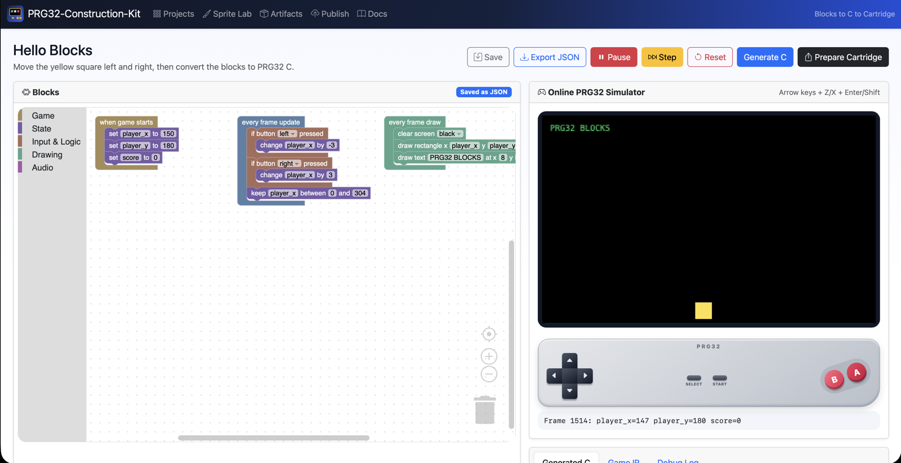
Meet the Construction Kit
Blocks on the left, the game screen and game pad on the right

Slide 13
Four places to know
1
Toolbox
2
Workspace
Where the blocks live, sorted by colour.
The big area where you build.
3
Game screen
4
Buttons
Where your game appears.
Save, Play, Step, Reset.

Slide 14
03
The screen is a grid
Every dot has an address

Slide 15
Pixels
1
The screen is made of tiny squares called pixels
x=0 y=0
2
320 across
x=152 y=92
3
200 down
x=319 y=199
320 x 200 game viewport
Notes:
Ask a child to point to where x is 0 and y is 0.

Slide 16
Two numbers find any place
x: across
y: down
How far to the right
0 is the left edge
319 is the right edge
Bigger x: more to the right
How far down
0 is the top
199 is the bottom
Bigger y: lower!

Slide 17
Bigger y is LOWER.
On a game screen, counting starts at the top and goes down, like reading a page.

Slide 18
Quick question
Where is x = 0, y = 0?
In the middle
Top left corner
A
B
Bottom left corner
Top right corner
C
D
Notes:
Answer: B. Have the class point together.

Slide 19
Quick question
The square is at y = 50. We change y to 150. The square moves...
Up
Down
A
B
Left
Right
C
D
Notes:
Answer: B. Bigger y is lower.

Slide 20
04
Three big blocks
Every game has them

Slide 21
The three big yellow blocks
1
Starts: runs one time. Get ready!
when game starts
every frame update
every frame draw
2
Update: runs again and again. Change things!
3
Draw: runs again and again. Paint the picture!

Slide 22
A game is a loop
Get ready
Change
Paint
Change
Paint
one time
update
draw
update
draw
Like a cartoon: many pictures, very fast. Each picture is called a frame.

Slide 23
What is a frame?
1
A frame is one picture
2
A cartoon shows many pictures quickly
3
A game does the same
4
Between pictures, the game changes its numbers

Slide 24
Quick question
Which block runs only ONE time?
every frame update
every frame draw
A
B
when game starts
All of them
C
D
Notes:
Answer: C. Starts runs once; the other two repeat.

Slide 25
05
Boxes with names
How a game remembers

Slide 26
A variable is a box
1
It has a name
2
It holds one number
3
You can change it
Like player_x. You choose the name.
Like 152.
Put a new number in. The old one is gone.
Notes:
Use a real box and number cards. Putting in a new card replaces the old one.

Slide 27
Set: put a number in the box
1
Purple blocks are for variables
when game starts
set player_x to 152
2
set puts a number in
set player_y to 92
3
player_x is how far across
4
player_y is how far down

Slide 28
Draw: paint with the numbers
1
Blue-green blocks draw
every frame draw
clear screen BLACK
2
First clean the screen
draw rectangle x player_x y player_y w 16 h 16 color YELLOW
3
Then draw a rectangle
4
w is how wide, h is how high

Slide 29
What the computer paints
1
A black screen
2
A yellow square
3
16 wide and 16 high
4
At x 152, y 92
320 x 200 game viewport

Slide 30
Why clear the screen first?
1
The computer paints on top of the old picture
2
If you never clean, old drawings stay
3
So: clear first, then draw
4
Order matters, just like for the robot

Slide 31
Now you know
1
A program is a list of instructions
2
x goes across, y goes down
3
Starts, update, draw: the three big blocks
4
A variable is a box with a name
5
Clear first, then draw

Slide 32
Next time, and for grown-ups
Next time
For the grown-ups
We build it for real on the computers
Think: what would YOU like to draw with rectangles?
Teach the Robot game to someone at home
Textbook, Part IV (pupil chapters) and Chapter 15 (teacher's guide)
PRG32 Construction Kit: github.com/riscv-prg32/PRG32-Construction-Kit
Reference projects: examples/blocks_first_steps/
CS Unplugged activities (Bell et al.)

