Slide 1
CHAPTER 14 | LABORATORY | 45 MINUTES
Missions 4 and 5 Workshop: Sound It, Draw It, Share It
Add beeps, build the Music Pad, paint a sprite, peek at the C, and make a cartridge
Audience: children aged 7 and over, led by a teacher (read aloud for the youngest)
Playing with RISC-V: Assembly, C, and Retro Games on the PRG32 Platform
Notes:
Teaching support for Chapter 14 of the textbook. Practical, step-by-step session: learners work at their machines; keep each step to its time box. Preparation: Headphones or low speaker volume. Decide beforehand whether Compile Cartridge will produce real cartridges (toolchain) and whether you will publish to a school Store. Reference: music_pad.blocks.json.

Slide 2
Today you will learn to
1
Add a happy beep and a sad beep
2
Build the Music Pad
3
Draw and save a sprite
4
Find one of your blocks in the C
5
Make a cartridge and share it with your teacher
Notes:
State the objectives; return to this slide at the end.

Slide 3
Plan of the session
8'
12'
9'
5'
11'
1
2
3
4
5
Beeps in Lemon Catcher
Music Pad
Sprite Lab
Peek at the C
Cartridge and showcase
Notes:
Total: 45 minutes.

Slide 4
How we work today
1
Sound on, but quiet!
2
Driver and navigator, swapping
3
Build, Play, listen
4
Save often

Slide 5
01
Mission 4
Sound

Slide 6
Add a happy beep
1
Open Lemon Catcher
if rect lemon_x lemon_y 10 10 touches rect basket_x 180 32 8
change score by 1
2
Find the 'caught' block
play beep freq 880 ms 80
3
Open the Audio drawer
4
Snap the beep inside

Slide 7
Happy and sad
1
Add 'play beep freq 880 ms 80' inside the caught block
Step 1
about 6 min
2
Add 'play beep freq 220 ms 150' inside the missed block
You should see
A high short beep for a catch, a low longer beep for a miss.
3
Save and Play
4
Close your eyes: catch or miss?

Slide 8
Experiment
1
Change 880 to 1760. Higher or lower?
Step 2
about 3 min
You should see
2
Change 80 to 500. What changed?
Bigger freq is higher. Bigger ms is longer.
3
Pick the sounds you like best

Slide 9
Noise on purpose
1
Drag a beep block out and put it alone in update
Step 3
about 2 min
You should see
2
Play for two seconds
A horrible buzzing! A beep every frame is noise. Sounds go inside an if.
3
Put it back inside the if

Slide 10
02
The Music Pad
A new project

Slide 11
Start the Music Pad
1
New Project: Music Pad
Step 4
about 2 min
You should see
A new project with one start block.
2
when game starts: set marker_x to 400

Slide 12
Draw the pads
1
Four pads
every frame draw
clear screen BLACK
draw rectangle x 40 y 80 w 48 h 48 color BLUE
2
Only x changes: 40, 104, 168, 232
draw rectangle x 104 y 80 w 48 h 48 color GREEN
draw rectangle x 168 y 80 w 48 h 48 color RED
draw rectangle x 232 y 80 w 48 h 48 color MAGENTA
3
The last one is the marker
draw rectangle x marker_x y 136 w 48 h 6 color WHITE

Slide 13
Build and look
1
Build the draw blocks
Step 5
about 5 min
You should see
Four coloured squares in a row. No white bar: it is hiding at x = 400.
2
Save and Play

Slide 14
Play the notes
1
Build these first
every frame update
set marker_x to 400
if button LEFT pressed
2
Then add RIGHT: 168, note 67
set marker_x to 40
play MIDI note 60 on channel 0 for 120 ms
if button UP pressed
3
Then add A: 232, note 72
set marker_x to 104
play MIDI note 64 on channel 0 for 120 ms

Slide 15
Make music
1
Build update with all four buttons
Step 6
about 7 min
You should see
2
Save and Play
Four rising notes, and the white bar jumps under each pad.
3
Press LEFT, UP, RIGHT, A in order

Slide 16
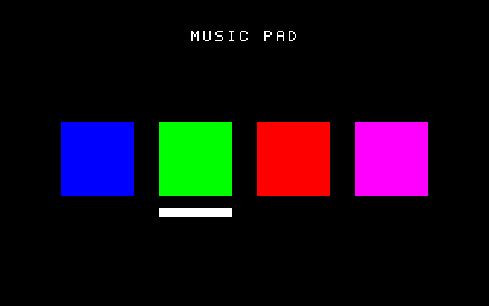
The Music Pad, for real
UP held: the white bar is under the green pad

Slide 17
Playing UP
1
UP is the green pad
2
The white bar is under it
3
You hear note 64
320 x 200 game viewport

Slide 18
Your own tune
1
Change the four note numbers
Step 7
about 4 min
You should see
2
Use the note table: 60 62 64 65 67 69 71 72
A four-note tune of your own that another pair can play back.
3
Teach your tune to another pair

Slide 19
03
Sprite Lab
Paint with pixels

Slide 20
A lemon with a face
1
Click Sprite Lab at the top
Step 8
about 7 min
2
New Sprite: name it lemon, 16 by 16
You should see
Your own 16 by 16 picture, saved with your name on it.
3
Paint a yellow lemon; give it eyes and a smile
4
Click Save

Slide 21
Count the pixels
1
How many pixels across?
Step 9
about 2 min
2
How many down?
You should see
16 across, 16 down, 256 in all. The C shows 256 numbers: one for each pixel.
3
How many altogether? (16 times 16)
4
Click Convert to C: how many numbers do you see?

Slide 22
04
Peek at the C
Under the blocks

Slide 23
Find your blocks
1
Open Lemon Catcher
Step 10
about 4 min
2
Click Generate C
You should see
score += 1; and two lines that start with if. One block can become more than one line.
3
Find the line for 'change score by 1'
4
Find the lines for 'keep basket_x between 0 and 288'

Slide 24
Quick question
In C, 'change score by 1' is written...
score = 1;
score += 1;
A
B
score == 1;
if (score)
C
D
Notes:
Answer: B. += means add to.

Slide 25
05
Mission 5
Your game on a cartridge

Slide 26
Get ready to share
1
Choose your best game
Step 11
about 3 min
2
Check the title: is it a good name?
You should see
A game you are proud of, with a title that is kind and safe.
3
Check: no full names, no private things
4
Play it once more from the start

Slide 27
Make the cartridge
1
Click Compile Cartridge
Step 12
about 3 min
You should see
2
Wait for the message
Green buttons mean a real cartridge was made. If there are none, your teacher will explain the source bundle.
3
Look for the green download buttons

Slide 28
Share with your teacher
1
Call your teacher over
Step 13
about 4 min
2
Open the Publish page together
You should see
Your game is waiting for review, then it appears in the class Store.
3
Click Publish next to your game
4
Your teacher checks it and says yes

Slide 29
Showcase
1
Swap seats with another pair
Step 14
about 5 min
2
Play their game for two minutes
You should see
Every game has been played by someone who did not make it.
3
Tell them one thing you liked
4
Tell them one idea to make it even better

Slide 30
You are a game maker!
1
Sounds that mean something
2
A musical instrument
3
Your own sprite
4
You read real C
5
A cartridge with your game
6
You shared it safely

Slide 31
Next time, and for grown-ups
Next time
For the grown-ups
Keep making games: there are more examples on the Kit's home page
Show your game to your family
One day: try writing the C yourself
Textbook, Part IV (pupil chapters) and Chapter 15 (teacher's guide)
PRG32 Construction Kit: github.com/riscv-prg32/PRG32-Construction-Kit
Reference projects: examples/blocks_first_steps/
CS Unplugged activities (Bell et al.)

