Slide 1
CHAPTER 15 | LECTURE | 45 MINUTES
Teaching with the PRG32 Construction Kit
What the Kit is, why blocks and games work, how to plan, teach, assess, and keep pupils safe
Audience: primary and lower-secondary teachers, club leaders, and teaching assistants
Playing with RISC-V: Assembly, C, and Retro Games on the PRG32 Platform
Notes:
Teaching support for Chapter 15 of the textbook. Front lecture: about 45 minutes including the questions.

Slide 2
Learning objectives
1
Describe the Kit's components and its pipeline from blocks to cartridge
2
Justify blocks and games with evidence from computing education
3
Plan a ten-session unit and a 45-minute session
4
Use five teaching moves and answer six common misconceptions
5
Assess ideas with a progression rubric
6
Run the Kit safely with respect to data and publishing
Notes:
State the objectives; return to this slide at the end.

Slide 3
Agenda
9'
8'
9'
8'
5'
6'
1
2
3
4
5
6
What the Kit is
Why blocks, games, seven
Planning
Teaching moves
Assessment
Safety and publishing
Notes:
Total: 45 minutes.

Slide 4
A child of eight and a first-year undergraduate can program the same machine through the same interface.
That is the design idea of the Construction Kit, and the reason nothing has to be unlearned later.

Slide 5
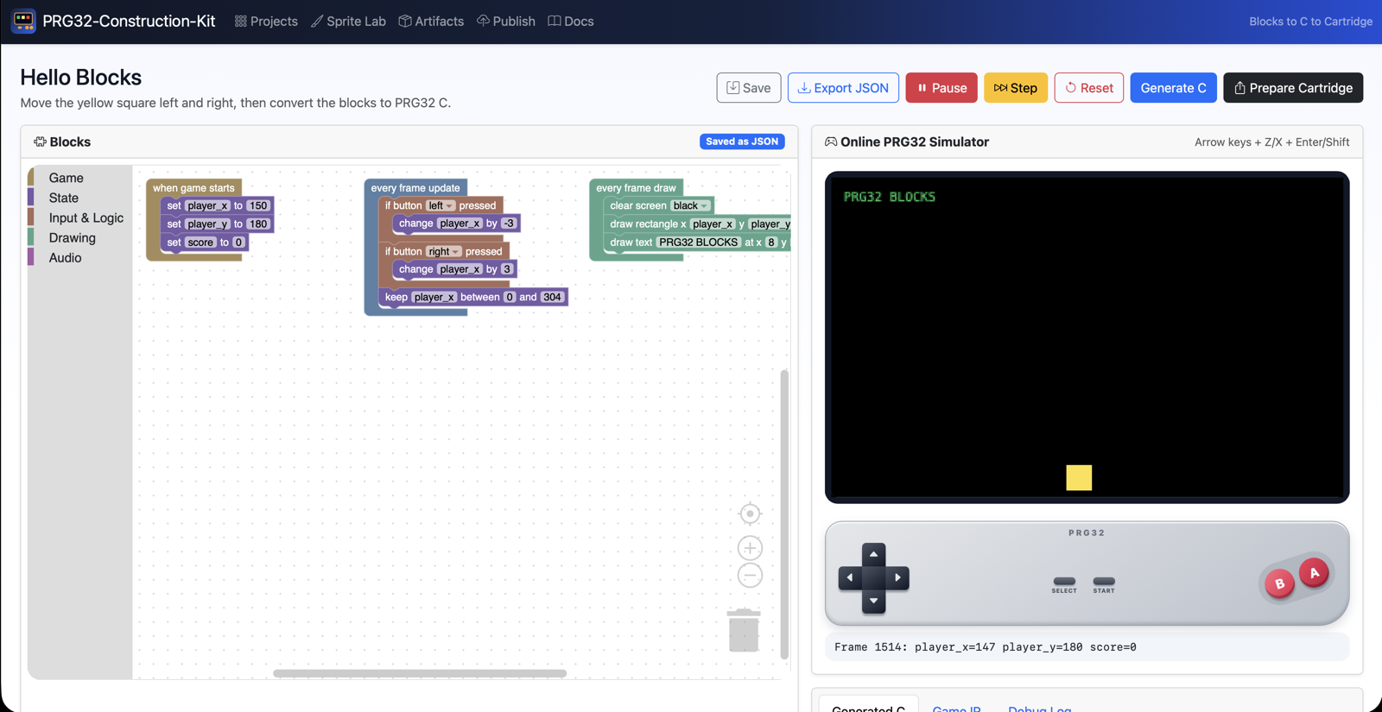
The Construction Kit
Blocks workspace, browser simulator with game pad, generated C, and build tools

Slide 6
Five components
Component | What it gives the class
Blocks editor | 20 blocks in five drawers: Game, State, Input & Logic, Drawing, Audio
Simulator | 320 x 200 screen, game pad, Play/Pause, Step, Reset, live variables
Sprite Lab | A pixel editor; converts sprites to C arrays
C generator | Deterministic translation of blocks into PRG32 C
Packager / publisher | Builds .prg32 cartridges; submits bundles to a Store

Slide 7
Nothing is magic: the pipeline
Blocks
Game description
Simulator and C
Cartridge
Cartridge Store
what pupils build
an intermediate form
run it; read it
.prg32
reviewed, shared
Every stage is visible to the pupil. The three top-level blocks are the init, update, and draw functions older students write by hand.

Slide 8
What the Kit covers, and what it does not
In the Blocks language
Only through Advanced C
Game lifecycle, one controller
Integer variables, clamp, random
Rectangle collision
Rectangles, pixels, text, palette
Beeps and notes
Tile maps and scrolling
Sprites and animation in games
Tracker music and samples
Scores and multiplayer
Not simulated in the browser

Slide 9
Limits to tell colleagues about
1
The simulator approximates the runtime: sound and random sequences differ
2
There is no general comparison or loop block: thresholds use the collision block
3
Text blocks show fixed text: scores are drawn as bars
4
No pupil accounts: everyone sees every project

Slide 10
01
Why blocks, why games, why seven
The pedagogy in three claims

Slide 11
Three well-supported claims
1
Constructionism
2
Blocks remove syntax, not concepts
3
Computational thinking transfers
Children learn powerful ideas by building things they care about and can show (Papert, 1980).
Block-first learners reach comparable or better understanding, with more confidence (Weintrop and Wilensky, 2017).
Decomposition, naming state, testing one change, reading what the machine did (Wing, 2006).

Slide 12
Why seven is a floor, not a rule
1
Read short labels; type small numbers
2
Reason about bigger and smaller; add within a few hundred
3
Negative numbers appear: teach them as 'going back' on a floor number line
4
Multiplication appears once, in the score bar: a recipe for the youngest

Slide 13
Pacing by age
Age | Pace | Adaptations
7-8 | One mission per two sessions, in pairs | Read aloud; starter projects; floor number line
9-10 | One mission per session | Written prediction before each Play
11-13 | Missions 1-3 in two sessions | Generated-C discussion; Advanced C; publish
14+ | One session as an on-ramp | Move to the C track; compare with generated source

Slide 14
Check your understanding
Which statement about block-based programming is supported by the cited research?
It delays real programming
It removes syntax errors while keeping the concepts
A
B
It only suits children under ten
It cannot express conditions
C
D
Notes:
Answer: B. Weintrop and Wilensky (2017); Resnick et al. (2009).

Slide 15
02
Planning
A unit and a session

Slide 16
A ten-session unit
# | Mission | Outcome | Idea
1-2 | 1 | Robot game; a square; a picture from rectangles | sequence, coordinates
3-4 | 2 | Buttons move it; the fence; Step | condition, variable
5-6 | 3 | Lemon Catcher: fall, catch, score | loop, collision, random
7-8 | 4 | Beeps on events; Music Pad; Sprite Lab | event, representation
9-10 | 5 | Own game; generated C; showcase | design, abstraction

Slide 17
The 45-minute session
1
2
3
4
5
Hook (5)
Guided build (15)
Make it yours (15)
Under the hood (5)
Circle (5)
Show the finished behaviour or play unplugged.
The mission steps, together.
'Try it yourself' changes, in pairs.
Step, or Generate C, on one project.
What did you change? What happened?

Slide 18
What you need in the room
1
One teacher computer running the Kit; pupils open its address in a browser
2
Nothing to install on pupil devices; tablets work
3
Python 3.11 or Docker on the teacher machine
4
The cartridge toolchain is optional
5
A projector for Step and Generate C

Slide 19
03
Teaching moves
What to do at the front of the room

Slide 20
Five moves that work
1
Predict, run, explain
2
Pair programming
3
One change at a time
Ask what will happen before every Play.
Driver and navigator; swap every ten minutes.
When three changes break it, undo two.
4
Step as slow motion
5
Public, normal bugs
Project a screen; the class calls out the next value.
A 'bug of the day', credited to the pupil who found it.

Slide 21
Misconceptions and responses
Pupil believes | Try
The computer knows what I meant | The Robot game; swap two blocks and run
y goes up | A wall grid with (0,0) at the top left; walk it
It is caught because I can see it | Change the drawn basket, not the 'touches' numbers
A variable keeps its old values | A real box and one card
Update runs when I press a button | Step with no button held: the lemon still falls
More blocks is better | Celebrate the shortest project that meets the brief

Slide 22
The vertical curriculum
What the pupil did
What it is called later
Snapped 'if button LEFT pressed'
Used 'change x by -3'
Used 'keep x between'
Pressed Compile Cartridge
A conditional on a bit mask: if (input & LEFT)
Load, add, store
A clamp: two compares, two branches
Cross-compiling and packaging
Notes:
Older students can read the younger pupils' generated C, or rewrite a Blocks game by hand (Appendix C does this for Lemon Catcher).

Slide 23
04
Assessment
Assess ideas, not artefacts

Slide 24
A progression rubric
Idea | Beginning | Secure | Extending
Sequence | Builds from a model | Explains why order matters | Predicts the effect of reordering
Variables | Changes a given value | Names and uses own | Uses an expression (score * 3)
Conditions | Uses a button block | Combines conditions for a rule | Thresholds via collision
Debugging | Asks for help | Uses Step and the read-out | Forms and tests a hypothesis
Design | Modifies a game | Plans on paper first | Reviews a peer's game well

Slide 25
Three cheap sources of evidence
1
The saved project, exported as JSON
2
A one-minute 'explain this block to me' conversation
3
A prediction sheet filled in before pressing Play
4
A beautiful copied game shows less than a plain explained one

Slide 26
05
Safety and publishing
Data, access, and the review step

Slide 27
Running the Kit responsibly
1
Network
2
Data
School network only. There are no pupil accounts.
First names or team names; back up the data directory with the server stopped.
3
Advanced C
4
Secrets
Compiles pupils' source on your machine. Validated, not sandboxed: trusted classes only.
Change SECRET_KEY on shared deployments; pupils never hold tokens.

Slide 28
Publishing a class's games
Pupil
Kit
Store
Teacher as editor
Catalogue
Compile Cartridge
bundle + publish profile
pending submission
verify or reject
public in your Store
A human decision always stands between a child's work and its publication.

Slide 29
Check your understanding
A pupil's game is published from the Kit. When does it become visible in the Store?
Immediately
After an editor verifies the pending submission
A
B
After 24 hours
When the pupil logs in
C
D
Notes:
Answer: B. Uploads create pending submissions.

Slide 30
Ready-to-teach checklist
1
The Kit runs and opens from a second device
2
The four reference projects are imported and played
3
You have used Step with a button held
4
You matched three blocks to three lines of generated C
5
You know whether you build real cartridges or source-only bundles
6
You know who the editor of your Store is

Slide 31
Next steps and reading
Before the next session
Reading and sources
Do the hands-on workshop: install, import, rehearse Mission 1
Read the three pupil chapters as a pupil would
Decide your age band and pacing
Textbook, Chapter 15 and Part IV
Papert (1980); Resnick et al. (2009); Wing (2006); Weintrop and Wilensky (2017)
PRG32-Construction-Kit docs/ (setup, blockly, tutorials)
Bell et al. (2009), CS Unplugged

