Slide 1




UNDERSTAND NOW
USE NOW
UNDERSTAND LATER
Lecture deck. The listings, the complete program and how to test it are in the code deck:
09-Computer_Architecture-Boolean_Algebra_2-Lab.pptx
ARC12 COMPUTER ARCHITECTURE · LECTURE 09
Elements of Boolean Algebra
Part 2: Boolean functions, canonical forms, minimisation and the adder
“Oh dear! Oh dear! I shall be too late!”
Lewis Carroll, Alice's Adventures in Wonderland, 1865
Prof. Raffaele Montella, PhD
University of Naples “Parthenope” · A.Y. 2026/27
raffaelemontella.it · raffaele.montella@uniparthenope.it
Notes:
The previous lecture supplied operators and their properties. This one addresses the practical question that follows: given what a circuit must do, how are its gates found? The answer is a method in three steps, truth table, canonical form and minimisation, applied to the most important circuit of the course, the adder. The lecture opens with two instructions that add two bits, and closes with the thirty-two adders that execute every add written so far. It thus passes from the algebra as a calculus to the algebra as a design method.
Learning status: UNDERSTAND NOW, by the end of this lecture you explain it, trace it and apply it on your own; USE NOW, you follow and use the recipe today; how it works inside is explained later, or is not part of the course; UNDERSTAND LATER, recognise the name and what it is for; a later lecture explains it. A slide without a badge is context: a story, an example, a question, an exercise.
Learning status of this lecture. UNDERSTAND NOW: the adder; Boolean functions; canonical forms; minimisation, Karnaugh maps. USE NOW: the complete program, the PRG32 tools (used, not studied, in this course). UNDERSTAND LATER: nothing. A slide without a badge is context: a story, an example, a question, an exercise.
For the lecturer: Spiral: the lecture opens with two instructions that add two bits, shows that they are a half adder, then develops the method (truth table, canonical form, minimisation) that produces such circuits, and closes on the 32-bit adder behind the add instruction.

Slide 2
What you will be able to do by the end
1
Define literal, clause, factor, minterm and maxterm
2
Say how many Boolean functions of n variables exist, and name those of two variables
3
Write a function in canonical sum-of-products and product-of-sums form from its truth table
4
Minimise a function of up to four variables with a Karnaugh map
5
Derive the half adder and the full adder, and explain how thirty-two of them execute add
Notes:
Five learning outcomes. Mastering the vocabulary: literal, clause, factor, minterm, maxterm. Stating how many Boolean functions of n variables exist. Writing a function in both canonical forms from its truth table. Minimising a function of up to four variables with a Karnaugh map, the skill most exercised by the midterm and the laboratory. And deriving the half adder and the full adder, then explaining how thirty-two of them perform an addition.

Slide 3
Boolean expressions: the vocabulary
UNDERSTAND NOW · Boolean functions
Literal: a Boolean variable, or its complement, as it appears in an expression
– a, b', x
Clause, or product term: the logical product of two or more literals
– a . b' . x
Factor, or sum term: the logical sum of two or more literals
– (a + x'), (b + c)
Clauses and factors with more than one literal are functions of level 1: one layer of gates
Notes:
Three terms. A literal is a variable, or its complement, as it occurs in an expression: a, b', x. A clause, or product term, is a logical product of literals: a b' x. A factor, or sum term, is a logical sum of literals: (a + x'). The number of literals is a first measure of the cost of an expression, because each occurrence of a variable is an input to some gate; counting literals is how two forms of the same function will be compared.
UNDERSTAND NOW: Boolean functions.
For the lecturer: Letterale; clausola o termine elementare; fattore elementare. Each occurrence of a variable counts as a literal: the number of literals measures the cost of an expression.

Slide 4
How many functions of n variables?
UNDERSTAND NOW · Boolean functions
A Boolean function maps every combination of n binary inputs to one binary output
2^(2^n)
There are 2^n input combinations, and each can be mapped to 0 or to 1
So the distinct functions of n variables are 2^(2^n): a finite number
– 1 variable: 4 functions; 2 variables: 16; 3 variables: 256; 4 variables: 65,536
the number of distinct Boolean functions of n variables
Boolean functions are isomorphic to digital circuits: every circuit can be written as an expression, and every expression can be built as a circuit
Notes:
A Boolean function assigns 0 or 1 to each combination of its n inputs. There are 2^n combinations, and for each of them two possible outputs, so the number of distinct functions is 2^(2^n): 4 for one variable, 16 for two, 256 for three, 65,536 for four. The number is finite but grows doubly exponentially. The last line states why the subject matters: every digital circuit can be written as a Boolean expression, and every Boolean expression can be built as a circuit. The correspondence between algebra and hardware is exact.
UNDERSTAND NOW: Boolean functions.
For the lecturer: f: B^n -> B with B = {0, 1}. For n = 5 there are already more than four billion functions: 2^32.

Slide 5
The sixteen functions of two variables
UNDERSTAND NOW · Boolean functions
Columns 00, 01, 10, 11 give the output for each pair of inputs x y
f | 00 | 01 | 10 | 11 | name
f0 | 0 | 0 | 0 | 0 | constant 0
f1 | 0 | 0 | 0 | 1 | AND: x . y
f2 | 0 | 0 | 1 | 0 | x . y'
f3 | 0 | 0 | 1 | 1 | x (identity)
f4 | 0 | 1 | 0 | 0 | x' . y
f5 | 0 | 1 | 0 | 1 | y (identity)
f6 | 0 | 1 | 1 | 0 | XOR
f7 | 0 | 1 | 1 | 1 | OR: x + y
f | 00 | 01 | 10 | 11 | name
f8 | 1 | 0 | 0 | 0 | NOR
f9 | 1 | 0 | 0 | 1 | XNOR (equivalence)
f10 | 1 | 0 | 1 | 0 | NOT y
f11 | 1 | 0 | 1 | 1 | x + y'
f12 | 1 | 1 | 0 | 0 | NOT x
f13 | 1 | 1 | 0 | 1 | x' + y
f14 | 1 | 1 | 1 | 0 | NAND
f15 | 1 | 1 | 1 | 1 | constant 1
The index of each function is its output column read as a binary number. Highlighted: the gates of Lecture 08. With one variable the four functions are: constant 0, x, NOT x, constant 1.
Notes:
All sixteen functions of two variables. Each row is a function, the four central columns giving its outputs for the inputs 00, 01, 10 and 11; the index of the function is that column of outputs read as a binary number. The gates of Lecture 08 appear among them, highlighted: AND is f1, XOR is f6, OR is f7, NOR is f8, XNOR is f9, NAND is f14. The remainder comprise the two constants, the two inputs passed through unchanged, their negations, and four less common functions such as implication.
UNDERSTAND NOW: Boolean functions.
For the lecturer: f0 and f15: constants. f3, f5: identity (buffer). f12, f10: NOT. f1 AND, f7 OR, f6 XOR, f9 equivalence, f14 NAND, f8 NOR. f13 is the implication x -> y, f11 is y -> x; f2 and f4 are the inhibitions.

Slide 6
Functionally complete sets
UNDERSTAND NOW · Boolean functions
Any Boolean function can be realised using only AND, OR and NOT
NAND
Example: x XOR y = (x' AND y) OR (x AND y')
The set {AND, OR, NOT} is called functionally complete
By De Morgan, AND can be built from OR and NOT, and OR from AND and NOT: {AND, NOT} and {OR, NOT} are complete too
a single type of gate is enough to build any digital circuit, a whole processor included
NAND alone is complete, and so is NOR alone: they are the universal gates
Notes:
A set of operators is functionally complete if every Boolean function can be expressed with it alone. AND, OR and NOT form a complete set. Since De Morgan's laws allow either AND or OR to be obtained from the other with the help of NOT, two operators suffice. The remarkable fact comes last: NAND alone is complete, and so is NOR alone. A single type of gate is sufficient to construct any digital circuit, an entire processor included, which is why NAND and NOR are called universal gates. Lecture 10 shows why this matters economically.
UNDERSTAND NOW: Boolean functions.
For the lecturer: NOT x = x NAND x; x AND y = (x NAND y) NAND (x NAND y); x OR y = (x NAND x) NAND (y NAND y). Real chips are largely built from NAND and NOR because they need the fewest transistors.

Slide 7
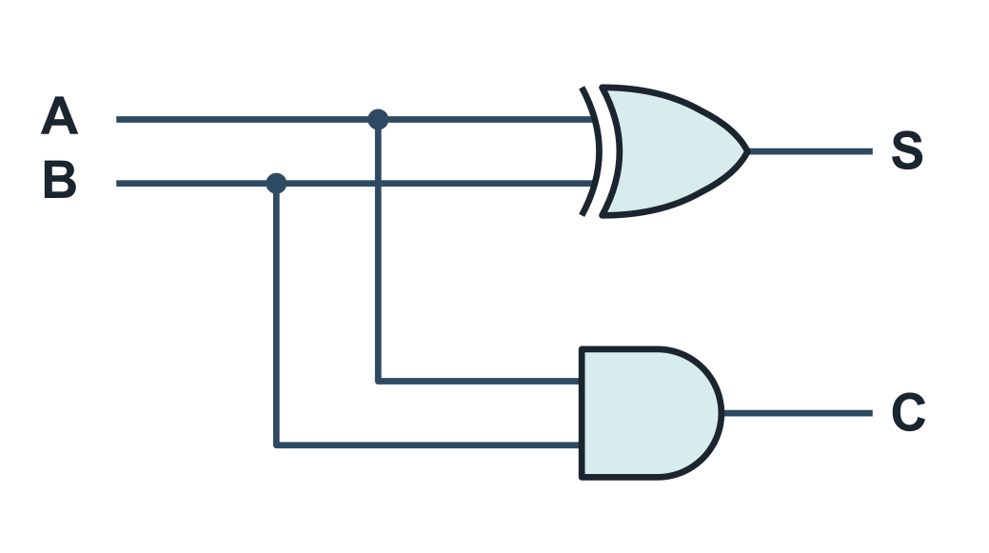
The half adder
UNDERSTAND NOW · the adder
Adds two bits A and B and produces a sum bit S and a carry C
In binary 1 + 1 gives sum 0 and carry 1
From the table: S is 1 when the inputs differ, C is 1 when both are 1
S = A xor B C = A . B
A | B | S | C
0 | 0 | 0 | 0
0 | 1 | 1 | 0
1 | 0 | 1 | 0
1 | 1 | 0 | 1
Notes:
The half adder adds two bits A and B and produces a sum bit S and a carry C. The truth table shows that S is 1 when the inputs differ, which is XOR, and that C is 1 when both are 1, which is AND. The circuit on the right corresponds exactly to the two instructions of the warm-up. It is called "half" because it has no input for a carry from a less significant position, so on its own it can add only the least significant bits of two numbers.
UNDERSTAND NOW: the adder.
For the lecturer: The circuit is exactly the two instructions of the warm-up. 'Half' because it has no carry input: it can only add the least significant bits.

Slide 8
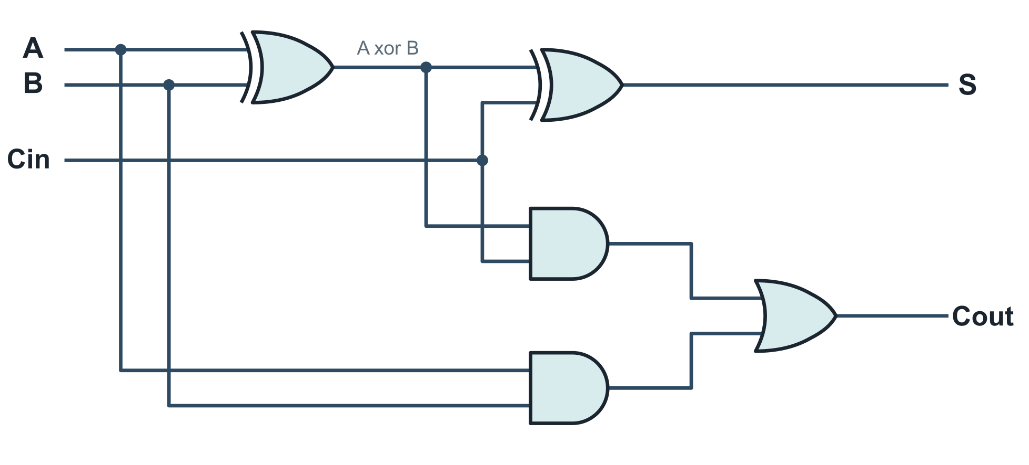
The full adder
UNDERSTAND NOW · the adder
A | B | Cin | S | Cout
0 | 0 | 0 | 0 | 0
0 | 0 | 1 | 1 | 0
0 | 1 | 0 | 1 | 0
0 | 1 | 1 | 0 | 1
1 | 0 | 0 | 1 | 0
1 | 0 | 1 | 0 | 1
1 | 1 | 0 | 0 | 1
1 | 1 | 1 | 1 | 1
S = A xor B xor Cin
Cout = A . B + Cin . (A xor B)
Adds two bits and a carry in; produces a sum bit and a carry out.
Notes:
The full adder has three inputs, the two operand bits A and B and an incoming carry, and two outputs, a sum bit and an outgoing carry. From the table, S is 1 when an odd number of inputs is 1, and the carry out is 1 when at least two inputs are 1. The circuit consists of two half adders and an OR gate: the first adds A and B, the second adds the incoming carry to their partial sum, and the OR merges the two possible carries, which can never both be 1. In the drawing, wires that cross without a dot are not connected.
UNDERSTAND NOW: the adder.
For the lecturer: Two half adders and an OR. S is 1 when an odd number of inputs is 1; Cout is 1 when at least two inputs are 1. Wires that cross without a dot are not connected.

Slide 9
Minterms and maxterms
UNDERSTAND NOW · canonical forms
Minterm: a clause of order n, that is, a product containing a literal of every variable
– n = 2: a b; n = 3: a' b' c; n = 6: a b c' d e' f
A minterm is 1 for exactly one row of the truth table
Maxterm: a sum of n literals, one for every variable
– n = 2: (a' + b'); n = 3: (a + b + c'); n = 6: (a' + b' + c + d' + e' + f')
A maxterm is 0 for exactly one row of the truth table
Notes:
A minterm is a product containing every variable exactly once, complemented or not. Its defining property is that it equals 1 for exactly one row of the truth table: a'b'c is 1 only when a = 0, b = 0 and c = 1. A maxterm is a sum containing every variable exactly once, and it equals 0 for exactly one row. To write the minterm of a row, the variables that are 0 in that row are complemented; for the maxterm, those that are 1. Minterms and maxterms are the building blocks of the canonical forms.
UNDERSTAND NOW: canonical forms.
For the lecturer: Mintermine (termine prodotto P); maxtermine (fattore somma S). Minterm i corresponds to row i: a variable appears complemented where the row has a 0.

Slide 10
From the truth table to the canonical forms
UNDERSTAND NOW · canonical forms
A | B | C | F | minterm (F = 1) | maxterm (F = 0)
0 | 0 | 0 | 0 |  | M0 = A + B + C
0 | 0 | 1 | 0 |  | M1 = A + B + C'
0 | 1 | 0 | 0 |  | M2 = A + B' + C
0 | 1 | 1 | 1 | m3 = A' B C
1 | 0 | 0 | 1 | m4 = A B' C'
1 | 0 | 1 | 1 | m5 = A B' C
1 | 1 | 0 | 1 | m6 = A B C'
1 | 1 | 1 | 1 | m7 = A B C
Canonical form P: sum of the minterms of the rows where F = 1
F = A'BC + AB'C' + AB'C + ABC' + ABC
F = sum of m(3, 4, 5, 6, 7)
Canonical form S: product of the maxterms of the rows where F = 0
F = (A+B+C) (A+B+C') (A+B'+C)
F = product of M(0, 1, 2)
Notes:
The procedure applied to F. For each row in which F is 1 its minterm is written, and the OR of these minterms is the canonical form P: F is the sum of minterms 3, 4, 5, 6 and 7. For each row in which F is 0 its maxterm is written, and the AND of these maxterms is the canonical form S: the product of maxterms 0, 1 and 2. Both expressions are correct and unique, which is their theoretical value; neither is economical, since the first has five clauses and fifteen literals.
UNDERSTAND NOW: canonical forms.
For the lecturer: Every function has exactly one canonical form of each type (up to the order of the terms). This is synthesis by recipe: always possible, rarely economical.

Slide 11
Algebraic minimisation of F
UNDERSTAND NOW · canonical forms
Expression | Law applied
A'BC + AB'C' + AB'C + ABC' + ABC | canonical form P: 5 clauses, 15 literals
= A'BC + A (B'C' + B'C + BC' + BC) | distributive: collect A
= A'BC + A (B' (C' + C) + B (C' + C)) | distributive, twice
= A'BC + A (B' + B) | complement: C' + C = 1
= A'BC + A | complement: B' + B = 1
= A + BC | simplification: x + x' y = x + y
Fifteen literals become three. It works, but each step needs an idea: we want a method.
Notes:
The canonical form of F reduced step by step with the laws of Lecture 08. A is factored from four clauses; a second factoring takes place within the parenthesis; the complement law is applied twice; finally the simplification x + x'y = x + y. Fifteen literals become three: F = A + BC. The method works, but the caption identifies its weakness: at every step one had to see which law to apply. For larger functions this is impractical, and a method independent of insight is required.
UNDERSTAND NOW: canonical forms.
For the lecturer: From five AND gates with three inputs and a five-input OR, to one AND and one OR. The source deck called this an 'empirical' minimisation: it works, but which law to apply next is left to intuition. Karnaugh maps make it mechanical.

Slide 12
Karnaugh maps: the idea
UNDERSTAND NOW · minimisation, Karnaugh maps
A graphical tool for simplifying Boolean functions
A function of n variables is drawn on a grid of 2^n cells: one cell per row of the truth table
B C
00
01
11
10
A
0
m0
m1
m3
m2
Cells are ordered so that neighbours differ in one variable only
– hence the column order 00, 01, 11, 10
1
m4
m5
m7
m6
Graphical adjacency is logical adjacency: two adjacent 1s merge into a clause with one literal less
The cell of each minterm for three variables. Note that m3 comes before m2. The left and right edges are adjacent too: the map wraps around.
Group the 1s in rectangles of 1, 2, 4 or 8 cells, as large as possible, until every 1 is covered
Notes:
A Karnaugh map is the truth table redrawn as a grid, one cell per row. Its essential feature is the ordering of the cells: any two neighbouring cells differ in the value of exactly one variable, which is why the columns are labelled 00, 01, 11, 10 (a Gray code) rather than in counting order. Consequently two adjacent 1s can be merged into a single clause with one literal fewer, by the law xy + xy' = x. The rule is to group the 1s into rectangles of 1, 2, 4 or 8 cells, each as large as possible, until every 1 is covered. The left and right edges are also adjacent.
UNDERSTAND NOW: minimisation, Karnaugh maps.
For the lecturer: The order 00, 01, 11, 10 is a Gray code. Maurice Karnaugh, 1953. An online tool was suggested in the source deck (edutecnica.it/apps/k/k.htm).

Slide 13
A map of three variables: our F
UNDERSTAND NOW · minimisation, Karnaugh maps
Write a 1 in the cells of minterms 3, 4, 5, 6 and 7
B C
00
01
11
10
Red group of four: the whole row A = 1
– B and C both change: the clause is A
A
0
0
0
1
0
Violet group of two: the column BC = 11
– A changes: the clause is BC
1
1
1
1
1
Every 1 is covered and no group can be made larger
F = A + BC
The same result as the algebra, found by eye in seconds
Notes:
The function F placed on a three-variable map. 1s are written in the cells of minterms 3, 4, 5, 6 and 7. The red group covers the whole row A = 1, four cells in which both B and C vary, so the clause is A. The violet group covers the column BC = 11, in which A varies, so the clause is BC. Every 1 is covered and no group can be enlarged: F = A + BC. This is the result of the algebraic minimisation, obtained by inspection in a few seconds.
UNDERSTAND NOW: minimisation, Karnaugh maps.
For the lecturer: A group of 2^k cells eliminates k variables. Always take the largest groups first, then cover what is left.

Slide 14
A map of four variables
UNDERSTAND NOW · minimisation, Karnaugh maps
C D
F = sum of m(0, 2, 5, 7, 8, 10, 13, 15): eight minterms, thirty-two literals
00
01
11
10
A B
00
1
0
0
1
Red group of four in the centre
– B = 1 and D = 1 throughout: the clause is BD
01
0
1
1
0
11
0
1
1
0
Violet: the four corners are one group
– the map wraps around horizontally and vertically: B = 0 and D = 0, the clause is B'D'
10
1
0
0
1
F = BD + B'D'
Result: four literals, and you may recognise it: F is the XNOR of B and D
Notes:
With four variables the map has sixteen cells, and both sets of labels follow the order 00, 01, 11, 10. The central red group of four yields BD. The four corners also form a group, because the map wraps around in both directions, as if drawn on the surface of a torus. In the corners B and D are both 0, so the clause is B'D'. The result has four literals instead of thirty-two. Before concluding that a 1 is isolated, the edges and corners should always be examined.
UNDERSTAND NOW: minimisation, Karnaugh maps.
For the lecturer: New slide. Think of the map as drawn on a torus: the top edge touches the bottom edge and the left edge touches the right edge.

Slide 15
Don't-care conditions
UNDERSTAND NOW · minimisation, Karnaugh maps
Sometimes an input combination can never occur, or the output does not matter when it does
x
Example: a digit in binary-coded decimal uses the patterns 0000 to 1001
– the six patterns 1010 to 1111 never appear
Those cells are marked with an x in the map: don't care
a cell whose value we are free to choose, 0 or 1, whichever simplifies the circuit
An x may be treated as a 1 when it makes a group larger, and as a 0 otherwise
More freedom means larger groups and a cheaper circuit
Notes:
Some input combinations can never occur, or their output is irrelevant when they do. A decimal digit encoded on four bits uses only ten of the sixteen patterns, and the other six never appear. Their cells are marked x, a don't care, and each x may be treated as 1 or as 0, whichever is more advantageous: as 1 when it enlarges a group, and otherwise ignored. Greater freedom yields larger groups and therefore a cheaper circuit. Lecture 11 meets this situation in binary-coded decimal and the seven-segment display.
UNDERSTAND NOW: minimisation, Karnaugh maps.
For the lecturer: New slide. Typical exam exercise: the seven-segment display decoder, where each segment is a function of four variables with six don't-cares.

Slide 16
Thirty-two full adders make an add
UNDERSTAND NOW · the adder
A31
B31
A2
B2
A1
B1
A0
B0
full adder
bit 31
full adder
bit 2
full adder
bit 1
full adder
bit 0
carry
out
0
. . .
the carry ripples leftwards
S31
S2
S1
S0
add t2, t0, t1 feeds the two registers into thirty-two full adders, one per bit position
The carry out of each position is the carry in of the next: a ripple-carry adder
sub uses the same adder: the second operand is complemented and the first carry in is 1 (Lecture 05)
Notes:
Thirty-two full adders are placed in a row, one per bit position. Each receives one bit of A, one bit of B and the carry from the position to its right, and passes its own carry to the left: this is a ripple-carry adder, and it is what executes add t2, t0, t1. The first incoming carry is 0. Subtraction uses the same adder: the second operand is complemented and the first incoming carry set to 1, which is exactly the two's complement negation of Lecture 05. The carry out of the last position is discarded. The carry must traverse all thirty-two stages, a delay whose consequences Lecture 11 examines.
UNDERSTAND NOW: the adder.
For the lecturer: The carry out of bit 31 is the unsigned overflow of Lecture 05, which RISC-V simply drops. Real processors use faster carry schemes (carry look-ahead), but the function computed is the same.

Slide 17
Check your understanding
How many distinct Boolean functions of three variables are there?
1
8
9
A
B
64
256
C
D
Which minterm of three variables A, B, C corresponds to row 5 of the truth table?
2
A'BC'
AB'C
A
B
A + B' + C
ABC'
C
D
Notes:
For the first question the formula for the number of functions is applied with n = 3, evaluating the exponent first: 2^3 = 8 is the number of rows of the truth table, and the answer is 2^8.
For the second, 5 is written in binary on three bits, 101. In a minterm a variable appears uncomplemented where the row has 1 and complemented where it has 0. The option containing plus signs can be discarded at once: it is a sum and therefore cannot be a minterm.
For the lecturer: 1. Answer: D. 2^(2^3) = 2^8 = 256.
2. Answer: B. Row 5 is 101: A = 1, B = 0, C = 1, so the minterm is A B' C.

Slide 18
Check your understanding
In a Karnaugh map, a rectangular group of four adjacent 1s eliminates:
1
one variable
two variables
A
B
three variables
four variables
C
D
In a full adder, the carry out is 1 when:
2
exactly one input is 1
an odd number of inputs is 1
A
B
at least two inputs are 1
all three inputs are 1 only
C
D
Notes:
For the first question: a group of 2^k cells eliminates k variables, and four is 2^2. The three-variable map confirms it: the row of four 1s lost both B and C.
For the second, the table of the full adder is consulted. The carry out is 1 in the rows with two or three 1s among the inputs: it is the majority function. "An odd number of 1s" describes the other output, the sum bit.
For the lecturer: 1. Answer: B. A group of 2^k cells eliminates k variables: four cells, two variables.
2. Answer: C. Cout is the majority function: AB + Cin(A xor B) = AB + ACin + BCin. An odd number of 1s describes the sum bit S instead.

Slide 19
Glossary: English and Italian
English | Italiano | English | Italiano
literal | letterale | canonical form | forma canonica
clause, product term | clausola, termine prodotto | sum of products (SOP) | somma di prodotti (tipo P)
factor, sum term | fattore, termine somma | product of sums (POS) | prodotto di somme (tipo S)
minterm / maxterm | mintermine / maxtermine | Karnaugh map | mappa di Karnaugh
half adder / full adder | semisommatore / sommatore completo | don't care | condizione di indifferenza
carry in / carry out | riporto entrante / uscente | ripple-carry adder | sommatore a propagazione del riporto
Notes:
Twelve terms. In Italian the canonical forms are designated P, for prodotti, and S, for somme; English texts use SOP and POS. The half adder is the semisommatore, the full adder the sommatore completo. A don't care is a condizione di indifferenza. The ripple-carry adder is the adder in which the carry propagates from each position to the next.

Slide 20
Conclusions and reading
A Boolean function is a truth table; a truth table always gives a canonical expression
Minimisation is the process that optimises a logic network to simplify its implementation
Karnaugh maps turn the algebra into a picture: group the 1s, read the clauses
The half adder and the full adder are the first real circuits of the course
Thirty-two full adders in a row are what executes the add you typed in the first lecture
Reading
– Patterson, Hennessy: Computer Organization and Design, RISC-V Edition, appendix A
– Bucci: Architettura dei calcolatori elettronici, chapters on combinational networks
– Charles Petzold: Code, chapters on logic gates and binary adding machines
Notes:
Five conclusions. A Boolean function is a truth table, and a truth table always yields a canonical expression. Minimisation optimises the network and reduces its cost. Karnaugh maps turn the algebra into a visual procedure: group the 1s and read off the clauses. The half adder and the full adder are the first genuine circuits of the course. And thirty-two full adders in a row execute the add typed in the first programming lecture. The next lecture asks what the gates themselves are made of.
Learning status, recap. UNDERSTAND NOW: the adder; Boolean functions; canonical forms; minimisation, Karnaugh maps. USE NOW: the complete program, the PRG32 tools (used, not studied, in this course). UNDERSTAND LATER: nothing. A slide without a badge is context: a story, an example, a question, an exercise.
For the lecturer: Next lecture: electronics, to see what these gates are made of; then combinational and sequential machines.

